Slide 1
Code Maintenance
or
How to put lipstick on a pig

Slide 2
Disclaimer
Notes:
Everything I will say is wrong. You will leave here knowing less not more. Eventually, you will become jaded like me. This is all normal. If you expected a technical talk, I’m sorry. Code maintenance is not all that much about actually writing code.

Slide 3
Let’s set the record straight…
Notes:
A few things have become murky in the programming world, mostly the definition of programming

Slide 4
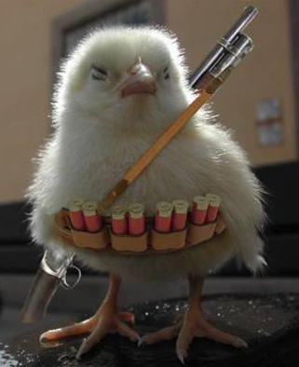
Coding does not make you a badass
Notes:
You’ve failed to break anyone’s knees in the past week. No one owes you $100, 000. You don’t carry bodies around in your trunk. In fact, you probably bike to work. You’re just not cut out for the mafia.

Slide 5
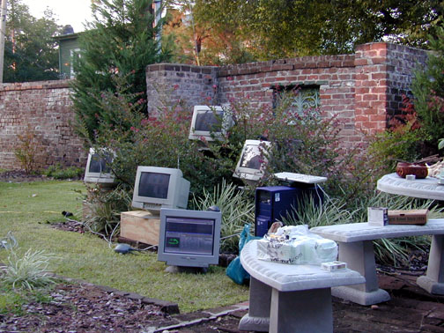
Programming is not gardening.
Notes:
Do you even know what outside looks like? When was the last time you saw the sun? Come, you live in portland for a reason.

Slide 6
Programming is not a poorly defined metaphor so I can get more page views and sound really awesome and get retweeted and shit...
Notes:
It’s really time for us to face the fact that programming doesn’t fit in with a lot of metaphors. Programming is what it is, so lets stop wasting time trying to figure that out and spend some time programming better.

Slide 7
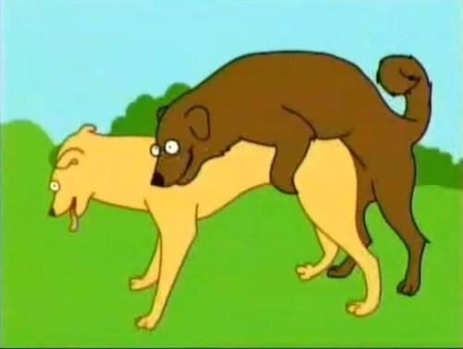
Programming is useful!
Notes:
Yeah its good for all sorts of things!

Slide 8
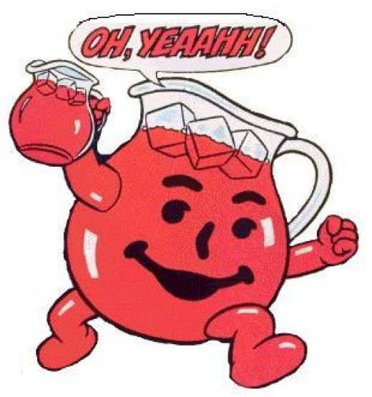
And you’re a programmer!

Slide 9
That makes you a winner!
Notes:
You win the really hard job of making programs work and keeping them that way

Slide 10
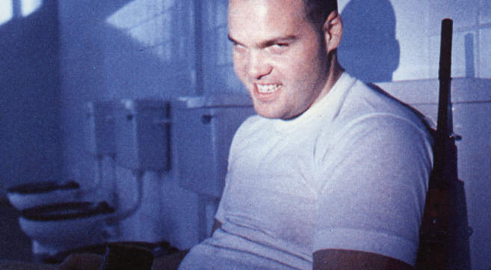
There are many like you
Notes:
You need to remember your history. There have been many others just like you. Many others have written code just like yours, but your code is unique… right?

Slide 11
In fact, there are many characters involved
Notes:
Some times these people can help, sometimes they’re just a pain in the ass. Always will you have to deal with them and if you don’t respect and fear at least one of these groups, the code you write will never be good.

Slide 12
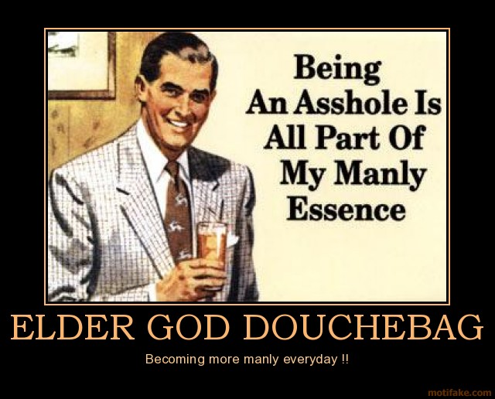
Business owners
Notes:
Always remember, you’ve been hired by these people to save them from themselves. Don’t let them just push you around. If altering something will make it broken, make your case. You or someone you like might end up dealing with the repercussions of decisions made here months from now.

Slide 13
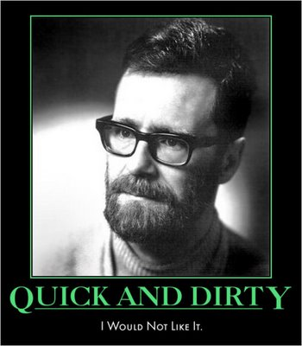
Other Programmers
No, this isn’t schmichael
Notes:
This is probably one of the more judgmental audiences for which you will write code. No one is meaner than someone who receives a crappy patch which totally rewrites everything. You need to play nicely to work with these folks!

Slide 14
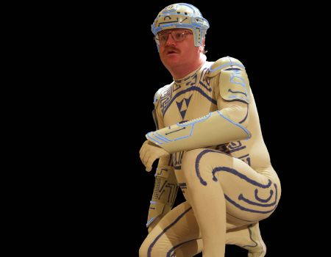
And then, there are the users
Notes:
The users are by far the most fickle, trend seeking group. They want more features and they want them now! Any code you write and maintain will eventually fall into the hands of users. At this point you will be insulted by your code’s inability to manage ever possible scenario on this green earth.

Slide 15
You must listen to others
Notes:
Critiques and feedback are very important. Nothing that’s said is useless. Even if its not very constructive, bad feedback can help identify pain-points.

Slide 16
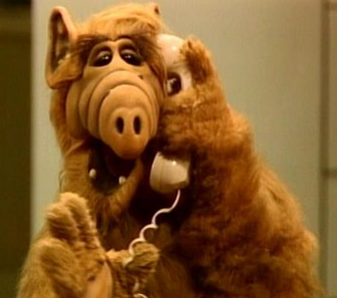
You can’t be an expert on everything*
*but it helps if you are
Notes:
You must listen to this cast of characters if you’re going to produce a useful solution. If only for the fact that you are not the only user of your code.

Slide 17
A few more things about programming

Slide 18

REALITY CHECK
Most of the time the code owner is you.
Your code sucks today
Notes:
Unless you stop learning right now, you’re bound to get better at what you do. Things you do today will not be as good as things you do in the future

Slide 19
The code you write will haunt you
Notes:
Sooner or later, some else is going to use that crap. What’s even worse is that they’ll ask you to add features and do things you never planned for.

Slide 20
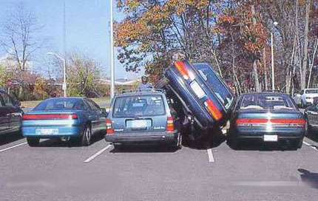
You need to deal with constraints
and constraints can be really tough
Notes:
Constraints can also help you stay focused. Don’t ignore the issues of a projects domain because you think you know better. You probably don’t if you’re coming on to a new project.

Slide 21
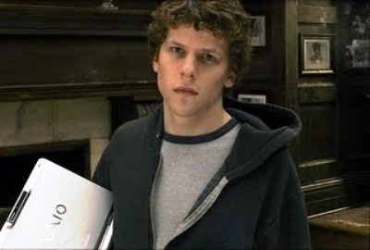
Don't be selfish
Notes:
When you write code that only makes you happy, you’re hurting a lot of people in the future. Don’t be fancy or clever! Keep things simple and sane.

Slide 22
Your code needs to fit in
Notes:
Pay attention to the project’s style. If they have a formatting guide read it, if they have coding guidelines read those too. Your additional code should be mostly indistinguishable from the code around it.

Slide 23
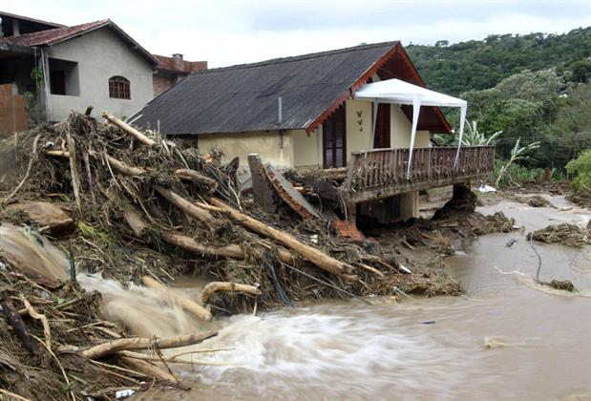
Code atrophies as systems change
Notes:
Code does not get old because it changes. It grows old for the system around it getting newer. For the love of god, remember that code is part of a system. Often that system is really beyond your control. Be aware of the surroundings. Don’t code in a vacuum.

Slide 24
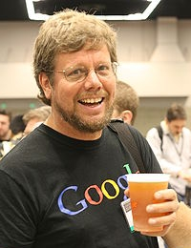
Know who wrote the code
Notes:
And seek them out. You need to make contact with these people if you’re going to work with them. Beer helps too. If you haven’t heard of IRC get on it! It’s a great tool for collaboration and you will be able to talk directly with core project developers over it. Sadly, if you do it too much they’ll give you commit access and make you write code.

Slide 25
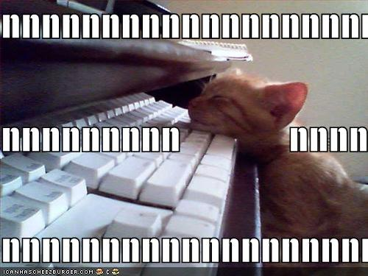
Use the commit messages
Notes:
Read the old commit messages. A good vcs tool will allow you to search through for when changes took place. Also, write useful commit messages so you can trace back through what you did later on.

Slide 26
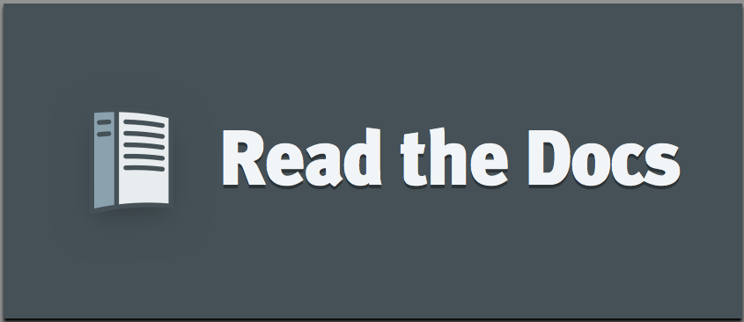
Use the Freaking Documentation!
Notes:
Here’s my shameless readthedocs plug… everything’s on there. Its got a nice search. If you fail to use it you’re a loser

Slide 27
Read the source code
from ast import Name, NodeTransformer, parse, Return
from itertools import chain
import sys
from warnings import warn
class StaticTransformer(NodeTransformer):
def _check_none(self, x):
if isinstance(x, Name) and x.id == 'None':
warn("Passing None Argument to function", RuntimeWarning)
def visit_FunctionDef(self, node):
self.generic_visit(node)
if not all([isinstance(x, Return) for x in node.body]):
warn("Returning None from function %s" % node.name, RuntimeWarning)
return node
def visit_Call(self, node):
self.generic_visit(node)
for x in chain(node.args, node.keywords):
x = x.value if hasattr(x, 'value') else x
self._check_none(x)
return node
Notes:
Attempting to work on patches for a project without reading what the code your changing actually does is grounds for dismissal. This is probably the single most important thing you can do. Read until it hurts then keep reading.

Slide 28
Know your type signatures!
# foo :: str -> bool -> str
def foo(hello='', baz=True):
if baz:
return ', '.join((hello, ‘i love you'))
else:
return ', '.join((hello, 'i hate you'))
Notes:
Ok, so this is python and the notion of types is always sort of pushed out of the frame, but its still there and you must understand them. Knowing types will help you be more confident when changing code. Scribbling down a type signature for a function is very helpful. Unfortunately there is no way for python to really enforce these types before you run code, but hey at least you’ll be paying attention.

Slide 29
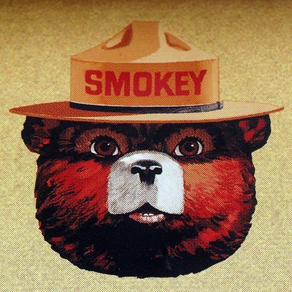
Only you can prevent bad code
Notes:
It’s so so important that you constantly stay humble and aware of the code you’re adding. Ocam’s razor is a fantastic tool

Slide 30
Credits
Slide 1: http://www.frigginrandom.com/wp-content/uploads/2008/11/badass-chick.jpg
Slide 2: http://www.elkabong.com/intersection00/images/computer_garden.jpg
Slide 3: http://s2.hubimg.com/u/768433_f520.jpg (stolen or something:( )
Slide 4: http://29.media.tumblr.com/tumblr_l06iwwneEY1qanc92o1_500.jpg
Slide 8: http://mindthegapcanada.files.wordpress.com/2011/01/elder-god-douchebag-elder-god-douchebag-manly-demotivational-poster-1244110369.jpg
Slide 9: http://4.bp.blogspot.com/_DnPwaEn8aGE/TKpEn90EkdI/AAAAAAAALo8/XIa6qG66TJk/s1600/sn2.jpg
Slide 11: http://www.clumsycrooks.com/media/files18/pictures/tight_spot.jpg
Slide 15: http://hispaniclondon.files.wordpress.com/2011/01/one-house.jpg
And a whole bunch of other photos which I forgot to credit, apologies!

