Slide 1
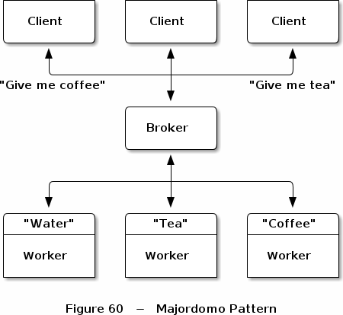
So Easy a Chinchilla Can Do It! Advanced Patterns with 0mq
that’s me

Slide 2
Warning!!
Nearly everything I am using in these slides was shamelessly ripped out of the most excellent ZeroMQ docs. If something seems wrong, its probably my fault for over simplifying or just getting it down right incorrect. My apologies to the ZeroMQ team for doing a cheap, backwater distillation of their materials. All standard messaging rates apply. If you’re still reading this bit you should really be listening to me instead. I might accidentally say something useful. Now, attention! EYES UP FRONT!

Slide 3
How to get crazy with Zeromq
Zeromq is a toolkit for gluing together network architectures.
Zeromq’s moniker is extremely misleading
If you think that something cannot be done with the toolkit, you are wrong.

Slide 4
Some simple advice
You will be able to do dumb things with 0mq.
Don’t mix socket pairs
Do trust that it just works
(Yes, this is all basically magic underneath)
Worrying about details will only hurt you

Slide 5
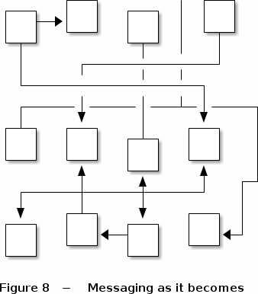
Down to Brass Tacks
Even though it could, your network should never look like this!

Slide 6
Leveling Up: Devices
Reduce complexity
Abstract clusters into distinct groups
Come in three default flavors:
Queue – like REQ/REP broker
Forwarder – PUB/SUB proxy
Streamer – Forwarder for Pipelines
Don’t go too crazy with these and stick to the basic socket pairs
Notes:
Pattern-extending components that allow you to reduce the interconnectivity of all pieces by placing forwarders or queuers or streamers in play. Also take note that the three devices provided by Zmq are not required to be used. Devices are just high level concepts for special node/socket-pairs.

Slide 7
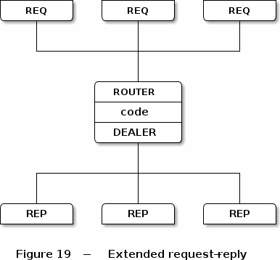
Plugging devices into your network
Notes:
Talk about this diagram a bit. See, there’s a device (the router) and its managing messages between the requesting and replying nodes. No this is not magic, its just nice.

Slide 8
More Patterns and Then More Patterns
Zmq is glue for distributed applications
The pattern names are very memorable
Keep in mind, programming by pattern has downsides!
Use patterns as templates not definitive designs
Notes:
Nothing sucks more than forcing a pattern on to some design because you think its cool. Just don’t do it. If you’ve never used design patterns then you might not have learned this lesson. If you have then you know.

Slide 9
Now lets take a look at some patterns
Here’s a brief list of the patterns described in the ZeroMQ docs:
Least Recently Used
Lazy Pirate
Binary Star
Freelance
Suicidal Snail
Blackbox

Slide 10
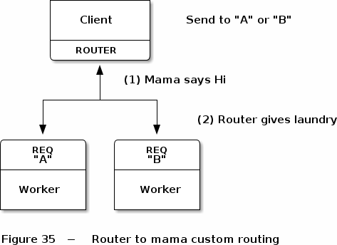
Least Recently Used
Notes:
Seems pretty straight forward, we end up routing to the worker that’s been used the least. You’ll notice this is exactly like what most load balancers do to get simple and fair use of a cluster.

Slide 11
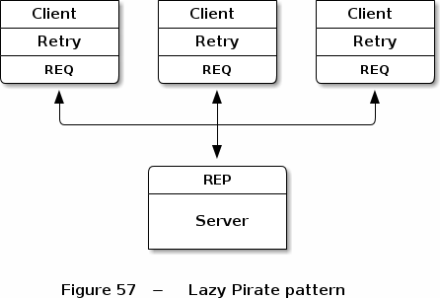
Lazy Pirate
Notes:
Builds some reliability on to a regular request reply. Adds the ability to make mutliple requests in a req/rep pattern (normally this is not allowed)

Slide 12
Suicidal Snail
Pub/Sub pattern
Subscribers manage themselves
If they are running too slow, they die
Effective to keep queues fast
Notes:
My favorite named pattern. Okay enough, just reading the docs to you what does this all look like.

Slide 13
SUPER DUPER EXAMPLE TIME!

