Slide 1

Machine Learning – an industry perspective
Derek Colley MSc BSc (Hons) MCP MBCS
Staffordshire University, December 2018
Email: derek.colley@research.staffs.ac.uk
LinkedIn: https://tinyurl.com/y92hs3kc
ResearchGate: https://tinyurl.com/y8l4r4gb
Session material at: https://www.github.com/dcolley99/public-repo/ML

Slide 2
Session Outline
What is machine learning?
Differences between ML and traditional programming/statistics
Identifying the organisational questions
An introduction to feature engineering
Data identification, cleansing and preparation
Worked examples: ML techniques in practice
Coding categorical data
ML in industry – case studies
Is ML the same as AI? Questioning determinism.
Q & A

Slide 3
Defining Machine Learning
Machine learning (NOUN):
The capacity of a computer to learn from experience, i.e. to modify its processing on the basis of newly acquired information. - Oxford English Dictionary (2018)
ML is an inductive approach – general predictions about some phenomena are inferred from specific examples of data and specific outputs.
ML is not prescriptive – there are hundreds of tools and techniques available to practice it
ML doesn’t stand alone – it is combined with other technologies to achieve goals.

Slide 4
What’s the difference between ML and traditional programming?
Traditional programming is proactive, ML is reactive.
E.g. we set up a program to perform a task.
Traditional programming insists we define the rules of the task before we process the data, to achieve specific outputs.
An ML program learns the rules in response to examining the data and the expected outputs.
Therefore – ML is for applications where we don’t know the rules.

Slide 5

Identifying organisational questions
Example:
Cottage Industries sells widgets and gizmos through an online shop.
Fact: Widgets cost £10. Fact: Gizmos cost £100. Fact: We have access to historical sales and visitor data.
The CEO says:
“I would like to know if we can predict what product our website visitors are most likely to buy.”

Slide 6
Identifying organizational questions
Question: Can we predict what a customer is most likely to buy?
This is a hard question.
What is it we are really asking?
We have facts about the visitors to the website.
We know what customers have bought before.
We know how much the products cost.
Therefore there should be a way of correlating some features about the customers to the products they have bought.
If –there are any correlations to be found.
How do we find correlations? Machine learning techniques can help us do this.

Slide 7
Feature engineering
Question: Can we predict what a customer is most likely to buy?
Feature engineering means to take a question and break it down to produce measurable quantities.
Can we break down the question, too? Given a website visitor…
Can we estimate the probability of a sale?
Can we estimate the total sale price?
Can we estimate which product will be most popular?
Question - Given that potential customers visit the website, what measurable features could be extracted from the fact of their visit?

Slide 8
Feature engineering
IP address → Location Referrer
Site interaction Cookies -> Previous visitor?
Time of day Browser version
Device type (mobile/desktop) Visit duration

Slide 9
Data preparation
We have identified our question(s), and our data, and worked out what features we want to include.
We now need to find our data, cleanse it, transform it and make it ready to be input into our ML process.
This is sometimes called Extract, Transform, Load (ETL) and refers to the process of extracting live data from a transactional platform and readying it for analysis.

Slide 10
Testing the waters – linear regression
Let’s start to experiment with the data.
We have a database called ‘CottageIndustries’. This database contains several tables with information about sales and website visitors. Each sale is linked to a visit.
We can use single-input linear regression, an ML technique, to interrogate an input variable and see if there is a correlation to the output variable. Also known as a line of best fit.
If there is a good correlation and good statistical significance, we can try to build a linear model and use it to make a prediction.
DEMONSTRATION

Slide 11
Codification
During the exercise in linear regression, we ran into several problems around data types.
The output variable was binary.
The input variables had to be ordinal – i.e. values that can be arranged in some kind of order (like the natural numbers) or a ranked category. Not values like ‘blue’, ‘red’ etc.
Sometimes we need to codify ordinals, and there’s various ways to do this.
Of course, sometimes, we just need to select a different variable!

Slide 12
Codification
Codifying ordinals:
For categorical data that has an order:
Number the categories in rank order
Only suitable for data where items are better, or worse, than each other
For categorical data without an order
Example: Colours, locations
Suitable for data that is unordered
Methods: one-hot encoding, feature hashing, bag-of-words, and many more.
Tip: Splitting your data into buckets will help identify meaningful patterns.

Slide 13
Artificial neural networks
Another type of ML technique is the neural network
Suited to multivariate data (more than one input column)
Many types: feed-forward, Radial Basis Function (RBF), recurrent
In a nutshell – we present the ANN with inputs and an expected output. Each input has a weight associated with it. We train the network with known data and adjust the weights through back-propagation (the distribution of errors from the output back through the network). When we’re finished, we have a network that can assess a new set of inputs and estimate an appropriate output.
DEMONSTRATION

Slide 14
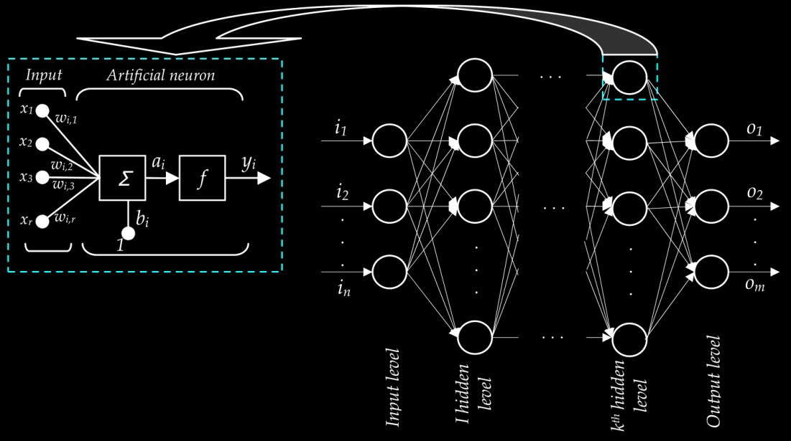
Picture credit:
Adapted from TechnoShares blog at https://hackernoon.com/artificial-neural-network-a843ff870338 (December 2018)

Slide 15
Recap
We use machine learning to solve organisational problems, often posed as questions.
First, we break down the question into its constituent parts
Next, we engage in feature engineering to identify the independent (input) and dependent (output) variables.
We analyse our available data and use Extract, Transform, Load (ETL) processes to find, clean, and present our data in the format we need.
We interrogate our data for likely patterns using statistical techniques
We choose, or even trial, different ML techniques depending on our requirements
We build a model that accepts some inputs and produces some outputs (the function)
We train the model and test the outputs for validity
We can combine models or chain them together
We integrate our models into our organisational business logic and continually update them

Slide 16
Machine learning in industry
Machine learning is a very popular approach at the present time – why?
There are many uses for it
We have powerful hardware and resilient software to support heavy computational requirements
It can help solve hard problems beyond the capabilities of human analysts
Many applications –
Sales analysis and trend prediction
Analysing consumer habits
Scientific purposes – finding patterns in large data sets
Visual image processing
Learning to emulate human behaviour, especially in robotics
Cryptography, finance technology (fintech) and blockchain technologies
UX (user experience/user interface design) for devices such as Alexa, Siri
… and thousands more

Slide 17
Applications of ML
AI in farming:
https://www.youtube.com/watch?v=7rzufxlGH4o
Teaching a model to walk:
https://www.youtube.com/watch?v=gn4nRCC9TwQ
Boston Dynamics
https://www.youtube.com/watch?v=rVlhMGQgDkY

Slide 18
Machine learning vs. Artificial Intelligence
This is a topic that can fill books (and has!)
One popular definition is that machine learning is a subset of AI
Machine learning tools form a part of the goal of achieving AI
The threshold of AI is still defined by the Turing test
The two terms are often interchanged
Final thought:
If computers are made up of components whose state can always be precisely defined (and therefore determined), then computers cannot be capable of independent, original behaviour, and therefore true artificial intelligence cannot be achieved. Do you agree?

Slide 19
Thank you for listening.
Q & A

