Slide 1
Email Sentiment Analysis
By: Daniel Griffin, Jeff Nainaparampil, and Olutobi

Slide 2
Outline
1) Problem description
2) Background research and current methods
3) Interesting email stats
4) First classification approach
5) Metrics and Results of first approach
6) Second classification approach
7) Comparison with first approach
8) Potential future work
9) Conclusions and take aways
10) Papers referenced

Slide 3
1) Problem Description
What is sentiment analysis?
Sentiment Analysis:
The study of people's opinions, attitudes, and emotions towards an entity.
Key goals of sentiment analysis:
Find opinions.
Identify the sentiments they express.
Classify their polarity (eg. Positive or negative emotion)

Slide 4
Abstract Sentiment Analysis Flow
Documents
Sentiment Identification
Feature Selection
Sentiment Classification
Sentiment Polarity

Slide 5
2) Background research and current methods
2 Main Methods For Sentiment Analysis:
1) Machine Learning Approach
Break documents into features, and classify based on feature sets.
2) Lexicon Approach
Function applied to a set of key words with scores found in a lexical database.

Slide 6
Ways to structure data.
Note: This is the key task for any text classification framework.
Representation kinds:
Bag-of-words
A dictionary where each attribute represents a word, and each value for an attribute indicates the presence or absence of a word.
Latent Semantic Indexing
Uses principal component analysis to reduce a bag-of-words representation to a smaller set of attriutes.
Bag-of-concepts
Uses a sentiment lexicon (database of words with sentiment scores), and assigns each word in a document with a weight.
N-grams
Uses strings of “N” words as features.
Parts of speech tagging
Each document is represented by a set of attributes representing parts of speech. These attributes could be adjectives, nouns, verbs, complements (eg. words like “not”)

Slide 7
Ways to choose features.
Point-wise mutual information (PMI):
Defines the level of co-occurrence between class I and word w.
Defines a level of correlation between a word and a document class.
Words with high correlation should be kept as features, while those with low should be dropped.
Ch-square method:
Measures the independence between two events (in this case, the occurrence of a word and the occurrence of a class label)
Other methods:
Hidden Markov Models
Latent Dirchlet Allocation

Slide 8
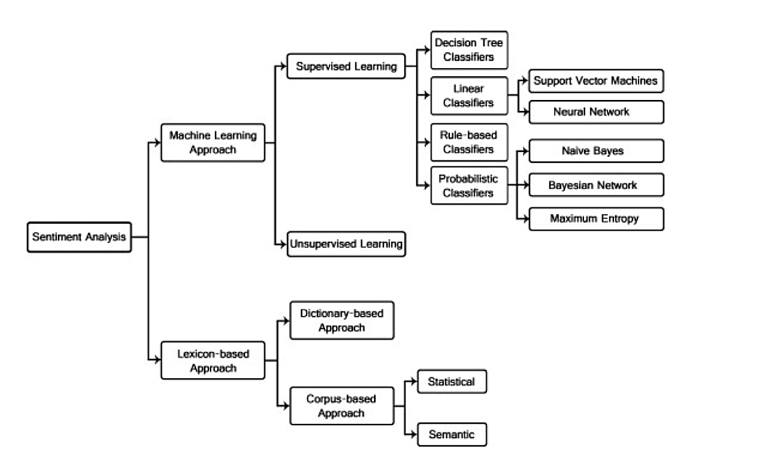
Sentiment analysis methods tree

Slide 9
3) Interesting Email Stats

Slide 10
4) First classification approach

Slide 11
Classifiers trained
Support Vector Machine
Radial Basis Function kernel
Naive Bayes
Multinomial Naive Bayes
Logistic Regression
Stochastic Gradient Descent (Shown to work well for sparse text classification models.)
Decision Trees
Random Forrest
AdaBoost

Slide 12
5) Metrics and Results of first approach

Slide 13
6) Second classification approach

Slide 14
7) Comparison with first approach

Slide 15
8) Potential future work

Slide 16
9) Conclusions and take aways

Slide 17
10) Papers referenced

