Slide 1
CSC 4402:
School Database
Dean Compton, Adam Kardorff, Jared Key, Justin Nguyen
Notes:
Justin introduces the project to the class and everyone introduces themselves

Slide 2
Problem
- Often, we see that public schools are behind the curve when it comes to the implementation of technology.
- Software is often outsourced to third parties and restricted to administrative purposes.
- School databases often lack support for sports and club activities.
Notes:
Justin does this

Slide 3
Our Solution
- We created a database system that allows for greater control, analysis, and management of extracurricular activities.
- We divided the database into different tables with each table holding relevant information to the clubs and individuals related to the club.
The tables are divided into 5 tables: students, clubs, sports, teachers, and players.
Notes:
Justin does this one

Slide 4
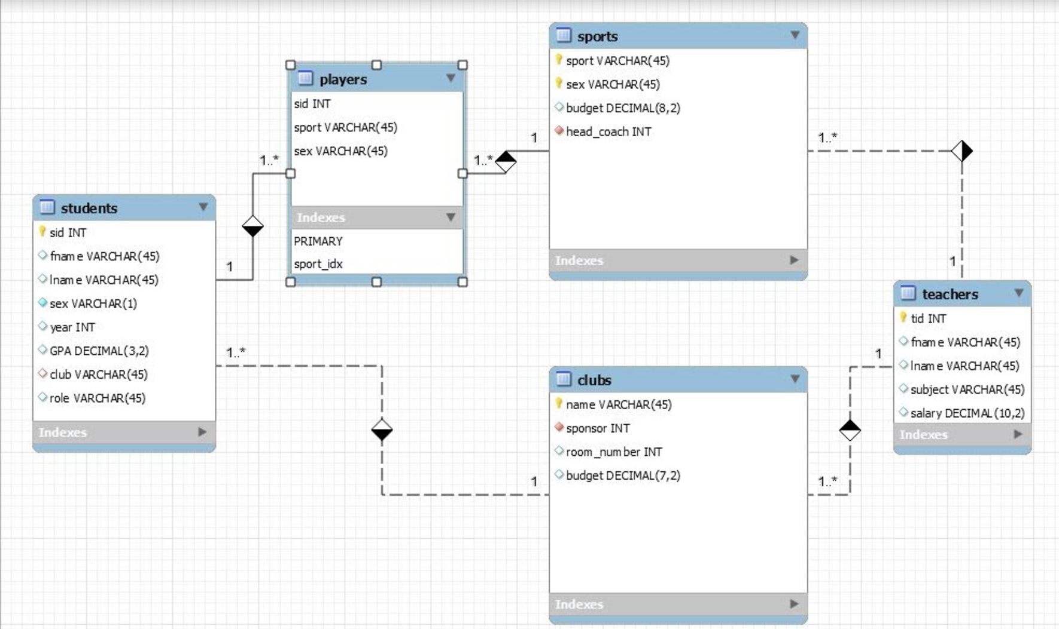
Relational Diagram
Notes:
Dean does this one
Key Points-- This relational diagram was built in MySQL workbench and is a good representation of the entities and relationships of our model.

Slide 5
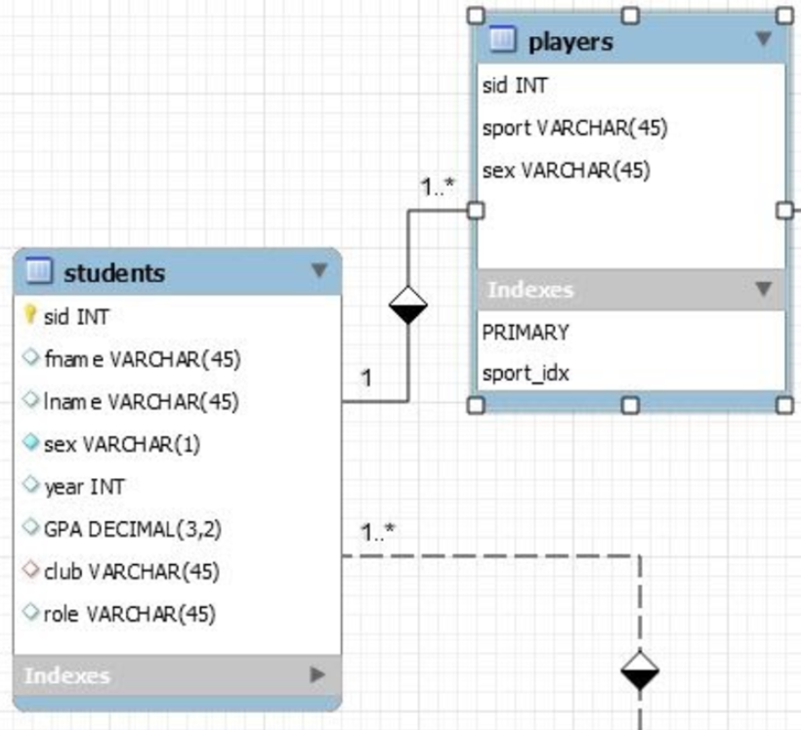
Students to Players
One to Many
One student can play on multiple sports teams
Each player is only one student
Notes:
Dean does this one

Slide 6
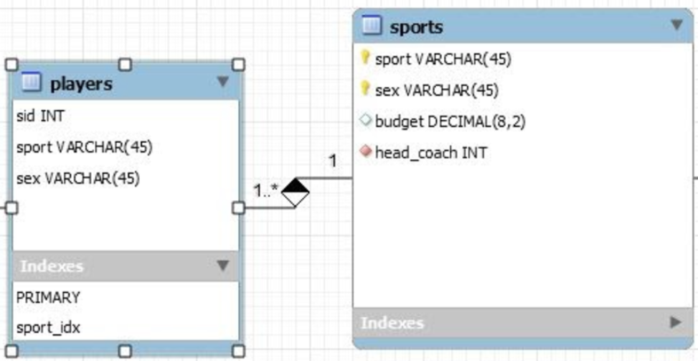
Players to Sports
Many to one
One sport can have many players
Each player record matches one sport
Notes:
Adam

Slide 7
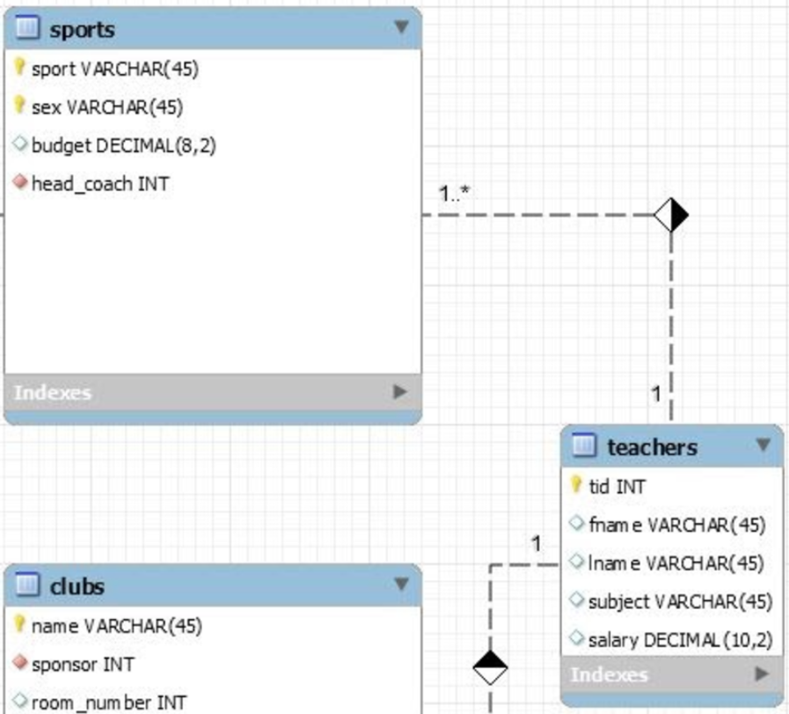
Sports to Teachers
Many to one
One teacher can be the coach of many sports
Each sport only has one head_coach
Notes:
Adam

Slide 8
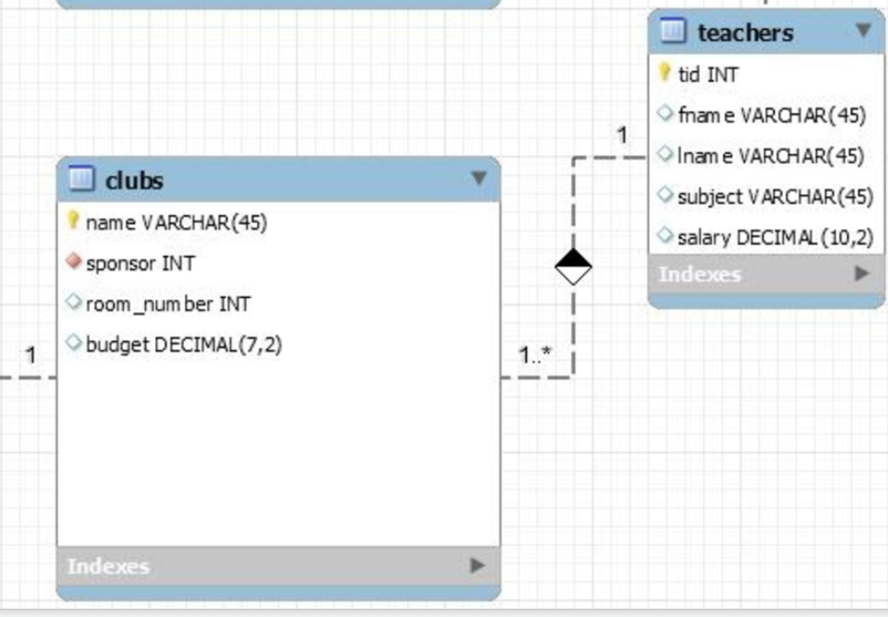
Clubs to Teachers
Many to One
One teacher can sponsor multiple clubs
Each club can have one sponsor
Notes:
Jared

Slide 9
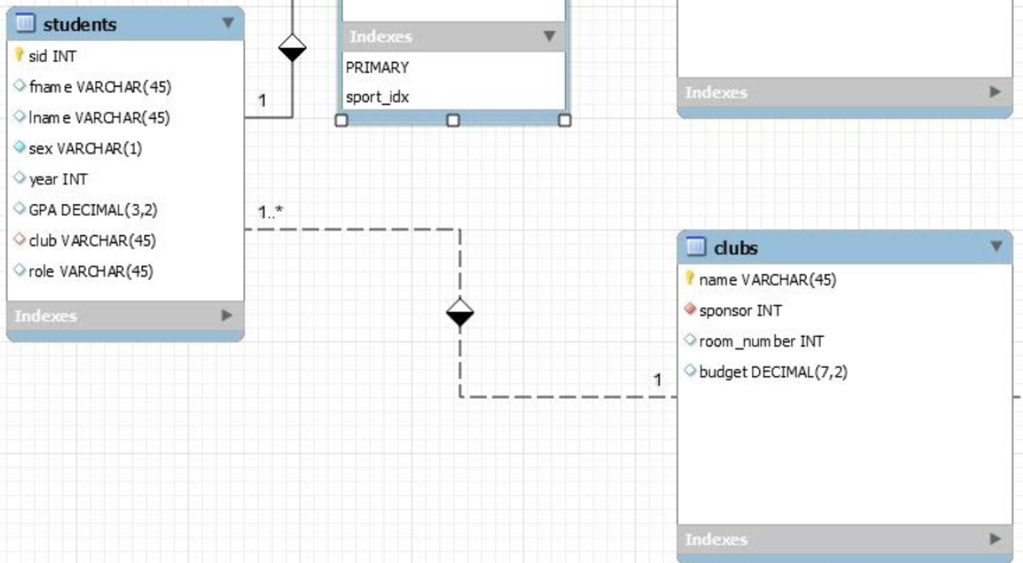
Students to Clubs
Many to One
One club can house multiple students at a time.
Notes:
Jared

Slide 10
Query Examples
Q1: Find all teachers in the Algebra or Calculus or Physics or Chemistry department that sponsor a club and a Sport
select distinct(t.tid), T.fname, T.lname, C.name, A.sport from Teachers as T, Clubs as C, Sports as A where T.tid = C.sponsor and T.tid = A.head_coach and (T.subject='Algebra' or T.subject = 'Calculus' or T.subject = 'Physics' or T.subject = 'Chemistry');
Purpose: Find teachers that are eligible for STEM teacher of the year award.
Output:
1007|Rachel|Davis|Science|Baseball
1013|Michelle|Taylor|FCA|Soccer
1019|James|Thompson|Debate|Gymnastics
1031|Laura|Young|DECA|Dance
1037|Todd|Green|Newspaper|Basketball
1046|James|Carter|Drama|Bowling
1052|Josh|Collins|4-H|Swim
1061|Clare|Rogers|Chess|Bowling
Notes:
Adam

Slide 11
Query Examples
225240|Elaine|Klein|1.98
225164|Kirsteen|Gordon|1.94
225188|Henry|Harrington|1.92
225342|Kathleen|Parks|1.92
225172|Eric|Griffin|1.87
225234|William|Keller|1.87
225214|Fiona|Howell|1.85
225295|Nicholas|Miles|1.84
225178|Zoe|Hale|1.76
225351|Alasdair|Perez|1.76
225189|Justin|Harris|1.75
225006|Susan|Alvarado|1.74
225186|Samuel|Harmon|1.73
225143|Melanie|Frazier|1.65
225343|Patricia|Parsons|1.65
225360|Calum|Porter|1.64
225287|Stewart|Mcguire|1.62
225301|Jonathan|Montgomery|1.62
225253|Barry|Lewis|1.56
225419|Scott|Simmons|1.56
225282|Simon|Mccormick|1.55
225413|James|Scott|1.53
225047|Margaret|Bryant|1.48
225323|Marie|Nichols|1.43
225101|Helen|Davis|1.41
225244|Elizabeth|Lane|1.39
225168|Cheryl|Gray|1.35
225235|Kevin|Kelley|1.34
225331|Jamie|Olson|1.31
225446|Alison|Thornton|1.31
225239|Alison|King|1.29
225150|Greig|Garner|1.27
225131|Paula|Fleming|1.25
225109|Samantha|Dixon|1.23
225222|Jennifer|Jacobs|1.21
225163|Murray|Goodwin|1.19
225170|Dean|Greene|1.07
225278|Allan|Maxwell|1.07
225324|Philip|Norman|1
Output:
Q2: Find the sid, fname, and lname, all 2nd year or greater students in a sport and a club with a GPA < 2.0, sort in descending order by GPA
select distinct(S.sid), S.fname, S.lname, S.GPA from Students as S, Players as P where S.sid = P.sid and S.year > 2 and S.GPA < 2.0 and S.club IS NOT NULL order by GPA desc;
Purpose: Need to meet with these students in order for them to focus on academics and graduate on time.
Notes:
Dean

Slide 12
Query Examples
2.81769230769231|Basketball
2.66192307692308|Swim
2.56583333333333|Gymnastics
2.50260869565217|Track
2.48714285714286|Bowling
2.47933333333333|Soccer
2.38111111111111|Football
2.37888888888889|Tennis
2.34136363636364|Cross Country
2.32818181818182|Golf
Output:
Q3: Find the average GPA of each sports team that has at least 20 students, order by average GPA in descending order:
select avg(S.GPA) as AVG_GPA, P.sport from Students as S, Players as P where S.sid = P.sid group by P.sport having count(P.sid) > 20 ORDER BY AVG_GPA desc;
Purpose: want to compare the academic achievements of the different sports teams at the school
Notes:
Jared Key

Slide 13
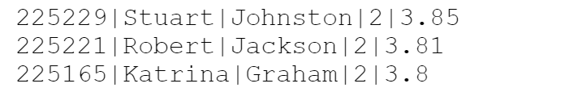
Query Examples
Q4: Find students who are on at least 2 sports team, in a club, and have a GPA > 3.5 and return their id, first and last name, number of teams, and GPA and order them by gpa in descending order:
select s.sid, s.fname, s.lname, count(p.sport), s.gpa from students s, players p where s.sid=p.sid and gpa>3.5 and club not null group by s.sid having count(p.sport)>1 order by s.gpa desc;
Purpose: Want to give a special award to students who are active in extracurricular activities, while maintaining a high GPA
output:
Notes:
Justin does this one

Slide 14
Thank You for Listening!
Questions?

