Slide 1

















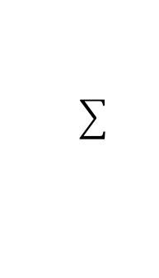





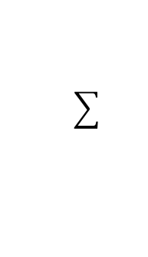





$$One−hot targets$$
$$b_{1}$$
$$x_{1}$$
$$W_{11}$$
$$W_{12}$$
$$t_{1}$$
$$W_{13}$$
$$W_{21}$$
$$b_{2}$$
$$x_{2}$$
$$W_{22}$$
$$W_{23}$$
$$t_{2}$$
$$y$$
$$W_{31}$$
$$W_{32}$$
$$x_{3}$$
$$W_{33}$$
$$b_{3}$$
$$W_{41}$$
$$W_{42}$$
$$t_{3}$$
$$W_{43}$$
$$x_{4}$$
$$argmax$$
$$Input Layer$$
$$SoftMax$$

Slide 2





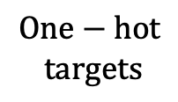
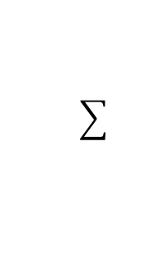

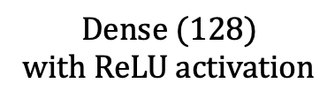

$$x_{1}$$
$$One−hot$$
$$targets$$
$$x_{2}$$
$$t_{1}$$
$$t_{1}$$
$$t_{2}$$
$$t_{2}$$
$$y$$
$$x_{3}$$
. . .
. . .
. . .
. . .
$$t_{40}$$
$$t_{40}$$
$$x_{92∗112}$$
$$Flatten (92, 112)$$
$$Dense (128)$$
with ReLU activation
$$Dense(40)$$
$Sof$tMax
$$argmax$$

Slide 3


















$$b_{1}$$
$$b^{(1)}$$
$$b^{(2)}$$
$$x_{1}$$
$$W_{11}$$
$$h_{1}$$
$$W_{1}$$
$$pred$$
$$W_{12}$$
$$W_{21}$$
$$W_{2}$$
$$x_{2}$$
$$h_{2}$$
$$b$$
$$W_{22}$$
$$W^{(1)}$$
$$W^{(2)}$$
$$b_{2}$$
$$Input Layer$$
$$Hidden Layer$$
$$Output Layer$$

Slide 4






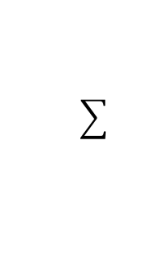

$$x_{1}$$
$$W_{1}$$
$$y=sigmoid(x_{1}W_{1}+x_{2}W_{2}+b)$$
$$W_{2}$$
$$x_{2}$$
$$b$$
$$Input Layer$$

Slide 5
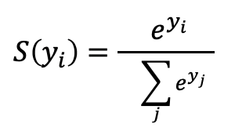



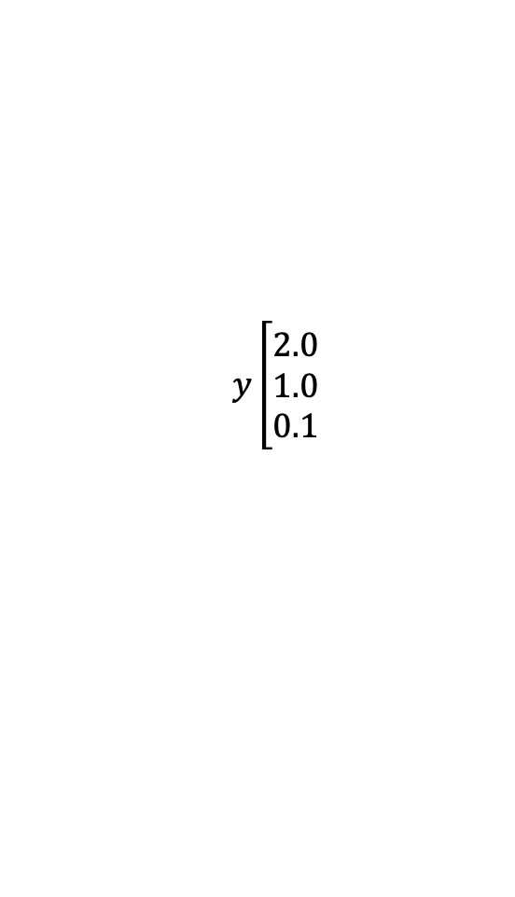

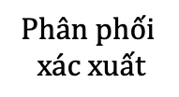

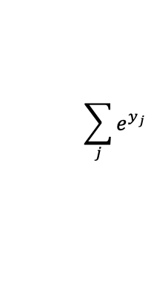
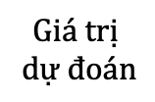
$$S\left(y_{i}\right)=\frac{ e^{y_{i}} }{ }$$
$$\sum_{j}{e^{y_{j}}}$$
$$Giá trị$$
$$dự đoán$$
$$SoftMax$$
$$Phân phối$$
$$xác xuất$$
$$y\left[\begin{matrix}2.0 \\ 1.0 \\ 0.1\end{matrix}\right.$$
$$p=0.7$$
$$p=0.2$$
$$p=0.1$$

Slide 6
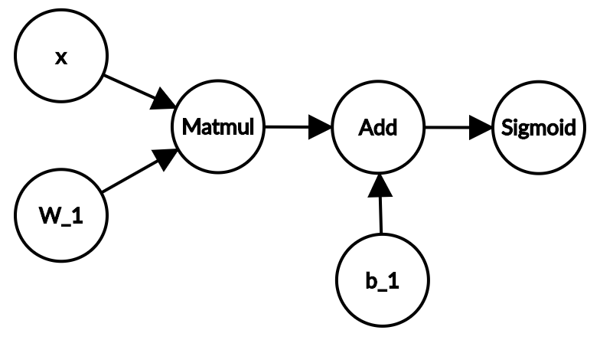
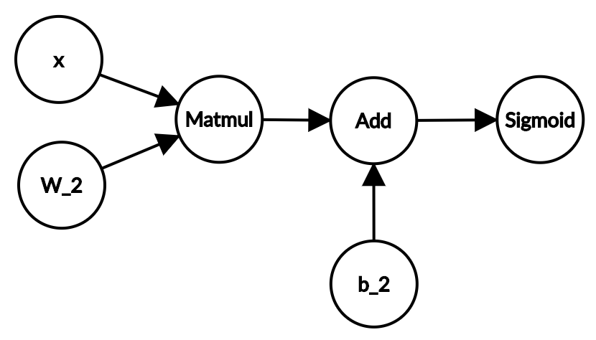

Slide 7
