Slide 1
Introduction to Property Based Testing
Increase your test coverage, and find more bugs, without writing more tests.

Slide 2
Intro
Today we are going to learn about a different way of testing our software, called Property Based Testing.
We’ll learn
- what it is, and how it differs from traditional testing, and what advantages it offers over traditional testing
- some common patterns on how to use PBT
- see some demos
- then we’ll try to work on the Diamond Kata, using some PB tests to assert that our code is working correctly
I’m not expecting you to be experts by the end, I simply want to get you interested in reading more about it and giving it ago.
Indeed, I’m not claiming to be an expert myself, nearly and advanced beginner who sees the benefits and wants to share.

Slide 3

Example Based Testing
Better than nothing
But is flawed by a wink link
Notes:
However, there is a slight flaw in the nature of Example Based testing, a weak link.
A wink link that will be exploited by evil little bugs, intent on worming their way into our code, burrowing in deep so that they are hard to find, causing havoc in weird an wonderful ways.
Can you guess that the weak link is?

Slide 4

Example Based Testing
It’s us!
We are are the wink link!
Notes:
It’s us - humans!
Humans are flawed creatures and we make mistakes…some more than others, but none of us is perfect!
We get tired, feel pressure from others to deliver, or apply pressure on ourselves.
Sometimes we are lazy, and sometimes we forget.
So the tests we write are only ever as good as we are;
But In order to find bugs, Example Based Testing requires us to think of all the different test scenarios, and all the different data permutations
At a time when we don’t necessarily fully understand the system that we are building.
So the chances are high, that we will miss something, some edge case, or some obscure input that we never imagined who ever happen.

Slide 5
Problems with Example Based Testing
Relies on us thinking of all the scenarios
All the permutations
How do we know when to stop?
How many tests is enough?
DO we NEED THIS?
Notes:
We make educated guesses on what tests to write, and on how many.
Often, our tests are aimed at ensuring that every line of code is covered, and every branch is tested.
But how many tests is enough?
Q: Did you test all the edge cases?
A: All the ones we thought about, yes!
We select our input data, again, using our experience and our knowledge of the domain, but these decisions are mostly arbitrary.

Slide 6
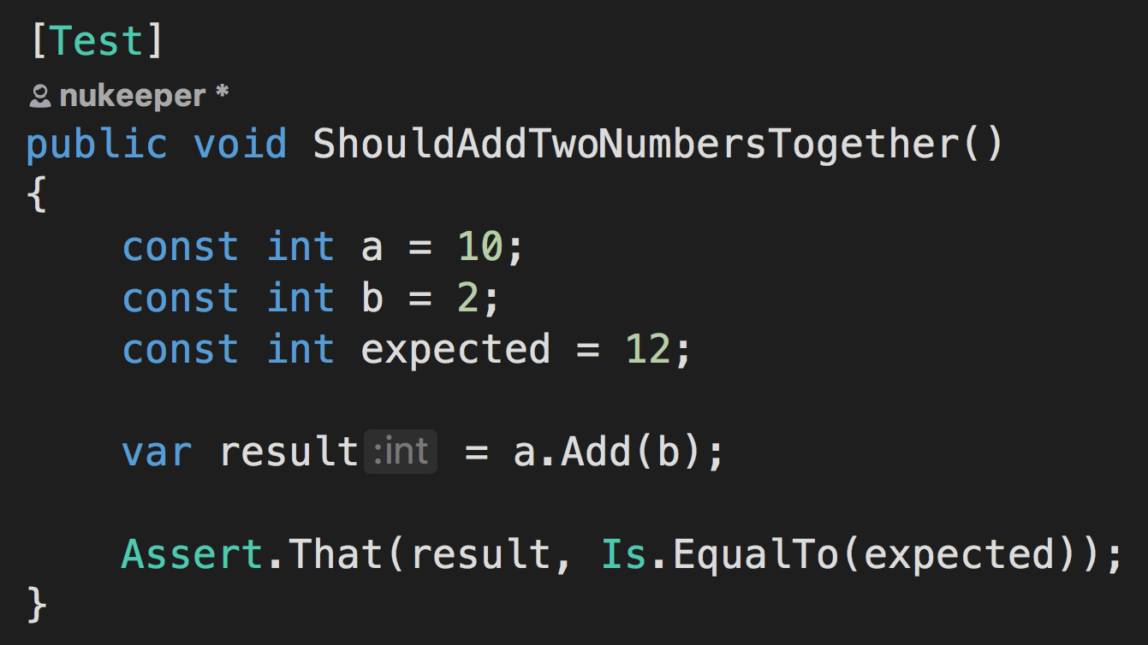
Traditional Testing: Example Based
Notes:
To illustrate this problem let’s quickly walk through an example:
We need to write a function that will add two values together and return the result….
Sounds fairly simple right.
So, we start writing a test:

Slide 7
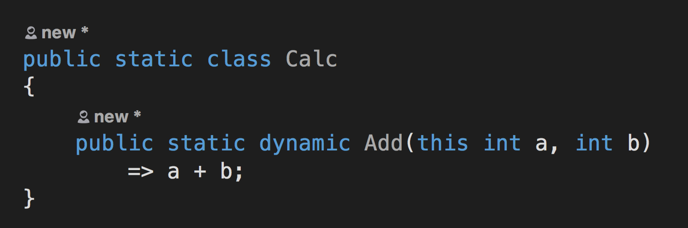
Traditional Testing: Example Based
Notes:
Ok. So, following good TDD practise, we run the test and see it fail, then we implement the method and see the test pass.
Are we done?
Are we confident that this works in all scenarios?
What about negative numbers?
What about zeros?
What about negative zeros?

Slide 8
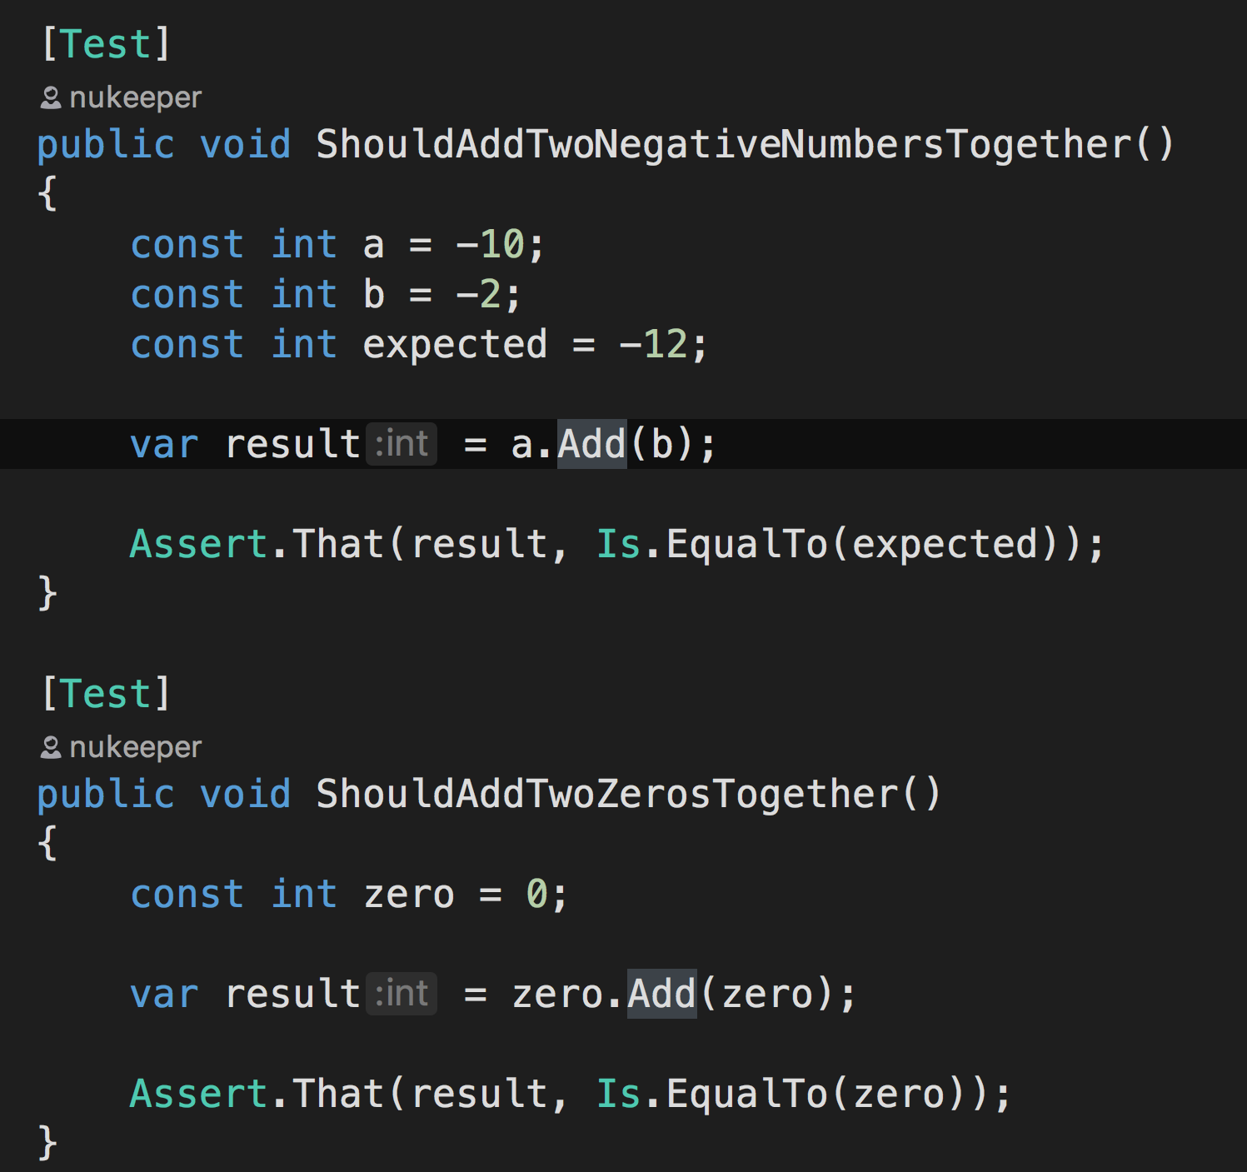
Traditional Testing: Example Based
Notes:
Ok, lets add a few more tests to cover those scenarios:
They are all green…are we done now, does the function definitely work?
Well what about if we add 1 to int.MaxValue?
If we are using javascript, what happens if a or b is null?
What happens if a or b is not a number?

Slide 9
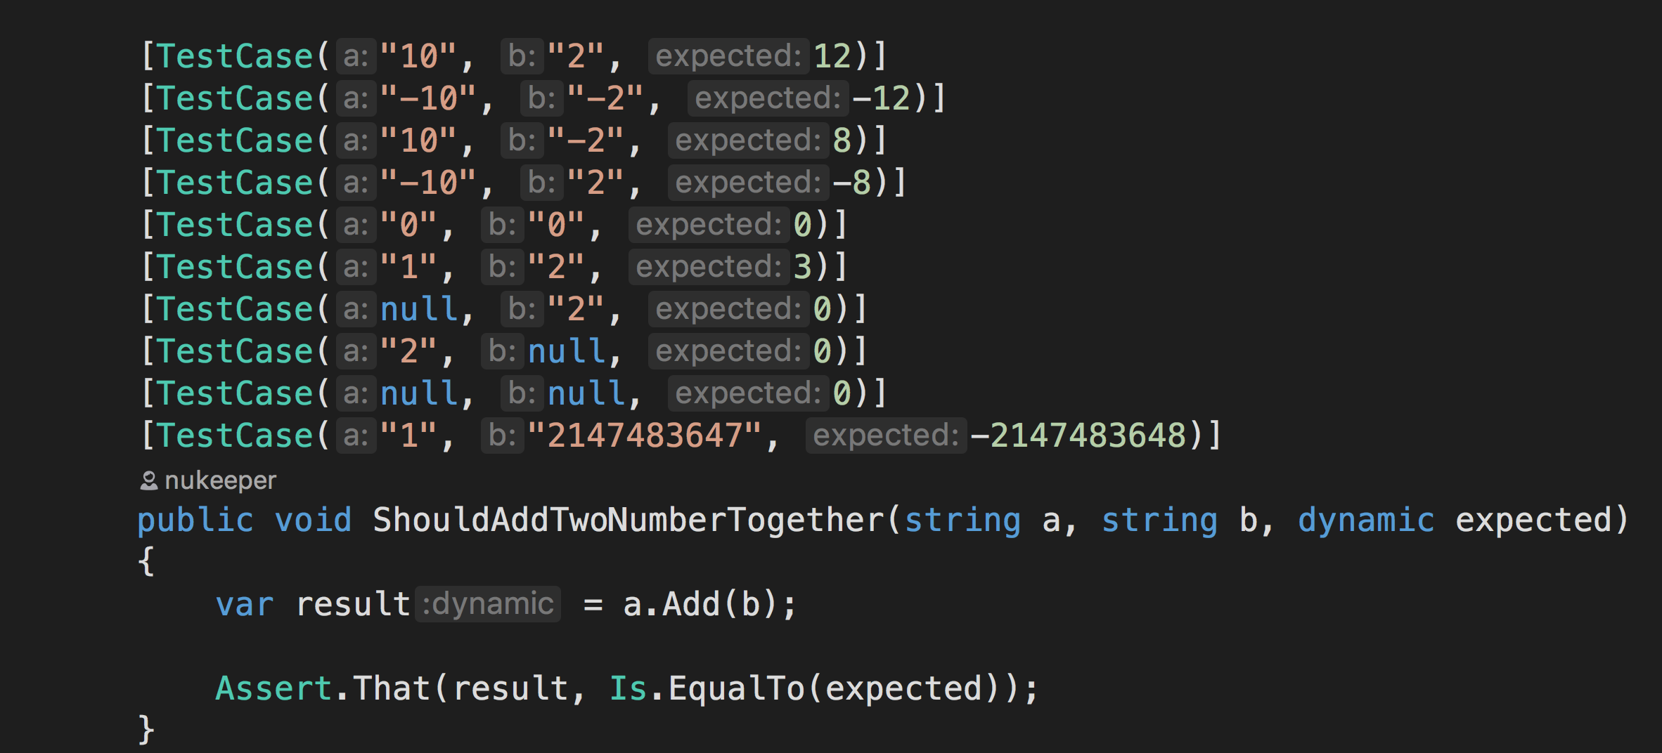
Traditional Testing: Example Based
Notes:
Ok, so we write a few more tests and we end up with something like this (I’ve used dynamic here in order to simulate dynamic typing in Javascript rather that switch to Javascript. Please don’t do this in your code, this is not a recommendation or an endorsement)
We’ve refactored our tests into test cases to reduce the duplication, and we’ve got a lot more tests than we started with.
Great.
But are we done?
Where do we stop?

Slide 10
Property Based Testing
Notes:
Property Based testing is a different form of Test Driven Development.
So like example based testing, we still write our tests up front.
But instead of arbitrarily thinking up our test scenarios and hard coding the inputs and expected outputs
PB Tests
- use randomly generated input data
in order
- to execute the test, a random number of times. (Let’s say 100 times…for reasons that will become clear shortly)

Slide 11
Property Based Testing
Notes:
Let’s focus on the first part of that: Random Test data….
Because our input data is randomly generated, we don’t actually know upfront what our input data is going to be.
And because we don’t know what our input data is going to be, we also have no idea of what the output of our functions under test will be …
PAUSE for thinking time
And now you are probably thinking, ‘well then how are we meant to know if its successful or not?’
And the sort answer to that is …that we need to calculate what the answer should be, and assert that the actual result matched the calculated result.

Slide 12
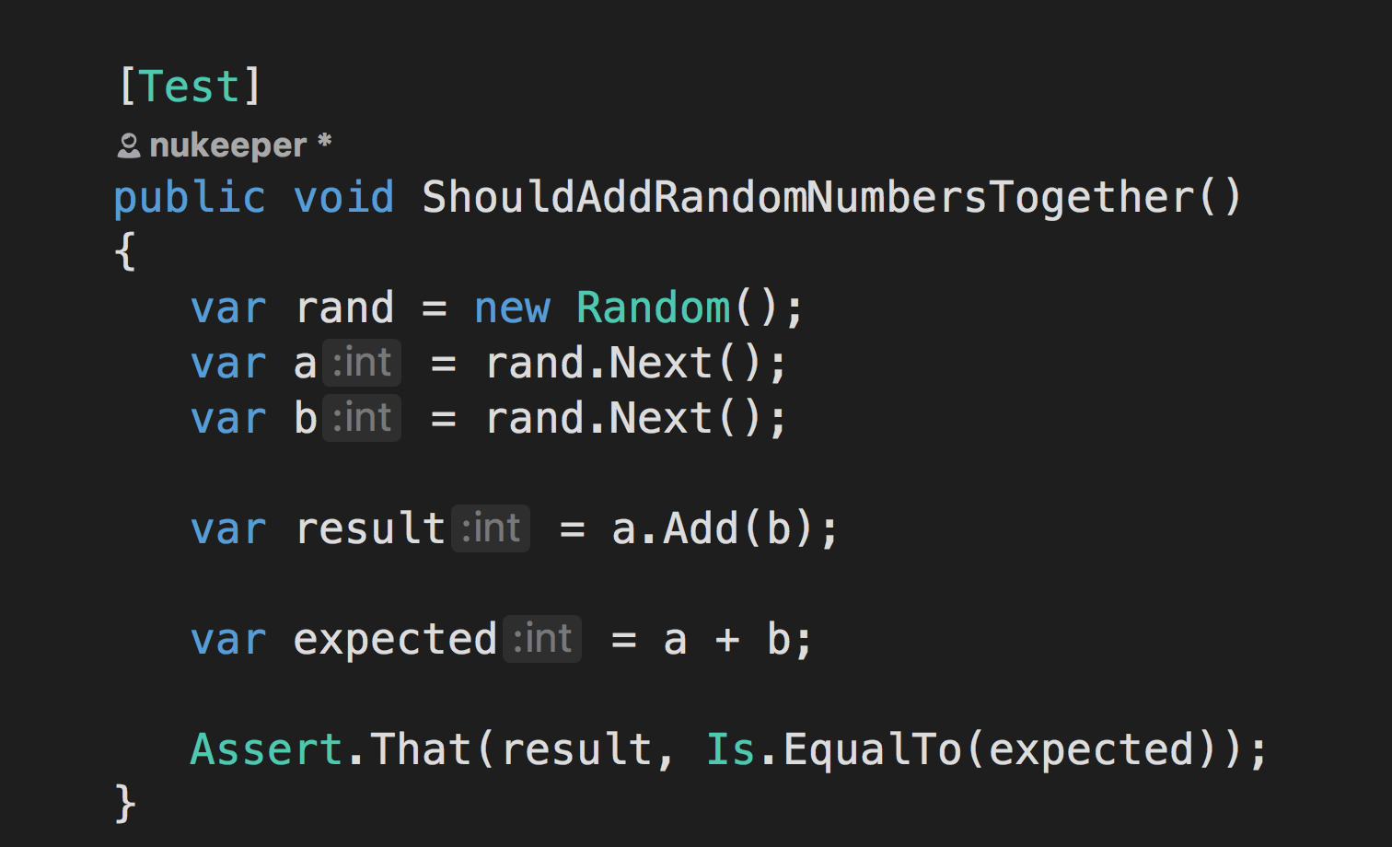
Property Based Testing
Notes:
Ok, so here we have a test that randomly generates the input, pumps it into our add function to get the result, and also, calculates what the expected result should be.
And this works, but there is an issue with this:
Because I have duplicated the logic from the actual implementation in the test…and this is bad because now I have two lots of code to maintain.
And we don’t want that - that breaks the DRY principle, and basically guarantees that when the requirements for this function change, we’ll need to apply two changes to the code base.
And this is bad regardless of whether you are writing Example Based Tests or Property Based tests.

Slide 13
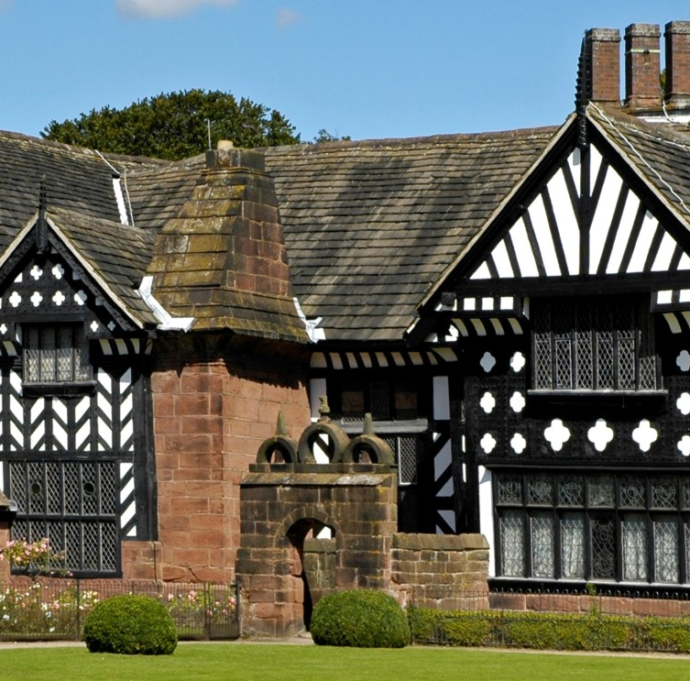
What do we mean by ‘Properties’?
Notes:
Lets take a Segway for a moment, and start by understanding the term Properties.
What do we mean by Properties?
Well, It’s not the getters and setters we see on objects in C# (show some code) - its got nothing to do with those properties, so put those out of your head
And it’s nothing to do with housing either.
A property is something that is usually described as ‘something that proves to hold true for all valid scenarios’
so you might say that a property a law, or a rule

Slide 14
Properties of a Guid Generating Function
f5b9d90e-6885-4375-a645-1ec261aa080f
36 characters
contains a mix of upper and lowercase letters, and numbers
no symbols or strange characters - except the 4 hypens)
always in a particular format
Notes:
for example, lets say we were building a function to generate a guid
some properties that we could assert are:
- a guid is always 36 characters long
- a guid is always contain 4 hyphens, and 5 parts
- a guid contains a mix of upper and lowercase letters, and numbers only (no symbols or strange characters)
- a guid is always in a particular shape (ie, 5 parts, and the 3 in the middle are always 4 chars long, the one at the start is always 8 chars long, and the last part is always 12 chars long)
And If were to write a test to assert that each of these rules held true for 100 randomly generated GUIDS (which would total 400 test cases) then we could say with a high confidence that the thing being generated by the function was actually, in fact, a GUID
And If were to write a test to assert that each of these rules held true for 100 randomly generated GUIDS (which would total 400 test cases) then we could say with a high confidence that the thing being generated by the function was actually, in fact, a GUID
So what are some of the Properties of the Add function that we could test for?
Lets work through a few examples for our Add function.

Slide 15
Properties of the Add Function
The order of the input arguments does not matter:
A + B == B + A
5 + 8 == 8 + 5
Notes:
Lets say that for Add to be implemented correctly, then the order of the two parameters does not matter: The result of A + B should be the same as B + A
So:
A + B == B + A
That is our rule, or our property, that we are asserting.

Slide 16
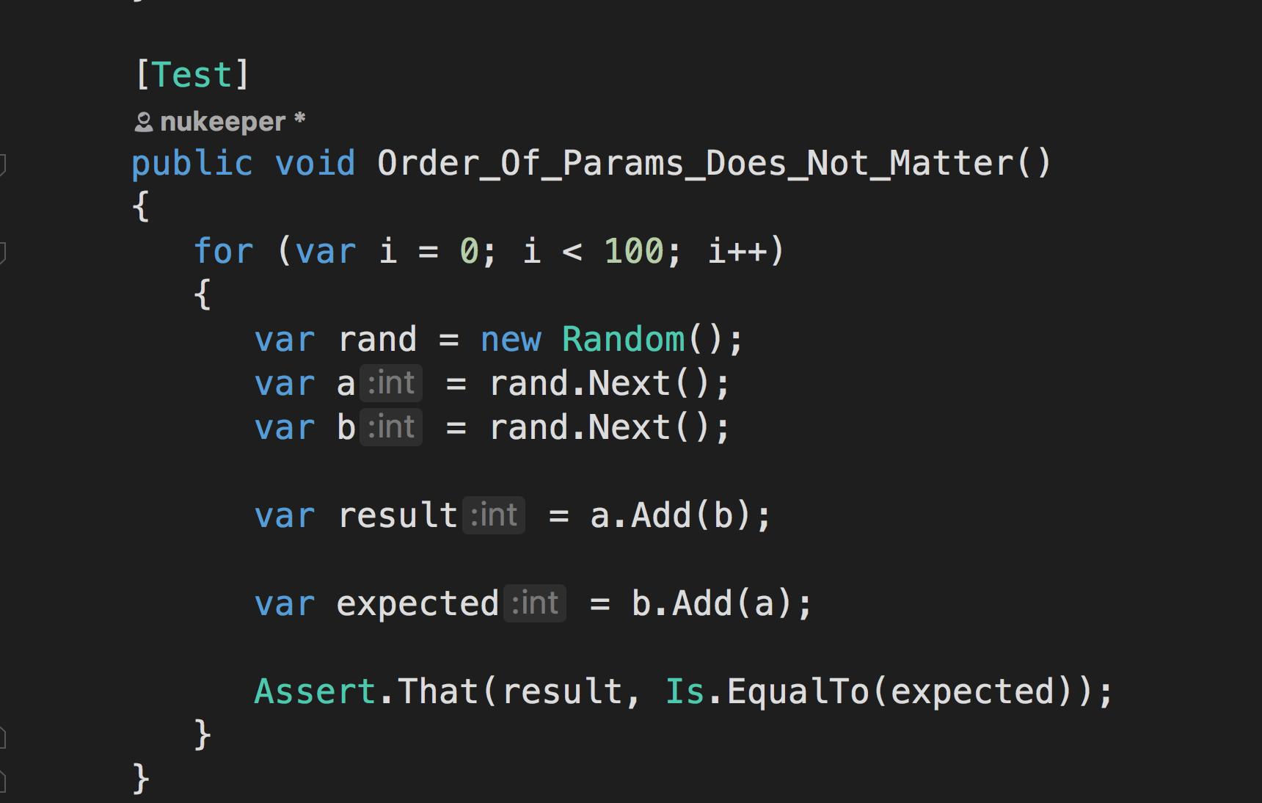
Properties of the Add Function
Notes:
Here we see that property (or rule) expressed in C#:
So we are asserting that you can supply the arguments in any order, and you get the same result…
What does this tell us?
If this rule holds true for 100 random test cases, what can we prove or disprove about our implementation of Add?

Slide 17
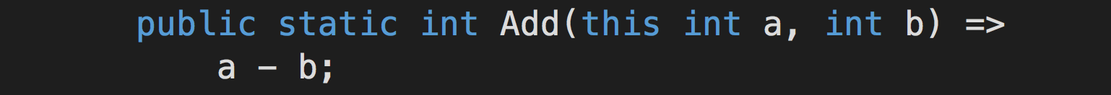
Properties of the Add Function
Rules out this implantation of Add:
5 - 8 != 8 - 5
Notes:
Well, it does rule out the possibility that Add actually does this:
return a - b;
Because with subtraction, the order of the arguments DOES matter.
The result of 8 - 5 is not the same as 5 - 8.
But on its own, it does not give us complete confidence that our method is 100% correct.
For example, if we accidentally implemented Add as a * b then this test would still pass, because 5*8 is the same as 8*5.

Slide 18
Properties of the Add Function
For any valid integer (x),
calling Add(1) twice is the same as calling Add(2) once:
x + 1 + 1 == x + 2
Notes:
So we need another test.
What else can we say about Add?
Well, we could say that for any valid integer X, the result of calling Add(1) twice is the same calling Add(2) once:
x + 1 + 1 == x + 2

Slide 19
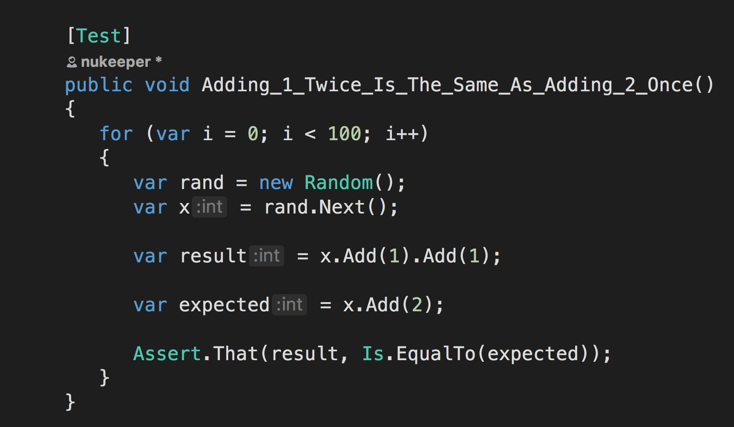
Properties of the Add Function
Notes:
Here it is in C#
So with these 2 tests (which have actually generated 200 test cases), we can be fairly sure that our implementation of Add is working correctly.
But there is actually still a scenario we’ve not catered for.
If we had accidentally implemented Add to simply return 0, then these 2 tests will still pass, but obviously our function isn’t working.
So we need another test.

Slide 20
Properties of the Add Function
For any valid integer (x),
the result of calling Add(0) is the same as x :
x + 0 == x
Notes:
So another Property we could test for is that, for any valid integer X, adding zero to X is the same as X
x + 0 == x

Slide 21
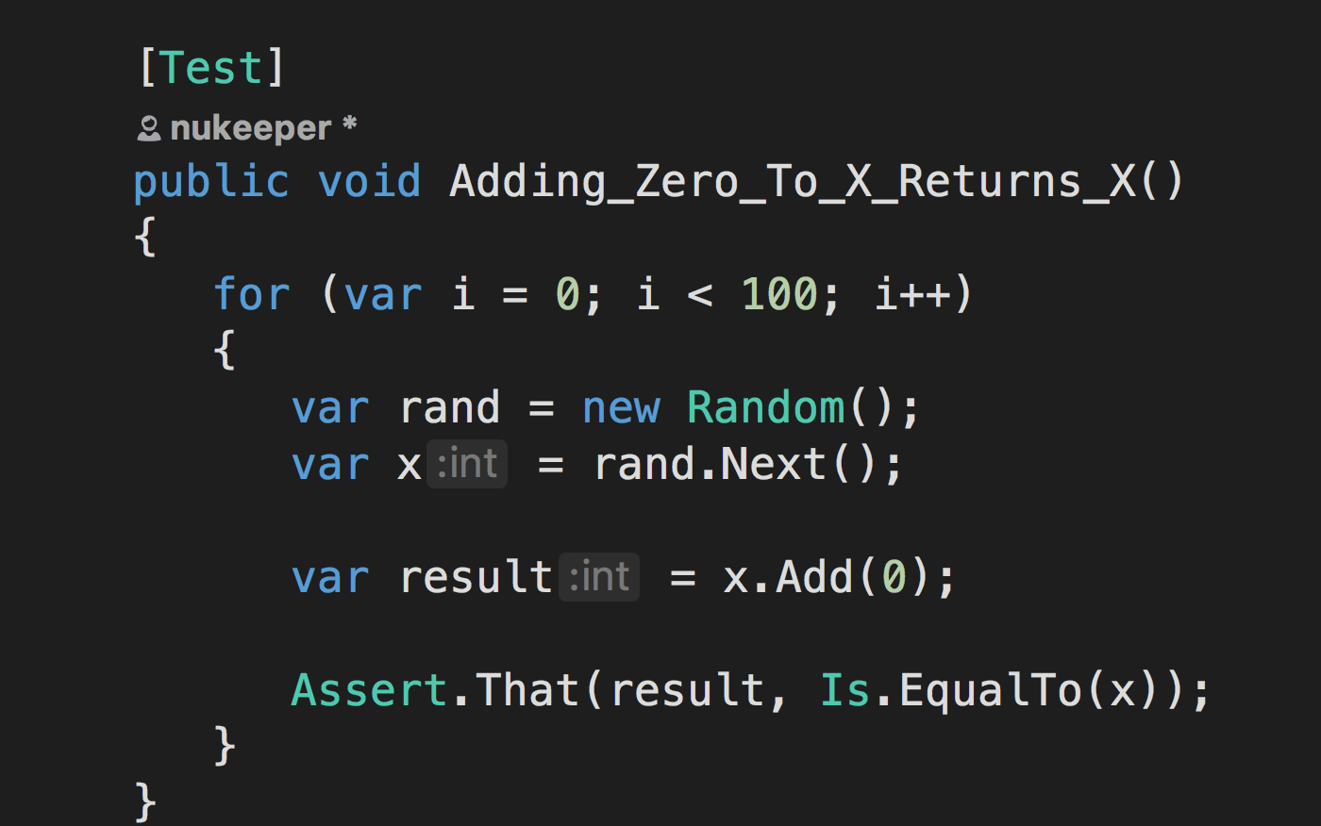
Properties of the Add Function
Notes:
Here it is in C#
Now with the combination of these 3 tests, which actually cause 300 random tests to execute, we can be fairly sure that our implementation of the Add method is working properly.
And that, in a nut shell, is Property Based Testing:
We run a test a random number of times, with random input data, and ensure that the expected properties/ or rules, hold true for all cases.
And sometimes, we need a combination of properties in order to be confident of our implementation.

Slide 22
Benefits of Property Based Testing
More test coverage
More edge cases covered
More comprehensive then humans
Notes:
So what benefits do we get?
Well, we are now running a lot more tests over our code each time we run the tests, both locally and on the CI server.
And the random nature of the input data means that we are we are getting machines to replace our flawed human brains when selecting test cases:
They don’t get tired, or feel pressure to deliver, and they don’t forget….so as a result, they will end up running far more weird and wonderful tests than we were willing to write code for….
And as a result, the chances of finding a bug in your implementation goes up.

Slide 23
Flawed implementation
boiler plate setup = noise
test failure diagnosis = murder
What about non-numeric data input?
Non-Deterministic test runs!!
Notes:
However, there are obviously a few issues here:
- first, we are doing quite a lot of work in order to setup the test, all those loops inside the test is duplication we could do without, and frankly, distracts from what the test is actually trying to do
with the code as it, If one of the random test cases fails, then diagnosing which of the randomly generated inputs caused the failure is going to be a pain, and we may have to add more noise in the form of logging to figure it out
Generating random integers is pretty easy, but what if we wanted something more complicated than primitive data types?
You may also be thinking that our tests are no longer deterministic….because of the randomly generated data, it is possible that they could fail intermittently. And you’d be right…..but the chances are that this is due to a defect that you didn’t know was there, and that’s the point!

Slide 24
Property Based Testing Libraries – FS Check
“Quick Check” is a Property Based Testing framework
Originally built for Haskell
Ported to many different languages
FS Check is the .Net implementation
Libraries available for Javascript, Pythod and Scala (see notes for links)
Notes:
Luckily there are tools out there that address some of those issues that we’ve just discussed and make writing Property Based Tests much cleaner and quickter todo
- Enter FS Check.
FS Check is Library based on something called QuickCheck, which was for Haskel, but has been ported to many different languages:
I’ve included some links to what a very quick google uncovered, but I’ve not tested that any of them are any good.
https://hypothesis.works/articles/quickcheck-in-every-language/
Javascript: https://github.com/jsverify/jsverify
Python: https://hypothesis.works/
Scala: https://www.scalacheck.org/
FS Check will automatically generate our random data for us, not just for primitive types like integers, but can actually generate complex data structures for use too.
It will also manage the running of our tests multiple times for us, the default is 100 times, but you can configure that if you like.
FS Check keeps running tests until it runs out of test cases (either it hits the desired target, or it exhausts the dataset), or until it finds a failing test case
If and when it finds a failing test, it does 2 things: I outputs the randomly generated data that caused the test to fail, and if the data generator has an associated shrinker, it will attempt to carry on testing, shrinking the data until it finds the smallest item that causes a failure…..
So its a pretty nifty bit of kit, and resolves a lot of the issues we were discussing before!

Slide 25
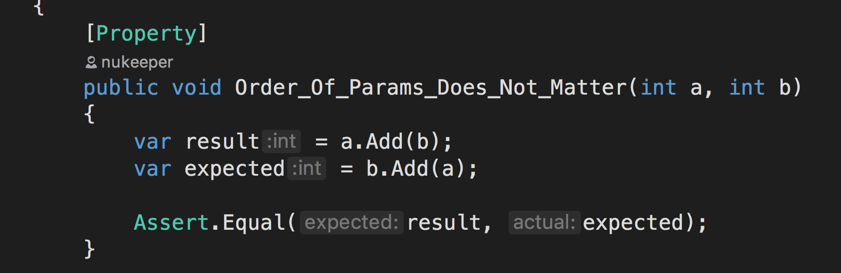
Notes:
Here is one of our tests now that we’ve added a reference to the FSCheck package:
Let’s walk through the changes:
First, The test is now decorated with a Property attribute instead of the previous Test attribute - this tells FSCheck that we want it to manage our test for us
Next, our input data is now supplied to the test as an argument, just like when we create test cases, but in instead of creating the test cases ourselves, FSCheck will be generating the input for us.
Lastly, we’ve done away with all that noisy looping logic, as FSCheck is managing that for us, and the Random object is gone too, because we no longer need it.
Overall, a lot cleaner and nicer to read.

Slide 26
Hands on!
Notes:
So now you have an idea of what Property Based Testing is all about and shown you a glimpse of how to do it
Hopefully I’ve managed to peek your interest just enough that you want to get your hands dirty.
And that’s exactly what we are going to do now.
Now we are going to have a crack at doing the Diamond Kata, using Test Driven Development, but instead of Example Based Tests, we are going to use Property Based Tests instead.
But before we start, we need to understand the problem a little more:

Slide 27
The Diamond Kata:
Build a function that
takes in a single character from the alphabet as input
returns a diamond shape ascii picture starting at A, all the way to the input Letter, and back down to A again.
B:
A
B B
A
D:
A
B B
C C
D D
C C
B B
A
Notes:
The Diamond Kata:
Take a single character from the alphabet as input, and as output, return a diamond shape ascii picture starting at A, all the way to the input Letter, and back down to A again:
So each row of the picture will be a string, and the overall response object will be a collection of strings.
And because you can’t make a diamond from just A, if the input is A, then the output is an empty collection.
Only only valid inputs are th characters a-z.
Any Questions about the requirements?

Slide 28
What Properties to test for?
Take 5 minutes to think of some Properties (or rules) that we might be able to test for:
Notes:
now, the hardest part of starting with PBT is figuring out what properties to test for, so, before we start I’d like you all to take 5 minutes to think of some properties that we might be able to test for in our output.
Remember these are rules that will be true for all valid inputs, and we don’t actually know what the input is going to be.

