Slide 1
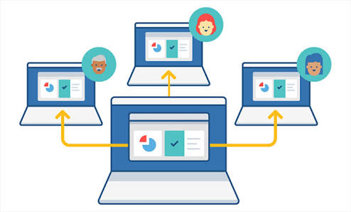
DESKTOP SHARING APPLICATION USING
RFB PROTOCOL ON PYTHON PLATFORM
Under the guidance of
Mr.Bhushan Deshpande
Assistant Professor
Mr. Akash S. Natkar (CT14057)
Mr.Yugant P. Kadu (CT14060)
Ms.Nilu Kant (CT14061)
Mr. Deepak Kumar Gupta (CT14068)
Mr.Satish W. Wanjari (CT14078)

Slide 2
Contents :-
Introduction
Objectives
Proposed Approach
Implementation
Result and Discussion
Future Scope
References

Slide 3
INTRODUCTION :-
Desktop sharing application allow remote access and remote collaboration of different client on single server screen.
This technology allow to share concurrent session among various user at remote location.
RFB protocol works at the frame buffer level hence applicable for windowing systems and applications.
Platform Independent

Slide 4
OBJECTIVES :-
Governments, corporations, Anti-criminal organizations, or individuals.
To monitor employee’s activity.
To track children’s activity.
To recognize and monitor threats, and prevent and investigate criminal activity

Slide 5
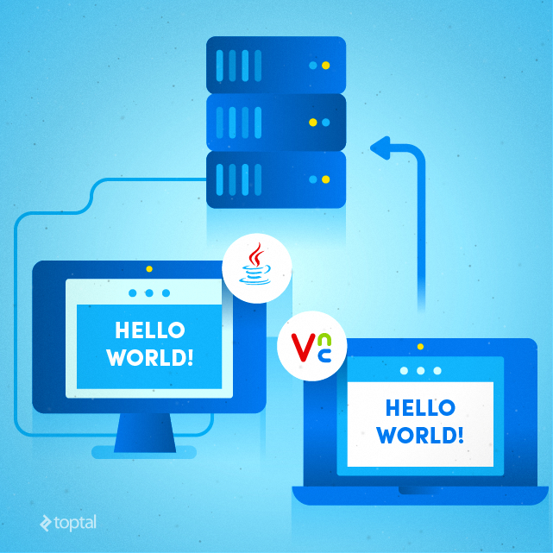

Proposed Approach
System Design

Slide 6
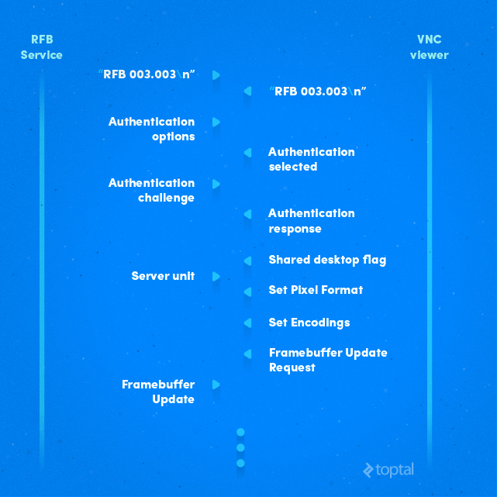
RFB protocol
Server
Client

Slide 7
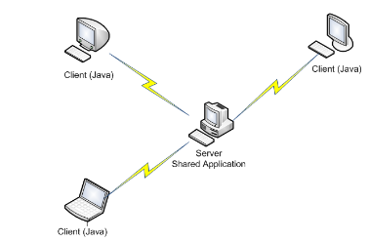
IMPLEMENTATION :-
RFB protocol sets up the Authentication between the communication channel.
Connection of Server – Client Machine using Socket Programming via WLAN or LAN

Slide 8
components
Screen Capture
Module:pyscreenshot
ImageGrab.grab_to_file('file.png')
Socket Connection
Module:socket
Server
host = socket.gethostname()
port = 9000
serversock.bind((host, port))
Client
prot = 9000
s = socket.socket()
s.connect((host , port))

Slide 9
File Handling
Module: file
file_pointer = open(“file_name", “file_mode")
Image File Sharing
Client
read = f.readline()
s.send(read)
Server
data = s.recv(BUFFER_SIZE)
Hotkeys
Module: pyhook and pyhk
GUI
Module: pyqt4

Slide 10
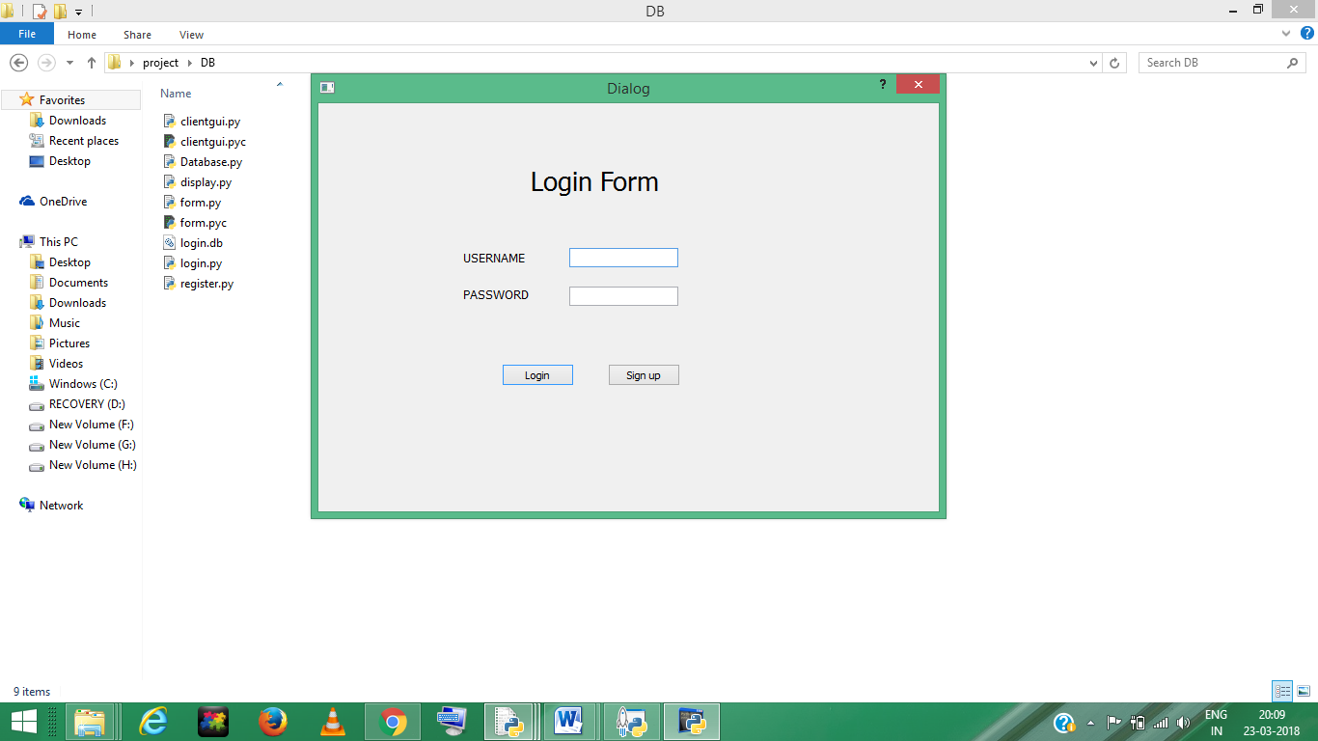
Login form

Slide 11
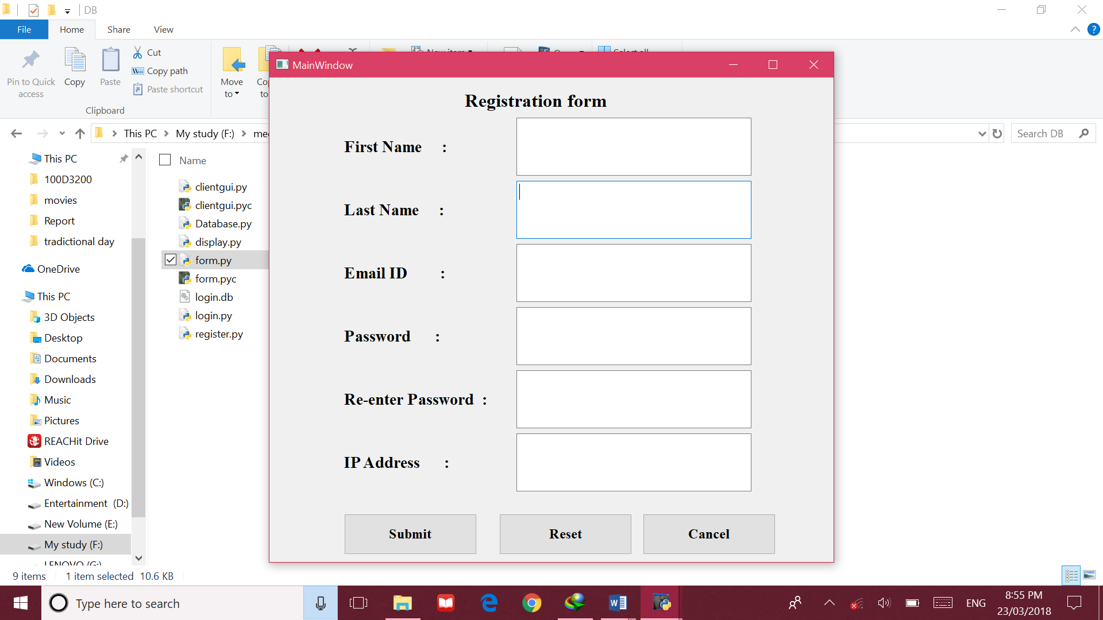
Registration form

Slide 12
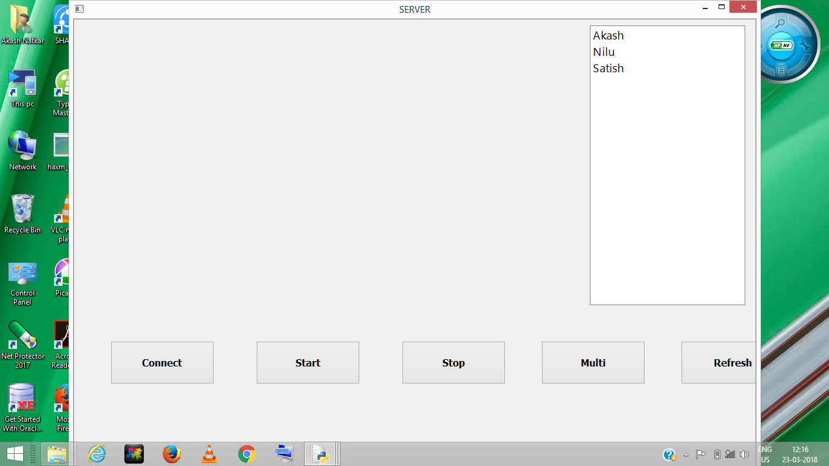
A. Peer to Peer
Server side

Slide 13
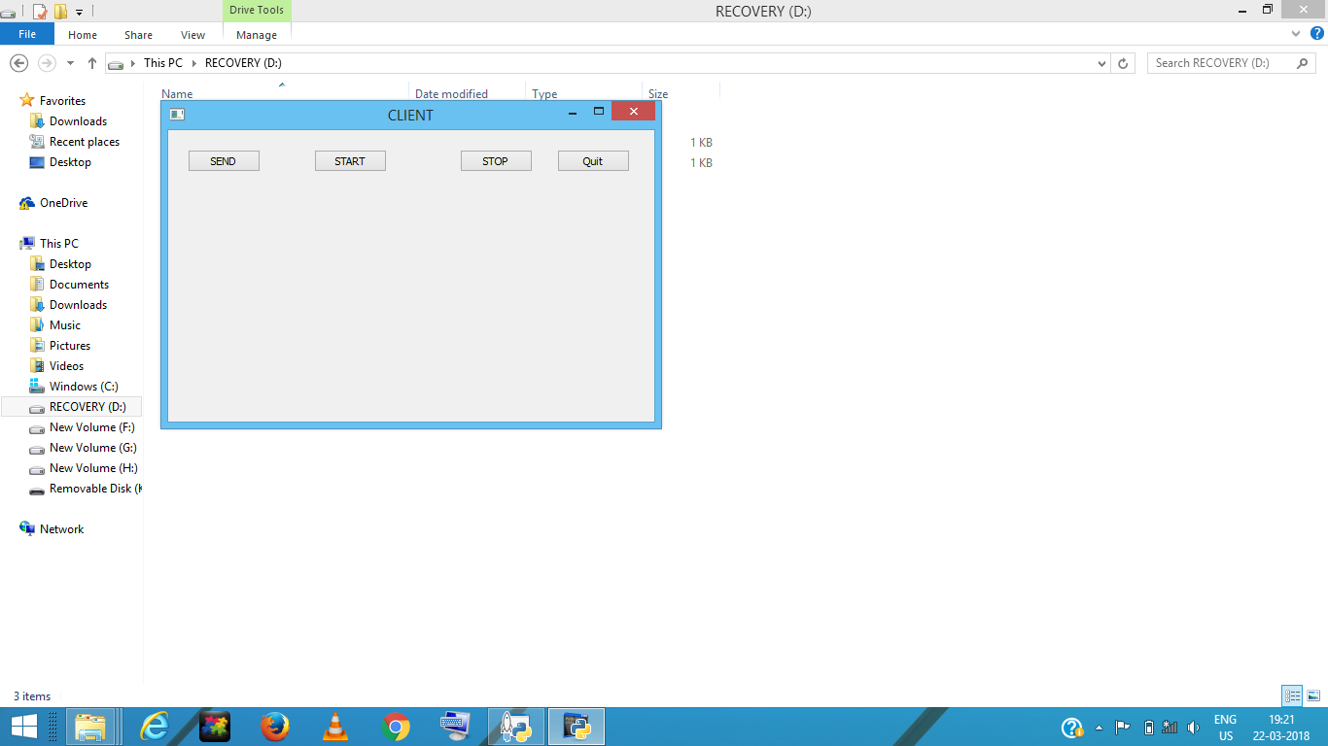
Client side

Slide 14
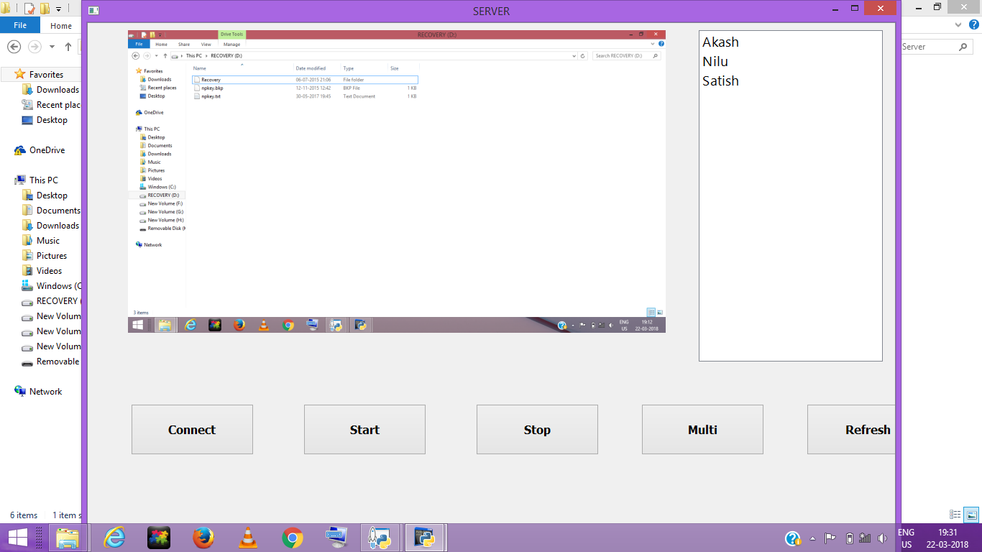
After Receiving of Image

Slide 15
b. Multiple Images
Server side

Slide 16
Client side

Slide 17
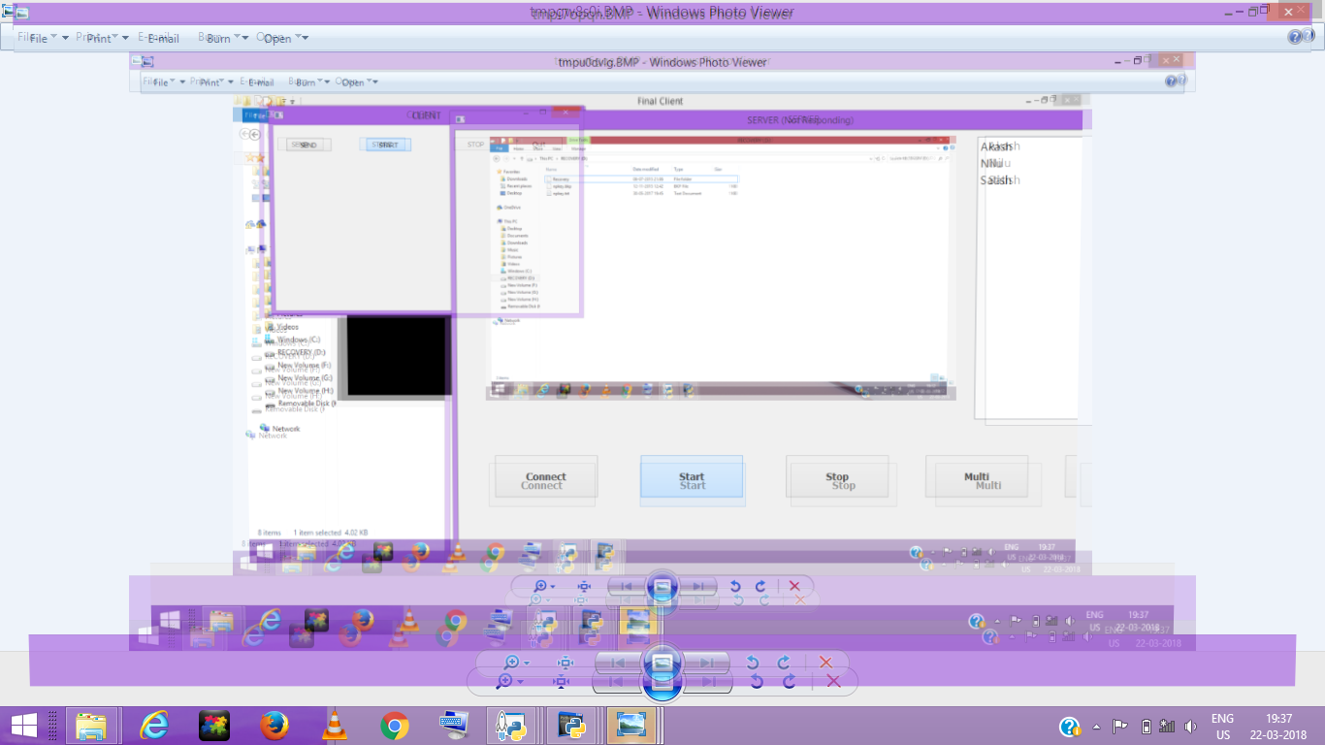
After Receiving Multiple Images

Slide 18
C. Broadcast
Server side

Slide 19
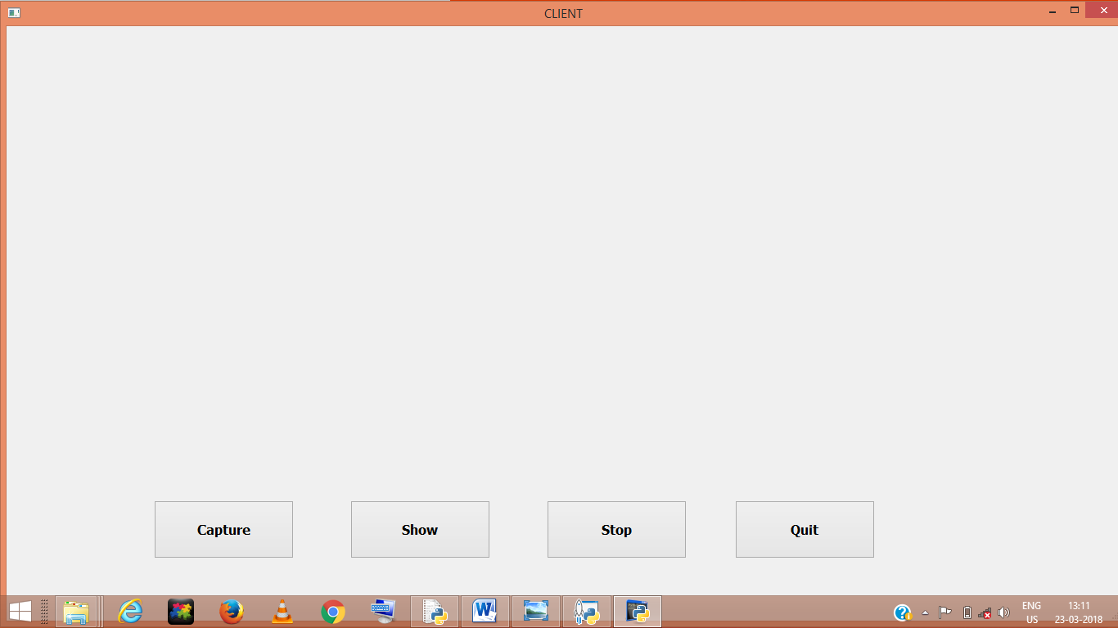
Client side

Slide 20
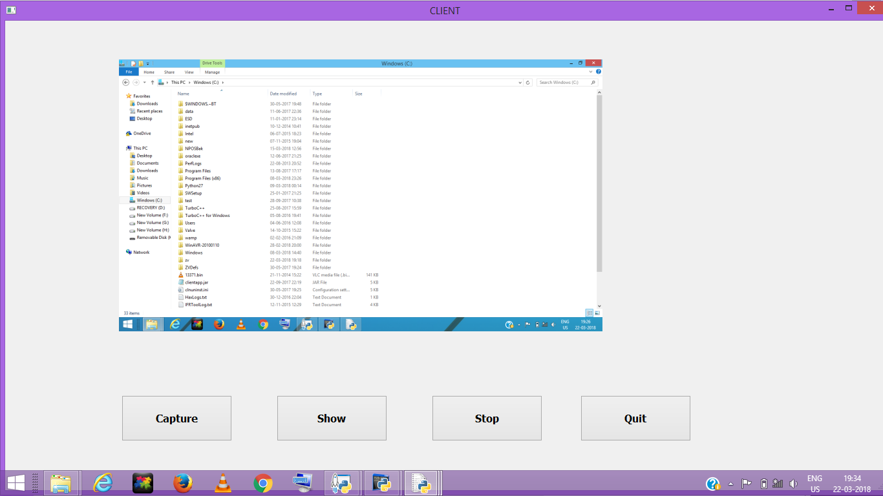
With Image

Slide 21
FUTURE SCOPE :-
Security (Encryption)
Voice recording
Video recording
Network Surveillance

Slide 22
references
Daniel Zinca (2010). “Design of a modified RFB protocol and its implementation in an ultra - thin client”, Ninth International Symposium on Electronics and Telecommunications, Timisoara, Romania.
Herbert Schild (2016). “Java – The complete reference”, McGraw Hill Education, Ninth Edition, ISBN-13: 978-1-25900-246.
http://vncdotool.readthedocs.io/en/latest/rfbproto.html#server-to-client-messages accessed on 27/06/2017 at 8.35 p.m.

Slide 23
https://www.toptal.com/java/implementing-remote-framebuffer-server-java accessed on 28/06/2017 at 8.35 p.m.
https://docs.oracle.com/javase/7/docs/api/java/awt/Robot.html accessed on 05/07/2017 at 8.00 p.m.
http://www.realvnc.com/docs/rfbproto.pdf accessed on 10/07/2017 at 9.00 p.m.

Slide 24

THANK YOU

