Slide 1
Analysis of restaurant markets by city using TripAdvisor and Scrapy
David Corrigan – Web Scraping Project
October 16, 2018

Slide 2
Restaurant Analysis by City -- Rationale
Potential interest for two groups – consumers and developers
Consumers
Which cuisines/types of restaurants are successful and well-received in a specific city?
Vacation planning – what to avoid, try in a particular place
Restaurant Developers
What cuisines/restaurant types are thriving in a given city?
Likely high barriers to entry
What types of restaurants are well-rated but underrepresented?
Good opportunities for development
What types of restaurants are poorly-received in a city of interest?
Further research needed – possible cultural or geographical reasons, potentially an opportunity to develop a market

Slide 3
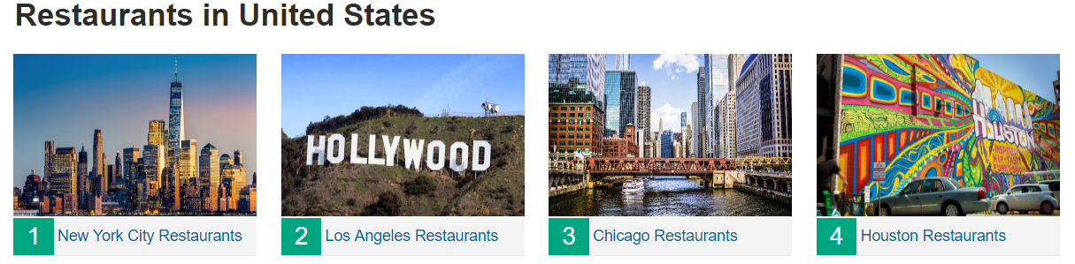
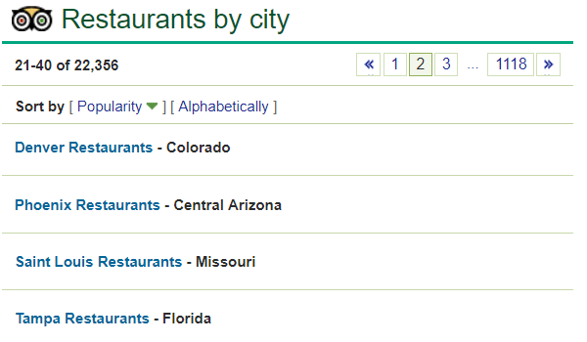
Web Scraping from TripAdvisor.com -- Scrapy
Top 20 Cities in the US on the first page:
All subsequent pages (20 cities per page)
Obtain URLS, parse the first page of the city (general info and the top 30 restaurants), create parse function for subsequent pages
137,000 restaurants parsed among the top 60 US cities
- Cut to 50 (Bronx, Scottsdale, AZ, Oahu&Honolulu)

Slide 4
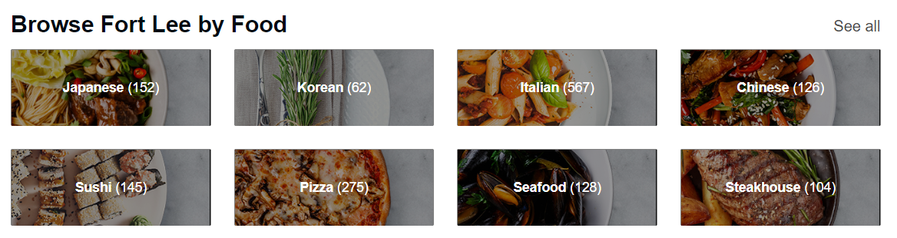

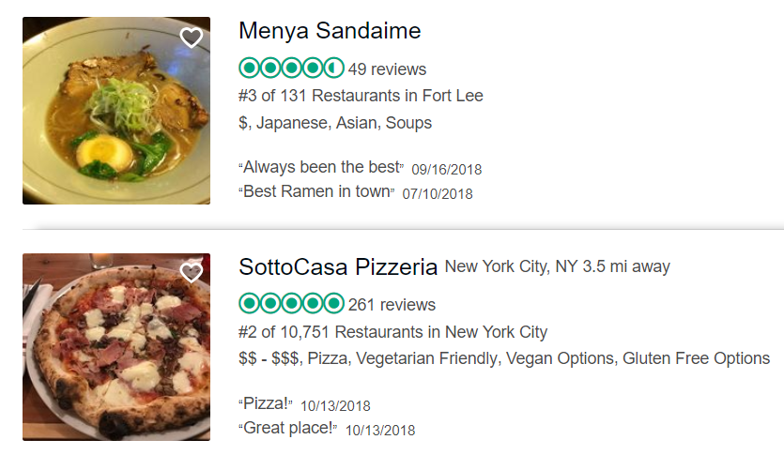
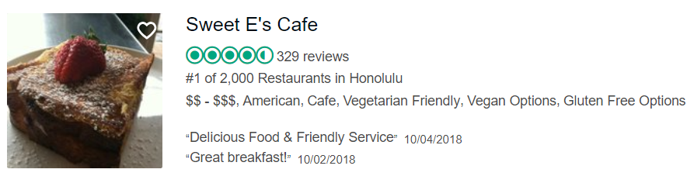
One technical issue – Is every restaurant on the city’s page actually in the city?
Fort Lee, NJ
#18 Oahu
#26 Honolulu
Extra Xpath element in restaurants outside of the target city that can be dropped using a Pipeline function

Slide 5
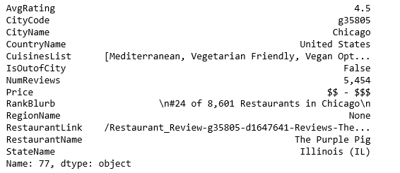
- Saved Scrapy output as a JSONL file, which was read into Python as text, converted null>None and false>False
- Literal_eval could then understand this as a dictionary, converted list of dictionaries to Pandas DF
Cleaned the data and removed some of the columns not needed for this analysis

Slide 6
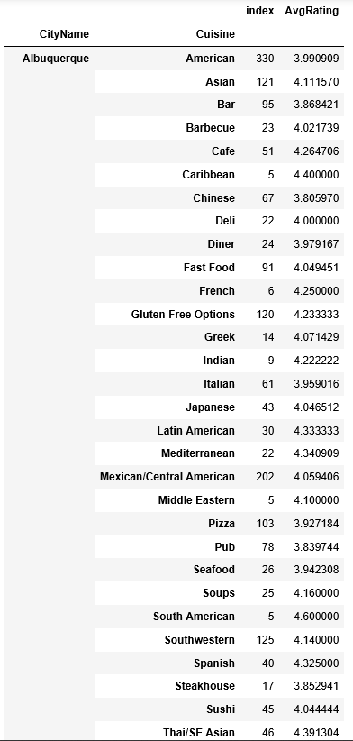
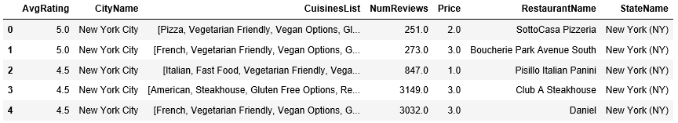
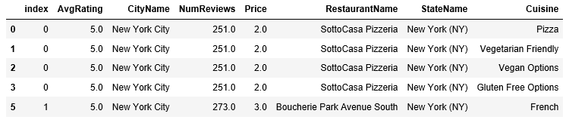
Finally, I “unlisted” the CuisinesList column from this data frame, creating a new line for each type of cuisine found at a restaurant (multiple lines per restaurant now). I also trimmed Cuisines that were very obscure.
- Careful to use either the “collapsed” DF or “expanded” DF, depending on which question being asked
118,000 length data frame – “Collapsed”
300,000+ length data frame – “Expanded”

Slide 7
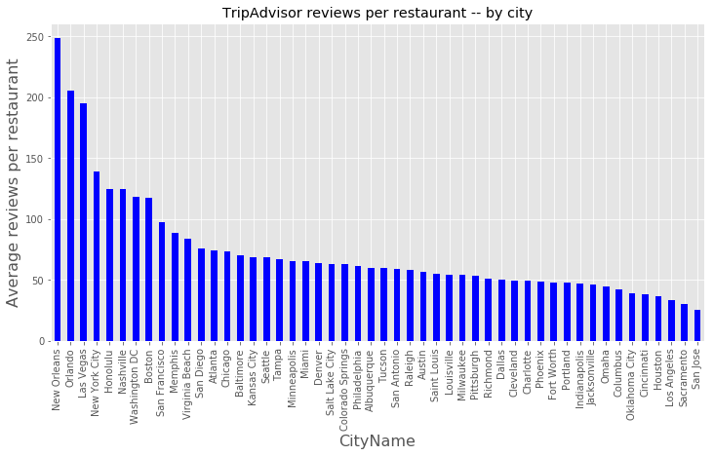
Does every city have a similar number of reviews per restaurant?
Larger cities – more restaurants – same average # of reviews per restaurant, right? No. It would appear that more “touristy” cities have more reviews per restaurant. May be particularly true of Tripadvisor.com

Slide 8
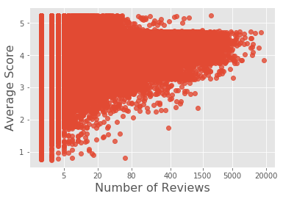
Does the average restaurant score correlate with the number of reviews per restaurant?
Linregress Result
Slope = 0.00011
Intercept = 4.043
Rvalue = 0.0596
Pvalue = 2.56e-74
Stderr = 6/27e-6
Yes, which seems like a logical conclusion, as the most popular restaurants (getting the most reviews) should be good enough to stay open and popular

Slide 9
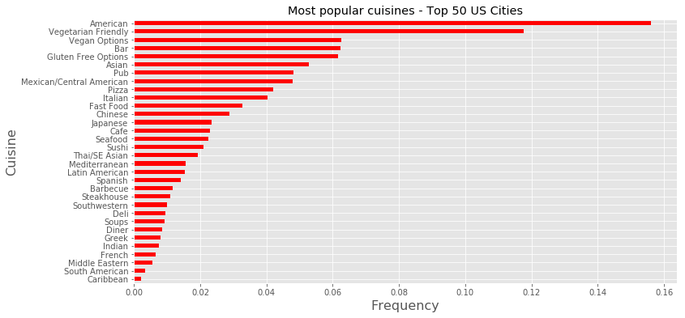
Which restaurant cuisines are most common overall?
Trimmed DF – less common cuisines not represented
This information used to compile a list of relative cuisine frequencies in each city

Slide 10
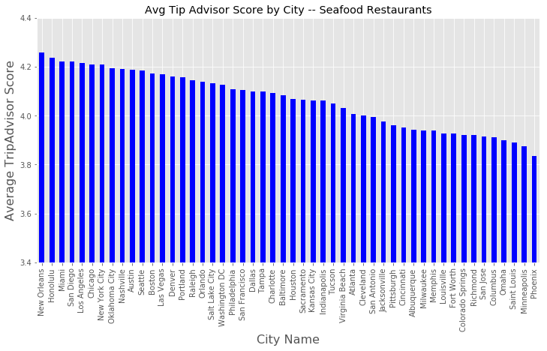
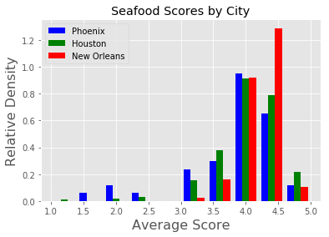
Using these modified DF, we can easily visualize the distribution of cuisines in a given city, or among all cities for a given cuisine – ex. Seafood

Slide 11
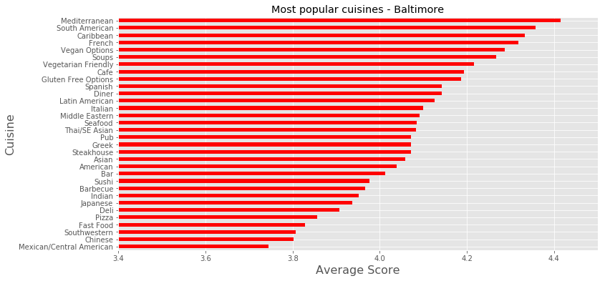
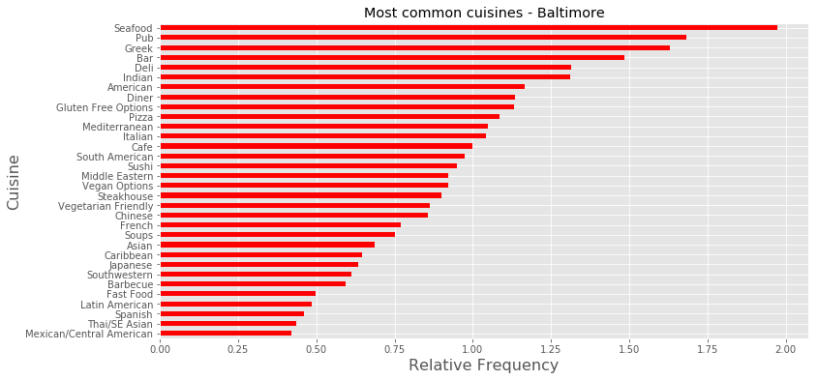
Importantly, we can also visualize the relative abundance and relative popularity of cuisines within a particular city
TripAdvisor Rating
Relative Abundance
Can we combine these two pieces of data to get a more succinct perspective?

Slide 12
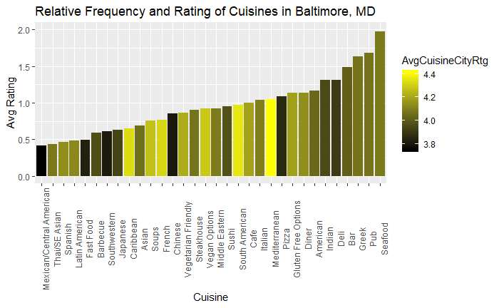
Ggplot can tell us in one glance both the relative abundance, and average TripAdvisor ratings of a cuisine within a particular city

Slide 13
Conclusions
Scrape of TripAdvisor data from 50 major US cities
50 cities, 110K restaurants
Cuisine type, opportunities to better understand a market from either a consumer or entrepreneurial perspective
Expandable to other geographies
Middlesex County, NJ – 1M people, plenty of restaurants
Analysis would need to be two-fold – scraping data from individual locations then joining to a larger “region” using another data source (the towns in Middlesex county, for example)
Able to visualize data either by cuisine, or city name, quickly using Python or R
In some instances (vegan options, i.e.), may be a question of marketing, or an indication that restaurants in that city could do a better job of informing TripAdvisor about their dietary options

