Slide 1
S&P 500 Sentiment-Driven
Trading System
Interim Presentation — May 2026
Costache Darius Daniel
Grid Dynamics

Slide 2
System Architecture
End-to-end pipeline: from raw data to trading signal
01
02
03
04
05
Data
Collection
Sentiment
Analysis
Feature
Engineering
XGBoost
Training
Evaluation
& Backtest
→
→
→
→
Kaggle CSV
17,800 headlines
FinBERT
transformers
pandas
16 features
xgboost
walk-forward
sklearn
matplotlib
INPUT
OUTPUT
OUTPUT
OUTPUT
OUTPUT
Kaggle CSV
2010–2024
3,311 prices
17,800 articles
sentiment score
per day (3,310d)
3,297 rows
16 features
xgb_model.pkl
acc=0.508
Final Output: Trading signal (Up/Down) | Accuracy 50.8% | 48 walk-forward folds | 3,024 days tested
Privileged and confidential
S&P 500 Sentiment Trading

Slide 3
Project Overview
01
Data Collection
02
Sentiment Analysis
17,800 headlines from Kaggle dataset (2010–2024) paired with S&P 500 daily prices. One headline per trading day — covers 3,311 days fully.
FinBERT (ProsusAI) classifies each headline as positive, negative or neutral — pre-trained on financial text. 3,310 days with sentiment coverage.
03
Feature Engineering
04
XGBoost + Walk-Forward
16 features: RSI, MACD, ATR, volatility, returns + sentiment lags (1/2/3d), moving averages (5/20d), sentiment_change, article_count
48 folds of walk-forward validation on 3,024 days. Always trains on past, tests on future — simulates real trading. Mean accuracy 50.8% (±0.071)
Privileged and confidential
S&P 500 Sentiment Trading

Slide 4
Step 1 — Data Collection
Library: pandas | Source: Kaggle sp500_headlines_2008_2024.csv | Output: news.csv, prices.csv
Why Kaggle instead of RSS?
What the CSV contains
— RSS feeds only return the last 2-3 days of news — no historical archive
— Column Title → renamed to 'title' — the news headline
— First version had 60 articles covering only 45 days out of 501
— Column Date → renamed to 'date' — format YYYY-MM-DD
— Kaggle dataset: 17,800 headlines from 2008 to 2024
— Column CP → renamed to 'close_price' — S&P 500 close
— Prices and news extracted from same CSV in one load
— START_DATE = '2010-01-01' → 3,311 trading days fully covered
— drop_duplicates on title removes any repeated headlines
— One headline per trading day — consistent, clean structure
— sort_values on date ensures chronological order
✓ Result: 17,800 headlines loaded | 3,311 days of price data | Sentiment coverage: 99.9% of trading days
Privileged and confidential
S&P 500 Sentiment Trading

Slide 5
Step 2 — Sentiment Analysis (FinBERT)
Libraries: transformers, torch | Model: ProsusAI/finbert | Output: sentiment_daily.csv
Why FinBERT?
How It Works
Generic models count positive/negative words.
FinBERT was pre-trained on financial texts:
"earnings miss" → negative | "beats expectations" → positive
1. Tokenizer: headline text → numbers
2. Model outputs 3 raw scores (logits)
3. Softmax → [pos, neg, neu] summing to 1.0
4. Sentiment = label with highest probability
Technical Implementation
— Batch size: 16 headlines — avoids memory overflow
— Net score = prob_positive − prob_negative (−1 to +1)
— padding=True, truncation=True, max_length=128
— Daily score = weighted avg, confidence as weight
— torch.no_grad() — no gradients, saves memory
— Formula: Σ(score × confidence) / Σ(confidence)
✓ Result: 17,800 headlines analyzed | Scores for 3,310 days (99.9% coverage) | vs 45 days in V1
Privileged and confidential
S&P 500 Sentiment Trading

Slide 6
Step 3 — Feature Engineering
Library: pandas | Input: prices.csv + sentiment_daily.csv | Output: features.csv (3,297 rows × 16 features)
Price-Based Features
Sentiment-Based Features
daily_return
Daily % change in Close
sentiment_score
Today's weighted sentiment (−1 to +1)
return_5d / return_20d
5 and 20-day momentum
sentiment_lag1/2/3
Sentiment from 1, 2, 3 days ago
rsi_14
Overbought (>70) / oversold (<30)
sentiment_ma5/ma20
5 and 20-day moving average
volatility_5d / 20d
Std dev of daily returns
sentiment_change
Diff vs yesterday — sudden shifts
macd
EMA(12) − EMA(26) trend signal
article_count
Articles published that day
atr_14
Average True Range — daily swing
volume_ratio
Volume vs 20-day average
⚠ Target Definition — Critical Step
target = (Close.pct_change().shift(−1) > 0).astype(int)
shift(−1) = TOMORROW's return, not today's.
Without this, the model predicts the past — not the future.
price_vs_ma20
Close vs 20-day moving average
✓ Result: 3,297 rows × 16 features | 1,798 up days (54.3%) | 1,513 down days
Privileged and confidential
S&P 500 Sentiment Trading

Slide 7
Step 4 — Model Training (XGBoost)
Libraries: xgboost, scikit-learn | Output: models/xgb_model.pkl
Why XGBoost?
Why Walk-Forward?
Gradient boosted trees handle mixed feature types (prices + sentiment) without normalization. Fast to train, robust to outliers, and provides feature importances natively.
Financial data is temporal — random shuffle leaks future into training. Walk-forward always trains on the past and tests on the future, simulating real trading conditions.
Best Hyperparameters (Grid Search)
Selected Walk-Forward Folds (48 total)
n_estimators
200
number of trees
Best
Fold 5 | 2012-09-17 to 2012-12-17
acc=0.571 f1=0.585
max_depth
3
max depth per tree
Avg
Fold 25 | 2017-12-22 to 2018-03-27
learning_rate
0.1
step size
acc=0.508 f1=0.516
subsample
1.0
use all data per tree
Worst
Fold 28 | 2018-10-03 to 2019-01-07
acc=0.365 f1=0.429
✓ 48 folds completed | Mean accuracy 0.508 (±0.071) | Mean F1: 0.516 (±0.113) | 3,024 days tested
Privileged and confidential
S&P 500 Sentiment Trading

Slide 8
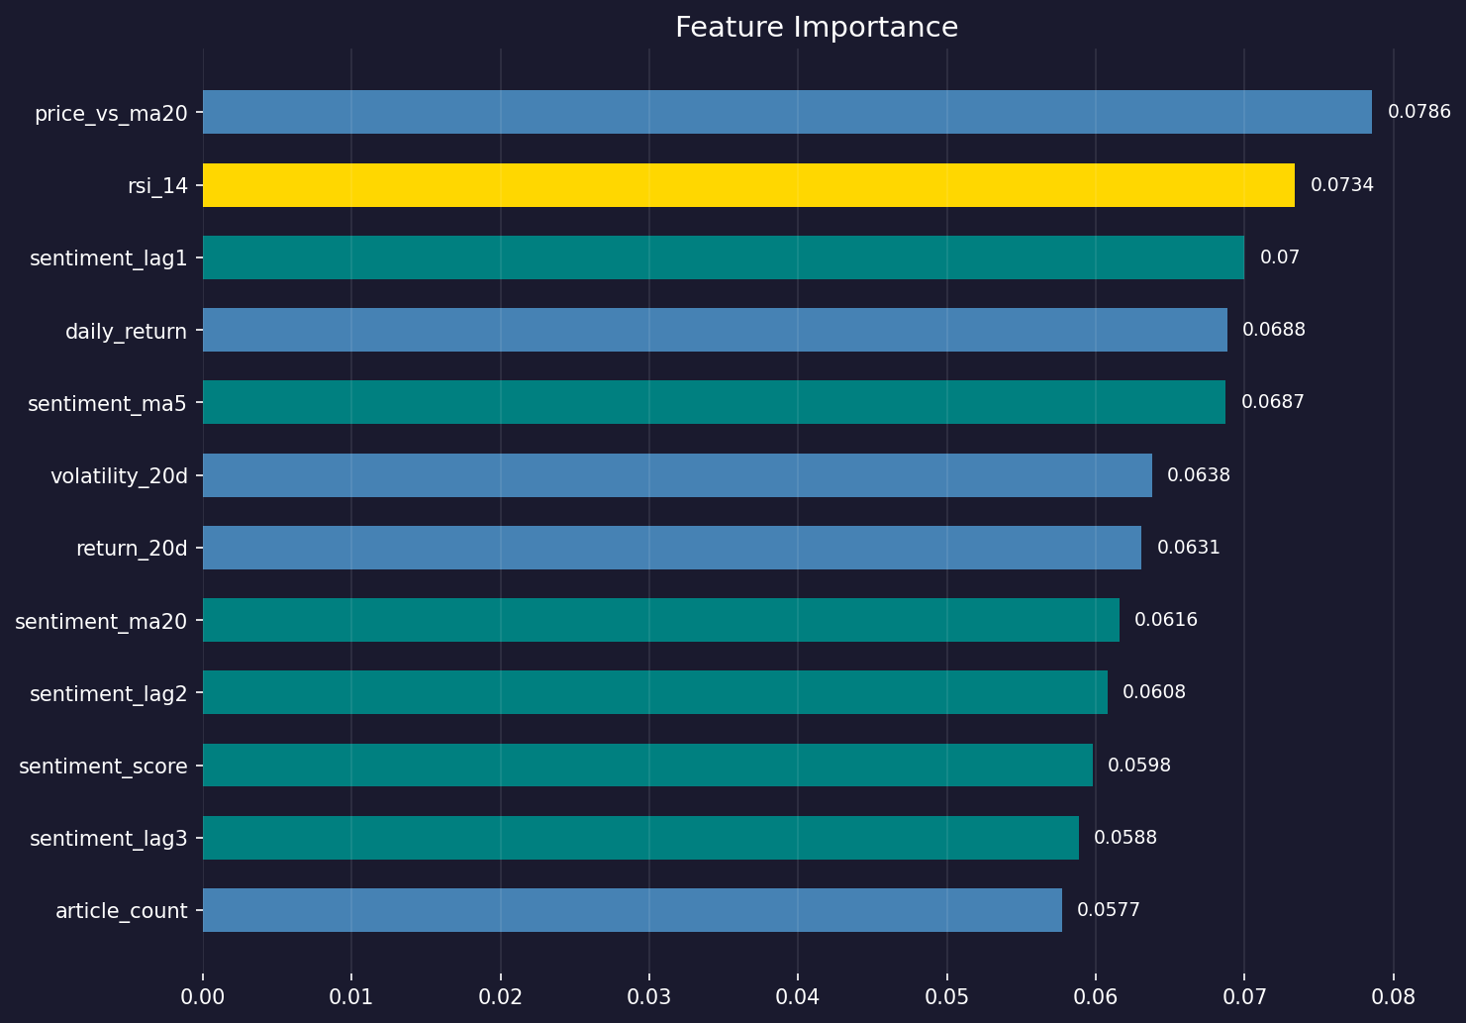
Feature Importance
What the XGBoost model relies on most — 7 out of 12 top features are sentiment-based
Key Insights
price_vs_ma20 (7.9%)
Price vs 20-day average — strongest predictor
rsi_14 (7.3%)
Overbought/oversold — 2nd most important
sentiment_lag1 (7.0%)
Yesterday's sentiment matters more than today's
sentiment_ma5 (6.9%)
7 out of 12 top features are sentiment-based
Privileged and confidential
S&P 500 Sentiment Trading

Slide 9
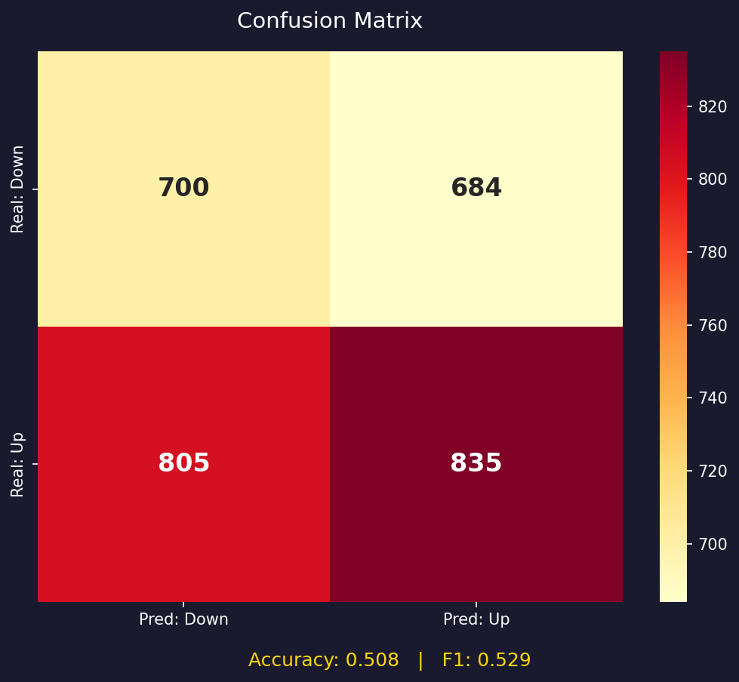
Step 5 — Evaluation & Results
Libraries: scikit-learn, matplotlib | 3,024 days tested across 48 walk-forward folds
Classification Metrics
Accuracy
0.508
51% correct — vs 50% random baseline
Precision (Up)
0.55
Correct 55% of time when predicting Up
Recall (Up)
0.51
Catches 51% of actual Up days
F1 Score
0.529
Harmonic mean of precision and recall
Precision (Down)
0.47
Harder — market goes up 54% of the time
Conclusions
— 50.8% vs 50% random — consistent over 3,024 days
— 7/12 top features are sentiment — hypothesis validated
— sentiment_lag1 ranks #3 — market reacts with 1-day delay
— One headline/day limits signal — needs multiple sources
S&P 500 Sentiment Trading

