Slide 1
HikingJunkie
Diego Covarrubias
Jane (Jaeyeon Kang)
Jake (Jong Min)
Vincent

Slide 2
Purpose
Provide a resource for hiking
Easy to find trails
Expand accessible trails
Create own user trail list
Favorite trail list

Slide 3
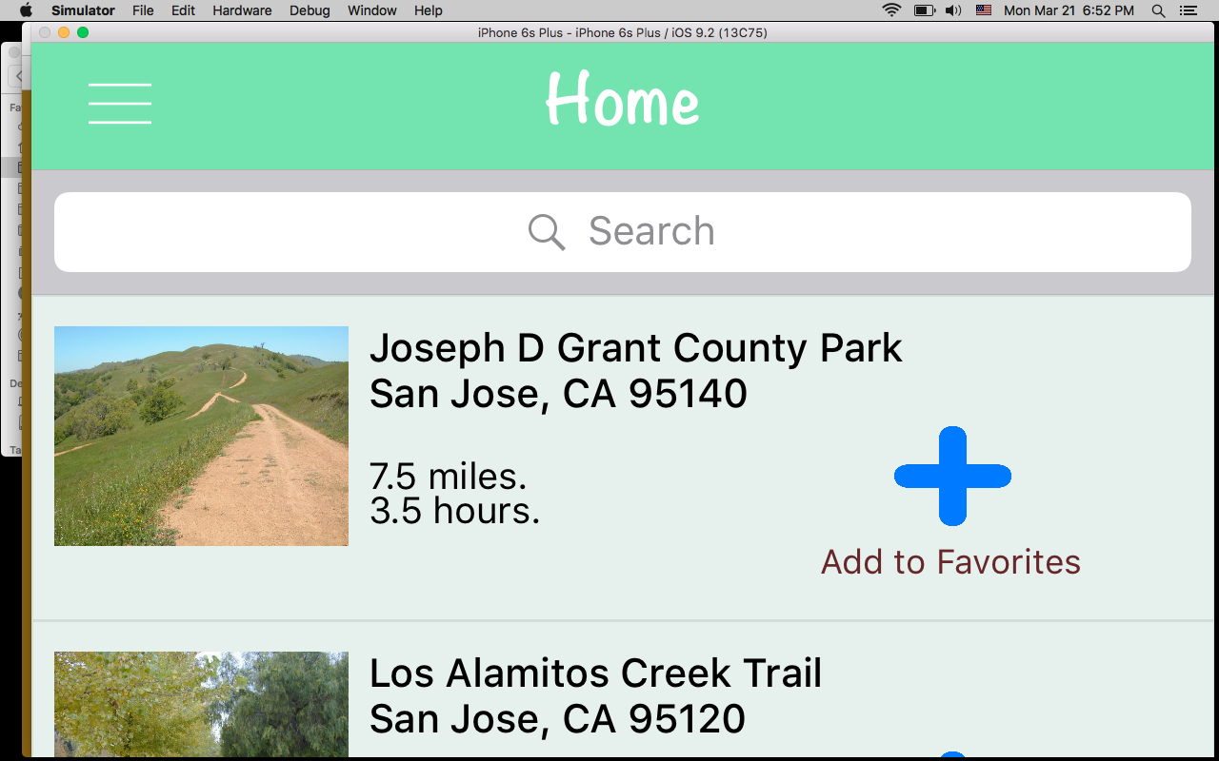
Home Screen
Display trail list
The list is saved in the core data
Display short information
Clicking on a cell will move users to a more detailed information pages (Using TabBarController)

Slide 4
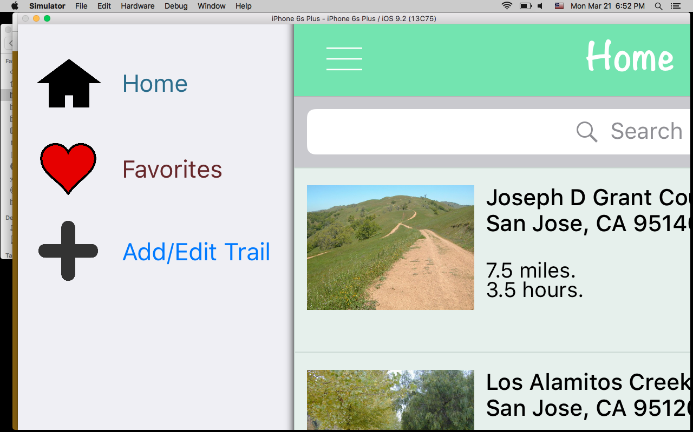
Menu Controller
Slide-in/slide-out menu
Present different menu
Triggered custom “push” segues
RevealViewController

Slide 5
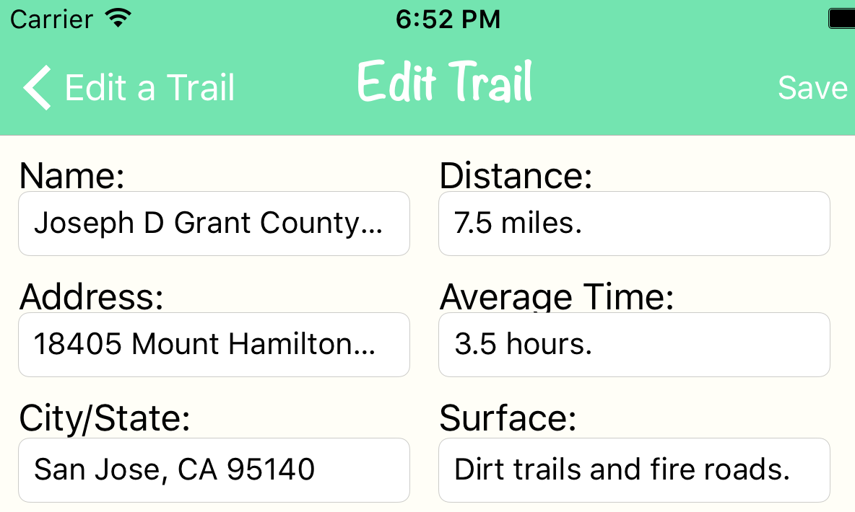
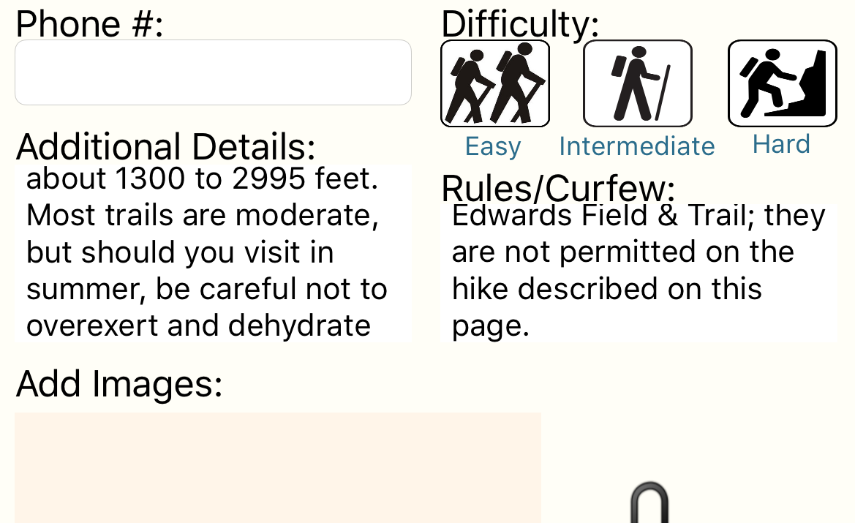
Add/Edit Trails
User can add or edit trails information
Offer detailed settings: difficulty level, surface, and more
User can upload own images

Slide 6
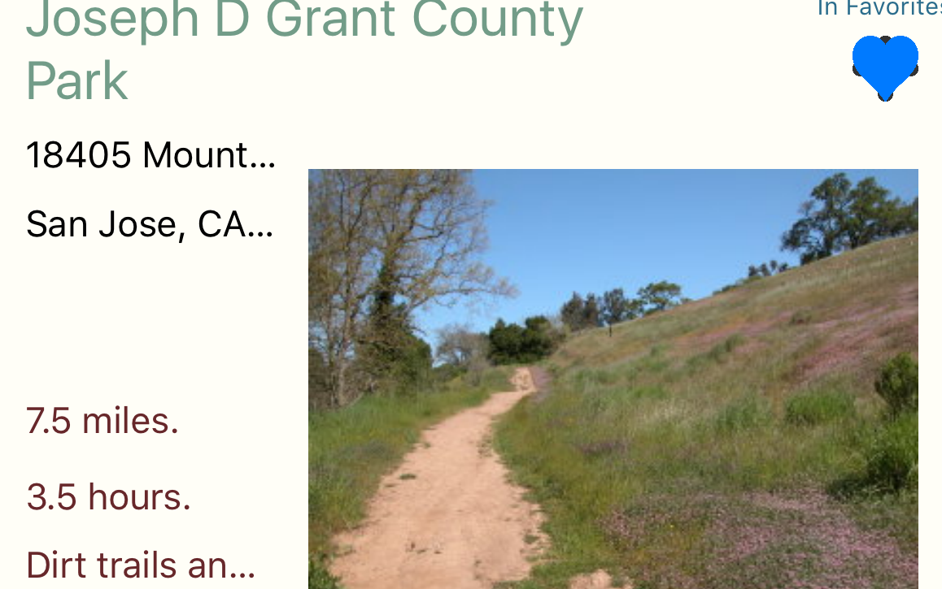
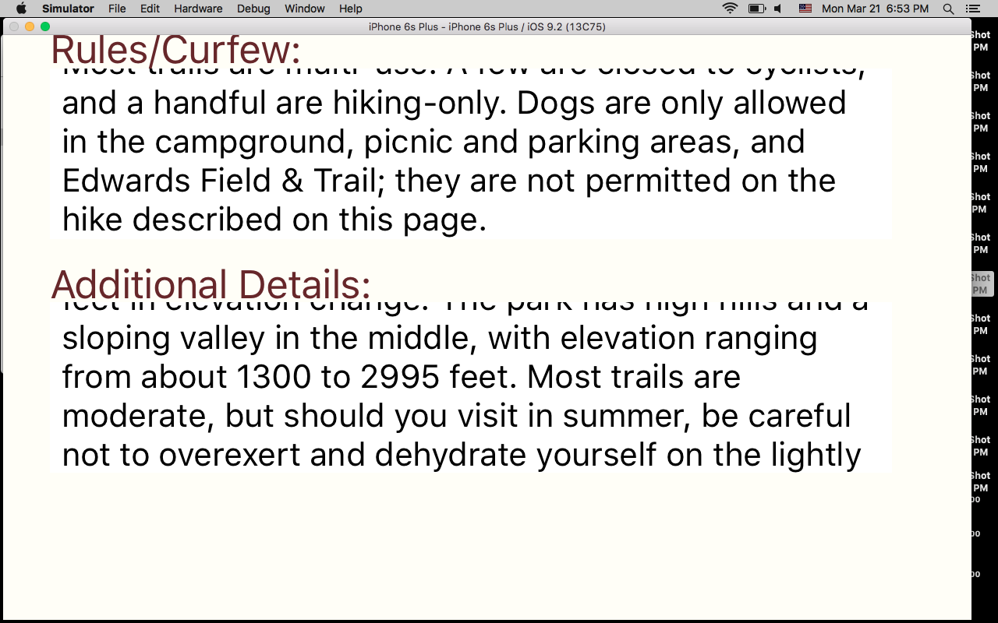
Detail Information
Display organized information
Control by TabBarController

Slide 7
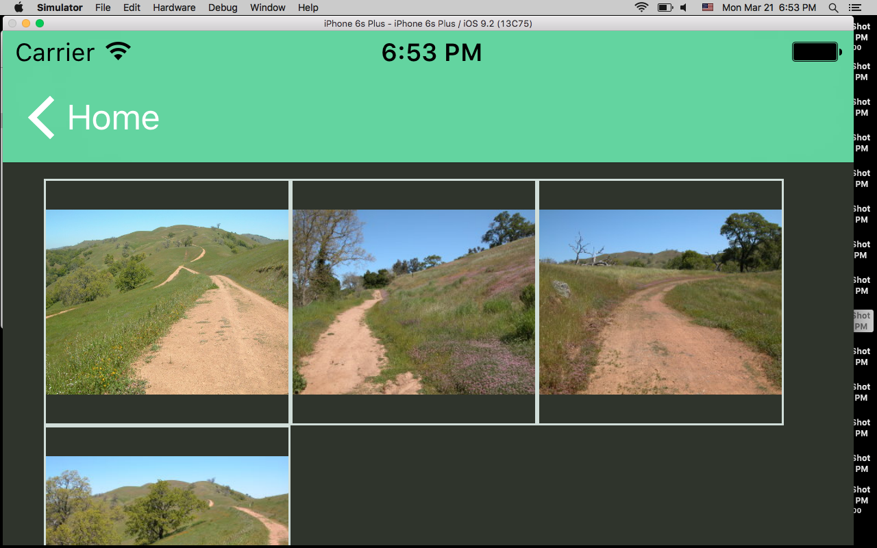
Photos
Display related images
Control by TabBarController
User can upload more images

Slide 8
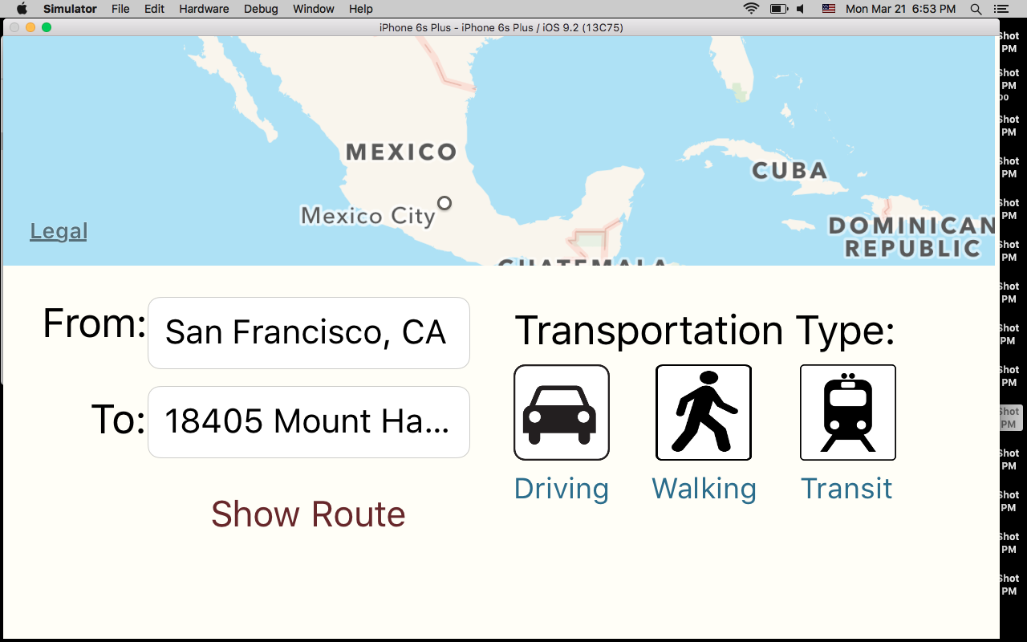
Direction
Display a route
By default, display user location and sets the value of the FromTextField to that location
By clicking “Show Route” triggers a segue to a DirectionsViewController
Show Route will display a step by step direction

Slide 9
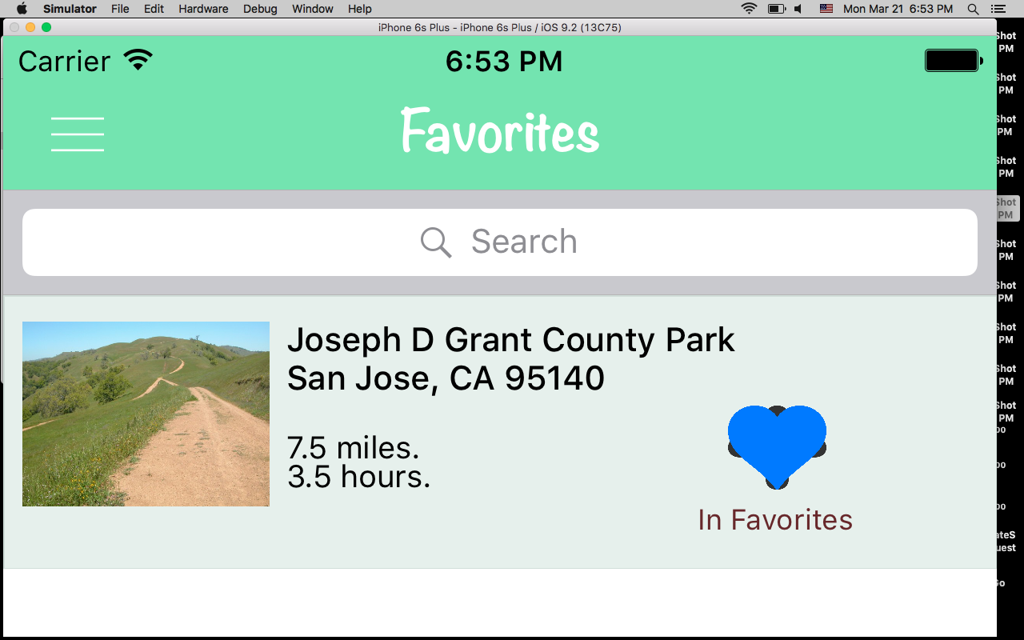
Add Favorites
Clicking a heart button enable users to add selected trail to Favorite list
Every cell in the list has a add favorite button
Favorites list loads all saved trails in core data, but display favorite trails

Slide 10
Search
Search bar accepts user input
Search is filtered by trail name
Any trail name that matches the input will be shown in the results.
Joe

