Slide 1
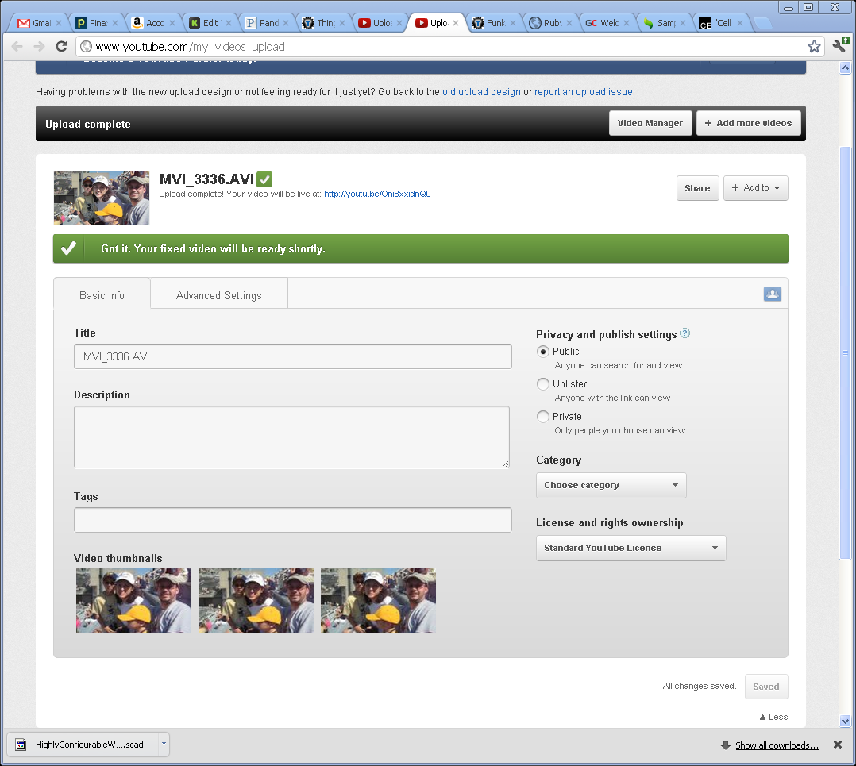
Options [youtube]

Slide 2
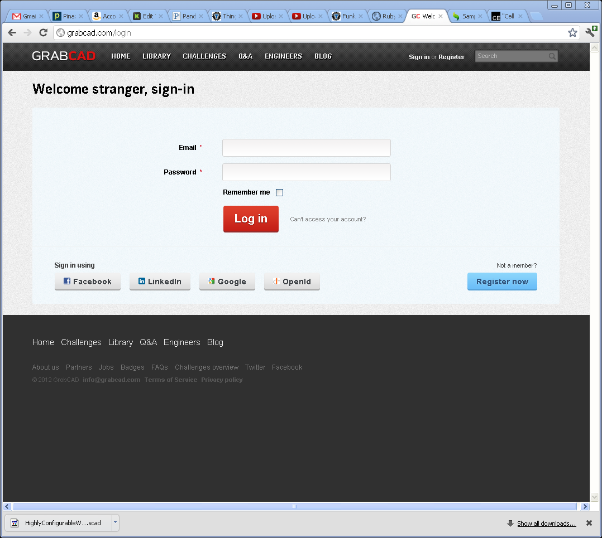
Signin-- grabcad

Slide 3
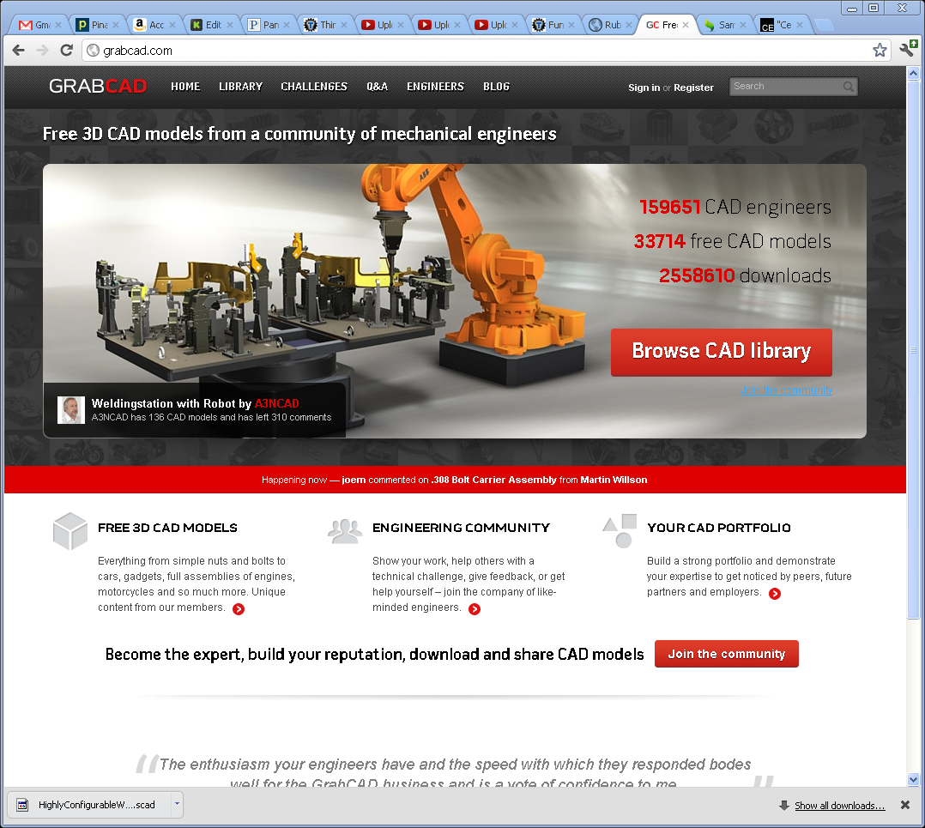
Nice front page [grabcad ]

Slide 4
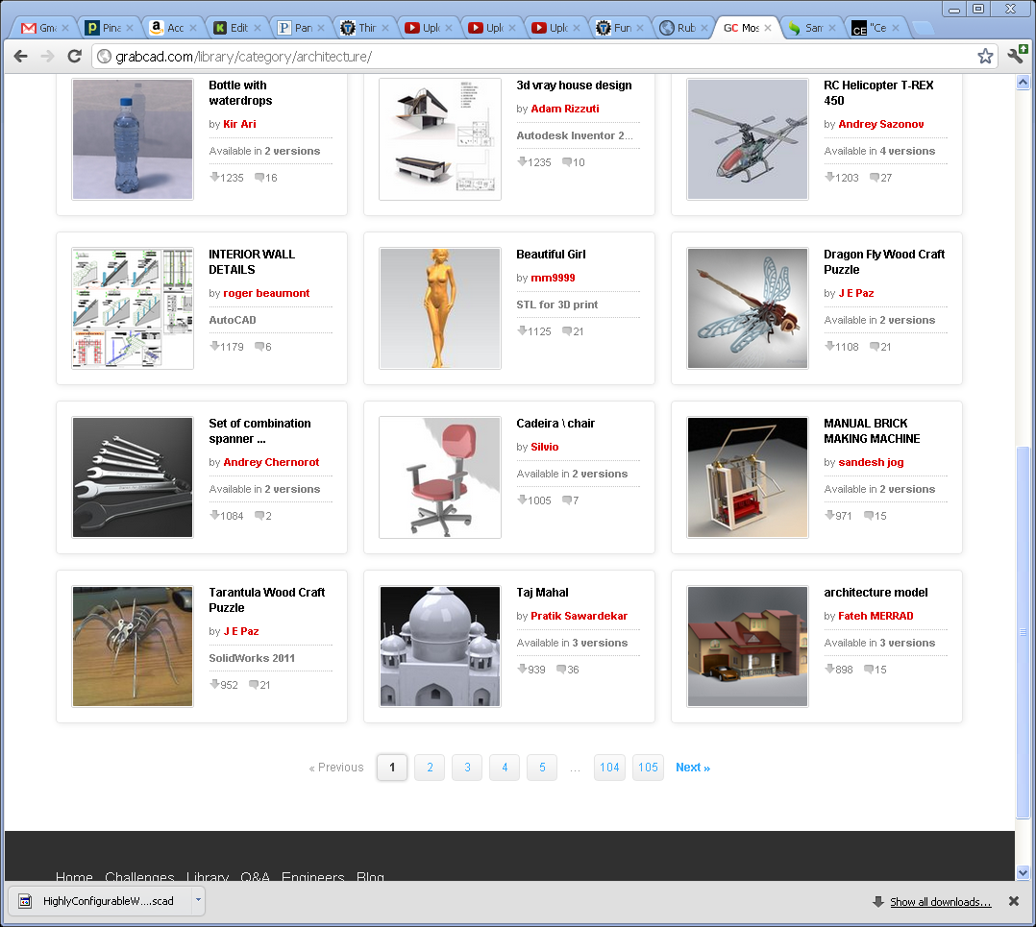
Part listing [grabcad]

Slide 5
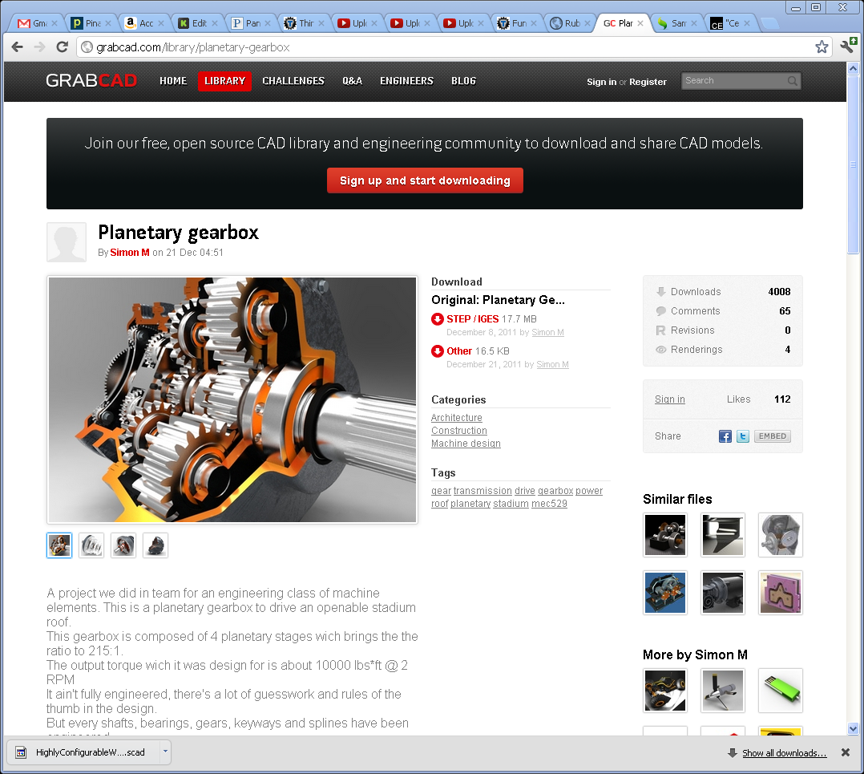
Part detail

Slide 6
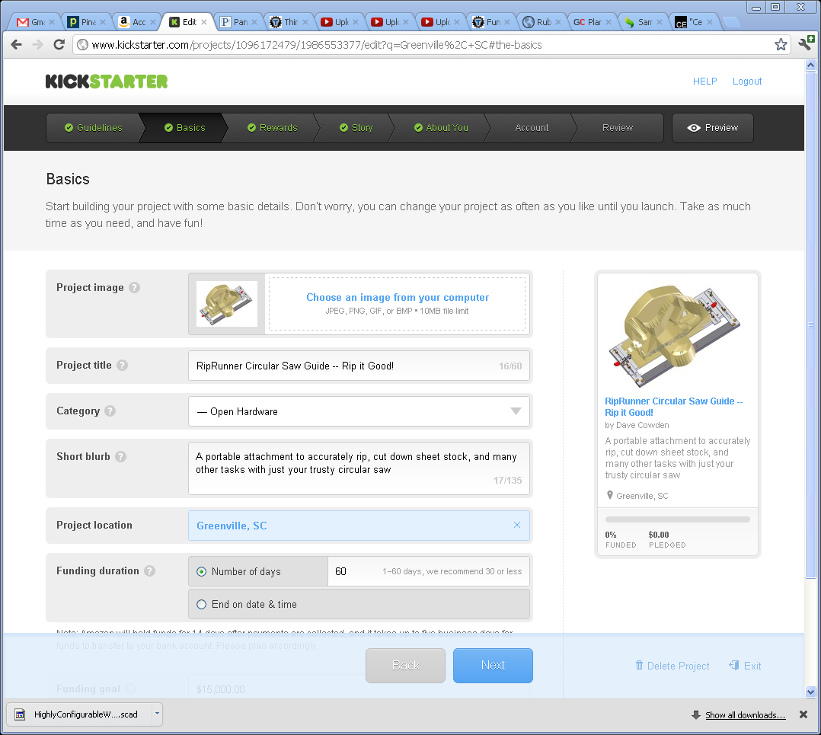
Nice wizard [kickstarter]

