Slide 1

Crime Prediction Using Classification Model
February 11, 2020
Notes:
A model that predicts high crime area in new York city

Slide 2

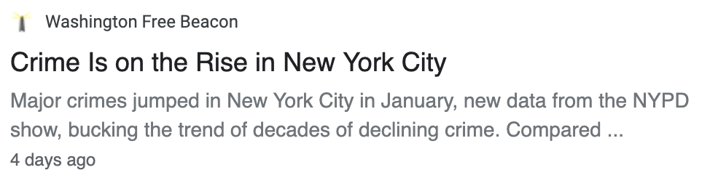
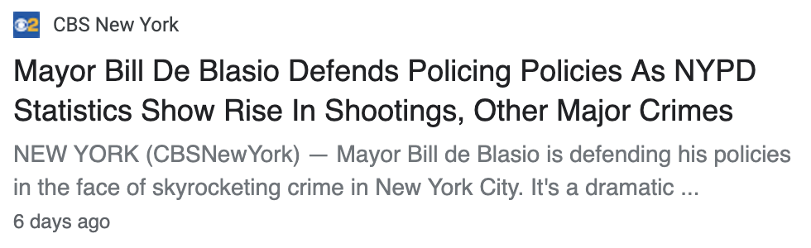
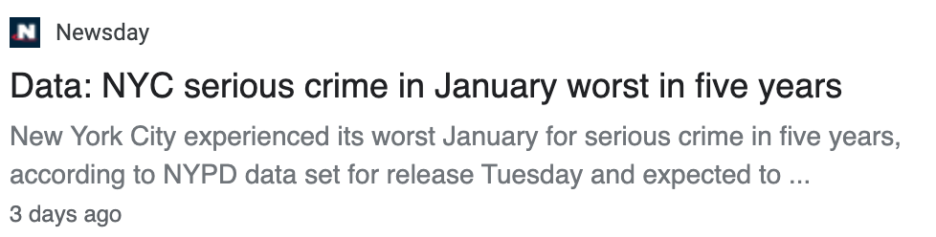
Rising Crime Rates in New York City
Crimes doesn’t seem to stop in New York City…
Notes:
As we all know, New York City is full of crimes and it never seems to stop even in 2020, as you can see on this article exerpts.
How can we make our city safer? Well, maybe machine learning can be an answer.

Slide 3

What if machine can predict crimes..?
Predictive policing using classification models
To predict most likely high crime areas in New York City on any given day
Dataset
Crime Data (from NYPD webpage)
Census Data (from census.gov)
Weather Data (from weather.com )
Notes:
So I questioned. what if machine can predict crimes and locate the most likely crime scene?
Well, my project is to build such prediction model to prove that movie minority report is not a far future!
My MVP model will predict the most likely high-crime areas in New York City on any given day.

Slide 4
Data Collection & Processing
Dataset
Key Attributes
NYC Crime Data
6.8M records from ‘06 to ‘19
Case #
Date
Time
Crime Type
District
Lat-long
NYC Census Data
Census Tract
Population
Income
Poverty
Unemployment
Last updated in 2016
Weather Data
Date
Precipitations
Snow Depth
Temperature
Daily weather data since 2016
Notes:
So I collected three main dataset, 1) 2) 3)

Slide 5
Data Collection & Processing
Dataset
Key Attributes
Reference Data
NYC Crime Data
Lat-Long to Census Tract
6.8M records from ‘06 to ‘19
Case #
Date
Time
Crime Type
District
Lat-long
NYC Census Data
Census Tract to NTA
Census Tract
Population
Income
Poverty
Unemployment
Last updated in 2016
NTA to Polygon
Weather Data
Date
Precipitations
Snow Depth
Temperature
Daily weather data since 2016
Notes:
Also I found three mapping files to merge the dataset and do featuring engineering to get a data to fit a model

Slide 6
Data Collection & Processing
Dataset
Key Attributes
Reference Data
NYC Crime Data
Lat-Long to Census Tract
6.8M records from ‘06 to ‘19
Case #
Date
Time
Crime Type
District
Lat-long
NTA | Crime Data | Census Data | Crime Level
Neighbor-hood name | Timing and daily crime counts | Population, Income, Poverty/Un-employment | High (1) Low (0) Threshold Daily Counts > 8
NYC Census Data
Census Tract to NTA
Census Tract
Population
Income
Poverty
Unemployment
Last updated in 2016
NTA to Polygon
Grouped by NTA on a daily basis
2016 ~ 2019
Manhattan, Queens, Brooklyn
Approx. 230K records
Weather Data
Date
Precipitations
Snow Depth
Temperature
Daily weather data since 2016
Feature Engineering
Notes:
As a results, I was able to get a crime data grouped by neighborhood with daily crime counts/timing, census information, and classification target of high vs low crime level.
For this binary classification, I used a threshold of daily crime counts greater than 8

Slide 7
Baseline Model Using Logistic Regression
Baseline Features
Total Population
Income level
Men/Women
Poverty/Unemployment Rate
Accuracy: 69%
Recall: 17%
Notes:
Now for Baseline mode. I used logistic regression and census related attributes as baseline features
When I fit the model with this feature set, I got …

Slide 8
Baseline Model Using Logistic Regression
Additional Features
Total Population
Income level
Men/Women
Poverty/Unemployment Rate
Location
Seasonality
Day time vs. Night time
12%
in accuracy
Baseline Features
Total Population
Income level
Men/Women
Poverty/Unemployment Rate
44%
in recall
Accuracy: 69%
Recall: 17%
Accuracy: 81%
Recall: 62%
Notes:
But when I included location, seasonality, and day vs night time as additional features. I got a huge improvement with accuracy of 81% and recall of 62%.
Because what matters the most is how well the model predict high crime areas among the actual high crime areas, I decided to focus on improving recall rates

Slide 9
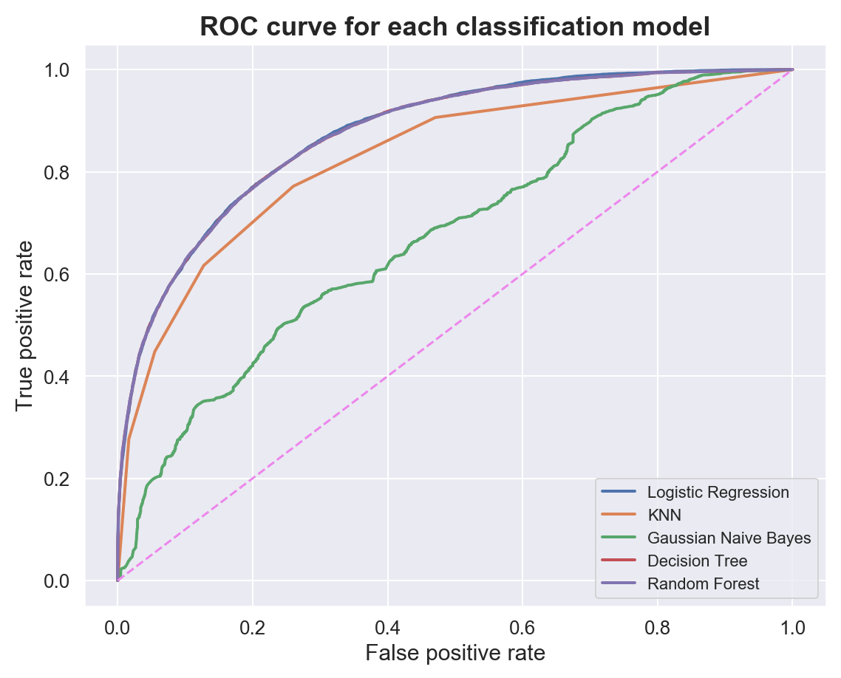
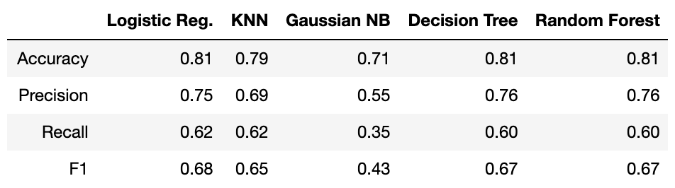
Model Selection
Logistic Regression, Decision Tree, Random Forest are all very good predictors!
Final model: Logistic Regression
Slightly higher recall rate and AUC
Simpler Model
Interpretability
Notes:
This slides shows the model comparison with ROC curve and performance metrics.
As you can see…
They all are on the outer edge of the roc curve with logistic regression being slightly higher in recall rate than the other two
In addition to the superior scoring, because it is a simpler and more interpretable model, I picked logistic regression as a final model.

Slide 10
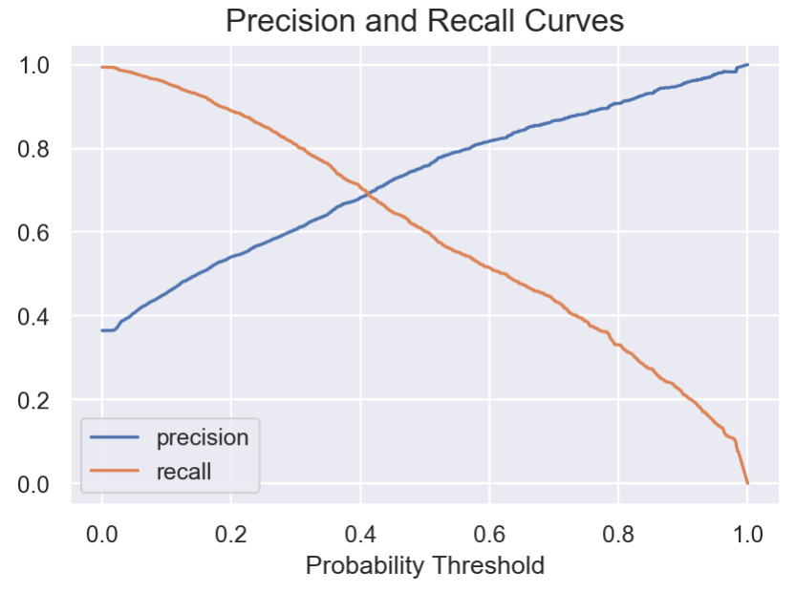
Improving Model Performance
Moving Probability Threshold
Probability Threshold: 40%
Accuracy: 80%
Recall: 71%
1%
frm default
9%
frm default
Adding Weather Related Features (e.g., precipitation, snow level, temprature)
No improvement found
Notes:
Now that I have final model, I wanted see if I can further improve the recall rate.
In order to do so, I first looked at the trade off point btw precision and recall. Intersecting at 40% probability.
When I used this as a probability threshold, my recall increased by 9% while only sacrificing 1 percent of accuracy
Also, I tried adding weather related features but it did not improve my model at all, it’s probaby because my weather data was not granular enough.

Slide 11
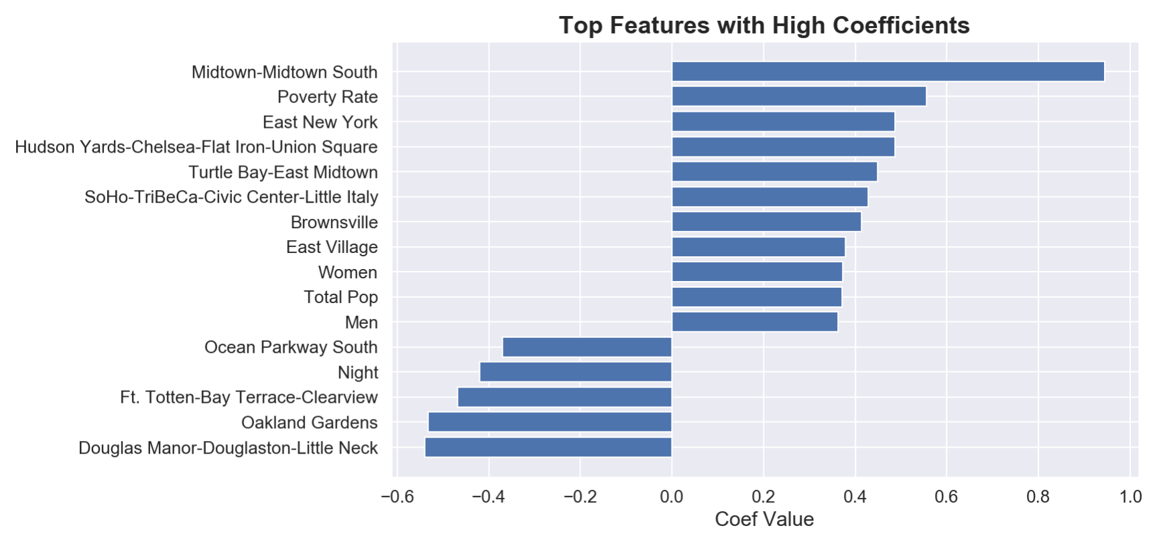
Feature Importance
Notes:
In terms of feature importance, some of the strong positive features are
Some of the negatively related features are neighborhoods in queens which makes pretty good sense

Slide 12
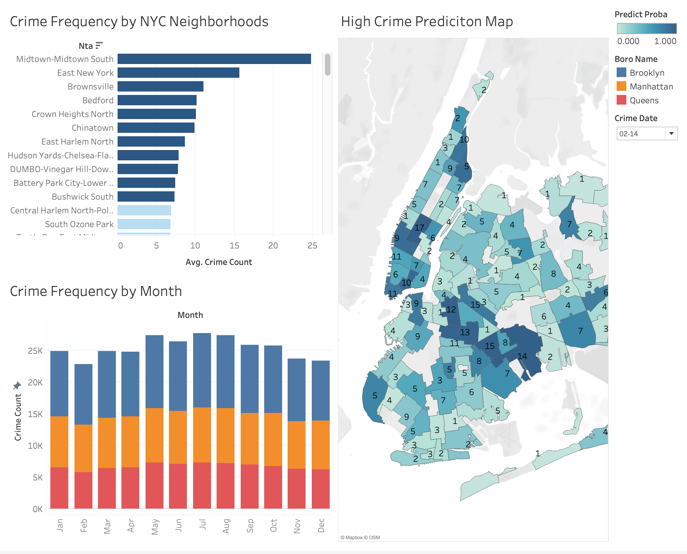
Visualization with Final Model
Notes:
This is my final visualization using Tableau. And this map shows my prediction probability with color density
And as I said on the feature importance, you can see midtown manhattan/ brooklyn in darker blue and queens are shown to be very safe.
May you might not wanna hang out in these darker areas

Slide 13

Future Work
Obtain more granular weather data
Predict crime counts and crime types
Scale it to other cities

Slide 14
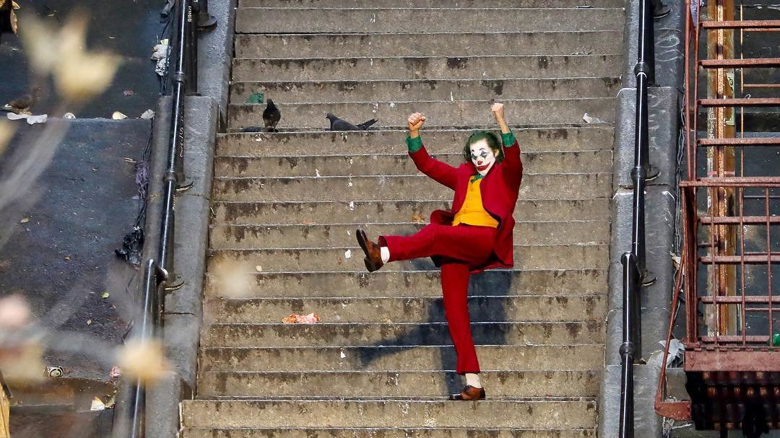
Question?

