Slide 1
Domain Specific Language and management environment for Extensible CPS
CPSWeek 2016, Vienna, Austria
Subhav Pradhan
Institute for Software Integrated Systems
Vanderbilt University
Nashville, TN, USA
Martin Lehofer
Siemens Corporate Technology
Princeton, NJ, USA
This work was supported in part by research grant from Siemens Corporate Technology

Slide 2
Outline
Introduction: CPS to Extensible CPS
CHARIOT Overview
CHARIOT-ML (Modeling Language)
Example: Smart Parking System
CHARIOT-ML Demonstration
CHARIOT Runtime Autonomous Resilience
CHARIOT Runtime Demonstration
Redundancy Patterns supported by CHARIOT
Redundancy Patterns Demonstration
Conclusion

Slide 3

Cyber-Physical Systems
Cyber-physical Systems interact with, and expand the capabilities of the physical world through computation, communication, and control
CPS systems combines fields to:
Connect machines embedded with sensors to other machines, operators, end users
Enable command & control of mechanical devices
Extract data from devices / humans & make sense of it
Deliver the right info to the right people at the right time
Derive value in terms of improved utility & cost savings
Radhakisan Baheti and Helen Gill, National Science Foundation (NSF), 2006

Slide 4
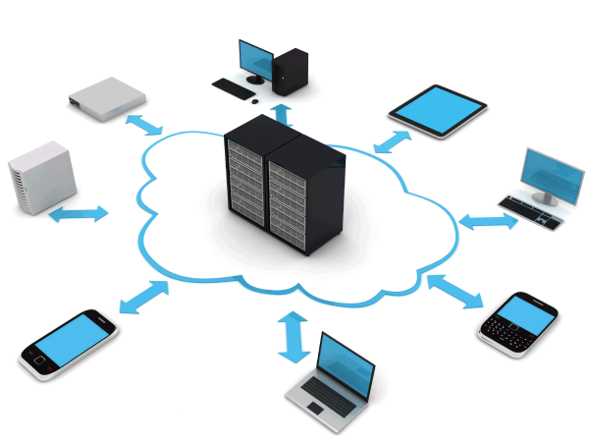
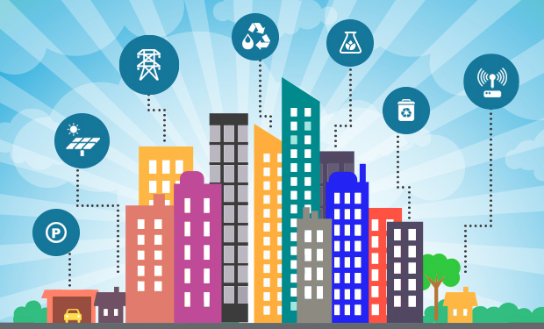
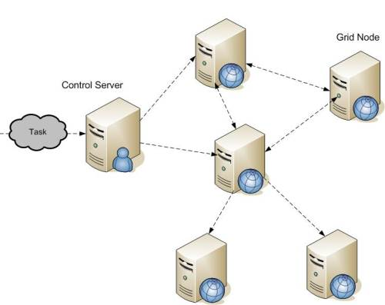
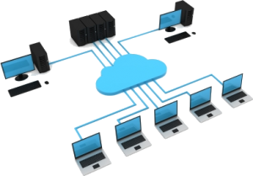
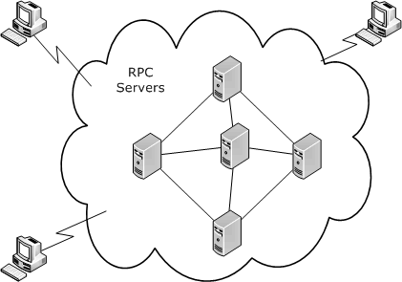
Evolution towards Extensible CPS
Focus on functionality as well as resource extensibility
Extensible schemas and object models
Grid system uses extensible object model
Class/metaclass objects for functionality
Host objects for resource
Mobile computing to IoT and IIoT
Large scale, dynamic and high degree of heterogeneity
Interoperability and extensibility crucial
Ubiquitous Computing
Ultra-large-scale, multi-domain CPS
Present
Late 2000s
Mid 2000s
Complex edge devices with purpose of connecting physical world with cyber world. E.g.: smart sensors
Future of ubiquitous systems is cyber-physical
Cloud Computing
Grid Computing
Focus mainly on functionality evolution
Functionalities provided by applications composed of distributed objects
Extensibility straightforward in case of one Cloud Service Provider (CSP)
Extensibility across multiple CSPs is much more complex and requires federation mechanism
Mid 1990s
Distributed
System

Slide 5
Extensible CPS
Building(s)
Collection of loosely-connected cyber-physical (sub-)systems that “virtualize” their resources to provide an open platform capable of hosting multiple cyber-physical applications simultaneously
Why are these systems extensible?
Dynamic resources and applications that can be added/removed at any time
Functionalities provided by a platform changes (evolves) over time depending on hosted applications
How does this differ from CPS?
Dynamic applications, so their lifecycle cannot be tightly-coupled with the underlying system
Resources shared by dynamic applications resulting in varying resource demand and usage
Challenges: Application management and autonomous resilience
Building automation
HVAC
Lighting
Safety
Energy
sun- shades
…
Energy Market
Local Smart Grid
National Power Grid
…

Slide 6
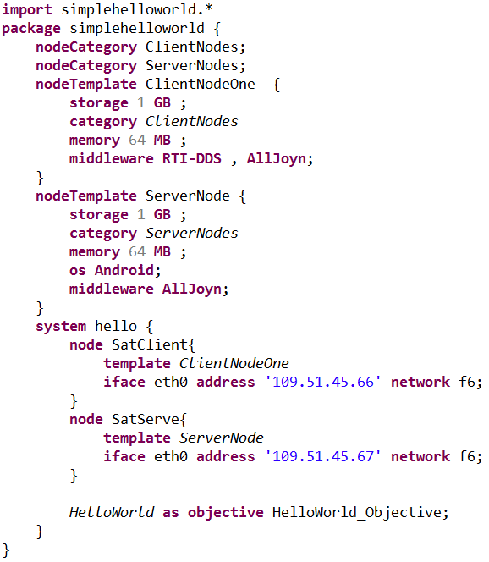


CHARIOT
Cyber-pHysical Application aRchiTecture with Objective-based reconfiguraTion
System model
Interpreter + Design-time analysis tools
System architect
Generated artifacts
Design-time
Distributed Database
Runtime
Autonomous
Resilience loop
Resilience infrastructure
Monitoring infrastructure
Managed system
Management Infrastructure
Notes:
Self-reconfiguration to achieve autonomous resilience

Slide 7
Goal-based System Description
A system’s goal requires one or more objectives to be satisfied
An objective requires existence of one or more functionalities, where functionalities are provided by components
A component provides exactly one functionality
Multiple components can provide same functionality
Dynamic representation of a system, which doesn’t require systems to be described as a collection of concrete components
Doesn’t matter which component provides a certain functionality as long as it is provided
Live system comprising one or more instances of different components
Redundancy patterns can be applied to functionalities for resilience
Voter, Consensus, Simple cluster patterns
System Model
Goal
Objective ₁
…...
Objective _{n}
Functionality₁
...
Functionality_{n}
Component_{A} (App)
Component_{B} (App)
Notes:
Underlying concept that allows generic system description at design-time.

Slide 8
Run-time Self-reconfiguration Logic
A great deal of information about a system is locked up in the models. When the requirements or environment experience an unforeseen change, we can use the models at runtime to recover.
Configuration space
Initial configuration point
Fault disables part of space
New configuration point
Reconfiguration
Function recovered
Another fault
New configuration point
Reconfiguration
Function recovered
Configuration space generated from models of the system

Slide 9
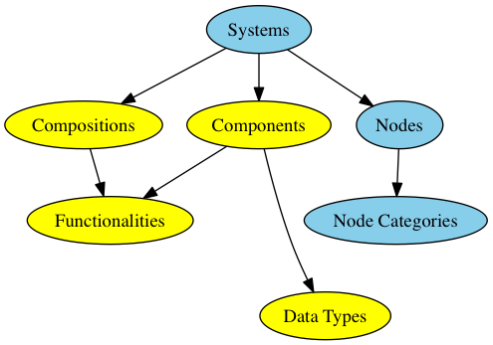
CHARIOT-ML
Textual Modeling Language (ML) for extensible CPS
Supports different first class modeling concepts
Facilitates goal-based system description
System Model
Modeling Concepts
Goal
Objective ₁
…...
Objective _{n}
Functionality₁
...
Functionality_{n}
Role assignment
App Developer
System Architect
Component_{A} (App)
Component_{B} (App)

Slide 10
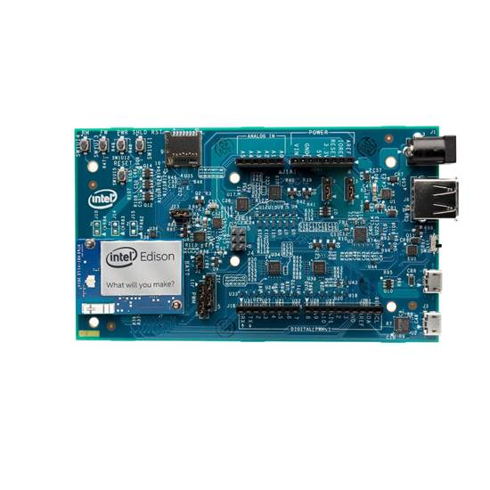

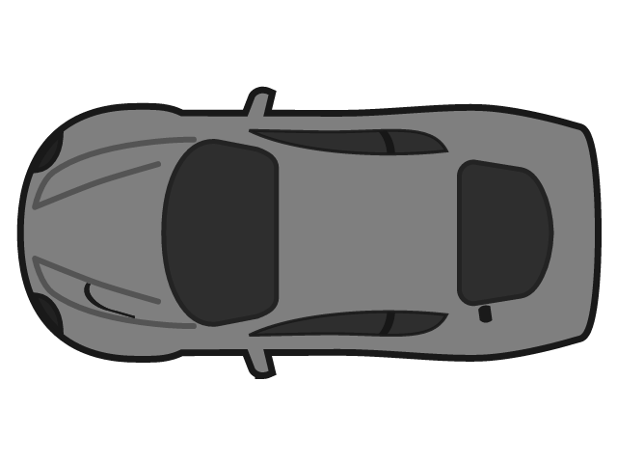

Example: Smart Parking System
Occupancy
Sensor
Parking Manager Server
Client
Deploy one on each edge node. Cannot be migrated.
Deploy on a single edge node. Can be migrated.
Edge nodes to run applications
Runs on client machine (phone/ tablet/ car)
1
2
3
4
Backend nodes to run Resilience Engine

Slide 11
Example: Smart Parking System
Occupancy
Sensor
Send status
information
Parking Manager Server
Client
Deploy one on each edge node. Cannot be migrated.
Deploy on a single edge node. Can be migrated.
Edge nodes to run applications
Runs on client machine (phone/ tablet/ car)
1
2
3
4
Backend nodes to run Resilience Engine

Slide 12
Example: Smart Parking System
Store and maintain status
for each space
Occupancy
Sensor
Send status
information
Parking Manager Server
Client
Deploy one on each edge node. Cannot be migrated.
Deploy on a single edge node. Can be migrated.
Edge nodes to run applications
Runs on client machine (phone/ tablet/ car)
1
2
3
4
Backend nodes to run Resilience Engine

Slide 13
Example: Smart Parking System
Store and maintain status
for each space
Send status
information
Send parking request
Occupancy
Sensor
Parking Manager Server
Client
Send parking response
Deploy one on each edge node. Cannot be migrated.
Deploy on a single edge node. Can be migrated.
Edge nodes to run applications
Runs on client machine (phone/ tablet/ car)
1
2
3
4
Backend nodes to run Resilience Engine

Slide 14
Example: Smart Parking System
Smart Parking System
System Goal
Occupancy Checking
Client Interaction
Objectives
Occupancy Sensor
Parking Manager Server
Client
Functionalities
Occupancy SensorComp
Parking Manager ServerComp
ClientComp
Component types

Slide 15
Example: Smart Parking System
Smart Parking System
System Goal
Local
Occupancy Checking
Client Interaction
Objectives
Per node
Occupancy Sensor
Parking Manager Server
Client
Functionalities
Occupancy SensorComp
Parking Manager ServerComp
ClientComp
Component types

Slide 16
Smart Parking System Modeling Demonstration
Notes:
Initially no replication

Slide 17
CHARIOT Autonomous Resilience Loop
Comprises a Resilience Engine (RE) or a solver that uses Z3 SMT solver to compute configuration points at runtime. Multiple of these can be deployed to tolerate single point of failure.
Design-time
Distributed Database
Runtime
Autonomous
Resilience loop
Resilience infrastructure
Monitoring infrastructure
Managed system
Management Infrastructure
Comprises distributed monitors responsible for monitoring and detecting failures. Current implementation of CHARIOT uses distributed Node Monitors (NMs) to detect node failures.
Comprises distributed Application Managers (AMs) that are responsible for starting and stopping local application processes. Each node has an AM.

Slide 18
CHARIOT Autonomous Resilience Loop
Configuration space
Deployment actions
Solver Nodes
Leader Reconfiguration actions
Query
Initial configuration point
Resilience Engine (Solver)
1
3
Distributed Database
Configuration point
Reconfiguration actions
2
4
Update
Compute Nodes
Reconfiguration
Node Monitor
3
2
Compute initial configuration point
Application
Stores
Query Solver
Update Failure
Generate and store configuration space
Manages
1
<C_{A}, C_{B}>
C_{B} - F
2
1
6
4
Notify
C_{A} - F
C_{A} – F, C_{B} - F
Application Manager
5
3
Distributed Database
C_{B} - F
5
7
Stores
C_{A} - F
Update

Slide 19
CHARIOT Autonomous Resilience Loop
NM
Database
RE
AM
Node failure detected
Update configuration space with detected failure
Ask RE to compute new configuration point
Get latest configuration space and point
Compute new configuration point and deployment actions
Store deployment actions
Deployment actions notification
Determine and take local actions
Update
configuration space

Slide 20
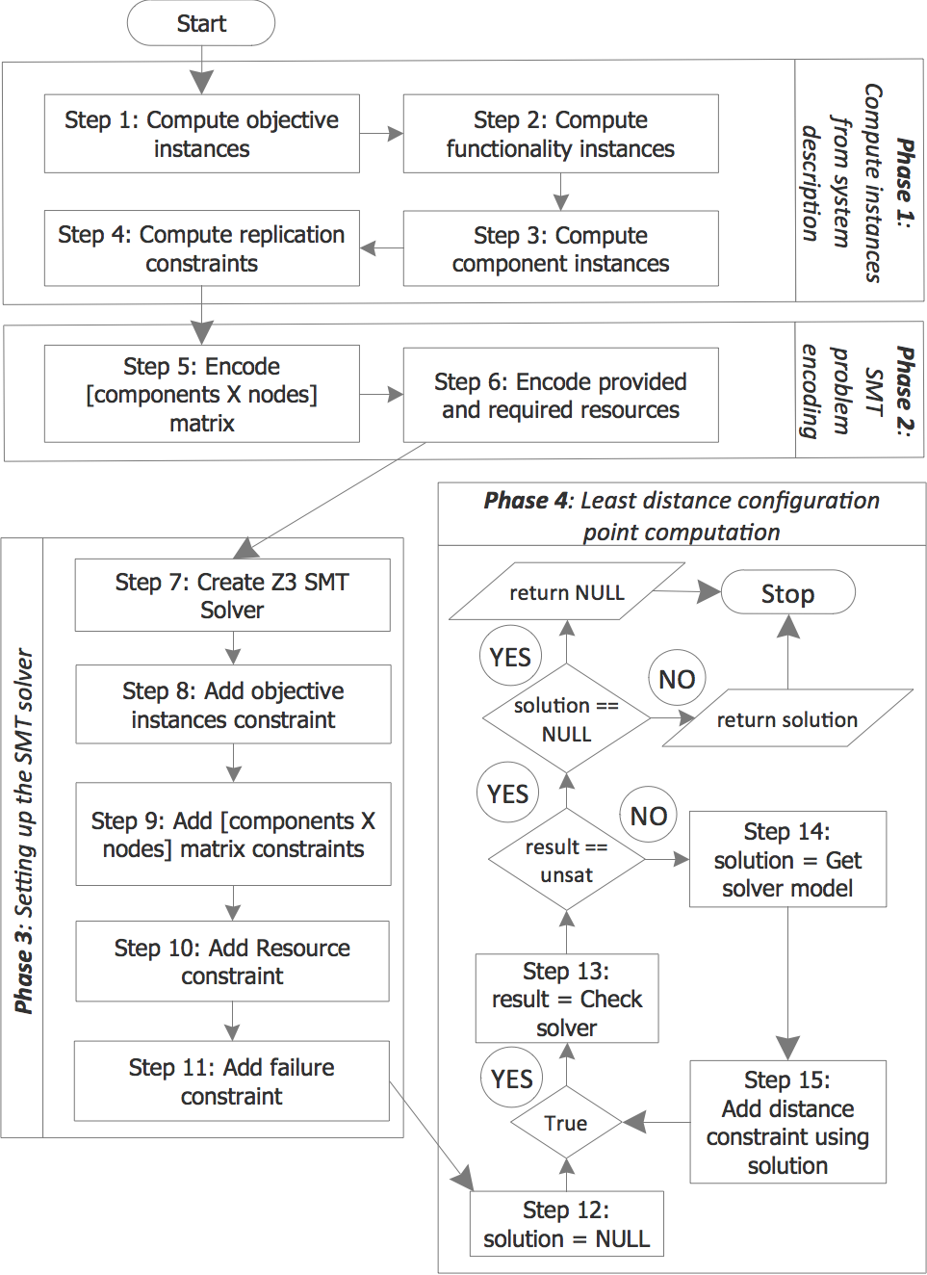
Configuration Point Computation (CPC) Algorithm

Slide 21
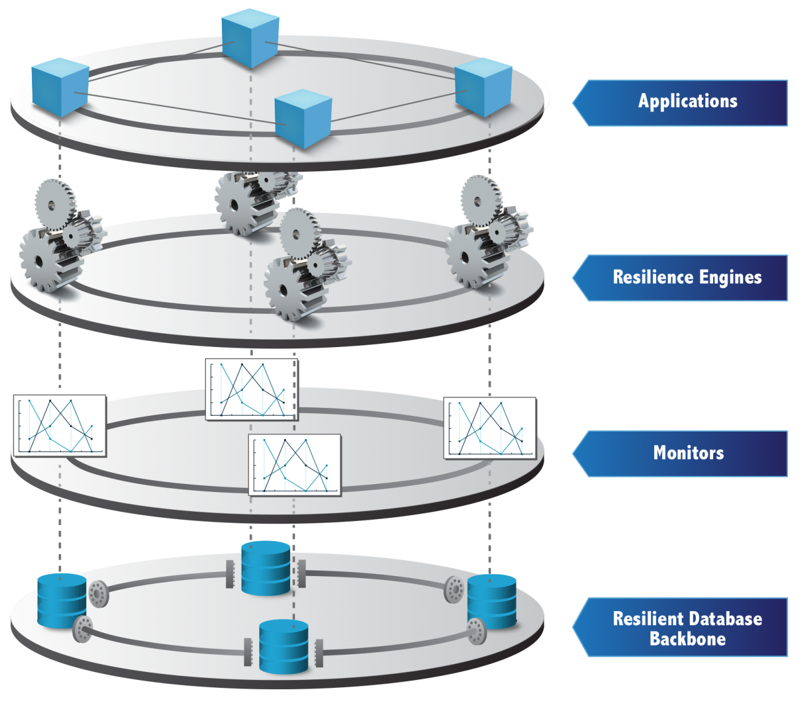
CHARIOT Layered Architecture

Slide 22
Smart Parking System Autonomous Resilience Demonstration
Notes:
Initially no replication

Slide 23
Redundancy Patterns
Redundancy patterns are important for various reasons in context of CPS
Redundancy to avoid anomalies
Useful for scenarios with multiple sensors measuring same property
Redundancy as a fault-tolerance mechanism
Useful for hard real-time systems that cannot tolerate re-configuration overhead
Redundancy for large-scale, multi-instance deployment
CHARIOT supports three different, well-known, redundancy patterns
Voter pattern
Consensus pattern
Cluster pattern

Slide 24
Redundancy Patterns
In CHARIOT redundancy patterns are associated with functionalities
F_{1_1}
Voter with 3 instances
F₁
F_{1_2}
Voter
F₁
F_{1_3}
Simple cluster with 2 instances
F_{1_1}
F_{1_2}
F_{1_1}
F_{1_2}
Consensus with 4 instances
F₁
Consensus ring
F_{1_3}
F_{1_4}
<Leader>

Slide 25
Redundancy Patterns Demonstration

Slide 26
Summary of Our Approach for Achieving Resilience
Fail-stop model, where failures are detected and handled as close to the source as possible
If failure handling not possible, propagate failure to the layer above
Component layer will comprises component monitors (future)
Detect and handle component failures/anomalies
Switching component modes is one mechanism of handling component failure (assuming components have modes)
Node layer comprises node monitors
Detect and handle process failures, node failures, and propagated component failures
Trying to re-spawn a process can be a mechanism to handle process failure (future)
Redundancy layer comprises redundant application entities
If a node failure affects some application components, their redundant replicas can achieve resilience as long as they are not deployed on the same node
Reconfiguration layer comprises resilience engine
If nothing else can be done, then the resilience engine tries to reconfigure the system in order to mitigate failure
If reconfiguration doesn’t work, system needs to shutdown
Reconfiguration layer
Failure Propagation
Redundancy layer
Node layer
Component layer

Slide 27
Example: Smart Parking System II
Occupancy
Sensor
Parking Manager
Navigation Server
Localization Server
Deca
Wave
Client
Send status info
Store and maintain status for each space
Loop
Send parking request
Find parking space
Send parking response
Send parking response
Start localization
Send location
Perform localization
Loop
Send localized info
Send target heading direction
Notes:
Extending previous smart parking example to include localization and navigation functionalities

