Slide 1
Biblio
Dan Crankshaw
Cain Lu
Paul O’Neill
Jiefeng Zhai

Slide 2
Agenda
Overview
Database Code
Typical Workflow
Demo
Searching Code

Slide 3
Motivation
Strange File Names
Music libraries, so why not text-based libraries?
Non-hierarchical relationships
Organize and view in one application
Notes:
Can also say something about how this would specifically be helpful for academic papers (i.e. grad students and professors), as well as for anyone who has ever had to do a research paper using
Jstore or similar.
Also, some of the design motivation was to make it minimalistic and as easy to use as possible. In some cases, we are willing to sacrifice complex functionality for ease of use.

Slide 4
Overview
Organize and read text-based files
Organization centers around tags
Tags are non-hierarchical (think directed graph not file system tree)
Files and tags have a many-to-many relationship

Slide 5
Database

Slide 6
Workflow
User has a set of criteria (tags) in mind
Searches for each tag
Builds a set of tags
Filters by selected tags to get the intersection of files tagged by those tags and their children

Slide 7
Demo

Slide 8
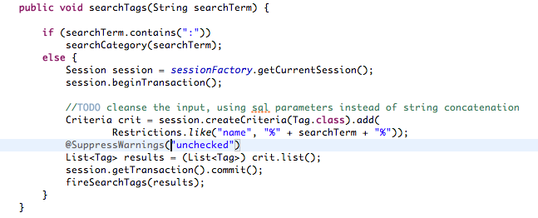
Search For Tag

Slide 9
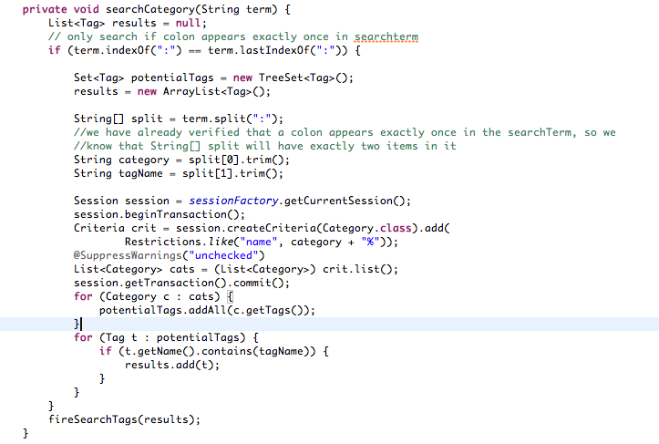
Search Tag in Category

Slide 10
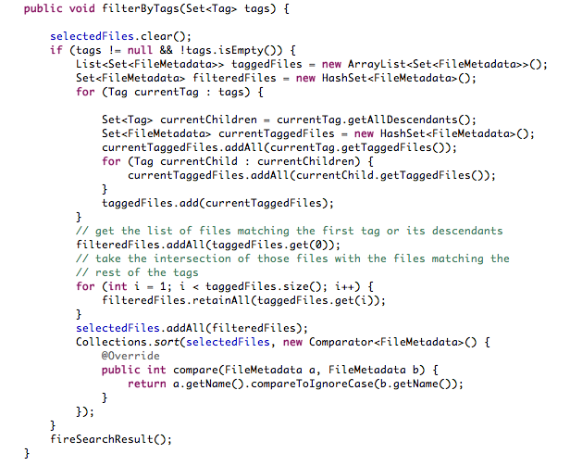
Filter by Tags

Slide 11
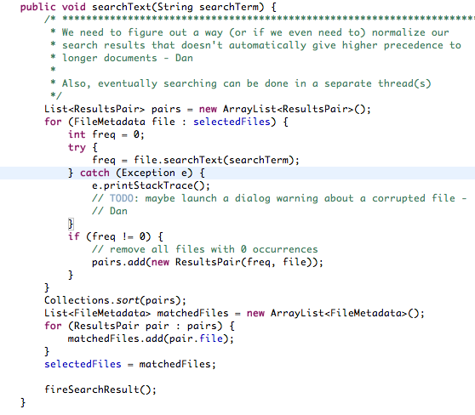
Full Text Search

Slide 12
Finishing Touches
Finish import support
RSS Reader
Expand to support EPUB
Add notes to files
Notes:
Say something about some of the difficulties of full-text searching PDFs. They are stored as a tree, basically with a pointer to each letter. So just traversing text is much more complicated than iterating through a linear data structure

