Slide 1

CUSTOMER CASE STUDY
BY ABHISHEK THOMAS

Slide 2
CONTENTS
Data quality and observations
Data preparation and assumptions
Key insights and visualization
Recommendations

Slide 3
Data Quality & observations

Slide 4
Data has missing, overlapping and redundant values
Missing values
~23% of CustomerID is missing(needs imputation)
~1% of Description is missing, it also contains lot of redundant data(needs to be standardized)
The 2 sheets of data are continuous, data starts from Dec 2009 to Dec 2011
Overlapping dates in both datasets from 01 Dec 2009- 09 Dec 2009, hence total rows are 1044848 not 1067371
Data not available
23 Dec 2009 - 4 Jan 2010
23 Dec 2010 - 4 Jan 2011
None of the columns are unique
CustomerID- 5942
Invoice- 53628
StockCode- 5305
Description- 5698
Incorrect format
StockCode has multiple values with incorrect format(ex: A, BANK CHARGES, gift_0001_60, C3, DOT, TEST002, DCGSSBOY)
Invoice has multiple values starting with A(Ex: A506401, A528059 (Adjusted bad debt))

Slide 5
Data Preparation & Assumptions

Slide 6
Append data sheets without overlap, impute CustomerID
The 2 data sheets from 2009- 2010 and 2010-2011 will be appended, the overlapping dates will be considered only from the 2010-2011 as they are both the same values(Total rows= 1044848 )
Columns such as Sales, Year, Month, Date, Cancelled will be created in order to keep operations simple
CustomerID is imputed on the logic as follows
Missing CustomerID data ~ 23%
Total unique CustomerID= 5942
Invoices with Missing CustomerID= 8752
Avg no. of invoices per CustomerID before imputation ~ 4 to 8 (median to mean)
Imputed CustomerID = 5942 x .23 = 1366
Avg no. of invoices per Imputed CustomerID = 8752/ 1366 ~ 6 or 7
All current CustomerID start from 12346 – 18287, to ensure we know which values are imputed we will start the imputed CustomerID from 20001-21366
Numbers from 20001-21366 will be assigned to each Invoice, this would ensure each CustomerID would get 6 or 7 invoices
Total imputed customers= 5942 +1366=7308
Cancelled column is Boolean where 1 states that Invoice starts with ‘C’ and 0 states that it starts without ‘C’
Make different tables by grouping year wise, month wise, quarter wise and other multiple ways to generate insights

Slide 7
Key Insights & Visualizations

Slide 8
Each Customers spend around 4.28£ per day and 2.39K £ per year
 | Quantity_per_invoice | Quantity_per_day | Quantity_per_month | Quantity_per_year | Sales_per_invoice | Sales_per_day | Sales_per_month | Sales_per_year
mean | 172.77 | 2.37 | 57.15 | 1.32K | 289.34 | 4.28 | 103.5 | 2.39K
std | 1.12K | 12.76 | 308.2 | 7.11K | 565.86 | 20.71 | 500.26 | 11.55K
min | -1.52K | -15.25 | -368.32 | -8.50K | -25.11K | -88.32 | -2.13K | -49.26K
max | 87.17K | 604.67 | 14.61K | 337.23K | 11.88K | 944.34 | 22.82K | 526.67K
Sales = Unit Prices * quantity
Cancelled invoices have -ve quantity
Total unique customers =7308 (after imputation)

Slide 9
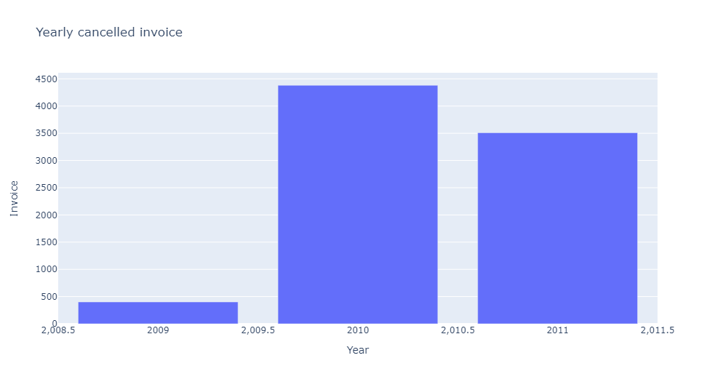
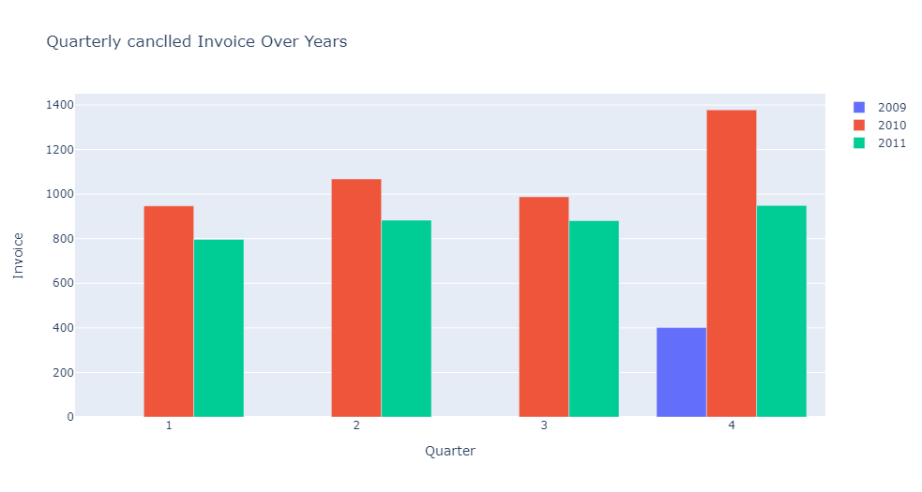
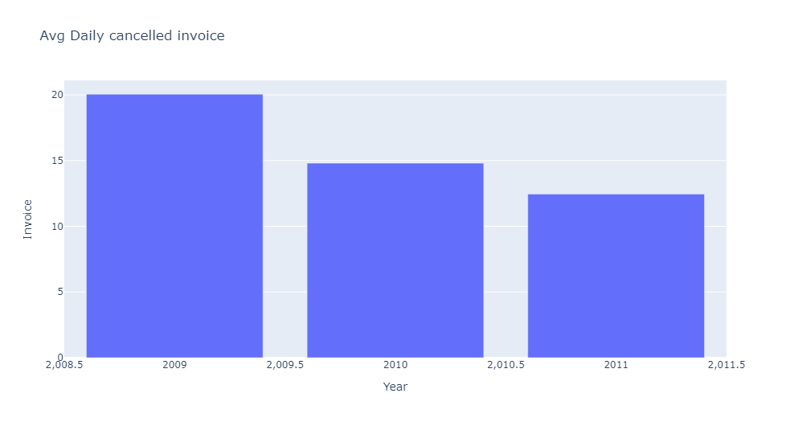
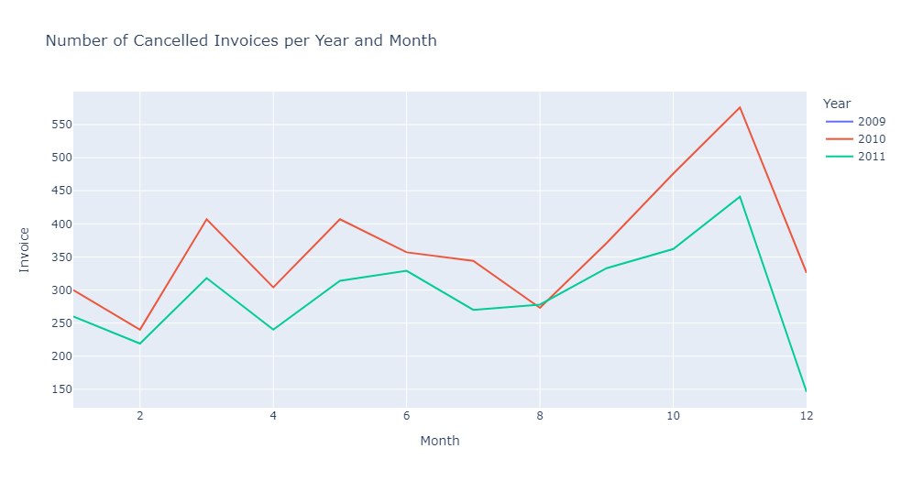
Avg daily number of cancelled invoices have decreased by years

Slide 10
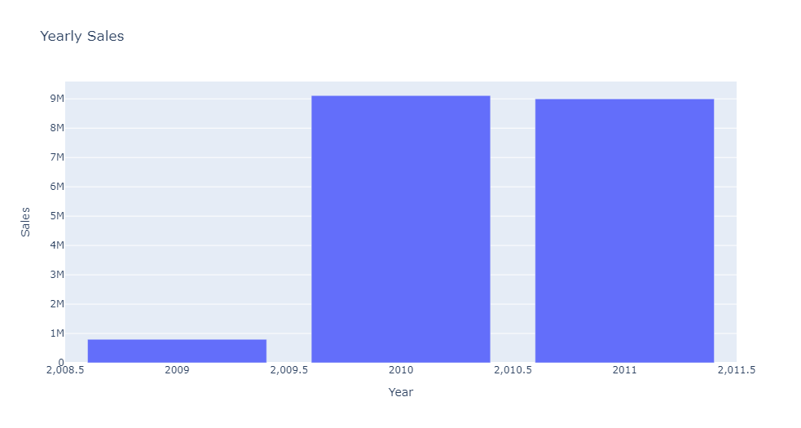
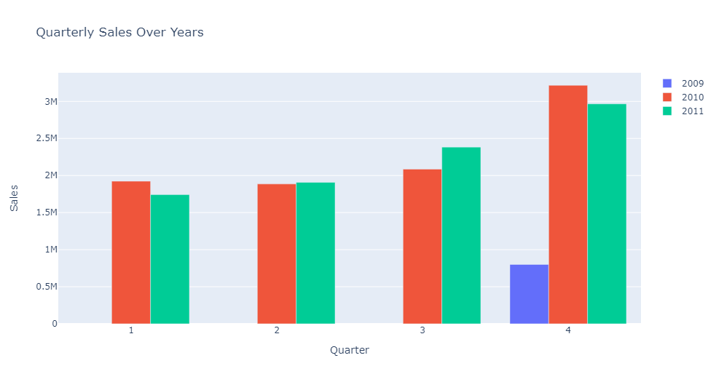
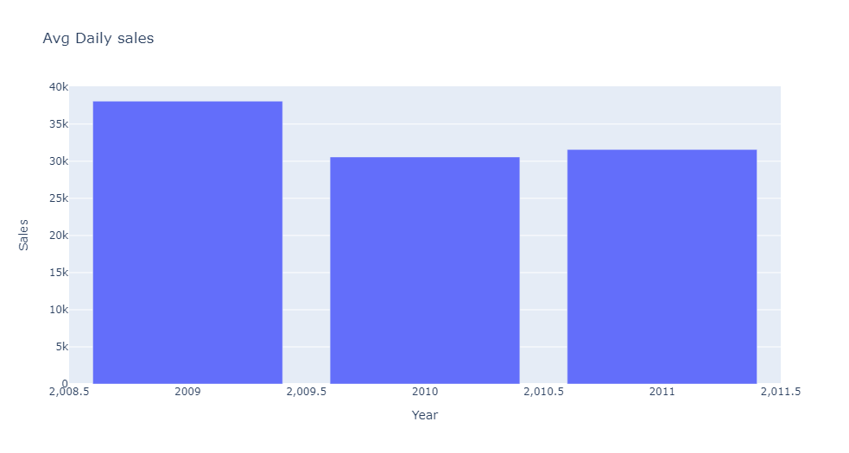
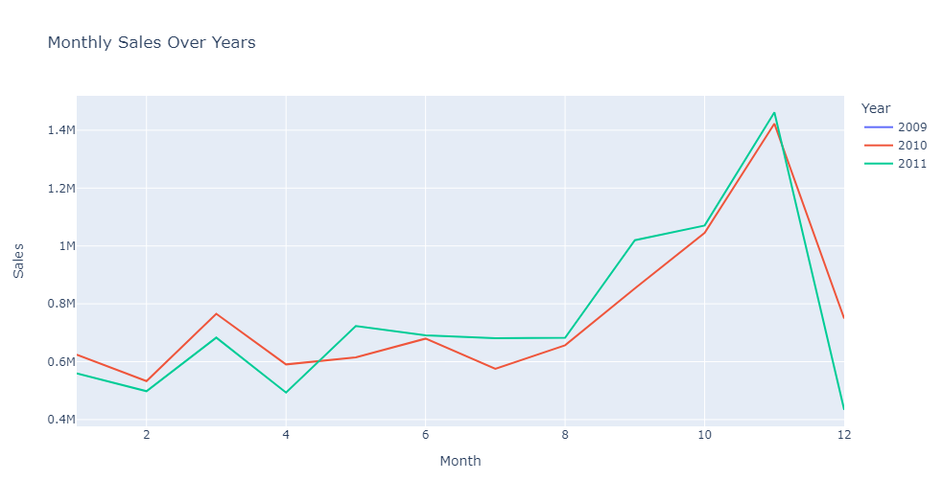
Increasing sales trend towards the end of the year

Slide 11
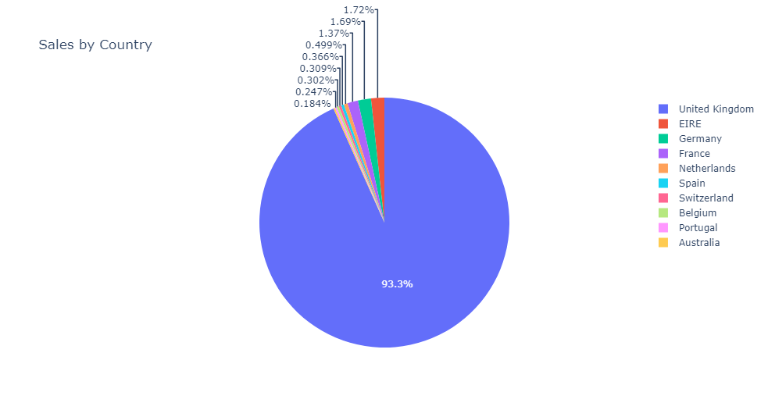
Majority of the customers are from UK
Countries with highest sales
Countries of each customer
Country | Sales
United Kingdom | 1,60,38,600.00
EIRE | 6,10,244.30
Netherlands | 5,48,332.30
Germany | 4,12,517.80
France | 3,21,928.50
Countries with lowest sales
Country | Sales
Korea | 949.82
Czech Republic | 707.72
West Indies | 536.41
Saudi Arabia | 131.17
Nigeria | -6.66

Slide 12
Customers like world war 2 planes
Top10 Best selling products
Top10 worst selling products
StockCode | Quantity | Description | Sales_Volume_% | Dense_Rank
84077 | 104786 | WORLD WAR 2 GLIDERS ASSTD DESIGNS | 0.502987 | 1
85099B | 94325 | missing | 0.452773 | 2
85099B | 94325 | JUMBO BAG RED WHITE SPOTTY | 0.452773 | 2
85099B | 94325 | RED RETROSPOT JUMBO BAG | 0.452773 | 2
85099B | 94325 | JUMBO BAG RED RETROSPOT | 0.452773 | 2
85123A | 94243 | WHITE HANGING HEART T-LIGHT HOLDER | 0.45238 | 3
85123A | 94243 | 21733 mixed | 0.45238 | 3
85123A | 94243 | ? | 0.45238 | 3
85123A | 94243 | wrongly marked carton 22804 | 0.45238 | 3
85123A | 94243 | CREAM HANGING HEART T-LIGHT HOLDER | 0.45238 | 3
21212 | 93862 | PACK OF 72 RETRO SPOT CAKE CASES | 0.450551 | 4
21212 | 93862 | PACK OF 72 RETROSPOT CAKE CASES | 0.450551 | 4
84879 | 79189 | damaged | 0.380118 | 5
84879 | 79189 | Dotcom multiples | 0.380118 | 5
84879 | 79189 | ASSORTED COLOUR BIRD ORNAMENT | 0.380118 | 5
22197 | 78007 | POPCORN HOLDER | 0.374444 | 6
22197 | 78007 | POPCORN HOLDER , SMALL | 0.374444 | 6
22197 | 78007 | NaN | 0.374444 | 6
22197 | 78007 | SMALL POPCORN HOLDER | 0.374444 | 6
17003 | 69675 | BROCADE RING PURSE | 0.33445 | 7
21977 | 56011 | PACK OF 60 PINK PAISLEY CAKE CASES | 0.268861 | 8
84991 | 53856 | 60 TEATIME FAIRY CAKE CASES | 0.258516 | 9
22492 | 43337 | MINI PAINT SET VINTAGE BOY+ GIRL | 0.208024 | 10
22492 | 43337 | MINI PAINT SET VINTAGE | 0.208024 | 10
StockCode | Quantity | Description | Sales_Volume_% | Dense_Rank
79323W | -3050 | Unsaleable, destroyed. | -0.01464 | 2605
79323W | -3050 | WHITE CHERRY LIGHTS | -0.01464 | 2605
79323W | -3050 | WHITE CHERRY LIGHTS | -0.01464 | 2605
79323W | -3050 | NaN | -0.01464 | 2605
16235 | -3269 | RECYCLED PENCIL WITH RABBIT ERASER | -0.015692 | 2606
16235 | -3269 | ? | -0.015692 | 2606
72024HC | -3669 | NaN | -0.017612 | 2607
C3 | -4999 | NaN | -0.023996 | 2608
72140F | -5193 | throw away | -0.024927 | 2609
72140F | -5193 | HAPPY ANNIVERSARY CANDLE LETTERS | -0.024927 | 2609
10120 | -8365 | DOGGY RUBBER | -0.040153 | 2610
10120 | -8365 | Zebra invcing error | -0.040153 | 2610
23003 | -8516 | Printing smudges/thrown away | -0.040878 | 2611
23003 | -8516 | TRAVEL CARD WALLET VINTAGE ROSE | -0.040878 | 2611
23005 | -14418 | TRAVEL CARD WALLET I LOVE LONDON | -0.069208 | 2612
23005 | -14418 | printing smudges/thrown away | -0.069208 | 2612
22126 | -16400 | NaN | -0.078722 | 2613
22126 | -16400 | given away | -0.078722 | 2613
20852 | -18800 | Given away | -0.090243 | 2614
20852 | -18800 | given away | -0.090243 | 2614

Slide 13
Recommendations

Slide 14
Personalizing products for each customer
Data quality would needed to be improved
Missing values need to be handled
No overlapping in data
No redundant data
Better format for product codes
Personalization techniques
Collaborative filtering - To deep dive into customer behavior and their purchasing MO’s
Market basket analysis - To understand the association between various products
Cancelled orders and Adjusted bad debt
No of cancelled orders have decreased per year, would need to maintain this
Sales are lost in most cancelled orders by products that are given away, destroyed and adjusted bad debt, research on different methods to reduce these

Slide 15
Thank you

