Slide 1


Pizza Planet
Python practice case

Slide 2
Pizza Planet
Design a set of scripts that work together, one calls the other and the input/output is passed between them.

Slide 3
Pizza Planet
presentPizza.ipynb
makePizza.py
addIngredient.py
Menu.csv
readRecipe.py

Slide 4
Pizza Planet
Presents menu,
Takes order,
Passes order to makePizza
Receives ‘pizza’ back
Presents it to the customer
presentPizza.ipynb
Provides a base, calls readRecipe to retrieve the ingredients, then loops over them calling addIngredient
makePizza.py
addIngredient.py
Menu.csv
readRecipe.py
Takes pizza name, looks up the recipe in Menu.csv, passes the recipe to makePizza

Slide 5
Pizza Planet
presentPizza.ipynb
Code this one from scratch, then pick one or more of the others to complete (the Dev version is incomplete)
makePizza.py
addIngredient.py
Menu.csv
readRecipe.py

Slide 6
Pizza Planet
loop
makePizza.py
addIngredient.py
Will make a list [] called pizza, looping over the add_ingredient() function, which will keep growing the list.
It calls with 2 arguments: the current pizza (the list) and the ingredient (character string) to append as an element.
Take 2 arguments: pizza (the list) and ingredient (character string) to append as an element.
Return the pizza

Slide 7
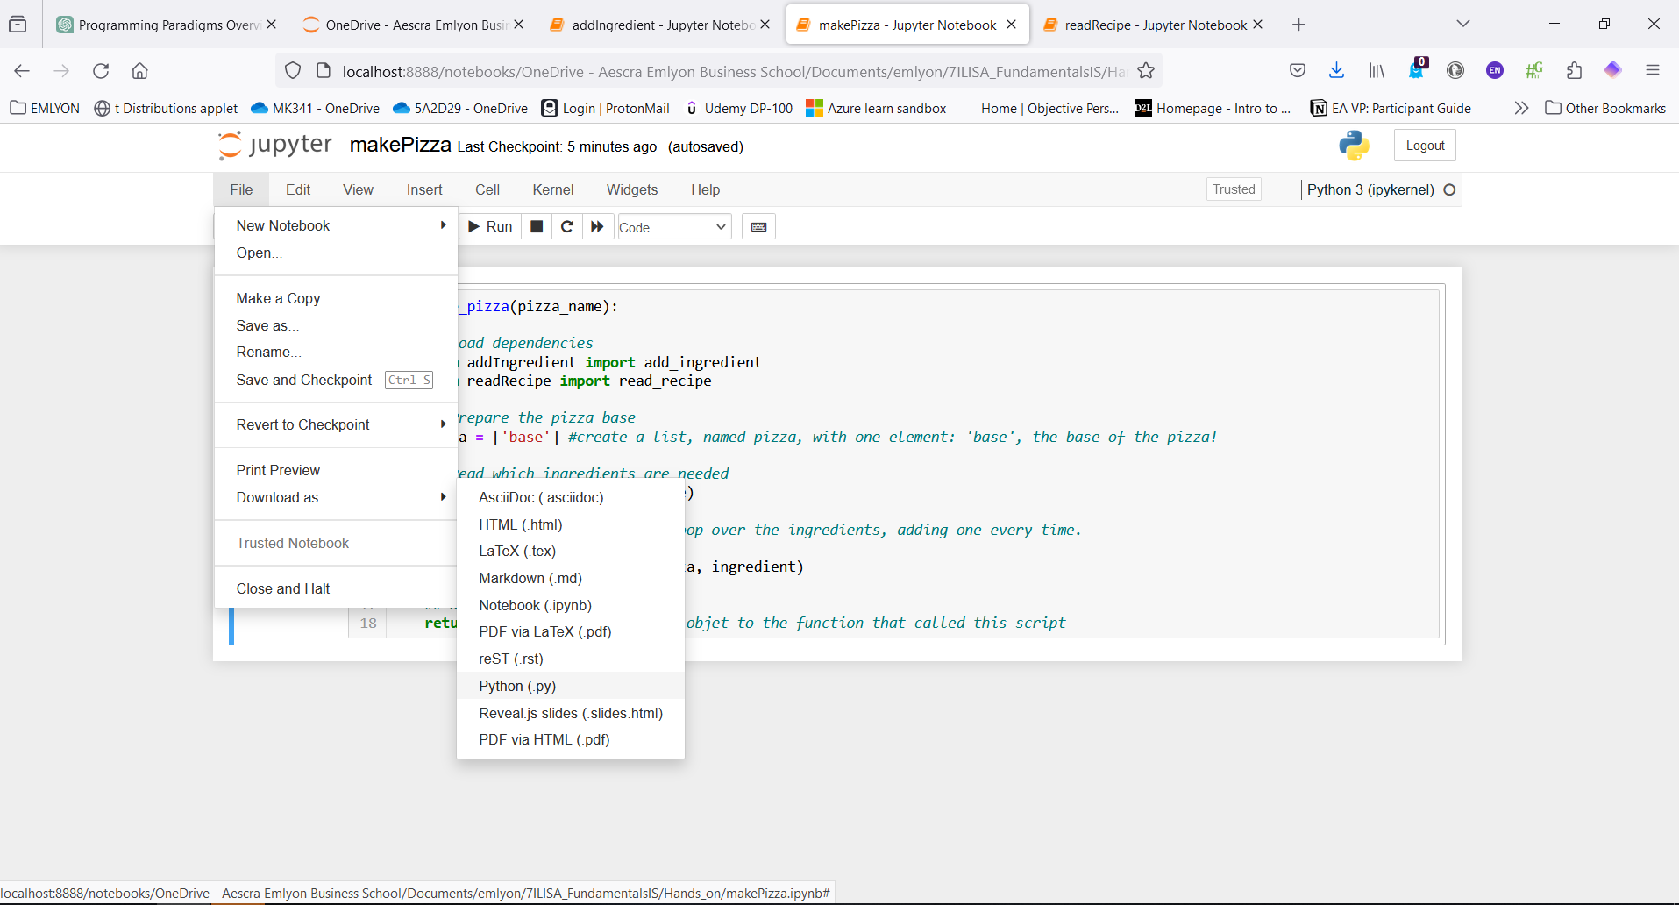
How to save a Notebook as .py, so it can be imported from:
Introduction to Python and its popularity.
Basic syntax and features of Python.

Slide 8
Pizza Planet
Our convention: store the scripts (the blue ones)
in camel case names (written here),
each containing only one function using snake_case
presentPizza.ipynb
makePizza.py
addIngredient.py
Menu.csv
readRecipe.py

Slide 9
Pizza Planet
*** (practice with data methods)
presentPizza.ipynb
*** (practice with data methods)
*
makePizza.py
addIngredient.py
Menu.csv
**
readRecipe.py
Notes:
Pick one of the tasks, open the Dev version and complete the code (stars indicate challenge level)

