Slide 1
Functions
Anonymous function
Functions: - void function (no output variables) - one output variable or more - input and output arrays
Sub function example
Nested function example
Recursive functions
Questions

Slide 2
Anonymous function
Create a function to implement y = x.^3+3*x-1 and save the function into mypoly.m file
function y = mypoly(x) ;
y = x.^3+3*x-1
end
In Anonymous function with the function handle @ , we create the function mypoly as
mypoly = @(x) x.^3+3*x-1
We can use the fun value as (ex: fprintf(‘%f’, myploy(10))
Purpose: save memory space

Slide 3
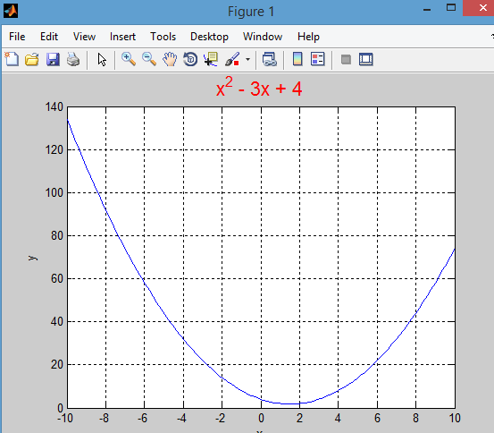
% anonFun.m
% anonymous function example
% Author: Th
myFun = @(x) x.^2 - 3*x + 4;
y1 = myFun(4)
y2 = myFun(-2)
x = linspace(-10,10);
y = myFun(x);
plot(x,y)
grid on
title('x^2 - 3x + 4', 'FontSize', 16, 'Color','r')

Slide 4
Function input and output …… to reduce complexity
z
2
function y=mypoly(x)
Main program
a=101;
z=2;
f=mypoly(z);
x
2
a
1
a
101
b
2
function y=mypoly(x)
a=1;
b=2;
c=3;
y=a*x.^2+b*x+c;
local variables:
x, a, b, c, and y
c
3
f
11
11
y
Variables created inside the function are local—not accessible outside the function.
Local variables are temporary. They are created when the function runs and disappear afterwards.

Slide 5
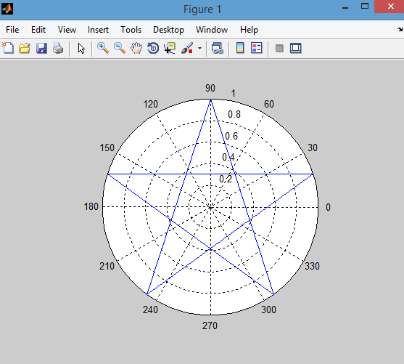
Void function function [ ]= function name()
function [ ]= star()
theta =pi/2: 8*pi: 4.8*pi % 90:144:810
r=ones(1,6)
Polar(theta,r)
end
thera =90,234,378,
522,666,810

Slide 6
Functions: - one output or more, arrays , strings,
function [max, index]= my_max(v)
n=length(v);
max=-inf;
for i=1:n
if v(i)>max
max=v(i);
index=I;
end
end
Output:
>>a=[1:10 75:-1:50]
[max,index]=my_max(a)
max =75
Index=11
`
function b= output_array(v)
b=v.^2;
output:
>>a=[1:3]
b=my_max(a)
---------------------------
function [a b]= output_array(v)
b=v.^2;
a=v.^3;
output:
>>a=[1:3]
[x y]=my_max(a)
x= 1 4 9
y= 1 9 27

Slide 7
function b= output_array(v)
x=v.^2;
x1=v.^3;
b=[x x1]
output:
>>a=[1:3]
output=my_max(a)
output= 1 4 9 1 9 27
-------------------------
function s= output_array(s1, s2)
s=[s1 s2]; % con cateating
Output
>>s=output_array(‘ddd’, ‘aaa’)
end
function b= output_array(v)
x=v.^2;
x1=v.^3;
b=[x x1]
output:
>>a=[1:3]
output=my_max(a)
output= 1 4 9 1 9 27

Slide 8
Program structure- Sub function example
myprog.m
function myprog
function myfun1
function myfun2
…
primary function
subfunctions

Slide 9
function [SA, Vol]= Barbell(r1,r2,h)
% This function finds the surface area and volume of a barbell (ignoring
% fact that the ends of the bartake away from the SA and vol of the
% sphere)
% INPUTS: r1, the radius of the sphere
% r2, radius of the cylinder, scalar
% h, the height of the cylinder, scalar
% OUTPUTS: SA, surface area of the barbell, scalar
% Vol, volume of the barbell, scalar
% Sample call: [SABarbell VolBarbell] = Barbell(4,.5,10)
[SA1,Vol1] = SAVolSphere(r1);
[SA2,Vol2] = SAVolCylinder(r2,h);
SA = 2*SA1+SA2;
Vol = Vol1+Vol2;
%======================================================================
function [SA, Vol]= SAVolSphere(r)
% This function finds the surface area and volume of a sphere given its radius
SA = 4*pi*r^2;
Vol = 4/3*pi*r^3;
%=====================================================================
function [SA, Vol] = SAVolCylinder(r,h)
% Thus function finds the surface area and volume of
% an open cylinder with radius r and height h.
SA = 2*pi*r*h;
Vol = pi*r^2*h;
Sub function example
>> [SA, Vol]=Barbell(.2,.03,1.5)
SA =
1.2881
Vol =
0.0378

Slide 10
Nested functions
0
main_function
nested_function_1
…
end %end function 1
nested_function_2
…
end %end function 2
end % main_function
function W=Weight_Cyl(H,R,D)
V=Volume_Cyl(H,R)
W= D*V
function V=Volume_Cyl(H,R)
A=Area_Cyl(R)
V= A*H
function A=Area _Cyl(R)
A= R^2*pi;

Slide 11
function W=Weight_cyl (H,R,D)
V=Volume_Cyl(H,R);
w= D*V
function V= Volume_Cyl(H,R)
A=Area_Cyl(R);
V= A*H;
end
function A= Area_Cyl(R)
A= R^2*pi;
end
output
>> ans=Weight_cyl(1,2,3)
37.6991

Slide 12
Recursive functions
function f= fact(n)
if n==0
f=1;
else
f=n*fact(n-1);
end
Output:
>>fact(4)
24

Slide 13
Questions
Q1- Write a void function to display an equilateral triangle on a polar plot.
Q2- Write a recursive function to evaluate the Fibonacci function
Q3- Write a function vout=insert_after(v,x,k) that insert the value x into vector v after the k’th element
Q4- Write a function that has two strings (s1,s2)and return 1,-1,0 if s1>s2, s1<s2 and s1=s2 respectively .

