Slide 1
Numerical Integration Formulas
Chapter Objectives
Recognizing that Newton-Cotes integration formulas are based on the strategy of replacing a complicated function or tabulated data with a polynomial that is easy to integrate.
Knowing how to implement the following single application Newton-Cotes formulas:
  Trapezoidal rule
  Simpson’s 1/3 rule
  Simpson’s 3/8 rule

Slide 2
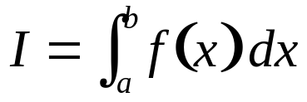
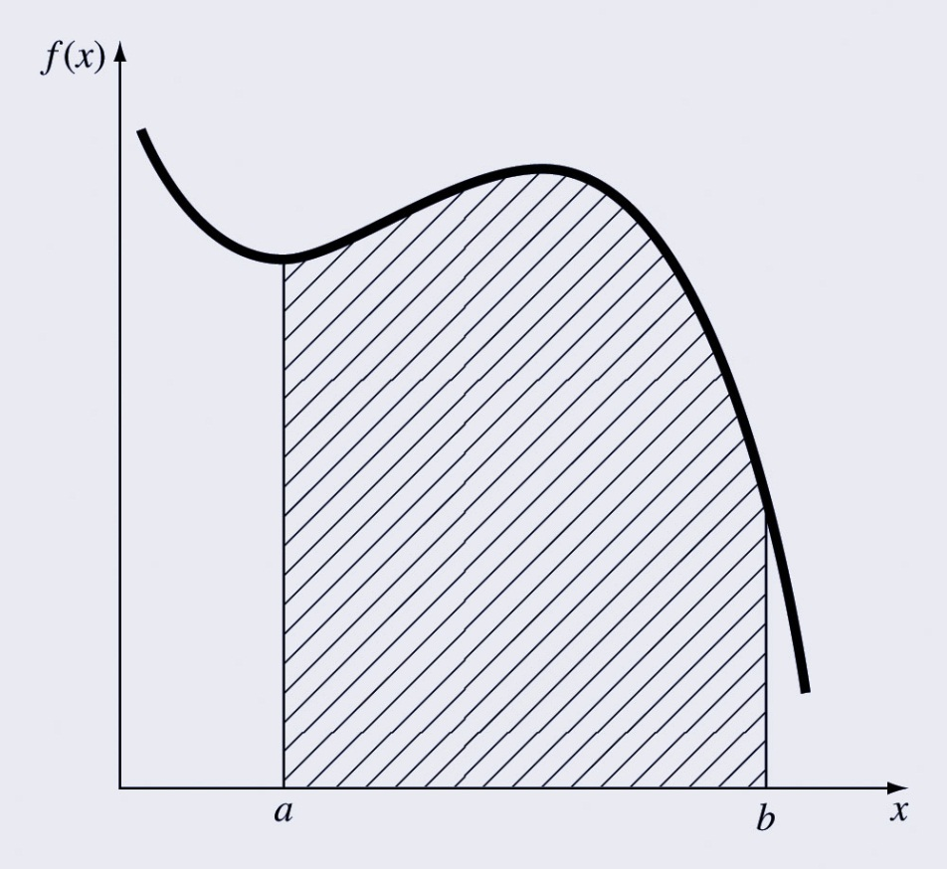
Integration
Integration:
is the total value, or summation, of f(x) dx over the range from a to b:

Slide 3
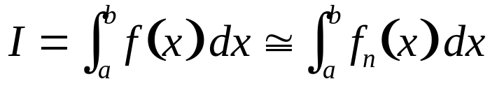
Newton-Cotes Formulas
The Newton-Cotes formulas are the most common numerical integration schemes.
Generally, they are based on replacing a complicated function or tabulated data with a polynomial that is easy to integrate:
where f_{n}(x) is an n^{th} order interpolating polynomial.

Slide 4
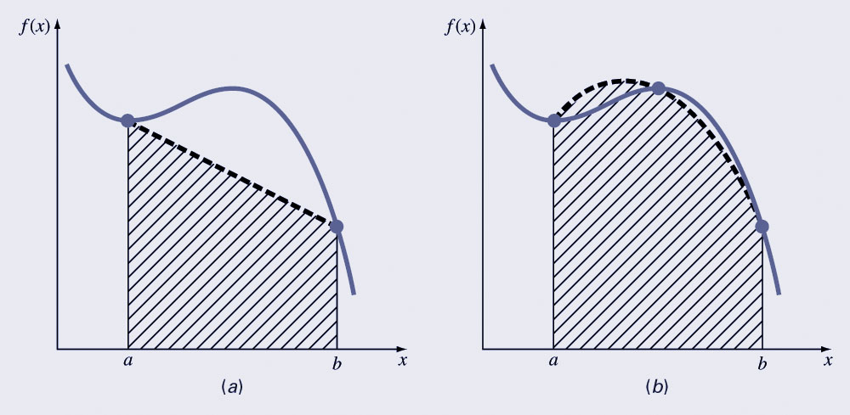
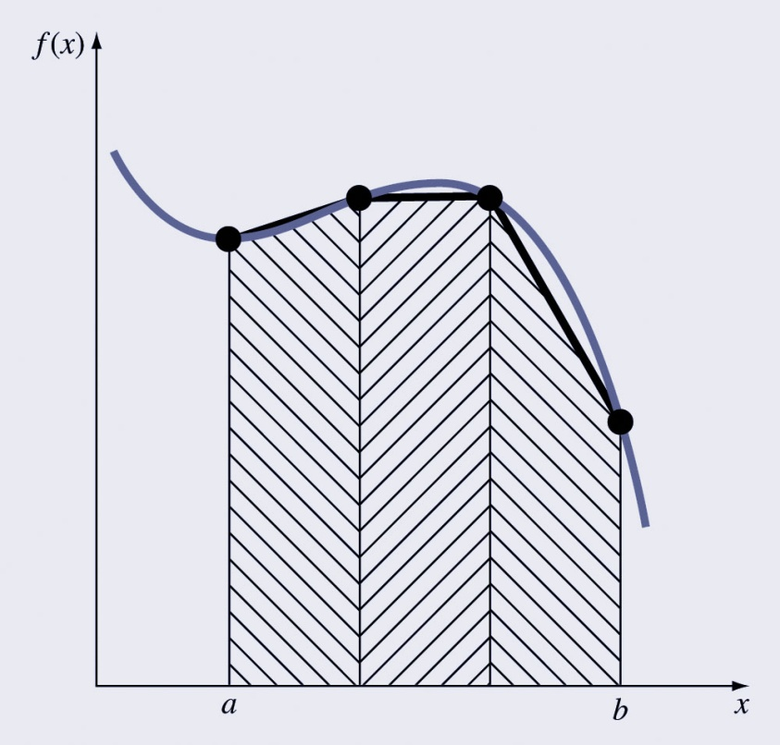
Newton-Cotes Examples
The integral can be approximated by polynomials of any order – for example, (a) straight lines or (b) parabolas
The integral can be approximated in one step or in a series of steps to improve accuracy.

Slide 5
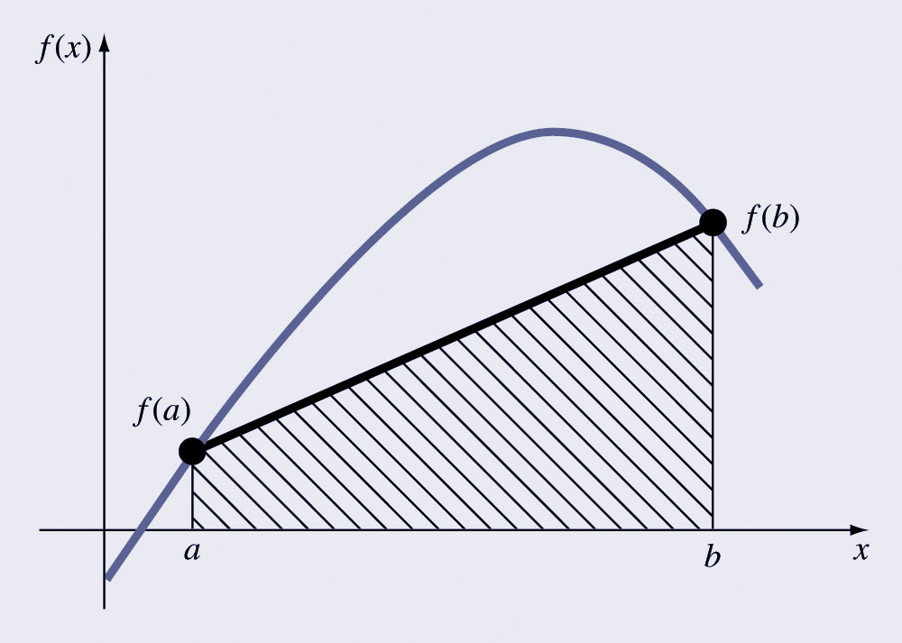
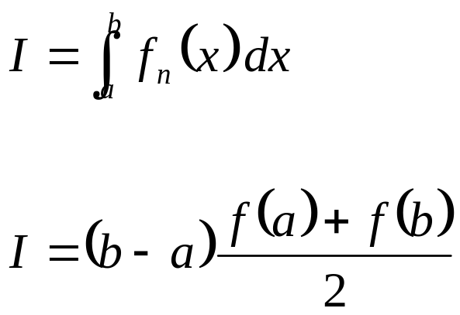
The Trapezoidal Rule
The trapezoidal rule is the first of the Newton-Cotes closed integration formulas; it uses a straight-line approximation for the function:

Slide 6
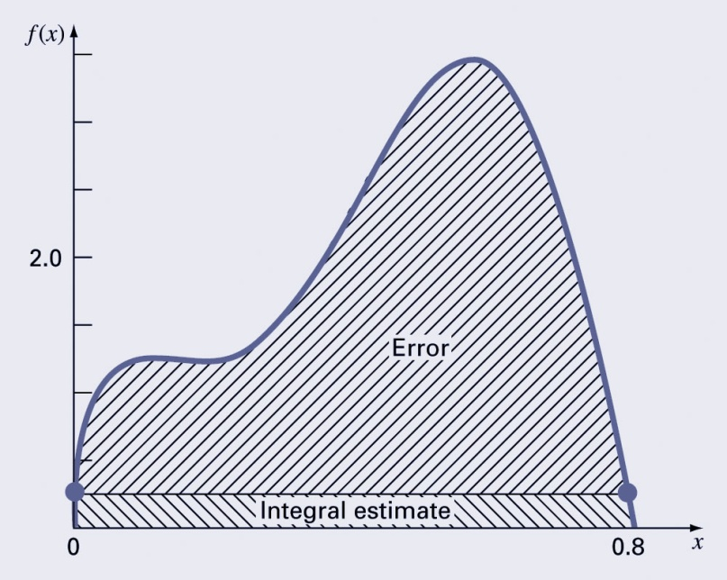
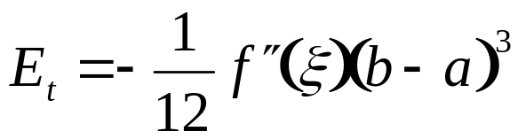
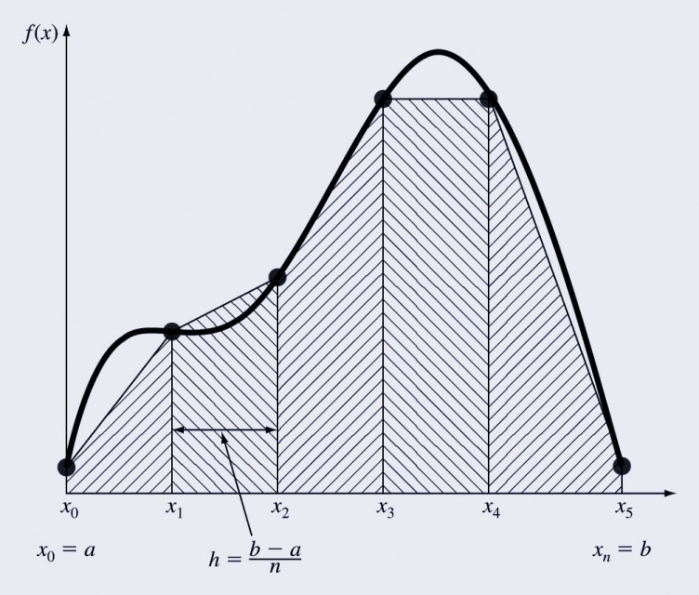
Error of the Trapezoidal Rule
An estimate for the local truncation error of a single application of the trapezoidal rule is:
where ξ is somewhere between a and b.
This formula indicates that the error is dependent upon the curvature of the actual function as well as the distance between the points.
Error can thus be reduced by breaking the curve into parts.

Slide 7
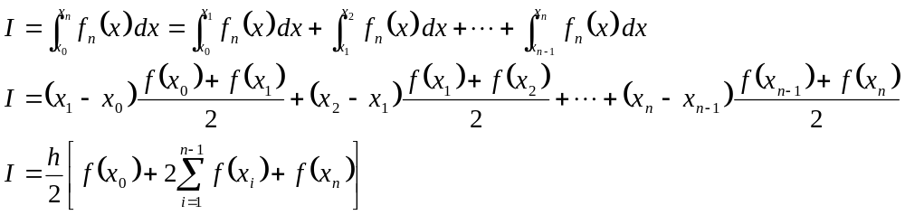
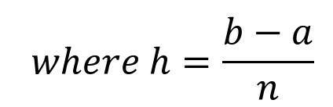
Composite Trapezoidal Rule
Assuming n+1 data points are evenly spaced, there will be n intervals over which to integrate.
The total integral can be calculated by integrating each subinterval and then adding them together:

Slide 8
MATLAB Functions
MATLAB has built-in functions to evaluate integrals based on the trapezoidal rule
z = trapz(y)
z = trapz(x, y)
produces the integral of y with respect to x. If x is omitted, the program assumes h=1.

Slide 9
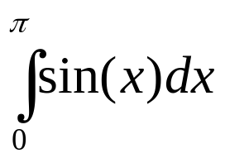
Example
The exact value of is 2.
To approximate this numerically on a uniformly spaced grid, use
X = 0:pi/100:pi; Y = sin(X);
Then Z = trapz(X,Y)
produces
Z = 1.9998

Slide 10
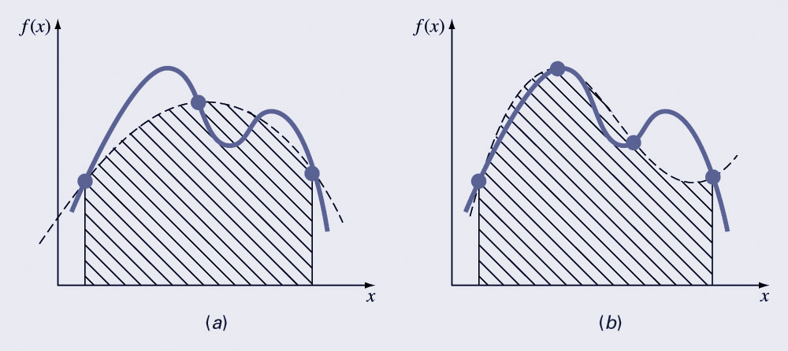
Simpson’s Rules
More complicated approximation formulas can improve the accuracy for curves - these include using (a) 2nd and (b) 3rd order polynomials.
The formulas that result from taking the integrals under these polynomials are called Simpson’s rules.

Slide 11
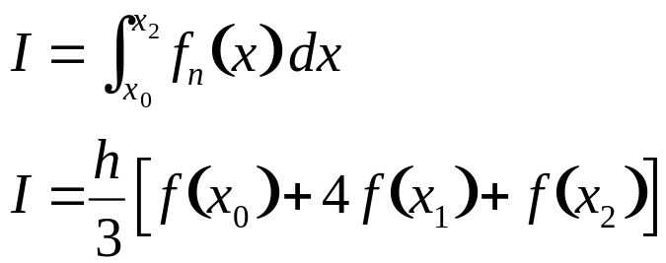
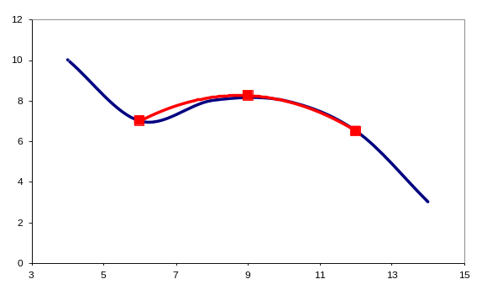
Simpson’s 1/3 Rule
Simpson’s 1/3 rule corresponds to using second-order polynomials. Using the Lagrange form for a quadratic fit of three points:
Integration over the three points simplifies to:

Slide 12
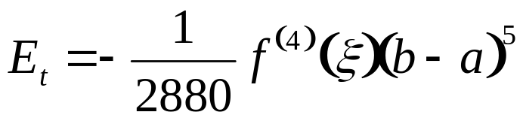
Error of Simpson’s 1/3 Rule
An estimate for the local truncation error of a single application of Simpson’s 1/3 rule is:
where again ξ is somewhere between a and b.
This formula indicates that the error is dependent upon the fourth-derivative of the actual function as well as the distance between the points.
Note that the error is dependent on the fifth power of the step size (rather than the third for the trapezoidal rule).
Error can thus be reduced by breaking the curve into parts.

Slide 13
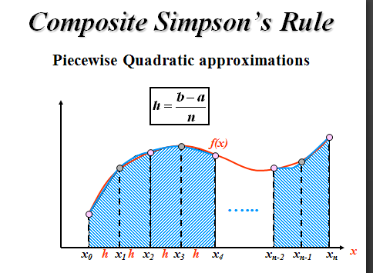

Slide 14
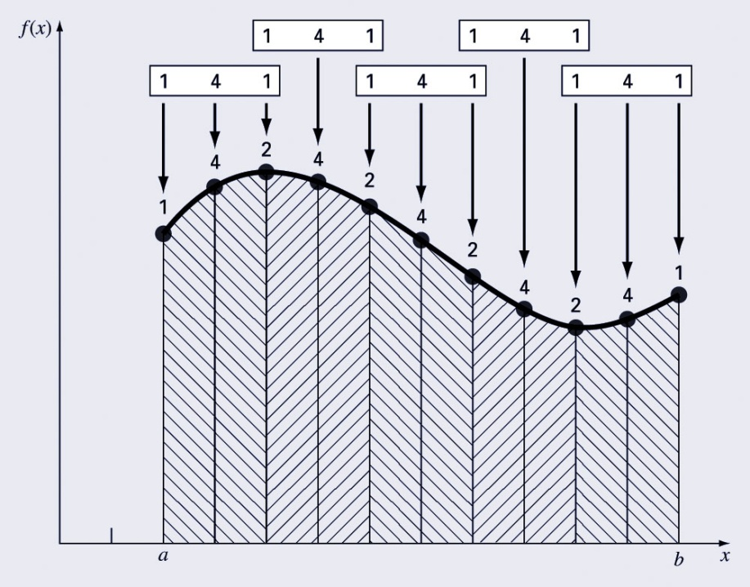
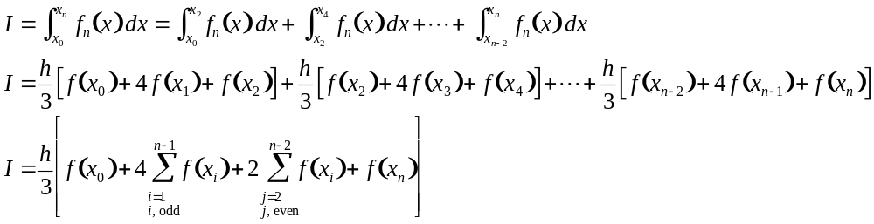
Composite Simpson’s 1/3 Rule
Simpson’s 1/3 rule can be used on a set of subintervals in much the same way the trapezoidal rule was, except there must be an odd number of points.
Because of the heavy weighting of the internal points, the formula is a little more complicated than for the trapezoidal rule:

Slide 15
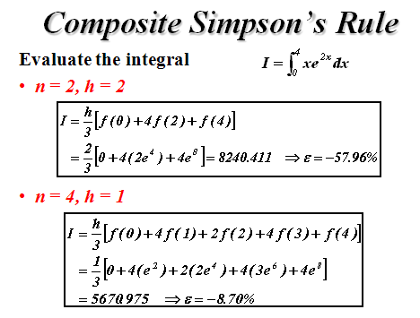

Slide 16
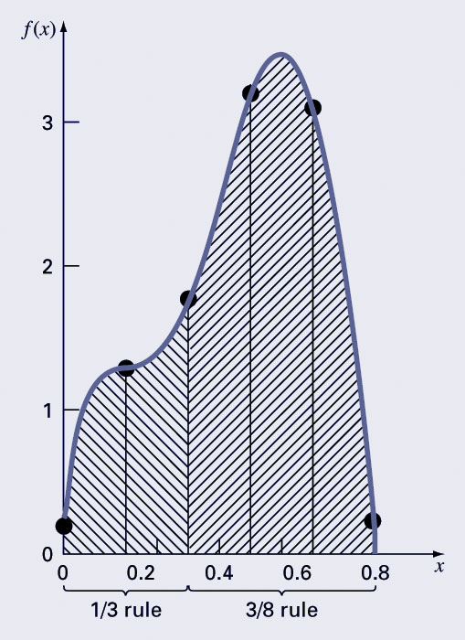
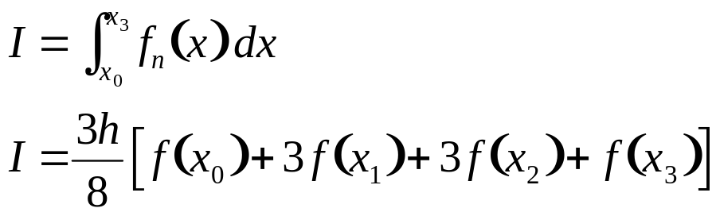
Simpson’s 3/8 Rule
Simpson’s 3/8 rule corresponds to using third-order polynomials to fit four points. Integration over the four points simplifies to:
Simpson’s 3/8 rule is generally used in concert with Simpson’s 1/3 rule when the number of segments is odd.

Slide 17
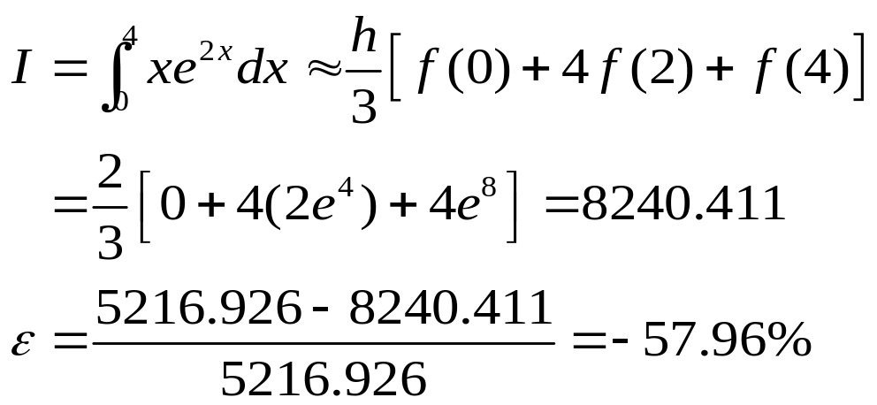
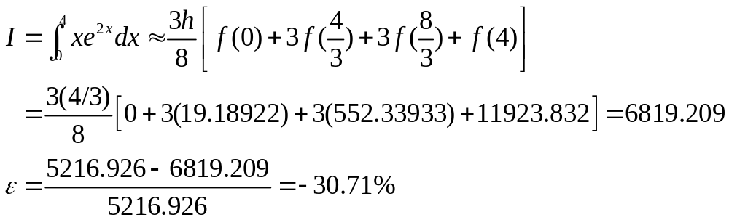
Example: Simpson’s Rules
Evaluate the integral
Simpson’s 1/3-Rule
Simpson’s 3/8-Rule

Slide 18
Q2
A = [1,3,4;5,4,3;9,10,8] for i=1:3 for j=1:3 if(A(i,j)>A(i,1)) B(i,j) = 0; else B(i,j) = A(i,j); end end end B 1 0 0 5 4 3 9 0 8 | A = [1,3,4;5,4,3;9,10,8] B =A for i=1:3 for j=2:3 if(A(i,j-1)<A(i,j)) B(i,j) = 0; else B(i,j) = A(i,j); end end end B 1 0 0 5 4 3 9 0 8

Slide 19
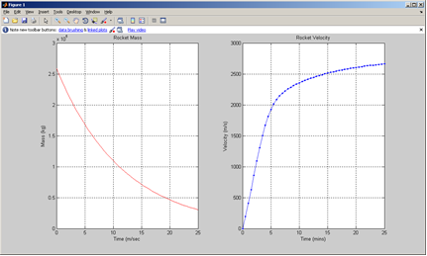
% This script will calculate the mass and velocity of a rocket for the
% first 25 minutes of flight with a time step of 30 sec. It will display
% the results in two separate plots. It will display the total amount of
% fuel left after 25 minutes.
% Initializations
v(1) = 0; % m/s
m(1) = 258500; % kg
% Given values
c_d = 0.55; % kg/m, drag coefficient
F_t = 4.2*10^6; % N, constant thrust
c_f = 1.4*10^-3; % burn coefficient
g = 9.81; % m/s^2, gravity
t = 0:.5:25; % time from 0 to 25 minutes % t=0:30:25*60
for i = 2:length(t)
m(i) = m(i-1) - c_f*m(i-1)*30;
v(i) = v(i-1) + (F_t/m(i-1) - g - c_d/m(i-1)*v(i-1)^2)*30;
end
figure
subplot(1,2,1)
plot(t,m,'r'),grid on
title(' Rocket Mass'), xlabel ('Time (m/sec'), ylabel ('Mass (kg)')
subplot(1,2,2)
plot(t,v,'.b-'), grid on
title('Rocket Velocity'),xlabel ('Time (mins)'), ylabel ('Velocity (m/s)')
FuelLeft = m(i) - 23500
Q3

