Slide 1
More Graphic (Chapter 13)
2D Rotation Matrix derivation
Plotting surfaces
Images: Dimensions, rotating, flipping, mixing with surface
Sphere plot
3D Rotation

Slide 2
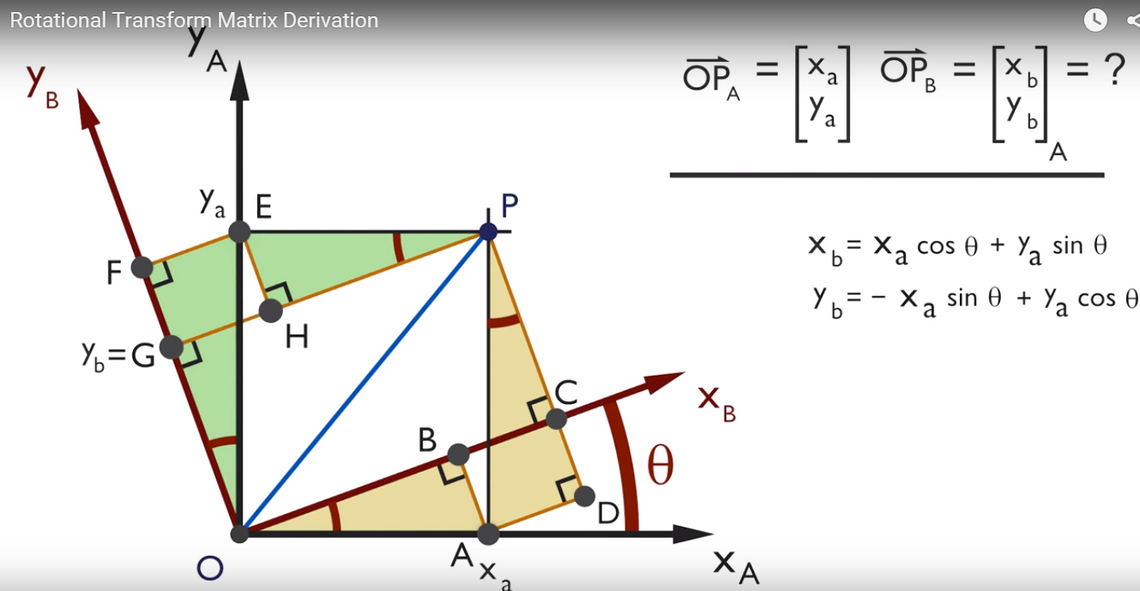
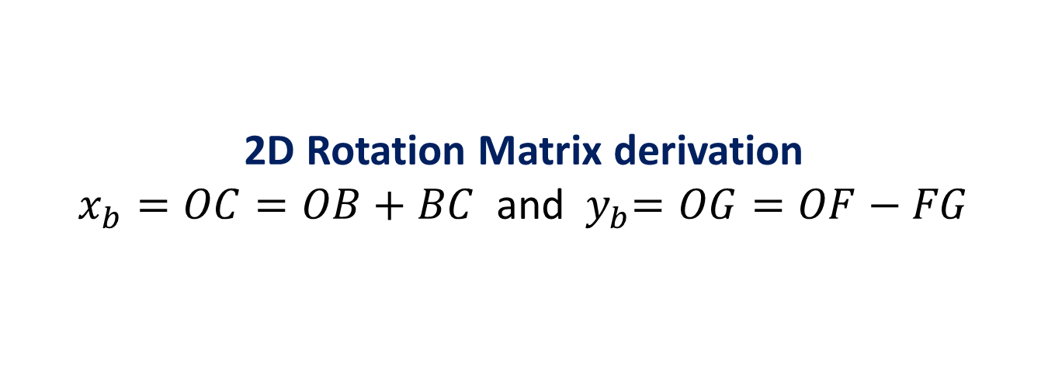
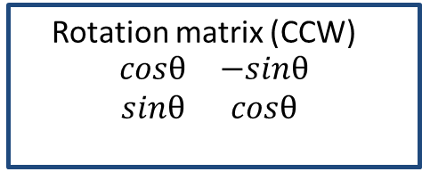


2D Rotation Matrix derivation $x_{b}=OC=OB+BC$ and ${ y}_{b}=OG=OF−FG$
$$x_{b}$$
Rotation matrix (CW)
$$\begin{matrix}cosθ & sinθ \\ −sinθ & cosθ\end{matrix}$$
Rotation matrix (CCW)
$$\begin{matrix}cosθ & −sinθ \\ sinθ & cosθ\end{matrix}$$

Slide 3
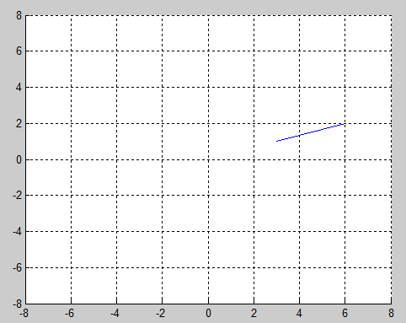
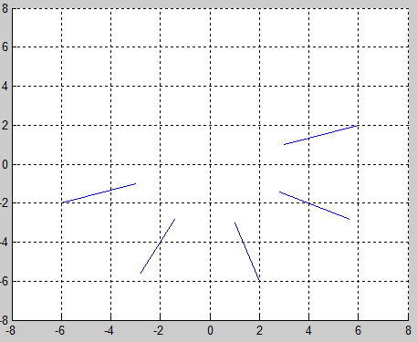
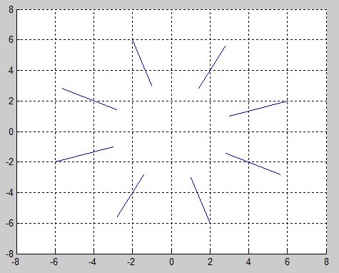
Example: Rotate a line by pi, 2*pi
clf
rp =[3 6;1 2];
line (rp(1,:),rp(2,:));
axis([-8 8 -8 8]);
for theta = 0:pi/4:pi
rot=[cos(theta), sin(theta); -sin(theta) cos(theta)];
%rot=[-cos(theta), sin(theta); sin(theta) cos(theta)];
r=rot*rp;
line(r(1,:), r(2,:));
end
Original line
Rotation 180 degree (pi)
Rotation 360 degree (2*pi)

Slide 4
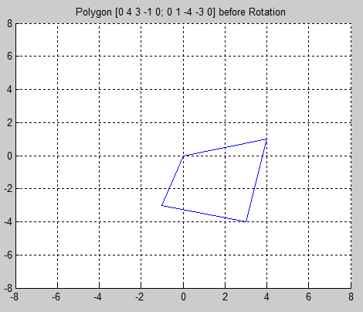
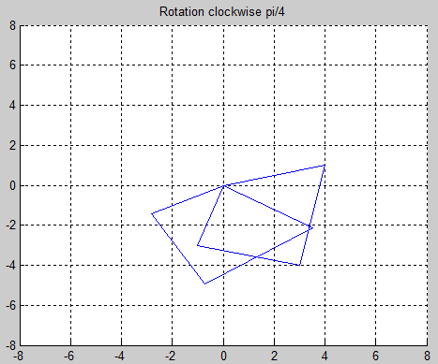
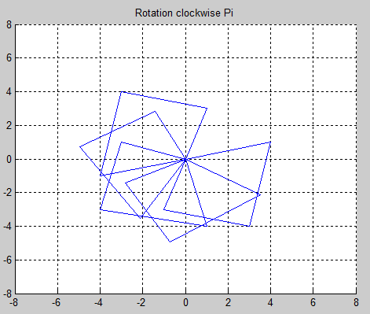
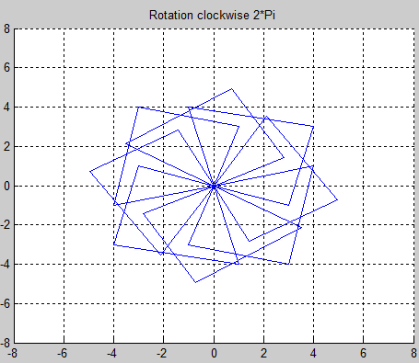
Question: Rotate a polygon ABCD pi/4, pi/2, …..2*pi A( 0,0), B(4, 1), C(2, -4), D(-1, -3)

Slide 5
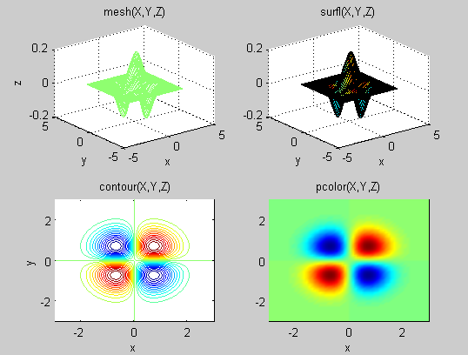
Plotting surfaces

Slide 6
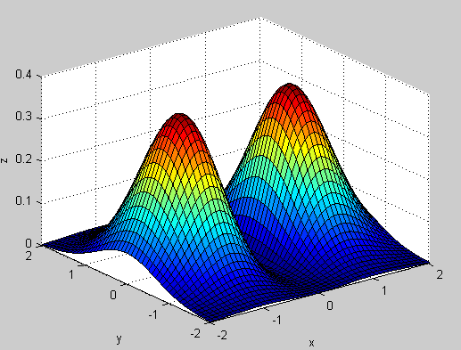
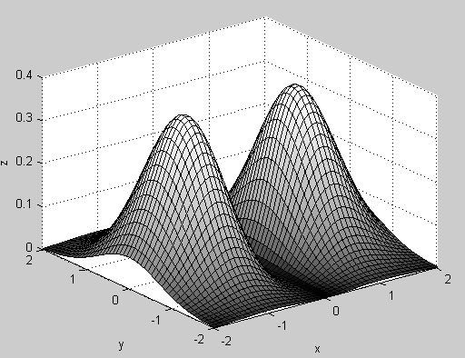
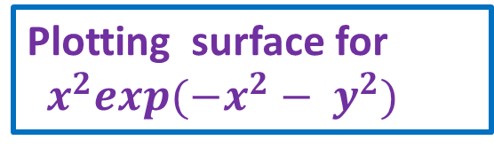
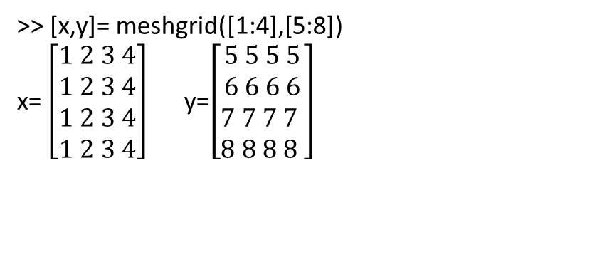
>> [x,y]= meshgrid([1:4],[5:8])
x= $\left[\begin{aligned}1 2 3 4 \\ 1 2 3 4 \\ 1 2 3 4 \\ 1 2 3 4\end{aligned}\right]$ y=$\left[\begin{aligned}5 5 5 5 \\ 6 6 6 6 \\ 7 7 7 7 \\ 8 8 8 8 \end{aligned}\right]$
Plotting surface for
$x^{2}exp({−x}^{2}− y^{2})$
% demoSurf
%% set parameters
Nx=50;
xmin=-2;
xmax=+2
clc
%% make grid
x=linspace(xmin,xmax,Nx);
y=linspace(xmin,xmax,Nx);
[X,Y]=meshgrid(x,y);
%% calculate function z=f(x,y)
Z = X.^2 .* exp(-X.^2 - Y.^2);
%% plot surface
figure
surf(X,Y,Z)
figure
surf(X,Y,Z,abs(Z).^0.3)
colormap gray;
xlabel('x')
ylabel('y')
zlabel('z‘)

Slide 7
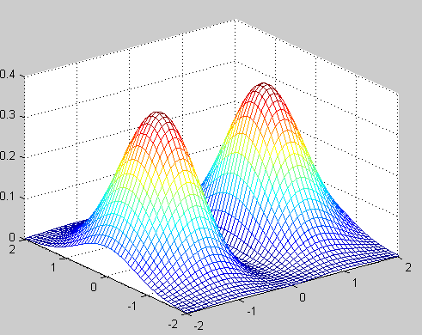
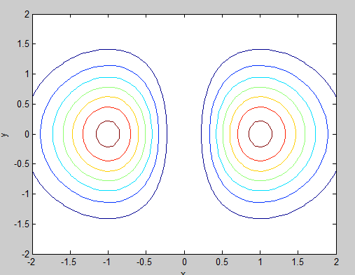
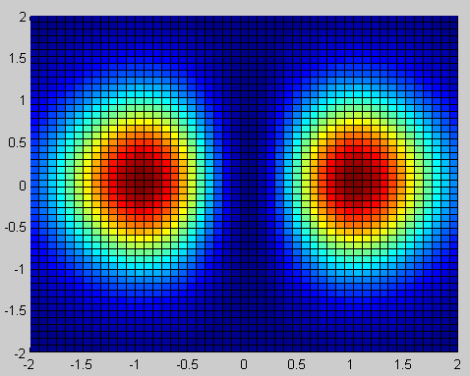
figure
mesh(X,Y,Z);
figure
contour(X,Y,Z)
Figure
pcolor(X,Y,Z)
xlabel('x')
ylabel('y')
zlabel('z')

Slide 8
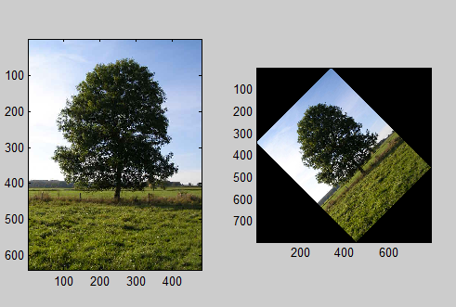
Images: Dimensions, rotating, flipping, mixing with surface [nrows,ncol,ncolors)=imread('photo.jpg')
clc
clear all
a=imread('photo.jpg');% size(a) is 640x480x3
b=imrotate(a,45);
subplot(1,2,1);
subimage(a);
subplot(1,2,2);
subimage(b)
What happens if you replaced subimage by image?

Slide 9
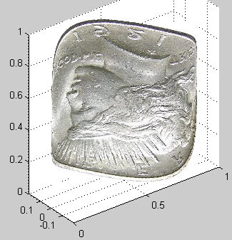
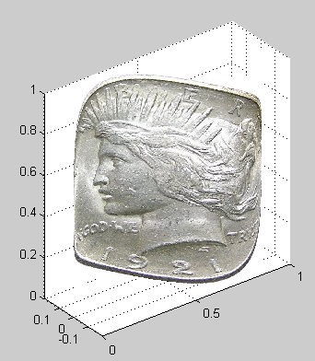
More properties: Flipud, 'FaceColor','texturemap','CData',dollarFront,...
'EdgeColor','none'
%% get image
dollarFront=imread('Peace_dollar.jpg' );
for k=1:3
dollarFront(:,:,k)=flipud(dollarFront(:,:,k));
end
%% plot surfac
surf(X,Y,Z,...
'FaceColor','texturemap','CData',dollarFront,...
'EdgeColor','none');
axis equal
% coinWavePlot
% place image on surface
%
%% set parameters
clear
N=100;
lambda=1;
%% make grid
y=linspace(0,1,N);
z=linspace(0,1,N);
[X,Z]=meshgrid(y,z);
Y=0.2*sin(2*pi*X/lambda);
axis([0, 1, -1, 1, 0, 1]);

Slide 10
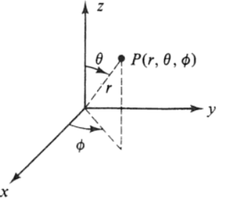
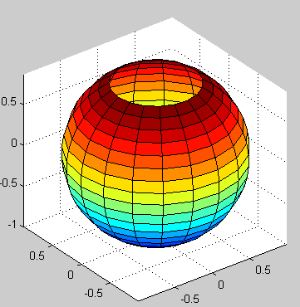
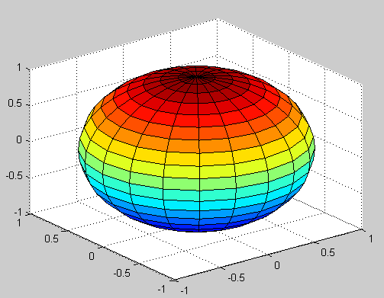
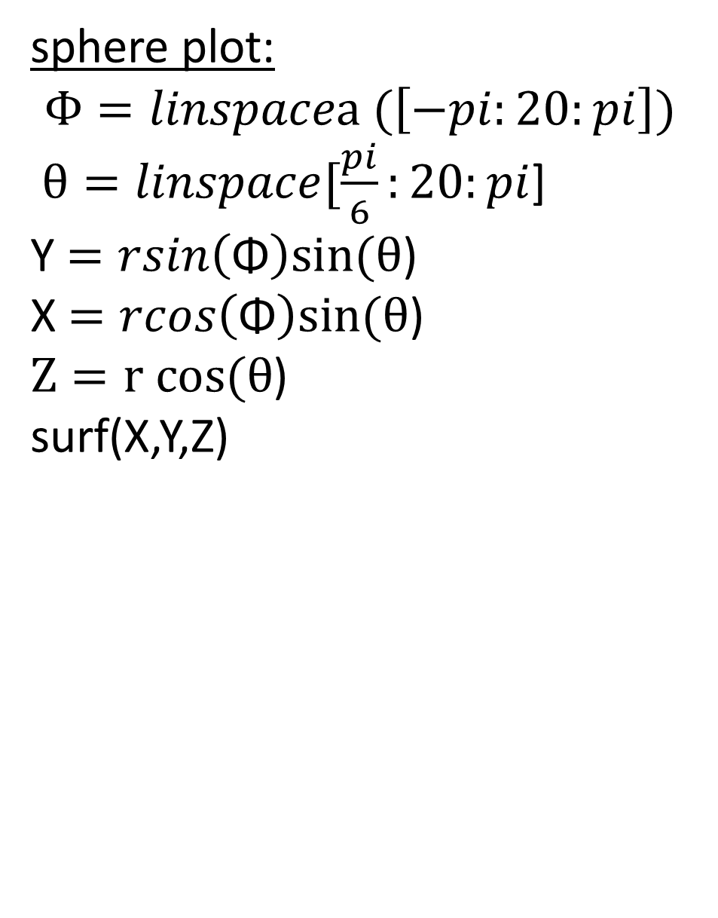
sphere plot:
$$Φ=linspacea (\left[−pi:20:pi\right])$$
$θ=linspace[\frac{pi}{6}:20:pi$]
Y $=rsin\left(\text{Φ}\right)sin⁡(θ$)
X $=rcos\left(\text{Φ}\right)sin⁡(θ$)
$Z=r cos⁡(θ$)
surf(X,Y,Z)
[x,y,z]=sphere(20);
surf(x,y,z)

Slide 11
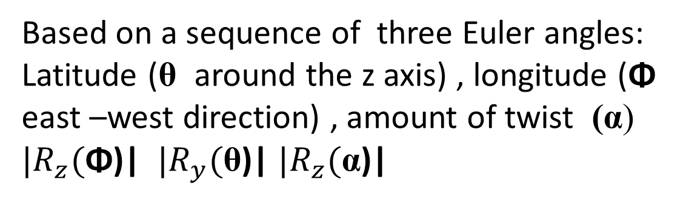
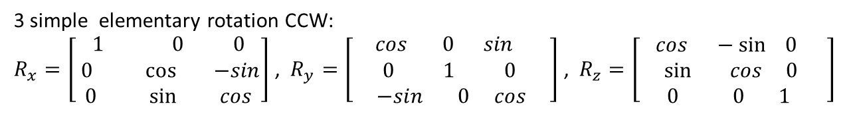
3D- Rotation Matrix with respect to the Coordination Axes
Z
3 simple elementary rotation CCW:
$R_{x}=\left[\begin{aligned}1 0 0 \\ 0\cos{ −sin} \\ 0 \sin{ cos}\end{aligned}\right]$ , $R_{y}=\left[\begin{aligned}cos 0 sin \\ 0 1 0 \\ −sin 0 cos\end{aligned}\right]$ , $R_{z}=\left[\begin{aligned}cos −\sin{ 0} \\ \sin{ cos } 0 \\ 0 0 1 \end{aligned}\right]$
Y
x
Based on a sequence of three Euler angles: Latitude (θ around the z axis) , longitude (Φ east –west direction) , amount of twist (α)
${|R}_{z}($Φ)| ${|R}_{y}($θ)| ${|R}_{z}($α)|

Slide 12
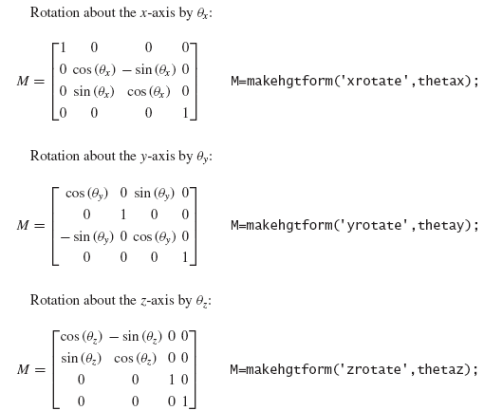
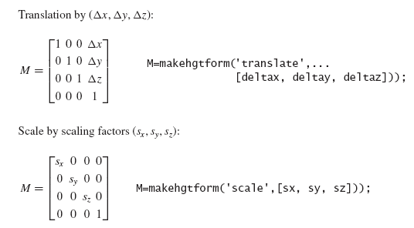
3D Rotation in Matlab
1- hgtransform: composite objects ( lines, sphere, cylinder, text) and create parent object.
2- set each object as a child to the created parent
3- Use the transformation matrix listed below

Slide 13
% rotateDumbbell
% Make hgtransform object and rotate it
% around object center which is displaced
% from the origin.
%
%% create two spheres connected by a line
[X,Y,Z]=sphere(12);
hs1=surf(X,Y,Z,'FaceColor',[0.8 0.8 0.8]);
hold on
hs2=surf(X+3,Y,Z,'FaceColor',[0.4 0.4 0.4]);
hold off
axis equal
hL=line([1 2],[0 0],[0 0],'LineWidth',7);
axis([-2 4 -2 4 -2 3]);
xlabel('x');ylabel('y');zlabel('z')
%% aggregate into Dumbbell object
hDumbbell=hgtransform('Parent',gca);
set(hs1,'Parent',hDumbbell);
set(hs2,'Parent',hDumbbell);
set(hL,'Parent',hDumbbell);
drawnow
Rotating dumbbell
%% rotate around center of dumbbell
% at r=(1.5, 0, 0)
Delta=[1.5, 0, 0];
Nth=60;
theta=linspace(0,0.2*10*pi,Nth);
v=1
for ith=1:Nth
Mt1=makehgtform('translate',-Delta);
M=makehgtform('yrotate',theta(ith));
%Mt2=makehgtform('scale',[.1, .1, .1]);
set(hDumbbell,'Matrix',Mt2*M*Mt1);
drawnow
% Mt2=makehgtform('scale',[v+0.01,v+0.01,v+0.01]);
% v=v+.01;
end

Slide 14
