Slide 1
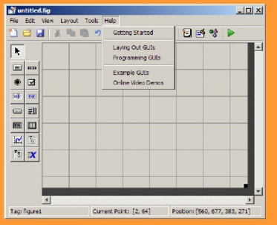
GUIDE (Graphical User Interface Development Environment)

Slide 2
GUIDE (Graphical User Interface Development Environment)
GUIDE is primarily a set of layout tools
GUIDE also generates an M-file that contains code to handle the initialization and launching of the GUI
This M-file also provides a framework for the implementation of the callbacks - the functions that execute when users activate a component in the GUI.

Slide 3
GUI control objects
Push Buttons
Toggle Buttons
Check Boxes
Radio Buttons
Edit Text
Static Text
Sliders
Frames
List Boxes
Popup Menus

Slide 4
Callbacks
Routine that executes whenever you activate the uicontrol object
Define this routine as a string that is a valid MATLAB expression or the name of an M-file
The expression executes in the MATLAB workspace.

Slide 5
Handles
Handles allow Matlab to keep track of figures and graphic objects.
Within the main figure each of our objects (the slider and the text box) also have a handle. Child objects.

Slide 6
Properties, get() and set()
We can retrieve a copy of the values associated with a graphic object through its handle by using S=get(handles.property)
We can output a copy of the values associated with a graphic object using set as:
set(handle.Property,Value)

Slide 7
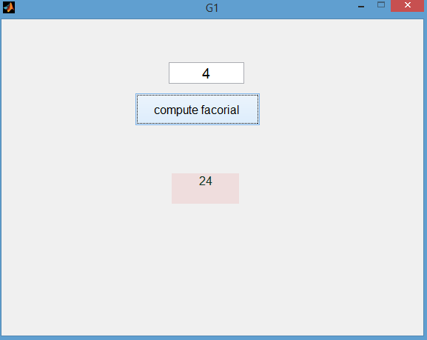
Edit Text, static test, push button
function factorial_Callback(hObject, eventdata, handles)
n=str2num(get(handles.number,'String'));
f=1;
for i=1:n
f=f*i;
end
ff=num2str(f);
set(handles.fact, 'String',ff);

Slide 8
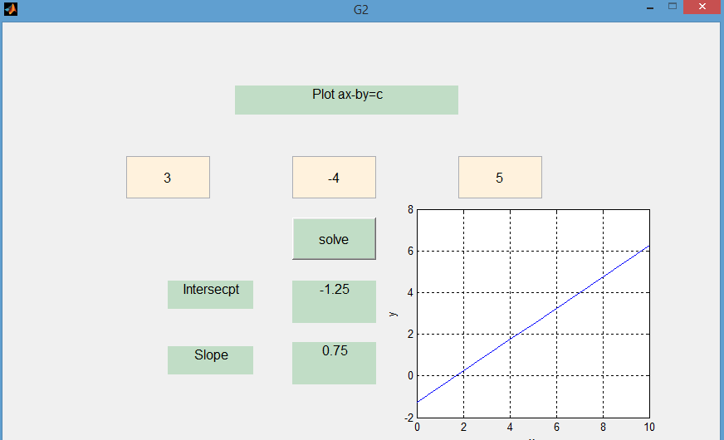
Plot “ax-by=c” Edit text, static test, push button, axes
function solve_Callback(hObject, eventdata, handles)
a1=str2num(get(handles.a,'String'));
b1=str2num(get(handles.b,'String'));
c1=str2num(get(handles.c,'String'));
yint=num2str(c1/b1);
m1=num2str(-a1/b1);
set(handles.yintercept,'String',yint);
set(handles.m,'String',m1);
x=0:10;
y=c1/b1-a1/b1*x;
plot(handles.axes1,x,y);
grid on;
xlabel('x');
ylabel('y');

Slide 9
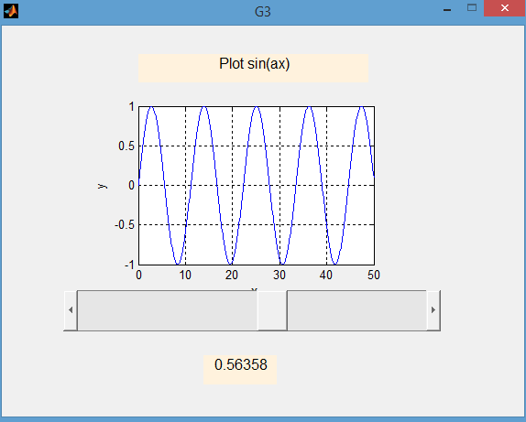
Plot sin(Ax) slider, static test, axes,
a=get(handles.slider1,'Value');
x=0:.1:50;
y=sin(x*a);
plot(handles.axes1,x,y);
xlabel('x');
ylabel('y');
grid on;
set(handles.text1,'String', num2str(a));

Slide 10
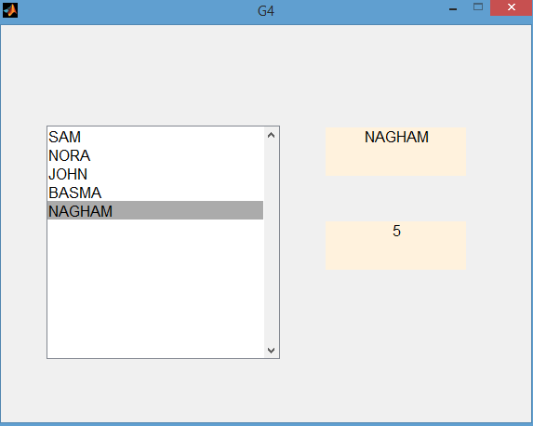
G4- Select a name list box, static test
function listbox2_Callback(hObject, eventdata, handles)
listValue=get(handles.listbox2,'Value');
listString=get(handles.listbox2,'String');
set(handles.text1,'String',listString(listValue));
set(handles.text2,'String',num2str(listValue));

Slide 11
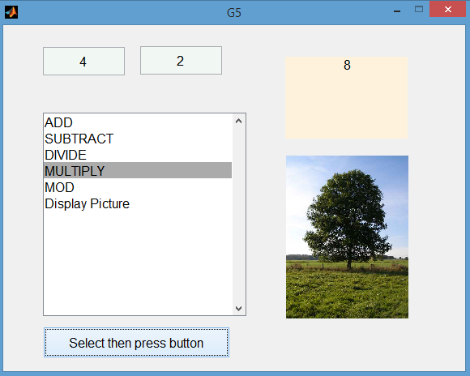
G5- List Box, static text, push button, imshow,imread

Slide 12
function pushbutton1_Callback(hObject, eventdata, handles)
cont=(get(handles.listbox2,'Value'));
a1=str2num(get(handles.a,'String'));
b1=str2num(get(handles.b,'String'));
switch cont
case 1
c=a1+b1;
set(handles.text3,'String',num2str(c));
case 2
c=a1-b1;
set(handles.text3,'String',num2str(c));
case 3
c=a1/ b1;
set(handles.text3,'String',num2str(c));
case 4
c=a1*b1;
set(handles.text3,'String',num2str(c));
case 5
c=mod(a1,b1);
set(handles.text3, 'String',num2str(c));
case 6
pp=imread('aa.jpg');
imshow(pp);
end

Slide 13
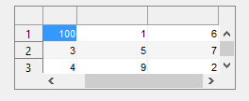
pp7- Table
- >> a=magic (3)
Modify the data properties to
Editable
Retrieve the data by this step I the UIT callback
data1=get(hObject,'data')
display(sum(data1))

Slide 14
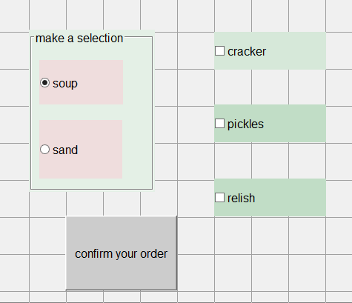
G7 - Panal buttons, radio button, check box, push button
function pushbutton1_Callback(hObject, eventdata, handles)
bla=get(handles.panlsos,'SelectedObject')
aa=get(bla,'String')
pick=get(handles.chkpickles,'Value')
rel=get(handles.chkrelish,'Value')
crack=get(handles.crack,'Value')
function panlsos_SelectionChangeFcn(hObject, eventdata, handles)
bla=get(handles.panlsos,'SelectedObject')
aa=get(bla,'String')
switch aa
case 'sand'
msgbox('check relish')
set(handles.crack,'Enable','off')
set(handles.crack,'Value',1)
set(handles.chkrelish,'Enable','on')
set(handles.chkrelish,'Value',1)
case'soup'
msgbox('check cracker')
set(handles.chkrelish,'Enable','off')
set(handles.chkrelish,'Value',0)
set(handles.crack,'Enable','on')
set(handles.crack,'Value',1)
end

Slide 15
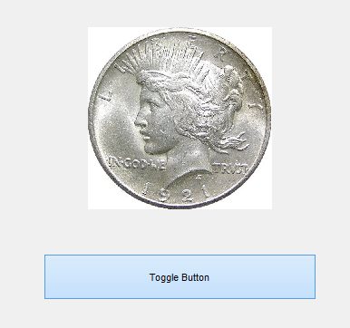
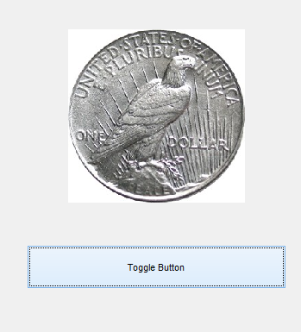
Toggle button
G8
function togglebutton1_Callback(hObject, eventdata, handles)
a=get(hObject,'Value');
if a==1
b=imread('peace_dollar.jpg');
imshow(b);
else
b=imread('peace_dollar_reverse.jpg');
imshow(b);
end

Slide 16
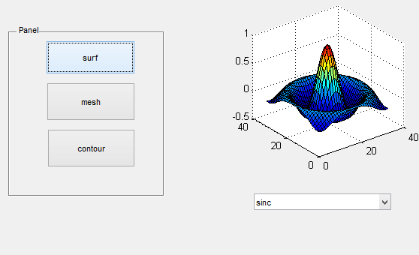
G10 Pop-up menu, push panel, check box, axes
function G10_OpeningFcn(hObject, eventdata, handles, varargin)
handles.peaks=peaks(35)%
handles.membrane=membrane;
[x,y]=meshgrid(-8:0.5:8);
r=sqrt(x.^2+y.^2)+eps;
sinc=sin(r)./r;
handles.sinc=sinc;
handles.current_data=handles.peaks;
surf(handles.current_data);
function popupmenu1_Callback(hObject, eventdata, handles)
val=get(hObject,'Value')
str=get(hObject,'String')
switch str{val}
case 'peaks'
handles.current_data=handles.peaks
case 'membrane'
handles.current_data=handles.membrane
case 'sinc'
handles.current_data=handles.sinc
end
guidata(hObject, handles);
function surf_Callback(hObject, eventdata, handles)
surf(handles.current_data)
function mesh_Callback(hObject, eventdata, handles)
mesh(handles.current_data)
function contour_Callback(hObject, eventdata, handles)
contour(handles.current_data)

Slide 17
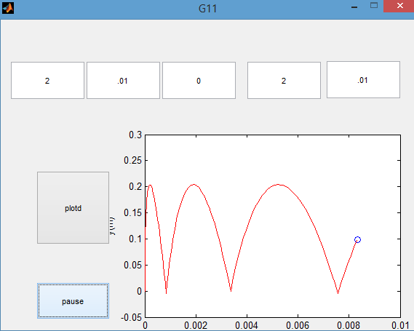
G11-Animation 2D with constant acceleration in GUI
function plotd_Callback(hObject, eventdata, handles)
Tf=str2num(get(handles.time,'String'));
deltat=str2num(get(handles.delta,'String'));
vx01=str2num(get(handles.vx0,'String'));
vy01=str2num(get(handles.vy0,'String'));
ax1=str2num(get(handles.ax,'String'));
x01=0;y01=0;g=9.81; Nt=1000;ay=-g;
t=linspace(0,Tf,Nt);
x=zeros(1,Nt);
y=zeros(1,Nt);
x=zeros(1,Nt);
vy=zeros(1,Nt);
x(1)=x01; y(1)=y01;
vx(1)=vx01; vy(1)=vy01;
% calculate the motion equation
for it=1:Nt-1
vx(it+1)=vx(it)+ax1*deltat;
vy(it+1)=vy(it)+ay*deltat;
x(it+1)=x(it)+0.5*(vx(it+1)+vx(it))*deltat;
y(it+1)=y(it)+0.5*(vy(it+1)+vy(it))*deltat;
if y(it+1)<0
vy(it+1)=abs(vy(it+1));
end
end
function pause_Callback(hObject, eventdata, handles)
v=get(handles.pause,'Value')
if v==1
pause(2)
end
% plot motion
xmax=max(x);
xmin=min(x);
ymax=max(y);
ymin=min(y);
axis([xmin 1 ymin ymax]);
for it=1:Nt
plot(handles.axes1,x(it),y(it),'bo',...
x(1:it),y(1:it),'r');
xlabel('x(m)');ylabel('y(m)');
pause(.01)
drawnow
end

Slide 18
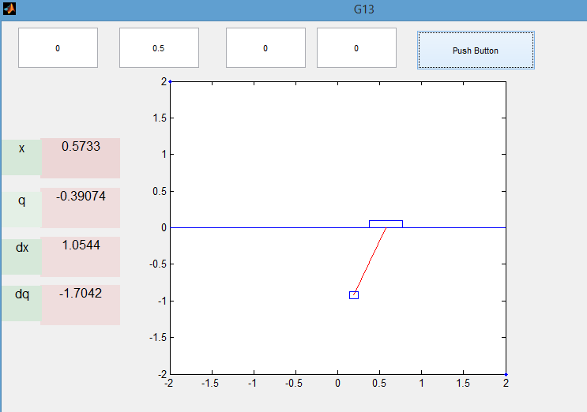
Dynamic motion for A I Kg mass swings from a gantry which weight 2 Kg.

Slide 19
Dynamic motion for A I Kg mass swings from a gantry which weight 2 Kg.
function pushbutton1_Callback(hObject, eventdata, handles)
n1=str2num(get(handles.xx,'String'))
n2=str2num(get(handles.qq,'String'))
n3=str2num(get(handles.dx,'String'))
n4=str2num(get(handles.dq,'String'))
dt =0.01;
X=[n1;n2;n3;n4];
for i=1:1000
dX=CartDynamics(X);
X=CartI(X,dX,dt);
% display position(x); angel(q); velocity(dx) ;angular velocity(dq)
set(handles.text1,'String',num2str(X(1)));
set(handles.text2,'String',num2str(X(2)));
set(handles.text3,'String',num2str(X(3)));
set(handles.text4,'String',num2str(X(4)));
% CartDisplay1(X);
x=X(1);q=X(2);
hold off
plot(handles.axes1,[-2 2],[2 -2],'.')
hold on
plot(handles.axes1,[-2 2],[0 0],'-')
% Draw the box
x1=x; y1=0;
plot(handles.axes1,[x1-0.2, x1+0.2,x1+0.2,x1-0.2,x1-0.2], [0,0,0.1,0.1,0],'-');
%Draw Pendulum
x2=x1+sin(q);y2=y1-cos(q);
plot(handles.axes1,[x1,x2],[y1,y2],'r-');
plot(handles.axes1,[x2-0.05,x2+.05,x2+.05,x2-.05,x2-.05],[y2-0.05,y2-0.05,y2+0.05,y2+0.05,y2-0.05],'-');
pause(0.1);
end

