Slide 1
Basic plotting
Express relationship between two vectors with plot.
plot(<vector of x-value>, < vector of y-value>,
<style option string>, <‘'lineWidth', number>)
Style option string is Control line type, data markers and colors
Control axes limits with axis command.
axis([xmin, xmax, ymin, ymax])
Label axes with xlabel(‘text’), ylabel(‘text’), title(‘text’)
Example: 2D Plotting having real numerical data
V1=[1,3,4,6,5,2], V2=[1,2,2,3,4,2]
plot(v1,v2,’-o’)
axis([0 7 0 5])

Slide 2
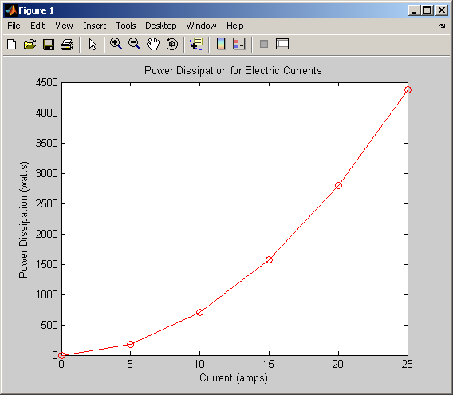
Example: 2D Plotting having real numerical data
Current (amperes) | 0 | 5 | 10 | 15 | 20 | 25
Power Dissipation (watts) | 0 | 175 | 700 | 1575 | 2800 | 4375
% PlotCurrent.m
% Plots Current vs Power Dissipation
% Author: Felix
%----------------------------------------------------
%% set parameters
Current = 0:5:25; % amps
PowerDis = [0 175 700 1575 2800 4375];
%------------------------------------------------------
%% plot data
plot(Current, PowerDis, '-ro')
title('Power Dissipation for Electric Currents')
xlabel('Current (amps)')
ylabel('Power Dissipation (watts)')

Slide 3
LINE SPECIFIERS IN THE plot() COMMAND
plot(x,y,‘line specifiers’)
Line Specifier Line Specifier Marker Specifier
Style Color Type
Solid - red r plus sign +
dotted : green g circle o
dashed -- blue b asterisk *
dash-dot -. Cyan c point .
magenta m square s
yellow y diamond d
black k hexagram h
pentagram p
triangle (left) >

Slide 4
Examples:
plot(x,y) A solid blue line connects the points with no markers.
plot(x,y,’r’) A solid red line connects the points with no markers.
plot(x,y,’--y’) A yellow dashed line connects the points.
plot(x,y,’*’) The points are marked with * (no line between the
points.)
plot(x,y,’g:d’) A green dotted line connects the points which are
marked with diamond markers.
Example: Plot the following points in the table below using the line specifier
(dashed red line and asterisk markers)
Year
1988
1989
1990
1991
1992
1993
1994
Sales (M)
127
130
136
145
158
178
211

Slide 5
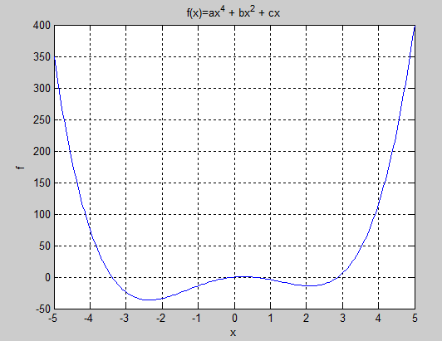
Example: 2D Plotting using mathmatical function
%% plotquad.m
% plot the quadratic function
% f=ax^4 +bx^2 + cx
% Author: L. Luthor
%---------------------------------------------------------------
%% set parameters
xmin=-5;
xmax=5;
Nx=200;
a=1;
b=-10;
c=+5;
%--------------------------------------------------------------
%% tabulate function
x=linspace(xmin, xmax, Nx);
f=a*x.^4 + b*x.^2 +c*x;
%----------------------------------------------------------------
%% plot function
plot(x,f);
xlabel('x');
ylabel('f');
title('f(x)=ax^4 + bx^2 + cx')
grid on

Slide 6
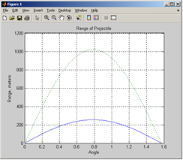
Plotting Functions
Given a function: 1) create a data vector for the independent variable (linspace, square bracket, colon operator) 2) use the function to obtain a data vector for the dependent variable (pay attention to when dot operator is needed) 3) generate the plot, include labeling , in general no markers should be present.
Ex) Projectile Problem Range given by: plot over [0, π/2] for v₀ = 50 m/s, then 100 m/s
% PlotProjectile.m
% A plot of two projectile paths
% Author: Kitty
%-------------------------------------------------------
%% Set parameters
thetaMin = o;
thetaMax = pi/2;
g = 9.81; % m/s^2
Vo1 = 50; % m/s
Vo2 = 100; % m/s
%-----------------------------------------------------
%% tabulate functions
theta = linspace(thetaMin,thetaMax);
R1 = Vo1^2/g*sin(2*theta); % m
R2 = Vo2^2/g*sin(2*theta); % m
%------------------------------------------------------
%% do the plots
plot(theta,R1,theta, R2,':')
title('Range of Projectile')
xlabel('Angle'),ylabel('Range, meters'), grid on

Slide 7
Overlay Plots
Overlay – overlay plots are for plotting families of curves
% OverlayPlotExample.m
% plots 4 sin functions with different periods
% and same amplitude in one plot window
% Author: Cosign
%--------------------------------------------------------
%% set parameters
xmin = 0;
xmax = 2*pi;
nx = 100;
a = 1:4;
%-------------------------------------------------------
%% define functions
x = linspace(xmin,xmax,nx);
% Four functions of the form y = sin(ax)
y1 = sin(a(1)*x);
y2 = sin(a(2)*x);
y3 = sin(a(3)*x);
y4 = sin(a(4)*x);
%-------------------------------------------------------
%% plot the functions
figure, hold on, grid on
plot(x,y1,'r','LineWidth',2) % a = 1
plot(x,y2,'c','LineWidth',2) % a = 2
plot(x,y3,'g','LineWidth',2) % a = 3
plot(x,y4,'b','LineWidth',2) % a = 4
legend(' a = 1', 'a = 2', 'a = 3', 'a = 4')
title(' y = sin(a*x)')
xlabel('x(radians)'), ylabel('sin(ax)')

Slide 8
Individual Exercise
[X,Y] = meshgrid(xgv,ygv) replicates the grid vectors xgv and ygv to produce a full grid. This grid is represented by the output coordinate arrays X and Y. The output coordinate arrays X and Ycontain copies of the grid vectors xgv and ygv respectively. The sizes of the output arrays are determined by the length of the grid vectors. For grid vectors xgv and ygv of length M and Nrespectively, X and Y will have N rows and M columns.
Create two curves on the same graph:
F = 1/(1+x^2)
G = exp(x^3)
Plot the points at 33 points equally spaced between 0 and 1
Use black *’s for F and green o’s for G
Label the horizontal and vertical axes
Create a title (including your name)
Create a legend
Make sure the font’s are readable (also figure out how to change the axis fonts)

Slide 9
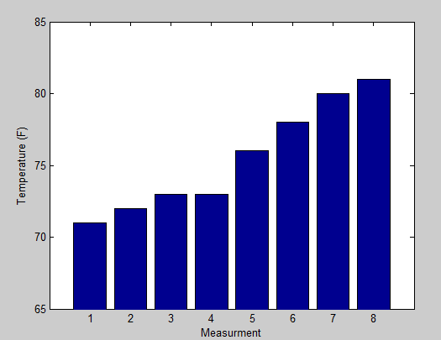
Bar graphs and histograms
bar(y): creates a bar graph with one bar for each element in y
bar (x,y) : draws the bars at the locations specified by x.
% % bar_vector.m
% bar program% set data
% programmer name
%%set data
temp=[71, 80,73,72,78, 81, 73,76];
sort_temp=sort(temp);
Tmin=65;
Tmax=85;
%% plot bar
bar(sort_temp);
xlabel(‘Measurment’)
ylabel(‘Temperature (F)’)
axis([0,length(temp)+1,Tmin,Tmax])

Slide 10
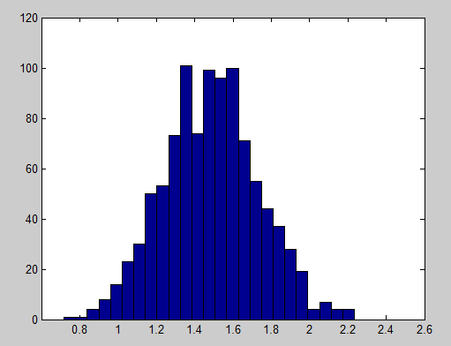
Histogram
%% randn generate Normally distributed pseudorandom numbers
Ndata=1000
q0= 1.5;
sigmaq=0.25;
qmin=0.0;
qmax=2.5;
nbins=25;
%%generate data
qdata=q0+sigmaq*randn(1,Ndata);
%% plot histogram
hist(qdata, nbins);
xlabel(‘value of q’)
ylabel(‘Number of data points in bins’)
axis([qmin,qmax,0,inf]);
Notation when x is normally distributed with mean μ and standard deviation σ :

Slide 11
Ndata=1000
q0= 1.5;
Sigmaq=0.25;
qmin=0.0;
qmax=2.5;
nbins=25;
%%generate data
qdata=q0+sigmaq*randn(1,Ndata);
%% plot histogram
[nq qs]= hist(qdata, nbins);
bar(qs,nq)
xlabel(‘value of q’)
ylabel(‘Number of data points in bins’)
axis([qmin,qmax,0,inf]);
%% plot normal distributed function
Nq=200
qa=linspace(qmin,qmax,Nq);
pq=max(nq)*exp(-(qa-q0).^2/(2*sigmaq^2));
hold on ;
plot(qa,pq,’k’,’LineWidth’,2)
The coef.: max number of data points in bin

Slide 12
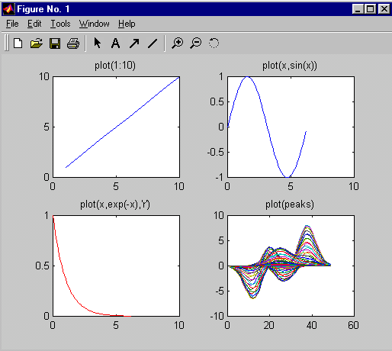
Subplots
SUBPLOT- display multiple axes in the same figure window
subplot(#rows, #cols, index)
subplot(2,2,1);
plot(1:10)
subplot(2,2,2)
x = 0:.1:2*pi;
plot(x,sin(x))
subplot(2,2,3)
x = 0:.1:2*pi;
plot(x,exp(-x),’r’)
subplot(2,2,4)
plot(peaks)
Notes:
You can display multiple plots in the same window with the SUBPLOT command:
» subplot(m, n, p)
The above call to SUBPLOT will divide the current Figure window into an m-by-n matrix of small subplots. The p'th subplot will be the current plot. The plots are numbered along first the top row of the Figure window, then the second row, and so on. For example, the following statement will display an Axes in the upper left hand corner of the Figure window:
» subplot(2,2,1)
And the following statement, will display an Axes in the lower left hand corner of the Figure window:
» subplot(2,2,3)

Slide 13
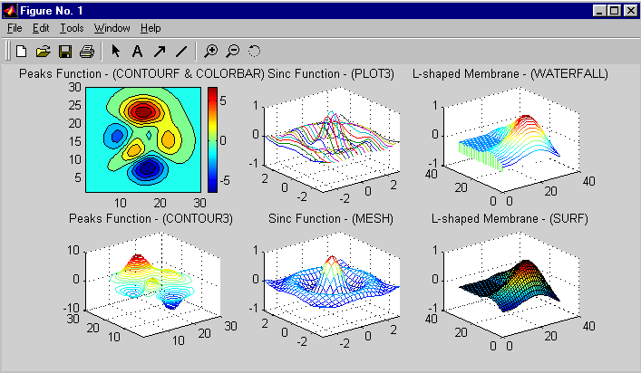
3-D Surface Plotting
Notes:
MATLAB provides a variety of functions for representing 3-D surface data. The following list summarizes these functions:
CONTOUR - creates a 2-D representation of 3-D surface data. The third dimension is represented by the contour lines (join points of equal height) and colormap.
CONTOUR3 - creates a 3-D version of the contour plot.
PLOT3 - plots 3-D lines representing the data contained in the columns of the input matrices. Each line is given a different color.
MESH - creates 3-D perspective plots of matrix elements, displayed as height above a reference plane. It generates a colored, wire-framed view of the surface.
WATERFALL - plots 3-D lines representing the data contained in the rows of the input matrices. Each line is joined to the reference plane creating a “curtain plot”.
SURF - creates 3-D perspective plots of matrix elements, displayed as height above an underlying plane. It generates a colored, faceted view of the surface.
NOTE:
To plot surfaces requires equal-sized 2-D matrices for each dimension (x-, y- and z-values for each point in the relevant portion of the x-y plane). If the z-value is a function of x and y, it is suggested to first create rectangular X and Y matrices which map out all of the points within the portion of the x-y plane to be used. To create these matrices, use:
MESHGRID - transforms the vector ranges (x & y) into matrices representing the specified portion of the x-y plane.
For further details, refer to the documentation and online help for each of these commands.

Slide 14
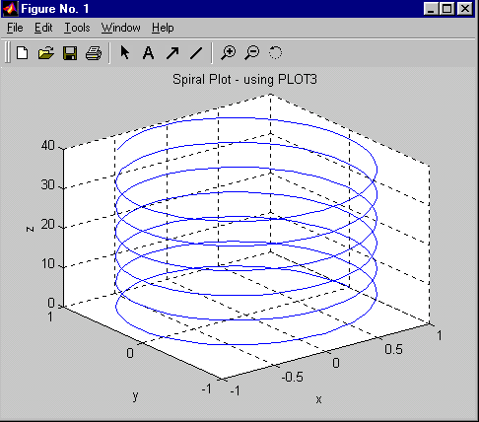
3-D Line Plotting
plot3(xdata, ydata, zdata)
» z = 0:0.1:40;
» x = cos(z);
» y = sin(z);
» plot3(x,y,z)
Notes:
PLOT3D can be used to create line plots of 3-D vectors. The syntax is similar to the PLOT command, with the addition of an input argument for the z-data (representing the height above the x-y plane). The the color, linestyle and marker type are specified in the same way as for the 2-D command.
UTILITY COMMANDS FOR 3-D PLOTTING:
ZLABEL - creates a label for the z-axis.
ROTATE3D - allows the user to rotate the plot to view from different angles
(Default angle: Azimuth: -38°, Elevation: 30°)
AXIS VIS3D - freezes aspect ratio properties to enable rotation of 3-D object.
ANOTHER INTERESTING COMMAND:
COMET3 - produces a comet-like trajectory of 3-D data points.

Slide 15
Exercise: 3-D Plotting
Data from a water jet experiment suggests the following non-linear model for the 2-D stress in the cantilever beam’s horizontal plane.
where: σ = localized planar stress [Pa]
x = distance from end of beam [10⁻¹m]
y = distance from centerline of beam [10⁻¹m]
For the particular setup used:
(x = {0 to 6}, y = {-3 to 3}, α = θ = φ = 1, β = -0.2)
Plot the resulting stress distribution
σ = αe^{-βx}[sin(θx)*cos(φy)]
x

Slide 16
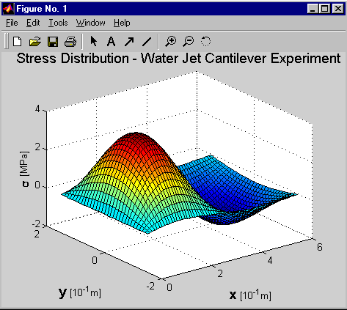
Solution: 3-D Plotting
B = -0.2;
x = 0:0.1:2*pi;
y = -pi/2:0.1:pi/2;
[x,y] = meshgrid(x,y);
z = exp(B*x).*sin(x).*cos(y);
surf(x,y,z)
[X,Y] = meshgrid(xgv,ygv) replicates the grid vectors xgv and ygv to produce a full grid. This grid is represented by the output coordinate arrays X and Y.

