Slide 1
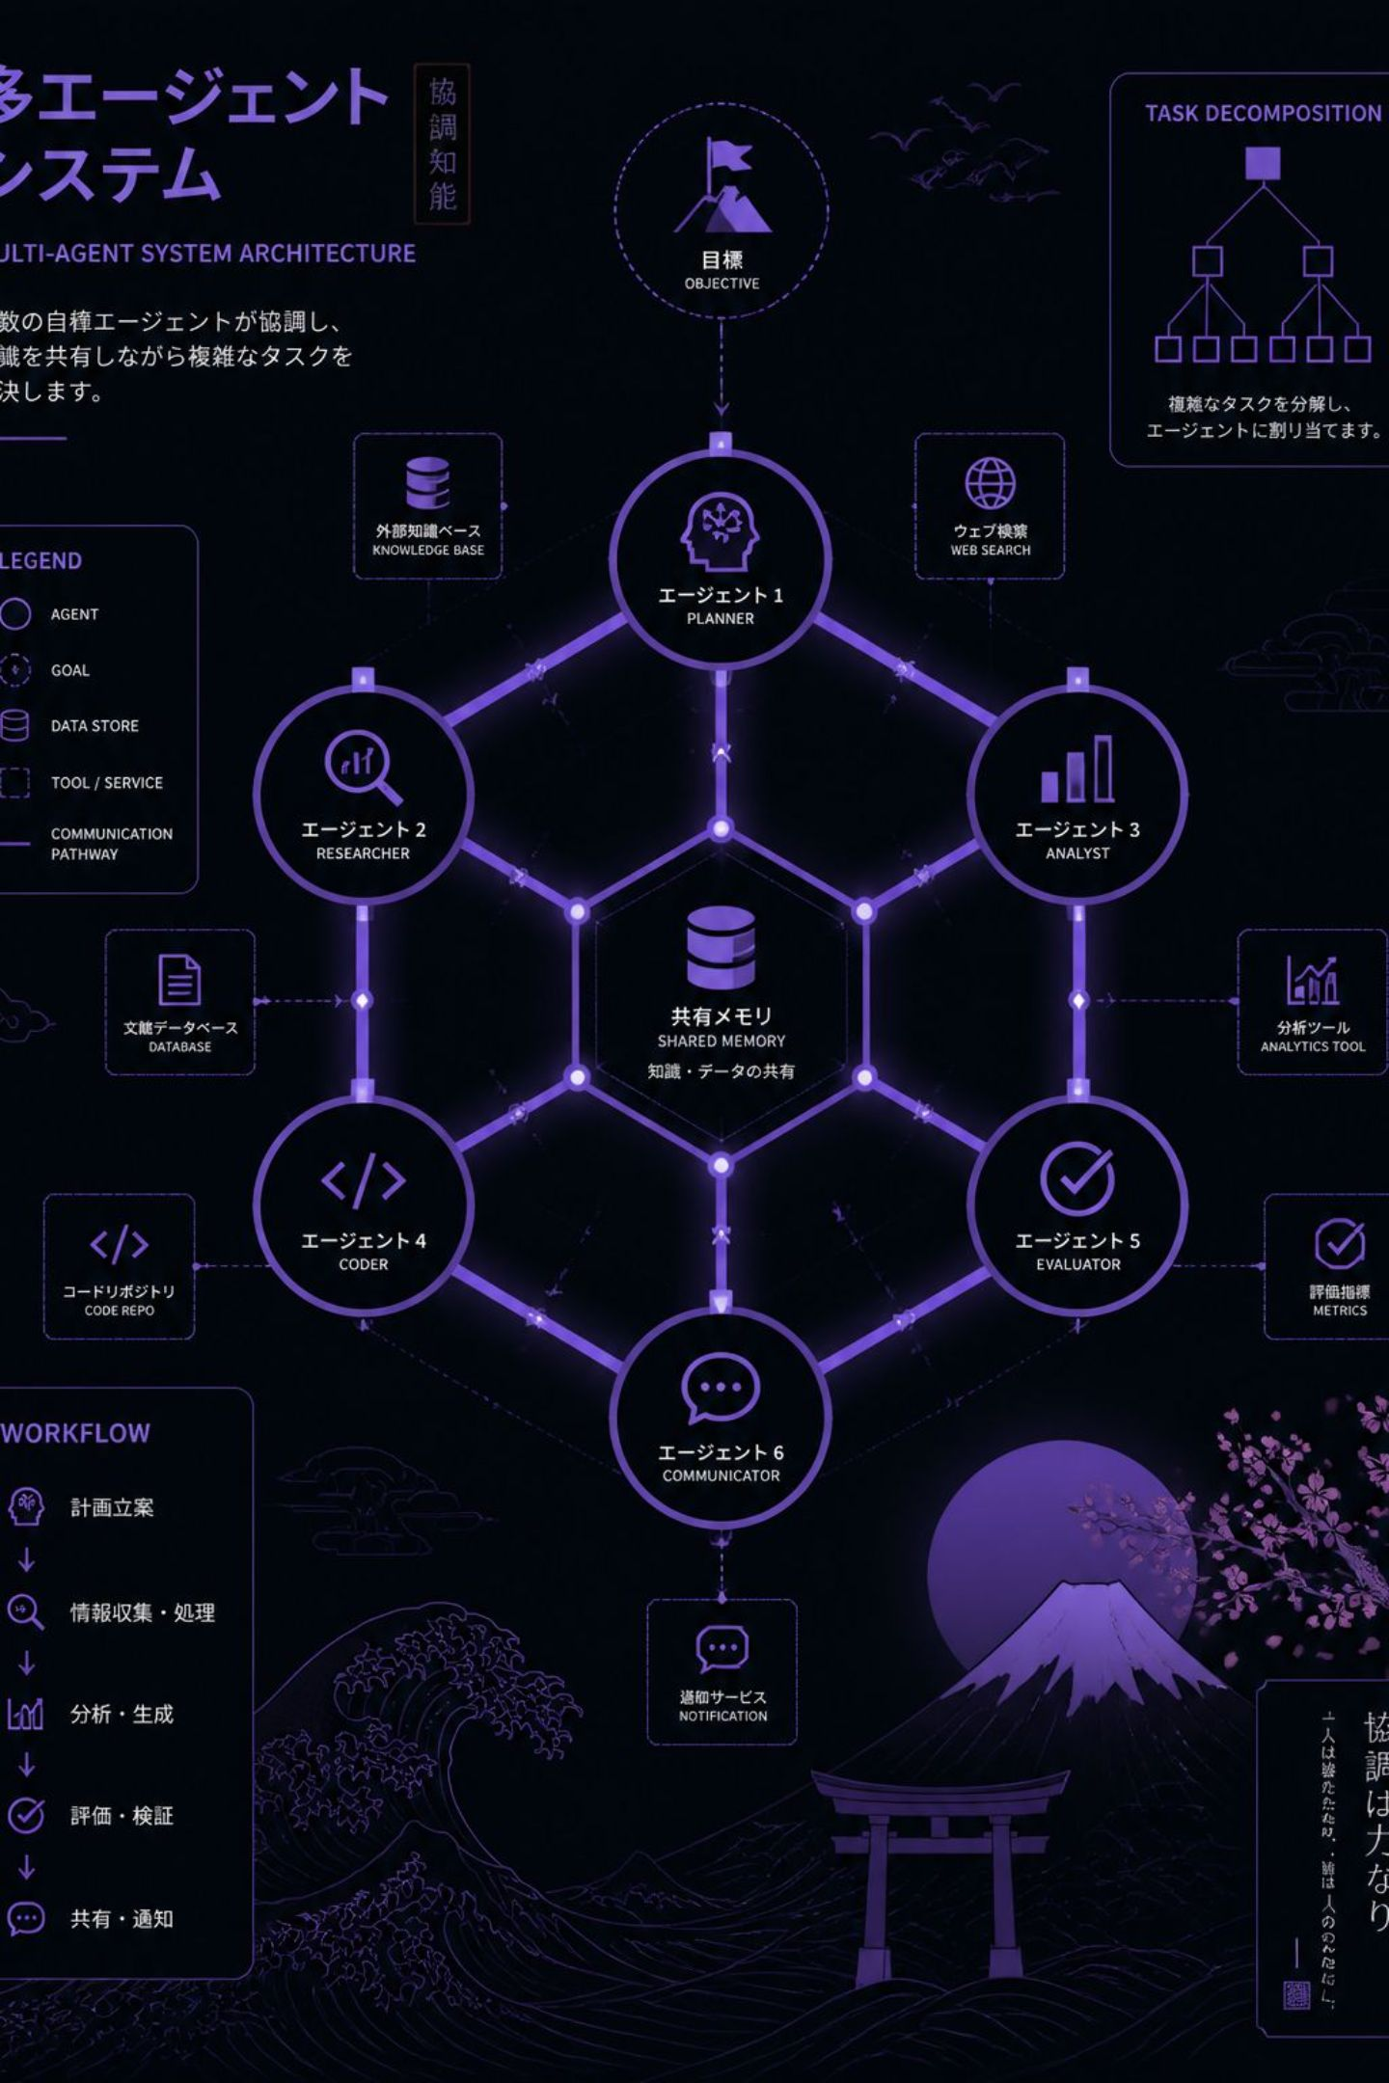
ENGINEERING MASTERCLASS 001
Career Intelligence Copilot
FR-016: Multi-Agent Orchestration
How authority boundaries — not role names — justify when to introduce multiple AI specialists. An engineering deep-dive for experienced software and AI engineers.

Slide 2
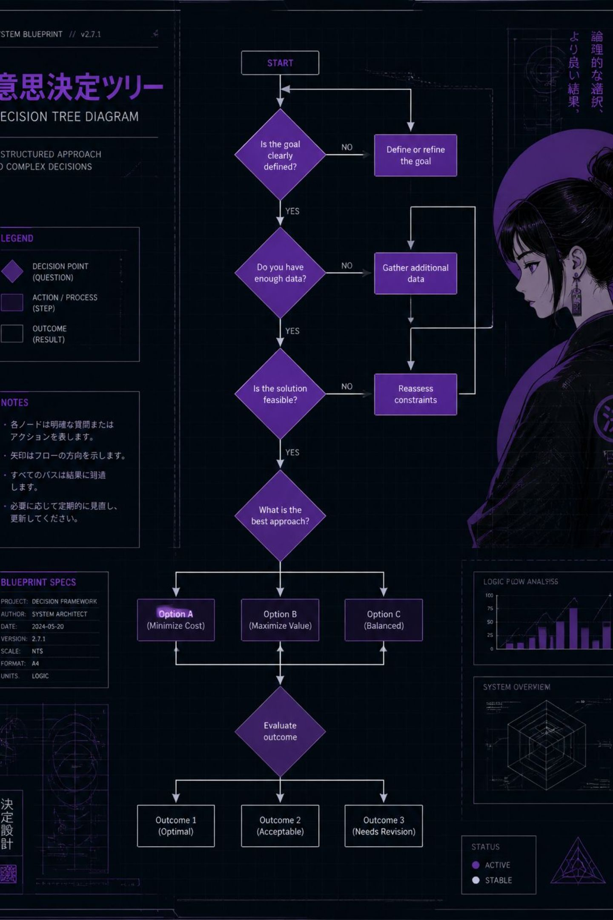
The Engineering Problem
FR-015 already solved everyday preparation. FR-016 asked a fundamentally different question:
When does adding a second specialist create real engineering value — and when does it just add complexity?
FR-015 Solved
Everyday preparation with a single bounded agent. Simple, direct, effective.
FR-016 Asked
When is multi-agent orchestration genuinely justified by engineering constraints, not just appealing in theory?

Slide 3
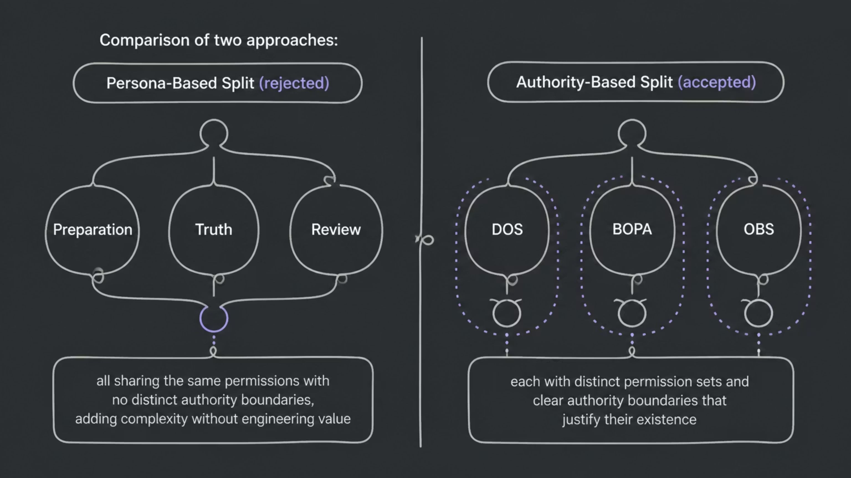
The Wrong Answer: "Multi-Agent Theatre"
The tempting design: split by persona — Preparation Agent, Truth Agent, Review Agent. It feels sophisticated. It adds nothing real.
Key insight: Role names are not authority boundaries. If every agent can do everything, you haven't added specialists — you've added indirection.

Slide 4

The Engineering Decision
The accepted solution separates three concerns, each justified by a distinct authority boundary — not a job title.
Identify Authority Boundaries
Validate Unique Permissions
Map distinct authority limits, not job roles.
Ensure each specialist has others' exclusive access.
Assign One Specialist
DOS coordinates, BOPA prepares, OBS briefs.
Coordination, bounded preparation, and read-only synthesis are three genuinely different engineering concerns. Each requires different permissions. That difference is what justifies three specialists.

Slide 5
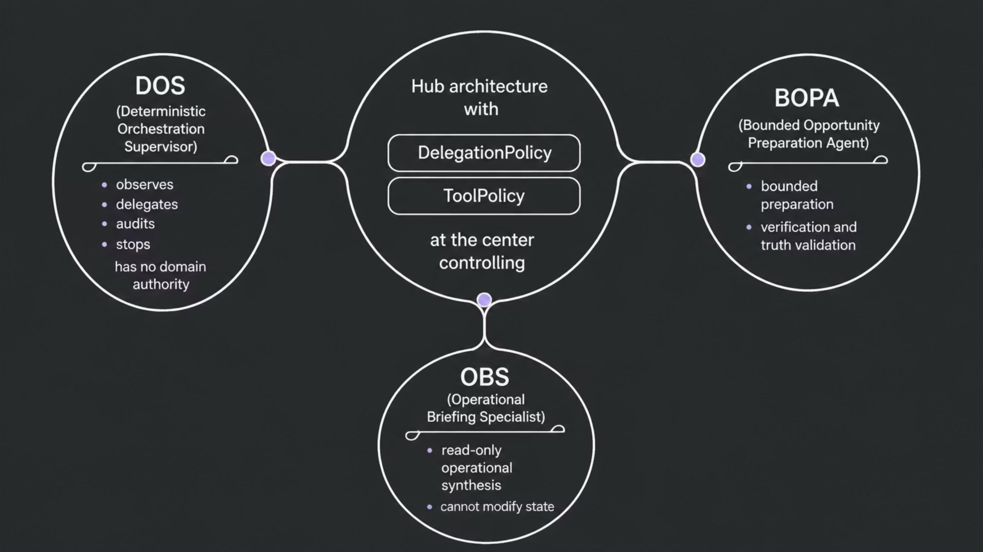
Final Architecture: DOS + BOPA + OBS
DOS
BOPA
OBS
Coordinates without inheriting permissions. Observes, delegates, audits, stops.
Bounded preparation, verification, and truth validation. The primary working agent.
Read-only operational synthesis. Independent analysis that cannot modify assessed state.

Slide 6
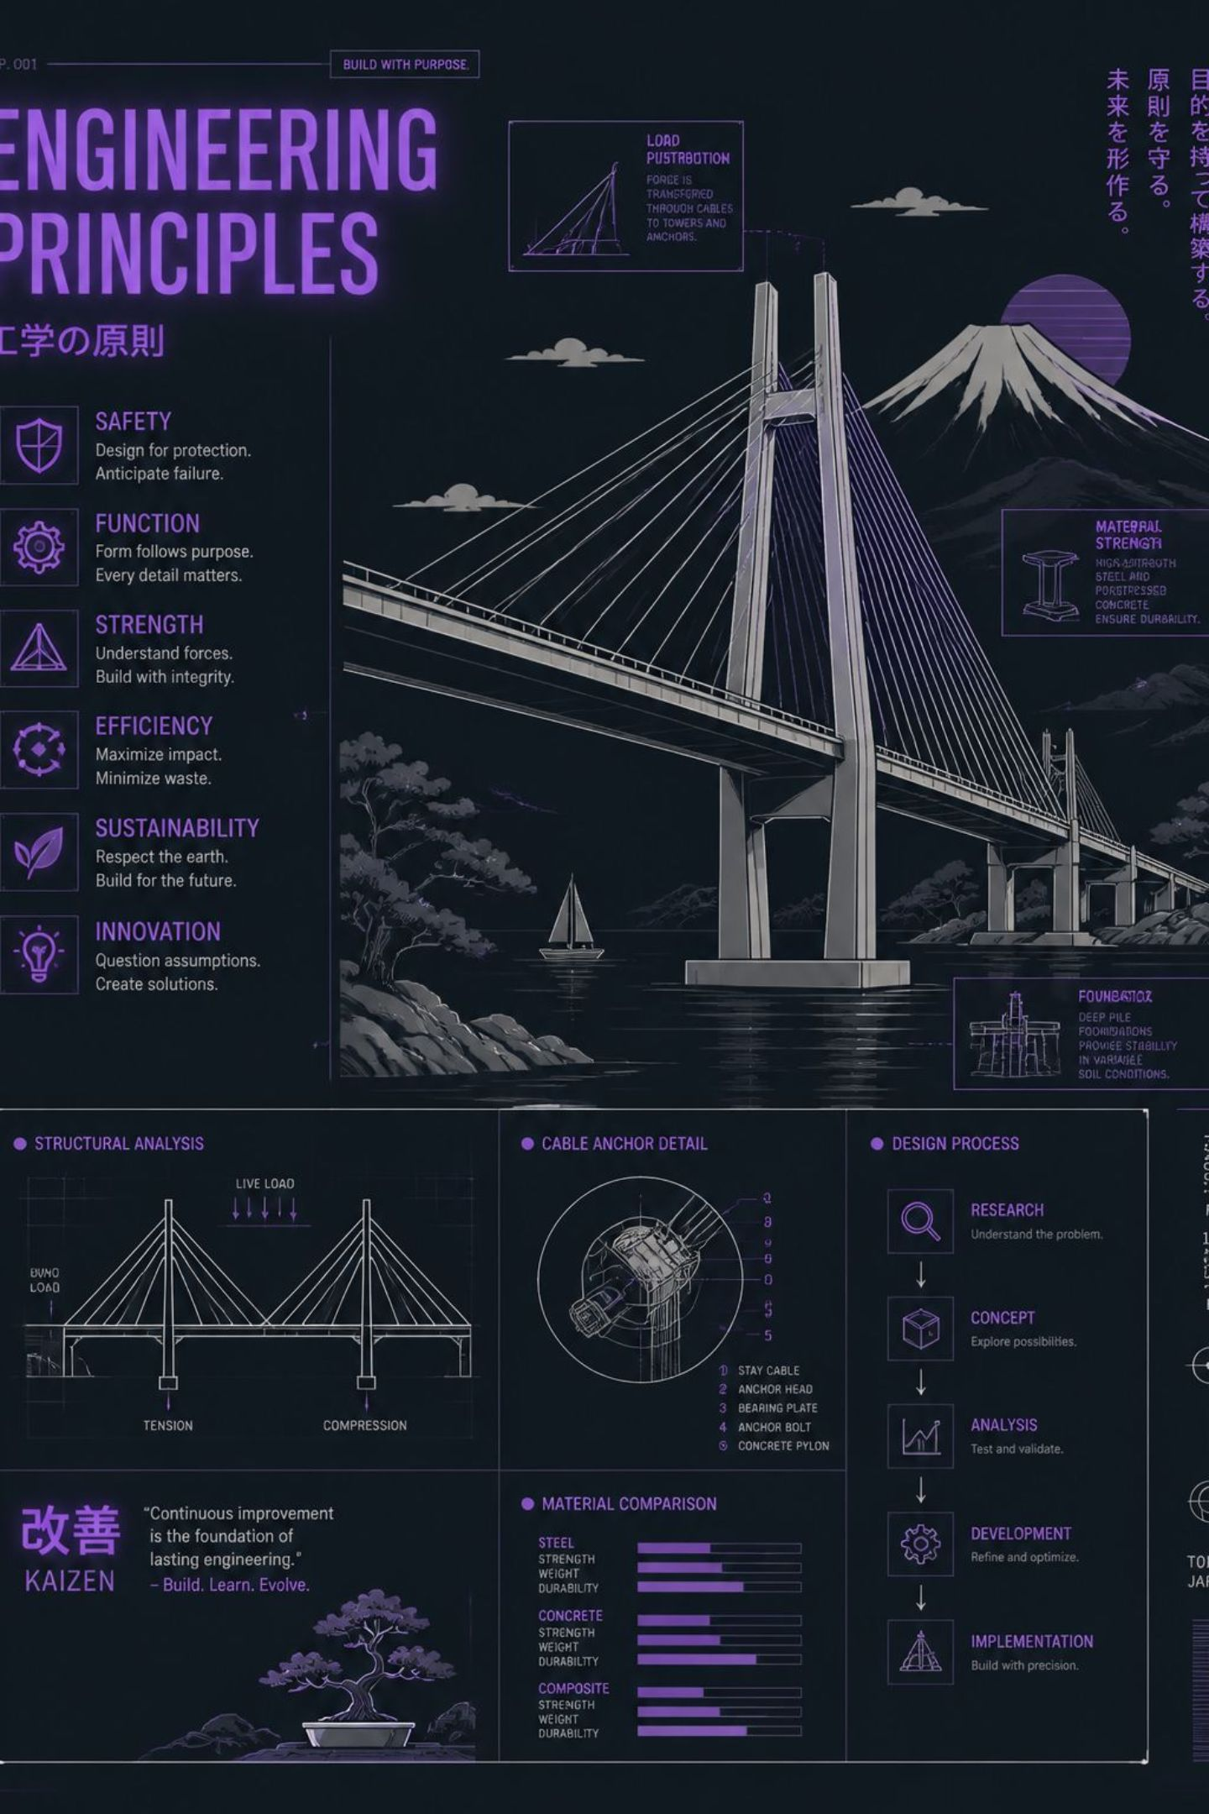

Key Engineering Principles
Authority boundaries justify specialists
Distinct permissions — not distinct responsibilities — are the engineering justification for introducing another agent.
Supervisors coordinate, not execute
A supervisor that inherits domain permissions collapses the boundary it was meant to enforce.
Typed handoffs beat conversational delegation
Structured state transfers are safer and more auditable than natural-language routing between agents.
Deterministic orchestration when routing is knowable
If the routing decision can be expressed from typed state, make it deterministic — not learned.

Slide 7

Trade-offs & Validation
What Was Validated
What Was Intentionally Limited
Safe deterministic orchestration
Permission isolation between specialists
Typed handoff safety
Read-only OBS independence
Commercial value was not the goal
Direct BOPA remains the preferred daily workflow
Orchestration is a validated foundation, not a product launch
Engineering outcome: Success. Product outcome: Intentionally limited. Technical success does not automatically justify product adoption.

Slide 8
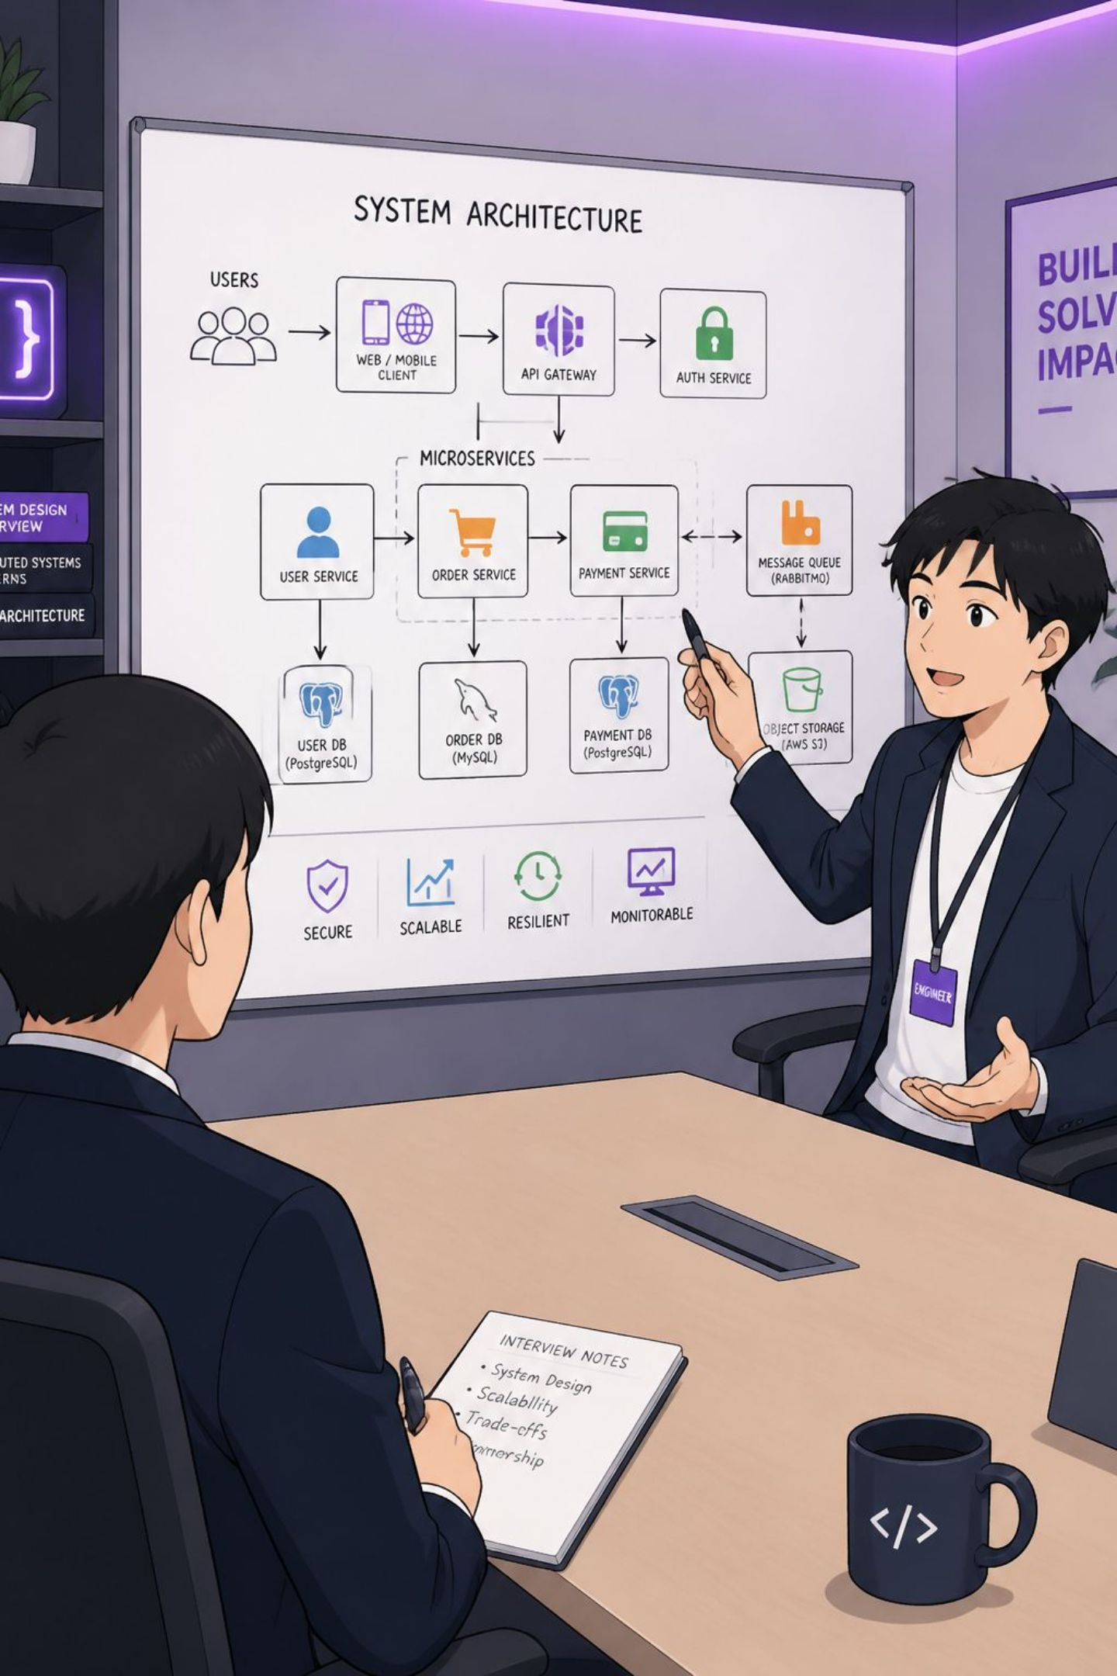



Why Employers Care About These Concepts
FR-016 demonstrates engineering judgment that goes beyond implementation skill. These are the signals interviewers are actually testing.
Authority Separation
Can you design systems where components have genuinely different permissions — not just different names?
Choosing Determinism
Do you reach for ML when a typed-state decision is sufficient? Knowing when not to use AI is a senior skill.
Complexity Discipline
Can you justify every layer of indirection? Simpler architectures remain preferable until complexity earns its place.

Slide 9
Interview Preparation
These are the four questions FR-016 prepares you to answer confidently.
1
Why introduce multiple agents?
2
Why is DOS deterministic?
To separate authority, not merely responsibilities. Authority boundaries are the engineering justification.
Routing was fully expressible from typed state. Determinism improves safety and repeatability over learned routing.
3
Why is OBS read-only?
4
Why wasn't orchestration made the default?
Independent analysis is stronger when it cannot modify the state being assessed. Write access corrupts objectivity.
Direct BOPA remained simpler for everyday preparation. Added complexity must earn its place.

Slide 10

Three Things To Remember
① Authority Boundaries
② Coordinate, Don't Execute
Specialists are justified by authority boundaries — distinct permissions — not by role names or responsibilities.
Supervisors coordinate rather than execute. A supervisor that inherits domain permissions collapses the boundary it enforces.
③ Simpler Is Preferable
Simpler architectures remain preferable until additional complexity earns its place. Technical success ≠ product adoption.
FR-016 Milestone: GO AS LEARNING PROOF ONLY — direct BOPA remains the preferred daily workflow while orchestration provides a validated architectural foundation.

