Slide 1

Engineering Masterclass 002
Career Intelligence Copilot — FR-017
Agent Evaluation & Observability
Derive-Only Metrics, Reconstructability, and Anti-Theatre Observability
ENGINEERING LEARNING ACADEMY
LEAN EDITION
STATUS: COMPLETE / FROZEN / ACCEPTED

Slide 2

Executive Summary
FR-017 answers a deceptively simple question: once a multi-agent orchestration layer has written honest audit records, how do you evaluate those records without inventing an observability product?
The accepted answer is a narrow derive-only evaluation substrate. Existing OrchestrationRun, Handoff, and child AgentRun artefacts are the only evidence. Pure functions derive metrics, correlate parent/child execution, and score reconstructability against twelve fixed questions (R1–R12).
The Core Posture
Low near-term product value
High learning and interview value
Nothing mutates the runtime
Nothing becomes a second system of record
Horizon 1B is not gated on this work
The engineering win: Honesty under uncertainty — especially the distinction between missing metadata and measured zero, and the refusal to repair contradictory audits.

Slide 3


The Engineering Problem
After FR-016, Career Intelligence Copilot had orchestration audits: parent runs, typed handoffs, stop reasons, child agent runs, and resume/idempotency keys. What it lacked was a first-class way to use those audits as evaluation evidence.
1
2
Reconstruct Authority
Offline Comparison
Can I reconstruct the authority story of a run without reading source code?
Can I compare runs offline, deterministically, without a live LLM?
3
4
Missing vs. Zero
Honest Gaps
When tokens or cost are absent, is that "zero usage" or "unknown"?
If a child id does not join cleanly to a handoff, do we invent linkage or surface the gap?
These are evidence, semantics, and source-of-truth problems — not "add Prometheus" or "build a Grafana board" problems.

Slide 4


Why Previous Approaches Were Insufficient
The Laundry-List Observability FR
Instrument the Runtime
Fork Child Metrics
Adding events until every chart is easy fails the derive-only gate. If evaluation requires new runtime events, you're evaluating a redesigned system — not the current one.
BOPA already had AgentRunMetrics with careful missing-vs-zero semantics. Re-implementing inside FR-017 creates two competing definitions of the same facts.
Traces, checkpoints, dashboards, richer telemetry — most already owned by FR-008, FR-014, FR-015, FR-016. Building the catalogue would have duplicated frozen work and delayed Horizon 1B for no acquisition gain.
Dashboards as Proof
Block Horizon 1B
A board plotting "latency = 0" for runs that never recorded latency converts absence into fake precision. Dashboards create the feeling of control — not reconstructability.
Coupling recruiter outreach to FR-017 inverts sequencing priorities. Evaluation substrate improves learning; it does not improve application throughput.

Slide 5
Ownership Matrix — What FR-017 Does Not Own
FR-017's scope is deliberately narrow. Understanding what it does not own is as important as understanding what it does.
Concern
Owner
FR-017 Role
Workflow traces
FR-008
None
Truth engine
FR-014
Cite status only
BOPA / AgentRun metrics
FR-015
Reuse
Orchestration audits
FR-016
Source records
Derive, correlate, evaluate, present
FR-017
Evaluation only
Crossing ownership boundaries creates twin definitions and silent drift. FR-017 evaluates — it does not become a system of record.

Slide 6

The Chosen Architecture
The architecture is deliberately boring. That is the point.
Handoff
Reconstruct
Collect run artefacts
Score R1–R12
Derivation
Read-only CLI
Compute metrics
Inspect results
No store writes. No supervisor start or resume. No specialist execution. No telemetry store. No new audit event kinds. No live tracing. No alerts. No pipeline mutation.

Slide 7

Runtime Example — Evaluation Flow
Score Reconstructability
Orchestration Audit
Derive Metrics
Owner Insight
Surface Gaps
What the module extracts
CLI surface
Per-run metrics: identity, goal, status, stop reason, limits
Handoff metrics: allow/deny, policy fields, lifecycle
Optional child roll-ups: provider, tokens, cost, latency (None when absent)
Parent/child correlation including orphans and join gaps
cic agent orchestrate metrics — one run
cic agent orchestrate metrics-corpus — offline suite summary
Presentation is subordinate to derivation. The CLI is an interview and debug surface, not a product dashboard.

Slide 8
R1–R12 Reconstructability Questions
Twelve fixed questions an owner must be able to answer from artefacts alone. PASS = supported by evidence. FAIL = names the missing or contradictory evidence. The evaluator never invents precision and never "heals" bad audits.
ID
Story Beat
What Must Be Evidenced
R1
Owner goal
Goal recorded and readable from artefact
R2
Observed state
Observation snapshot present
R3
Specialist selection
Selection decision traceable
R4
DelegationPolicy consistency
Policy fields consistent across handoff
R5
Authority boundary
OBS / BOPA boundary respected
R6
Handoff lifecycle
Allow/deny and lifecycle fields present
R7
Child output references
Child output joinable to parent
R8
Stop reason
Stop reason recorded and typed
R9
Owner next action
Next action derivable from artefact
R10
Limits
Limit fields present and evaluable
R11
Parent/child walk
Full parent→child chain walkable; orphans surfaced
R12
Resume / idempotency
Resume key present and consistent

Slide 9






Key Engineering Principles
Derive Before Instrument
Observability ≠ Dashboards
Prove what existing records support. Instrument only when reconstructability fails for a reason that cannot be fixed by better derivation.
Observability means: can a competent engineer reconstruct what happened and what was unknown? Charts are one possible presentation — not the definition.
Missing ≠ Zero
Detect, Don't Repair
None = field never recorded. 0 = measured empty. Coercing absence into zero is a semantic bug that infects every aggregate downstream.
Orphan child ids and contradictory linkage produce R-signal failures. Evaluation surfaces them. Repair belongs to runtime correctness work.
Preserve Source-of-Truth Boundaries
Read-Only Evaluation
FR-017 evaluates. FR-015 owns child metrics schemas. FR-016 owns orchestration audit shape. Crossing boundaries creates twin definitions and silent drift.
An evaluation CLI that can start supervisors or mutate pipelines is a control plane with a misleading name. FR-017 paths load only.

Slide 10

Validation Summary
15/15
GO
R12
Corpus PASS
Recommendation
Questions Scored
Deterministic cases; repeatability confirmed
ACCEPT AND FREEZE — remain narrow derive-only
Full reconstructability story from goal to resume/idempotency
Corpus shapes covered
Constraints confirmed
Successful orchestration and blocked delegation
BOPA child and OBS brief, including prepare_then_brief
Missing optional metadata vs. measured zero
Orphan child, missing child join, stale handoff
Resumed / idempotent run; loop stops; contradictory audit
No DOS/BOPA/OBS contract changes
No dashboards or telemetry SoT
Horizon 1B unblocked
Simpler daily prep path preferred
Byte-identical proof: metrics commands do not mutate stored JSON
Expected failures are part of the design: orphan cases fail R11; contradictory audits fail R7 and R11. A suite that only passes happy paths would be reconstructability theatre.

Slide 11
Trade-offs
✅ Accepted
⏳ Deferred / Out of Scope
Choice
Why Worth It
Token/cost completeness for every offline fixture
CLI polish and richer fault-injection productisation
Dashboards, alerts, live tracing platforms
Telemetry backends, monitoring SaaS
Pipeline mutation, submission behaviour
Horizon 1B integration
Derive-only over existing audits
Tests the real system, not a redesigned one
R1–R12 as first-class acceptance
Forces evidence, not storytelling
Reuse FR-015 child metrics
One definition of tokens/cost/provider
Richer time-travel replay or broader observability — only when derive-only evaluation fails to answer owner-critical questions at scale. Desire for dashboards is not justification.
Thin CLI instead of UI
Interviewable and owner-operable without product weight
Low commercial claim
Avoids observability theatre and false ROI

Slide 12
Honest Product Assessment
This honesty is itself an engineering artefact. Overclaiming value is a form of technical debt in product communication.
Improves daily preparation?
Materially improves Horizon 1B?
Useful operational / audit insight?
No material improvement
No
Yes
Justifies dashboards now?
Should remain narrow?
No
Yes

Slide 13


Why Employers Care
Employers need engineers who can evaluate complex systems without inventing parallel platforms. FR-017 demonstrates transferable production-grade judgment:
Derive evidence from existing records
Don't redesign the system to make it measurable.
Refuse false precision when data is missing
Honest semantics over pretty aggregates.
Detect parent/child inconsistency without silently fixing it
Surface contradictions; repair belongs to runtime correctness work.
Keep evaluation read-only
Diagnosis must not become accidental mutation.

Slide 14


Interview Preparation — Q&A
Use these as spoken answers, not memorised paragraphs.
What problem did FR-017 solve?
Why not add dashboards first?
What does derive-only mean in practice?
Explain missing versus zero.
How to evaluate multi-agent orchestration audits honestly — reconstructability, missing-data semantics, parent/child correlation — without building an observability platform or changing the runtime.
Dashboards present numbers; they do not create trustworthy semantics. If missing latency is plotted as zero, the board lies. Prove derive-only reconstructability first.
Pure functions over existing OrchestrationRun / Handoff / child AgentRun records. No new events, no telemetry store, no DOS/BOPA/OBS behaviour changes.
None = optional field never recorded. ∅ = recorded and measured empty. Aggregates must not coerce absence into zero or every cost roll-up becomes fiction.
Give an example of an expected FAIL.
When would you build richer observability?
An orphaned child reference fails R11. A contradictory completed run that cannot join child output fails R7 and R11. The corpus treats those as GO when detected correctly.
When owner-critical questions cannot be answered from derived audits at scale — with concrete failing evidence, not aesthetic preference for dashboards.

Slide 15


More Interview Q&A
What are R1–R12?
Why reuse FR-015 metrics instead of redefining them?
Is this the daily operator path?
Did this block the next product horizon?
Twelve reconstructability questions from goal through resume/idempotency. PASS requires evidence; FAIL names the gap. Contradictions are surfaced, not repaired.
No. Ordinary preparation remains the simpler bounded agent command. FR-017 is learning/substrate and audit evaluation.
Explicitly no. Application-loop usability unblocks Horizon 1B, not completion of every learning FR.
Child token/cost/provider semantics already existed. Forking them would create two truths. Evaluation should consume authoritative metrics, not re-author them.
What is the main risk this design avoids?
Observability theatre: instrumenting and charting until the system looks monitored while reconstructability and semantic honesty remain unproven.

Slide 16



Three Engineering Lessons to Remember
3. Observability Is Reconstructability Under Authority Boundaries — Not Dashboards
2. Missing Is Not Zero — Contradictions Are Not Repaired by Evaluation
1. Derive Before You Instrument
Probe what existing records already support. New telemetry is a design change, not a default first step.
Honest semantics beat pretty aggregates. An evaluation layer that heals bad audits is lying for convenience.
If you cannot walk goal → decision → handoff → child → stop → next action from artefacts, you do not have observability yet, no matter how many panels you ship.

Slide 17

The FR-017 Posture — What Senior Engineers Defend
Separate Evaluation from Runtime Mutation
Evaluation paths load only. They do not start supervisors or mutate pipelines.
Refuse Second Sources of Truth
FR-017 evaluates. FR-015 and FR-016 own their schemas. No twin definitions.
Keep Commercial Claims Proportional to Evidence
Low near-term product value is stated honestly. Overclaiming is technical debt in product communication.
Leave Adjacent Horizons Unblocked
Learning work not on the critical path must not gate acquisition work. Sequencing discipline is an engineering principle.

Slide 18
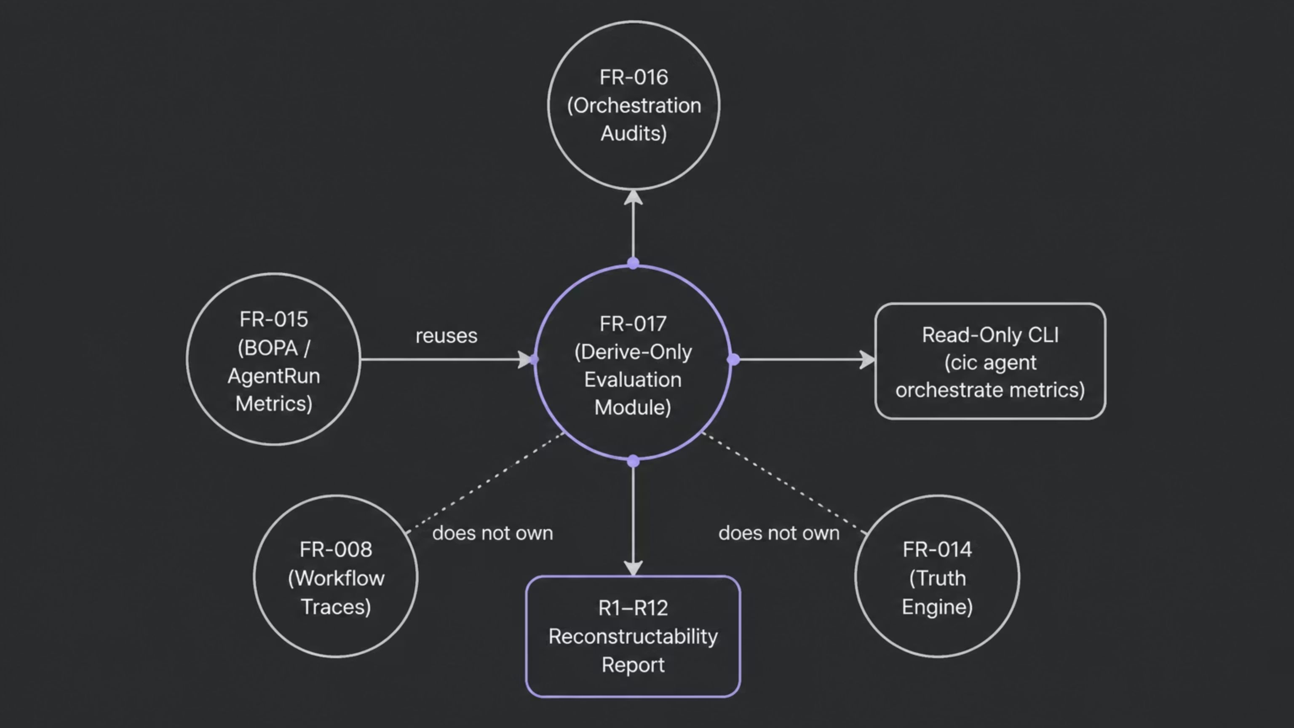
Architecture at a Glance
FR-017 sits at the centre of evaluation — consuming from FR-016, reusing from FR-015, and presenting through a thin read-only CLI. It touches adjacent FRs only to cite status, never to own their data.

Slide 19

The Interview-Ready Story
Not "we built observability" — but "we made orchestration audits evaluable: honestly, narrowly, and without theatre."
Chosen Architecture
Validation
Derive-only R1–R12, read-only CLI.
15/15 GO, deterministic, no instrumentation.
Engineering Problem
Engineering Posture
Audits existed but were not evaluable.
Honest, narrow, Horizon 1B unblocked.
FR-017 is a small system with a large teaching surface. It freezes a posture that senior engineers are asked to defend verbally in interviews: separate evaluation from runtime mutation, refuse second sources of truth, keep commercial claims proportional to evidence.

Slide 20
Memorable Closing Statement
Derive the truth
you already have —
before you instrument a truth you wish you had.
FR-017
Engineering Learning Academy
Audience
Agent Evaluation & Observability — Complete / Frozen / Accepted
Lean Edition Masterclass — canonical acceptance report and ADR-009 remain authoritative
Experienced software engineers preparing for technical interviews on multi-agent systems and observability

