Slide 1

ENGINEERING MASTERCLASS 002
Career Intelligence Copilot — FR-017
Agent Evaluation & Observability
Derive-Only Metrics, Reconstructability, and Anti-Theatre Observability
Edition
Status
Engineering Learning Academy — Lean Edition
Complete / Frozen / Accepted
Audience
Experienced engineers preparing for technical interviews

Slide 2

EXECUTIVE SUMMARY
What FR-017 Actually Answers
Once a multi-agent orchestration layer has written honest audit records, how do you evaluate those records without inventing an observability product?
The accepted answer is a narrow derive-only evaluation substrate. Existing OrchestrationRun, Handoff, and child AgentRun artefacts are treated as the only evidence. Pure functions derive metrics, correlate parent/child execution, and score reconstructability against twelve fixed questions (R1–R12). A thin read-only CLI presents the result. Nothing mutates the runtime. Nothing becomes a second system of record.
Commercial Posture
Core Honesty
Interview Signal
Low near-term product value — high learning and interview value.
Distinguishes missing metadata from measured zero. Refuses to repair contradictory audits.
Explains how mature systems separate instrumentation, evaluation, and dashboards — three distinct decisions.

Slide 3


SECTION 1
The Engineering Problem
After FR-016, Career Intelligence Copilot had orchestration audits: parent runs, typed handoffs, stop reasons, child agent runs, and resume/idempotency keys. What it lacked was a first-class way to use those audits as evaluation evidence.
1
2
Reconstruct Authority
Offline Comparison
Can I reconstruct the authority story of a run without reading source code?
Can I compare runs deterministically, without a live LLM?
3
4
Absent vs. Zero
Orphan Linkage
When tokens or cost are absent, is that "zero usage" or "unknown"?
If a child id doesn't join cleanly to a handoff, do we invent linkage or surface the gap?
These are evidence, semantics, and source-of-truth problems — not "add Prometheus" problems.

Slide 4
SECTION 2
Why Previous Approaches Were Insufficient
Several tempting approaches were considered and rejected. Understanding the rejections is half the lesson.
❌ Laundry-List FR
❌ Instrument the Runtime
❌ Fork Child Metrics
Traces, checkpoints, dashboards — most already owned by FR-008, FR-014, FR-015, FR-016. Building it duplicates frozen work.
Adding events until every chart is easy fails the derive-only gate. You're redesigning under measurement pressure, not evaluating the current system.
FR-015 already owns AgentRunMetrics with careful missing-vs-zero semantics. Re-implementing creates two competing definitions.
❌ Dashboards as Proof
❌ Block Horizon 1B
A board plotting "latency = 0" for runs that never recorded latency converts absence into fake precision — worse than no board.
Coupling recruiter outreach to FR-017 inverts sequencing. Evaluation substrate improves learning; it does not improve application throughput.

Slide 5

SECTION 3
The Chosen Architecture
The architecture is deliberately boring. That is the point.
Artefact Input
Deterministic Derive
Reconstructability
Read‑Only CLI
Operational Insight
Every step is read-only. No store writes. No supervisor start or resume. No specialist execution. The pipeline proves what existing records already support — without touching the runtime.

Slide 6

Ownership Matrix
FR-017 has a single, narrow role: evaluate. Every other concern is owned by an existing FR.
Concern
Owner
FR-017 Role
Workflow traces
FR-008
None
Truth engine
FR-014
Cite status only
BOPA / AgentRun metrics
FR-015
Reuse
Orchestration audits
FR-016
Source records
Derive, correlate, evaluate, present
FR-017
Evaluation only
Crossing ownership boundaries creates twin definitions and silent drift. FR-017 never becomes a system of record.

Slide 7
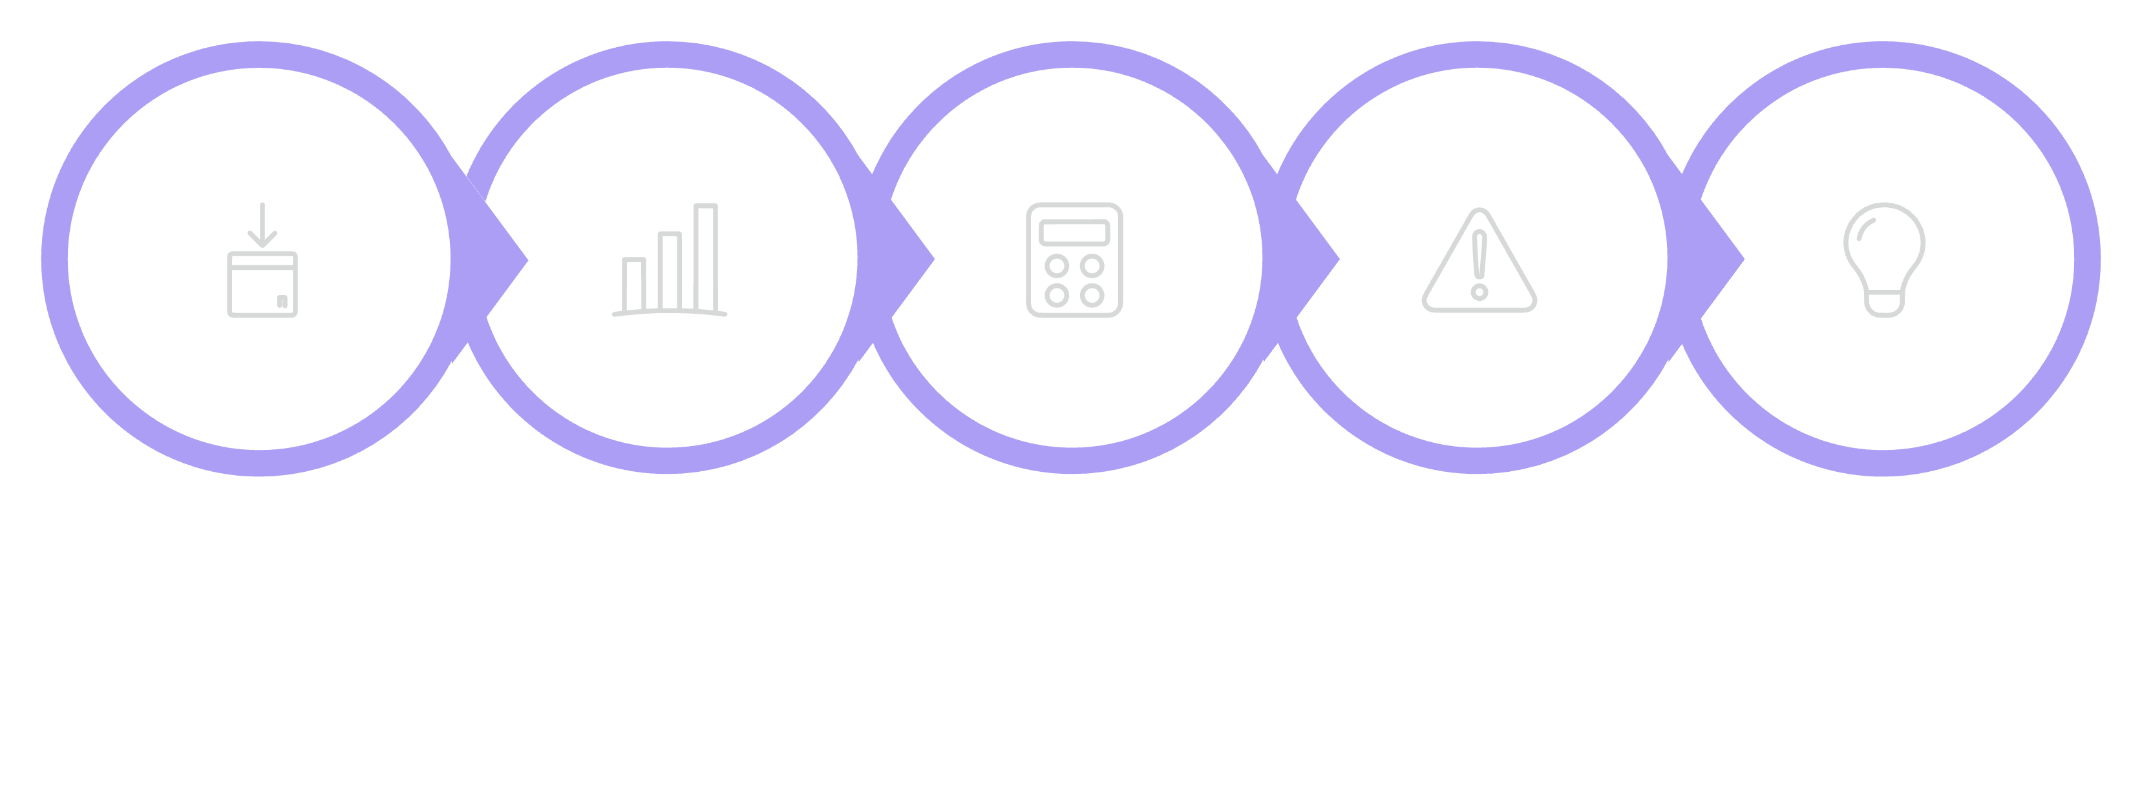
RUNTIME EXAMPLE
Evaluation Flow — Step by Step
Compute Scores
Deliver Insight
Load Audit
Read Metrics
Surface Gaps
The key invariant: the evaluator never invents precision and never heals bad audits. Gaps are named. Contradictions are surfaced. Repair belongs to runtime correctness work — not to an evaluation layer pretending success.

Slide 8
R1–R12
Reconstructability as Acceptance
Twelve fixed questions an owner must answer from artefacts alone. PASS = supported by evidence. FAIL = names the missing or contradictory evidence.
01
01
R1 — Owner Goal
R7 — Child Output References
02
02
R2 — Observed State
R8 — Stop Reason
03
03
R3 — Specialist Selection
R9 — Owner Next Action
04
04
R4 — DelegationPolicy Consistency
R10 — Limits
05
05
R5 — Authority Boundary (OBS/BOPA)
R11 — Parent/Child Walk
06
06
R6 — Handoff Lifecycle
R12 — Resume / Idempotency

Slide 9




SECTION 4
Engineering Principles
Derive Before You Instrument
Observability ≠ Dashboards
Prove what existing records support first. Instrument only when reconstructability fails for a reason that cannot be fixed by better derivation or clearer ownership.
Observability means: can a competent engineer reconstruct what happened and what was unknown? Charts are one possible presentation — not the definition.
Missing ≠ Zero
Detect Contradictions; Don't Repair Them
None = field never recorded. 0 = measured empty. Coercing absence into zero is a semantic bug that infects every aggregate downstream.
Orphan child ids and contradictory linkage produce R-signal failures. Evaluation surfaces them. Repair belongs to runtime correctness work.

Slide 10



More Engineering Principles
Preserve Source-of-Truth Boundaries
Read-Only Evaluation Surfaces
Don't Let Learning Block Acquisition
FR-017 evaluates. It does not become the system of record. FR-015 owns child metrics schemas. FR-016 owns orchestration audit shape. Crossing those boundaries creates twin definitions and silent drift.
An evaluation CLI that can start supervisors or mutate pipelines is not an evaluation CLI — it is a control plane with a misleading name. FR-017 paths load only.
Narrow evaluation substrate must not gate recruiter outreach. Sequencing discipline is an engineering principle, not only a roadmap preference.

Slide 11

SECTION 5
Validation Summary
15/15
GO
0
Corpus PASS
Recommendation
Runtime Changes
Deterministic cases; repeatability confirmed
ACCEPT AND FREEZE — remain narrow derive-only
No DOS/BOPA/OBS contract changes required
The offline corpus of fifteen fixtures covers: successful orchestration, blocked delegation, BOPA child and OBS brief, missing optional metadata vs. measured zero, orphan child, missing child join, stale handoff, resumed/idempotent run, loop stops, provider unavailable, contradictory audit, and mixed aggregate roll-up.
Expected failures are part of the design: orphan cases fail R11; contradictory audits fail R7 and R11. A suite that only passes happy paths would be reconstructability theatre.

Slide 12



SECTION 6
Trade-offs
✅ Accepted
⏳ Deferred
Derive-only over existing audits
R1–R12 as first-class acceptance
Token/cost completeness for every offline fixture, CLI polish, and richer fault-injection productisation. Nulls remain honest; polish is not a freeze blocker.
Tests the real system, not a redesigned one
Forces evidence, not storytelling
🚫 Out of Scope
Dashboards, alerts, live tracing platforms, telemetry backends, monitoring SaaS, pipeline mutation, submission behaviour, Horizon 1B integration.
Reuse FR-015 child metrics
Thin CLI instead of UI
Interviewable and owner-operable without product weight
One definition of tokens/cost/provider
🔮 Future FR (only if justified)
Richer time-travel replay or broader observability — only when derive-only evaluation fails to answer owner-critical questions at scale. Desire for dashboards is not justification.
Low commercial claim
Avoids observability theatre and false ROI

Slide 13




WHY EMPLOYERS CARE
Production-Grade Evaluation Discipline
Employers need engineers who can evaluate complex systems without inventing parallel platforms.
Derive from Existing Records
Refuse False Precision
Evidence-first thinking over instrumentation-first habit
Honest semantics when data is absent — None ≠ 0
Detect Inconsistency
Keep Evaluation Read-Only
Surface parent/child gaps without silently "fixing" them
Diagnosis must not become accidental mutation
This is useful anywhere audits, workflows, or multi-service traces must be trusted — not just in this codebase.

Slide 14

SECTION 7 — INTERVIEW PREP
Interview Q&A — Part 1
Q: What problem did FR-017 solve?
Q: Why not add dashboards first?
How to evaluate multi-agent orchestration audits honestly — reconstructability, missing-data semantics, and parent/child correlation — without building an observability platform or changing the runtime.
Dashboards present numbers; they do not create trustworthy semantics. If missing latency is plotted as zero, the board lies. We proved derive-only reconstructability first. Dashboards remain unjustified until that approach fails at scale.
Q: What does derive-only mean in practice?
Q: Explain missing versus zero.
Pure functions over existing OrchestrationRun / Handoff / child AgentRun records. No new events, no telemetry store, no DOS/BOPA/OBS behaviour changes.
None means the optional field was never recorded. ∅ means it was recorded and measured empty. Aggregates must not coerce absence into zero or every cost roll-up becomes fiction.

Slide 15


SECTION 7 — INTERVIEW PREP
Interview Q&A — Part 2
Q: What are R1–R12?
Q: Give an example of an expected FAIL.
Twelve reconstructability questions from goal through resume/idempotency. PASS requires evidence; FAIL names the gap. Contradictions are surfaced, not repaired.
An orphaned child reference fails R11. A contradictory completed run that cannot join child output fails R7 and R11. The corpus treats those as GO when detected correctly.
Q: Why reuse FR-015 metrics instead of redefining them?
Q: When would you build richer observability?
When owner-critical questions cannot be answered from derived audits at the scale that matters — with concrete failing evidence, not aesthetic preference.
Child token/cost/provider semantics already existed. Forking them would create two truths. Evaluation should consume authoritative metrics, not re-author them.

Slide 16



SECTION 8
Three Engineering Lessons to Remember
3. Observability Is Reconstructability Under Authority Boundaries — Not Dashboards
2. Missing ≠ Zero — Contradictions Are Not Repaired by Evaluation
1. Derive Before You Instrument
Probe what existing records already support. New telemetry is a design change, not a default first step.
Honest semantics beat pretty aggregates. An evaluation layer that heals bad audits is lying for convenience.
If you cannot walk goal → decision → handoff → child → stop → next action from artefacts, you do not have observability yet, no matter how many panels you ship.

Slide 17
Honest Product Assessment
This honesty is itself an engineering artefact. Overclaiming value is a form of technical debt in product communication.
Question
Answer
Improves daily preparation?
No material improvement
Materially improves Horizon 1B?
No
Useful operational / audit insight?
Yes
Justifies dashboards now?
No
Should remain narrow?
Yes
FR-017 is not "we built observability." It is "we made orchestration audits evaluable — honestly, narrowly, and without theatre."

Slide 18

CLOSING FRAME
What FR-017 Freezes as a Posture
Separate Evaluation from Runtime Mutation
Refuse Second Sources of Truth
An evaluation layer that mutates is a control plane with a misleading name.
Crossing ownership boundaries creates twin definitions and silent drift.
Keep Commercial Claims Proportional to Evidence
Leave Adjacent Horizons Unblocked
Overclaiming value is technical debt in product communication.
Learning work not on the critical path must not gate acquisition work.

Slide 19
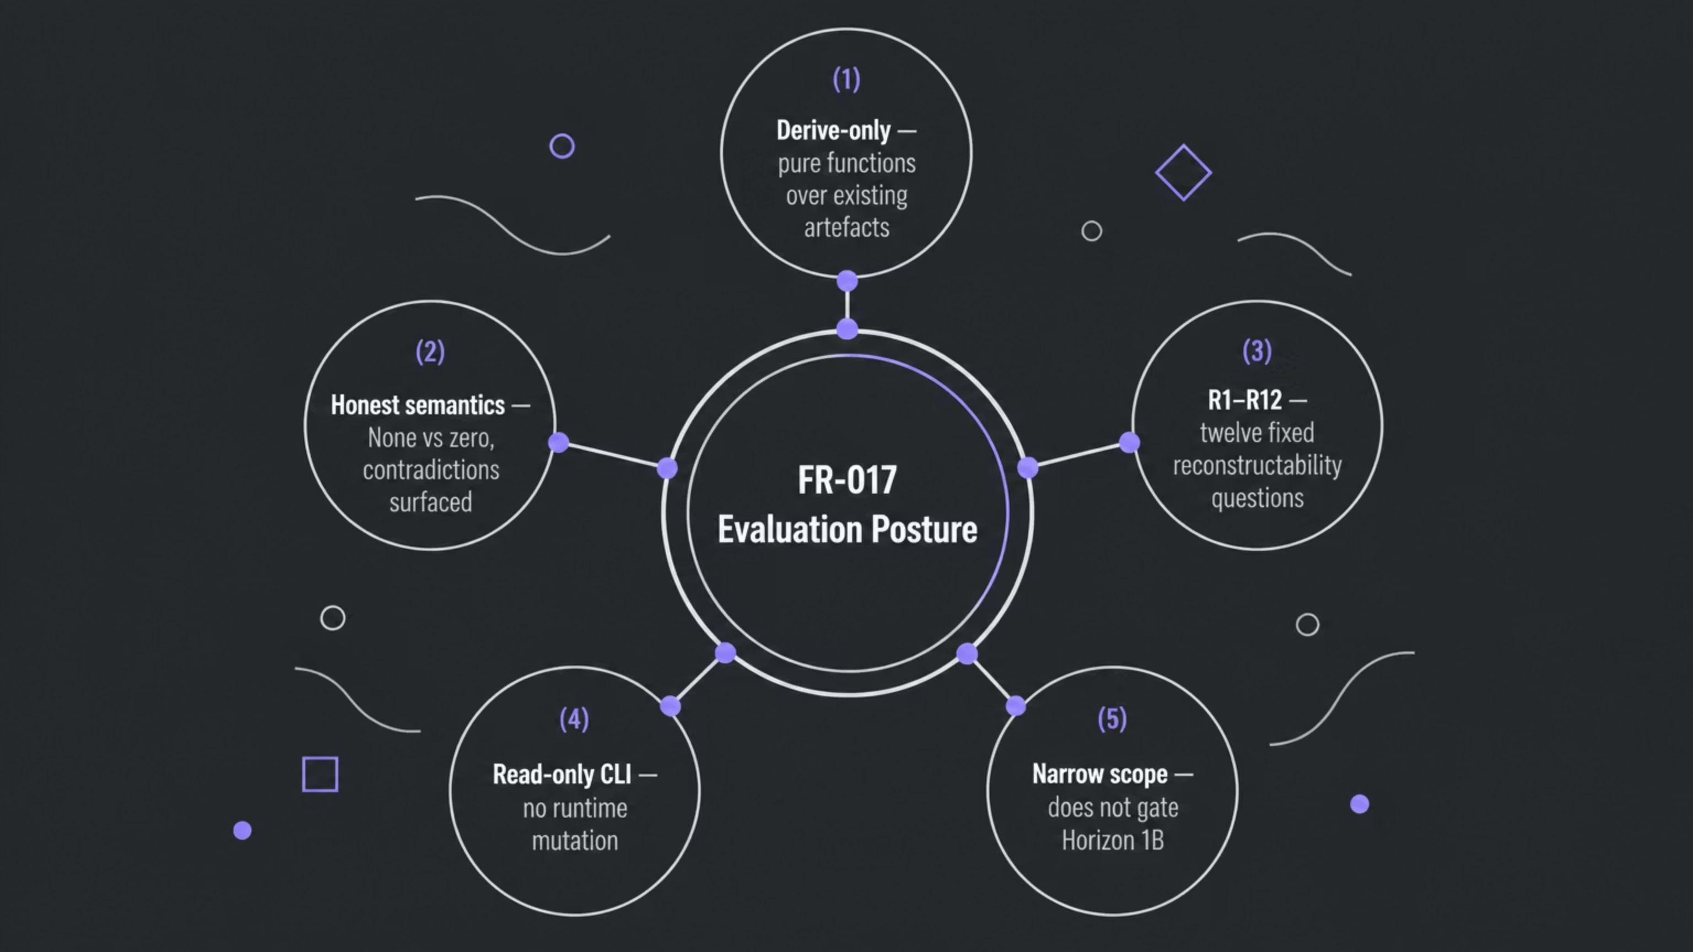
The Interview-Ready Story
FR-017 is a small system with a large teaching surface. It demonstrates how senior engineers separate instrumentation, evaluation, and dashboards — and why those three are not the same decision.

Slide 20
Derive the truth you already have —
before you instrument a truth you wish you had.
Engineering Learning Academy — Lean Edition Masterclass 002 · FR-017 Agent Evaluation & Observability · Status: Complete / Frozen / Accepted

