Slide 1
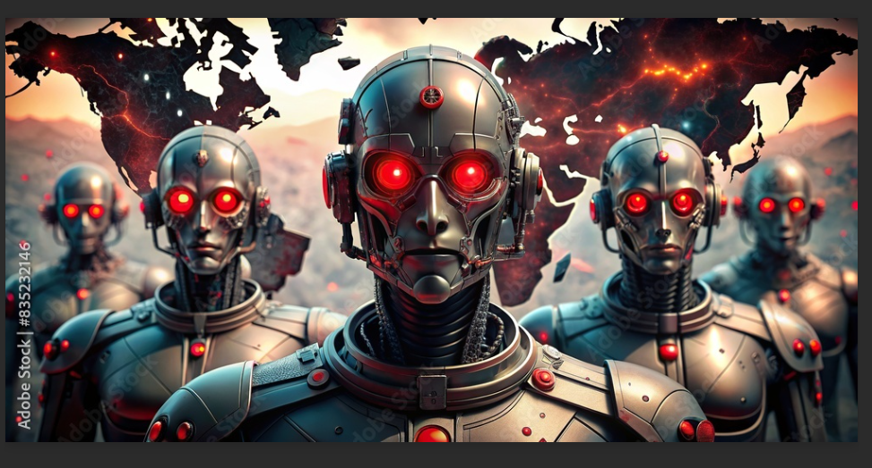
The Impact of AI
on Employment
THESIS
AI is disruptive, but current evidence suggests broad collapse is not inevitable or immediate.
Job displacement, labor-market stability, and whether an “AI apocalypse” is actually underway
Notes:
[Sources] - User-uploaded image: /mnt/data/AI Apocalypse.png - Essay - The Impact of AI on Employment.docx [/Sources]

Slide 2
Why this question matters
Public fears are real, but the evidence is more mixed than the headlines suggest.
Main concern
Core argument
Generative AI now performs some tasks once seen as “safe,” including coding and language work.
Recent labor-market research points to stability rather than collapse since ChatGPT launched.
That raises a common fear: large-scale job loss across many sectors.
Some occupations are clearly more exposed than others.
But automation of tasks is not the same thing as mass unemployment.
Even in a worse-case scenario, many highly exposed workers may still adapt successfully.
2022
2025–26
ChatGPT launch
Brookings evidence used
Notes:
[Sources] - Essay - The Impact of AI on Employment.docx - Outline - The Impact of AI on Employment.docx [/Sources]

Slide 3
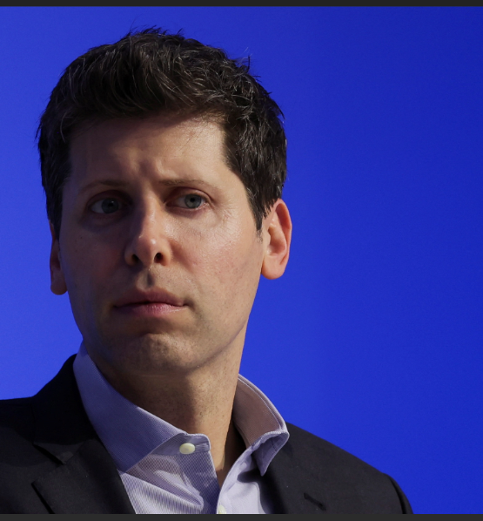
The “AI apocalypse” view
Sam Altman has warned that AI could replace work across large parts of the economy.
“A lot of current customer support ... will lose their jobs, and that’ll be better done by AI.”
— paraphrased from reporting on Sam Altman’s comments
Why people take this seriously
Example used in the essay
Customer service is already being automated.
Salesforce reportedly cut 4,000 support roles in pursuit of AI efficiency gains.
Developers and programmers are now discussed as exposed too.
Notes:
[Sources] - User-uploaded image: /mnt/data/Sam Altman.png - Essay - The Impact of AI on Employment.docx - Bibliographic Information.docx (Spirlet 2025 / Business Insider) [/Sources]

Slide 4
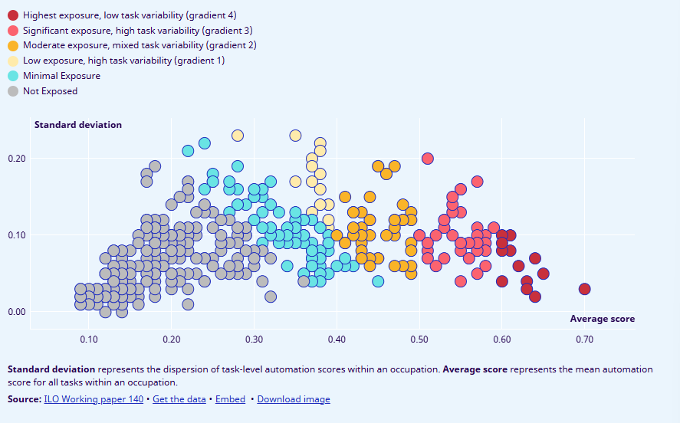
Across the whole labor market, exposure is distributed
The ILO chart shows a spectrum from minimal exposure to the highest-exposure occupations.
How to read the chart
Right side = higher average automation exposure.
Higher position = more variability across tasks in the same occupation.
Software roles sit well to the right, but not every task inside them is equally automatable.
Many occupations cluster in lower- to middle-exposure territory.
Notes:
[Sources] - User-uploaded image: /mnt/data/all jobs.png - Bibliographic Information.docx (ILO 2025) [/Sources]

Slide 5
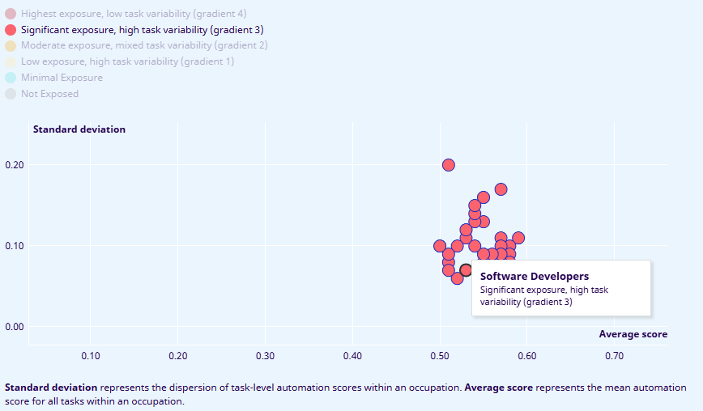
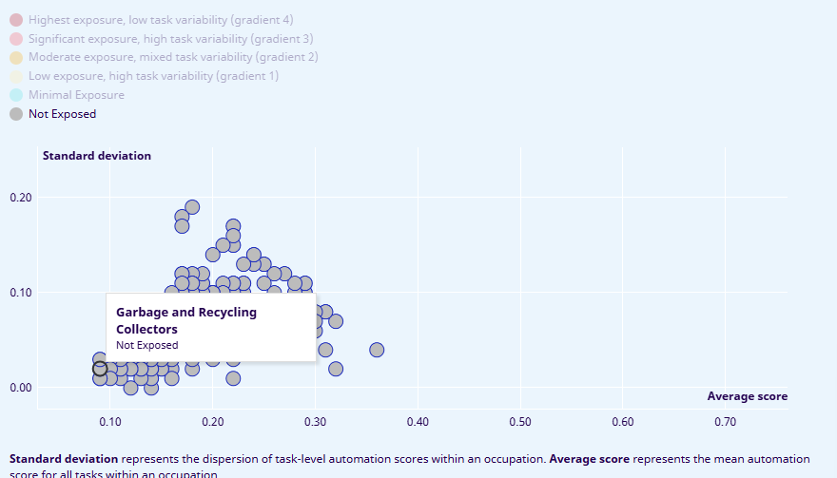
Not all jobs face the same level of exposure
Here we contrast highly exposed knowledge work with lower-exposure manual labor.
Higher-exposure example
Lower-exposure example
Takeaway
Routine, digital, and language-heavy tasks tend to be more exposed.
Physical, hands-on, and context-rich jobs often remain harder to automate.
Exposure means risk of disruption — not guaranteed replacement.
Software developers
Garbage & recycling collectors
ILO visualization: significant exposure, high task variability
ILO visualization: not exposed
Notes:
[Sources] - User-uploaded image: /mnt/data/Software engineers.png - User-uploaded image: /mnt/data/garbage men.png - Essay - The Impact of AI on Employment.docx - Bibliographic Information.docx (ILO 2025) [/Sources]

Slide 6
The counterargument: no jobs apocalypse — for now
Muro and Sifan (2025) finds broad labor-market stability rather than immediate disruption since ChatGPT’s release.
Muro-Sifan hypothesis
What this means
If generative AI were automating jobs at scale already, we would expect fewer workers in the occupations most exposed to automation.
The strongest collapse narrative is not supported by recent labor-market data.
AI may be changing tasks inside jobs without yet eliminating jobs at scale.
What the study reports
So the best conclusion is caution: disruption is possible, but not proven as a present-day collapse.
Instead, the percentage of workers in high-, medium-, and low-exposure occupations has stayed remarkably steady over time.
Notes:
[Sources] - Essay - The Impact of AI on Employment.docx - Bibliographic Information.docx (Muro & Liu 2025 / Brookings) [/Sources]

Slide 7
Two important caveats
Stability today does not guarantee stability tomorrow.
Caveat 1: technological change can be slow
Caveat 2: early-career workers may be more vulnerable
Past general-purpose technologies — like computers and the internet — took years or decades to reshape the workplace fully.
The essay notes emerging evidence that AI may be contributing to unemployment among early-career workers, even if the broader labor market still looks stable.
So today’s data may be suggestive rather than decisive.
Bottom line: “no apocalypse yet” is not the same as “no risk.”
Notes:
[Sources] - Essay - The Impact of AI on Employment.docx - Bibliographic Information.docx (Muro & Liu 2025 / Brookings) [/Sources]

Slide 8
Worst-case scenario: can displaced workers adapt?
Sifan and Muro (2026) argue that many highly exposed workers also have strong adaptive capacity.
37.1M
26.5M
6.1M
4.2%
workers in the top quartile of AI exposure
of them also have above-median adaptive capacity
face both high exposure and low adaptive capacity
of the workforce in the sample
Why adaptation may be possible
Who may struggle
Many high-exposure roles are held by skilled, financially secure, and well-networked workers.
Some workers face a double risk: high exposure plus low adaptive capacity.
Those advantages can make career transitions easier if displacement occurs.
These vulnerable workers are concentrated especially in clerical and administrative roles.
Notes:
[Sources] - Essay - The Impact of AI on Employment.docx - Bibliographic Information.docx (Liu & Muro 2026 / Brookings) [/Sources]

Slide 9
So what should computer science students take from this?
Exposure is real, but the bigger story is changing work, not instant replacement.
For developers
Practical implication
Balanced conclusion
Programming is exposed because parts of the workflow are automatable.
Learn to use AI tools well.
This study rejects panic, not risk.
AI may disrupt employment over time, but the available evidence points to a slower, more uneven transition than “apocalypse” language suggests.
But software work is varied: architecture, judgment, debugging, communication, and domain knowledge still matter.
Build strengths in problem framing, systems thinking, and collaboration.
The likely short-term effect is job redesign and productivity change, not total disappearance.
Treat AI as part of your workflow — and as a force shaping the market.
Notes:
[Sources] - Essay - The Impact of AI on Employment.docx - Outline - The Impact of AI on Employment.docx [/Sources]

Slide 10
Conclusion
The strongest claim supported by the materials is cautious realism.
Bottom line
1. AI is already affecting some occupations and making replacement fears understandable.
2.
Current research does not show a broad labor-market collapse since ChatGPT’s release.
3.
Future disruption remains possible, especially for early-career and lower-adaptability workers.
4.
For CS students, the key response is adaptation: pair technical skill with judgment, flexibility, and AI literacy.
AI may transform jobs — but “transformation” is not the same thing as immediate mass unemployment.
Notes:
[Sources] - Essay - The Impact of AI on Employment.docx - Bibliographic Information.docx [/Sources]

Slide 11
Bibliography
Sources supplied with the assignment materials
Works cited
International Labour Organization. Generative AI and Jobs: A Refined Global Index of Occupational Exposure. Geneva: ILO, May 20, 2025.
Liu, Sifan, and Mark Muro. “Measuring US Workers’ Capacity to Adapt to AI-Driven Job Displacement.” Brookings, January 21, 2026.
Muro, Mark, and Sifan Liu. “New Data Show No AI Jobs Apocalypse—for Now.” Brookings, October 1, 2025.
Spirlet, Thibault. “Sam Altman Predicts AI Will Take Customer Service Jobs First — and Speed up a ‘Historical’ Rate of Job Turnover.” Business Insider, September 11, 2025.
Notes:
[Sources] - Bibliographic Information.docx [/Sources]

