Slide 1


An Integration of Confucianism, Buddhism, and Taoism in Chinese Culture ——
A Case Study of Dwelling in the Fuchun Mountains
小组成员：魏小雨，冯启轩，惠子贤，曾邓斌，王飞，刘康祺
2025年4月20日

Slide 2


The Integration of the Three Religions Against the Background of Quanzhen Taoism
The Philosophical Symbolism in the Landscape Imagery
The Integration of the Three Religions in Artistic Techniques
The Ultimate Pursuit of the Realm of Life
Outline
Notes:
制作人:@芃苇_PengV

Slide 3
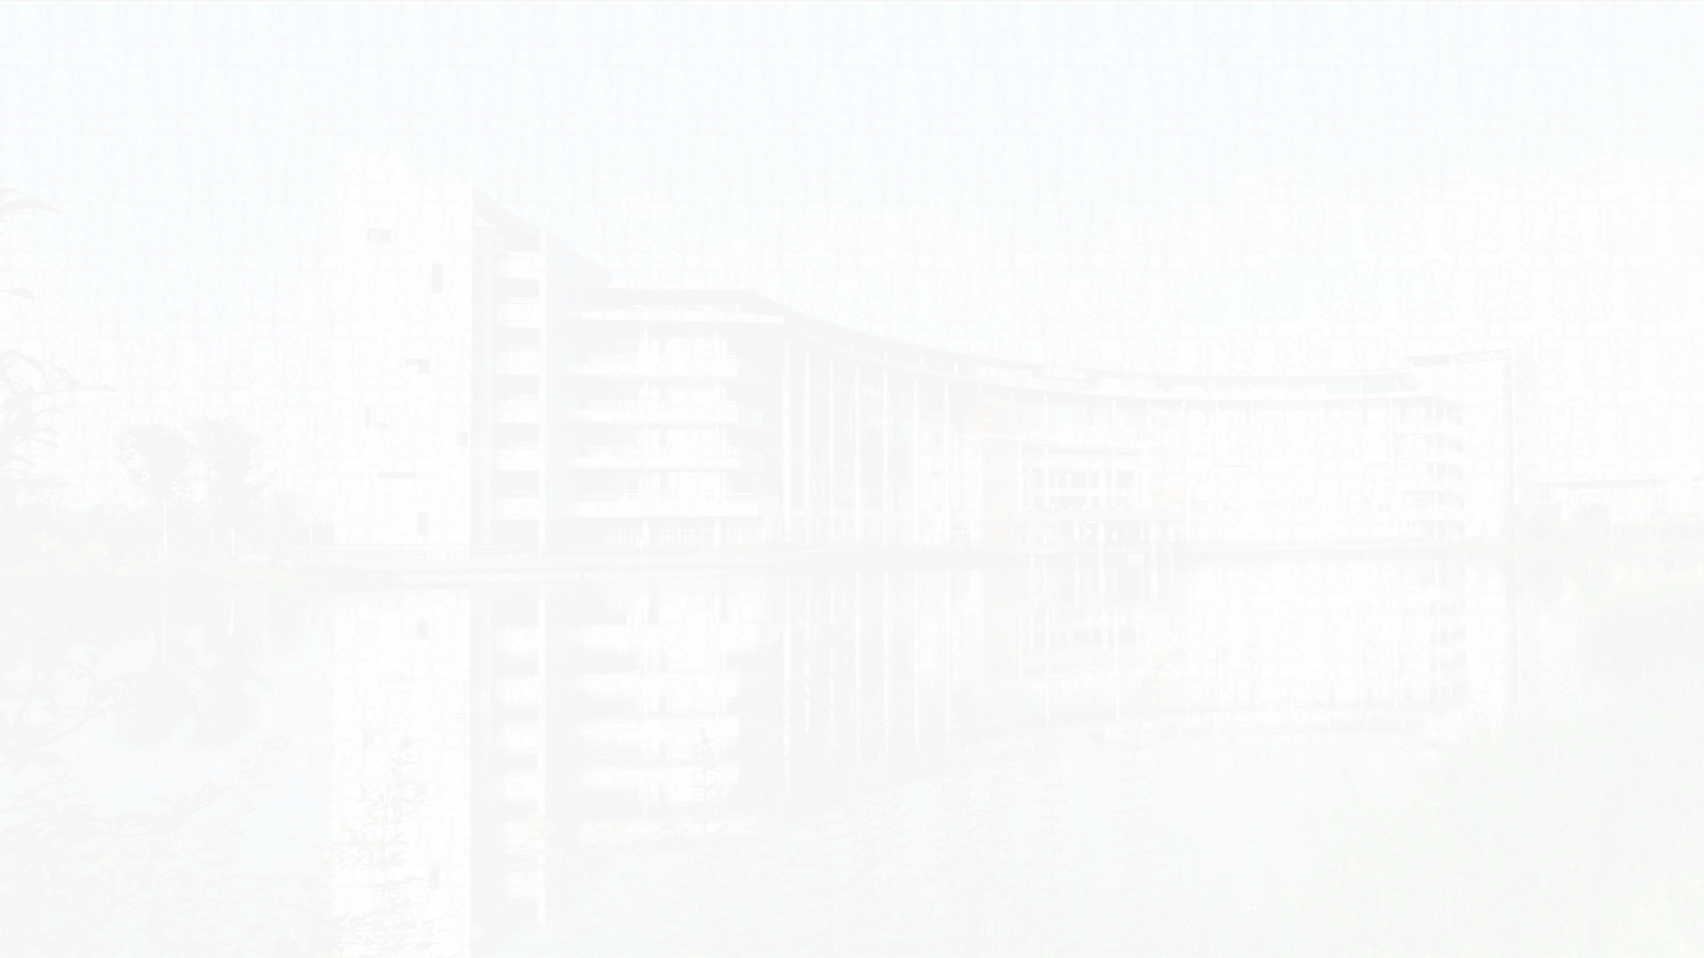
1.The Integration of the Three Religions Against the Background of Quanzhen Taoism
（1）The integration of the three religions:
It broke the sectarian boundaries among Confucianism, Buddhism and Taoism, advocating equality among the three religions. By depicting Mountains and waters convey thoughts on life and the universe, embodying Taoism's compliance with nature, Confucianism's proactive engagement in the world, and BuddhismThe ideological connotation that transcends the mundane world.
（2）Impact on Huang Gongwang:
①Ideological foundation: The concepts of Quanzhen Buddhism have become the internal driving force for his artistic creation.
② Creative purpose: To visually express the "Three Teachings Thought" through landscape painting.
竢实扬华 自强不息
Notes:
制作人:@芃苇_PengV

Slide 4
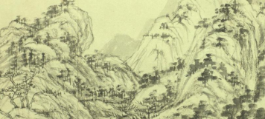
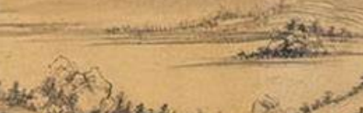
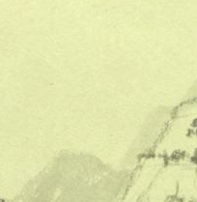
2.The Philosophical Symbolism in the Landscape Imagery
The symbols of the three religions in natural elements:
Confucian symbol Mountain The profoundness of a benevolent person
Taoist symbol River water The flow of the Dao
Buddhist symbol Cloud and mist Impermanence and Illusion
竢实扬华 自强不息
Notes:
制作人:@芃苇_PengV

Slide 5
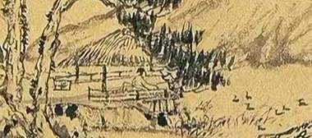

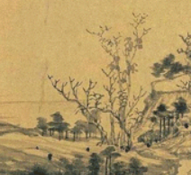
2.The Philosophical Symbolism in the Landscape Imagery
The symbols of the three religions in the humanistic elements
Confucian symbol Scholar Joining the World and shouldering responsibilities
Taoist symbol Fisherboat Seclusion and carefree
Buddhist symbol Withered tree Extinction and sudden enlightenment
竢实扬华 自强不息
Notes:
制作人:@芃苇_PengV

Slide 6
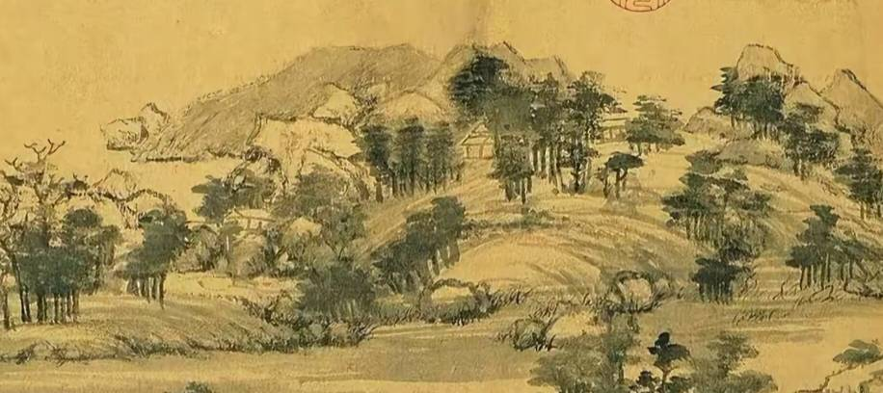

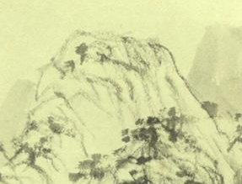
2.The Philosophical Symbolism in the Landscape Imagery
The three religious symbols in spatial relations
Confucian symbol Path Social progress
Taoist symbol Copy space Nature is infinite
Buddhist symbol Isolated peak Independent and detached
竢实扬华 自强不息
Notes:
制作人:@芃苇_PengV

Slide 7
3.The Integration of the Three Religions in Artistic Techniques
Screen Layout
Embodiment of Confucianism
Embodiment of Taoism
Embodiment of Buddhism
Sense of Order
The charm of nature
Void State
The layers are distinct and the density is appropriate
The mountain ranges are winding and naturally formed
Blank space and the distinction between reality and illusion
Integrate logic：The rites of Confucianism, the naturalness of Taoism and the emptiness of Buddhism coexist in the same space.
竢实扬华 自强不息
Notes:
制作人:@芃苇_PengV

Slide 8
3.The Integration of the Three Religions in Artistic Techniques
Application of brush and ink
Embodiment of Confucianism
Embodiment of Taoism
Embodiment of Buddhism
Upright and peaceful
The contrast of Yin and Yang
Simple and pure
The lines are steady and the ink color is gentle
Dry and wet, thick and thin, virtual and real
The brushstrokes are refined
Integrate logic：Confucian aesthetics, Taoist philosophy and Zen spirit are unified through the language of brush and ink.
竢实扬华 自强不息
Notes:
制作人:@芃苇_PengV

Slide 9
3.The Integration of the Three Religions in Artistic Techniques
Artistic conception creation
Embodiment of Confucianism
Embodiment of Taoism
Embodiment of Buddhism
Empty and transcendent
Theory that man is an integral part of nature
Social metaphor
Fishermen, woodcutters, farmers and scholars
Human beings and nature blend together
The clouds and mist are ethereal
Integrate logic：The concern for engaging in the world superimposes the artistic conception of natural freedom and liberation from detachment
竢实扬华 自强不息
Notes:
制作人:@芃苇_PengV

Slide 10
4.The Ultimate Pursuit of the Realm of Life
Ideological System | Core pursuit | The manifestation in the painting | Transcendent goal
Confucian school | The character of a gentleman who cultivates both benevolence and wisdom | The metaphor of mountains and waters and the metaphor of home and country | Social harmony(Outer Kingliness)
Taoist school | The carefree realm of following the laws of nature | The unity of heaven and man and the interplay of the virtual and the real | Individual freedom(Inner Sageliness)
Buddhist | The Zen enlightenment realm of realizing one's true nature and understanding one's mind | Ethereal artistic conception and sudden enlightenment experience | Liberation of the soul(detachment)
Inner Sageliness : The ultimate perfection of the moral essence
Outer Kingliness : The realistic realization of social values
竢实扬华 自强不息
Notes:
制作人:@芃苇_PengV

Slide 11
4.The Ultimate Pursuit of the Realm of Life
Logical sublimation
1
The complementarity of the three teachings
2
Ultimate harmony
Confucianism provides an ethical framework, Taoism endows nature with dimensions, and Buddhism contributes to the transcendence of the mind and nature.
To achieve "natural freedom (Taoism) + moral wisdom (Confucianism) + spiritual liberation (Buddhism)" through art The harmonious unity.
竢实扬华 自强不息
Notes:
制作人:@芃苇_PengV

Slide 12
References
［1］范玉秋 . 三教合一与全真道［J］. 管子学刊，2007（3）：77-80.
［2］鱼翼 . 海虞画苑略 ［M］ . 杭州：浙江人民美术出版社，2013：139.
［3］孔子 . 论语 ［M］. 陈晓芬，注译 . 北京：中华书局出版社，2016：12-20.
[4]李聪聪, 李彦昭. “儒释道”三教合一经典之作《富春山居图》探析[J]. 天工, 2022(32): 82 - 84.
竢实扬华 自强不息
Notes:
制作人:@芃苇_PengV

Slide 13

01
王飞，刘康祺
Search for information and collect pictures
Thank you！
02
惠子贤，曾邓斌
The logical train of thought and writing of the text
03
魏小雨，冯启轩
PPT production and revision

