Slide 1


Dunhuang Mogao Caves
小组成员：魏小雨，冯启轩，惠子贤，曾邓斌，王飞，刘康祺
2025年5月26日

Slide 2


History & Geography of Dunhuang Maogao Caves
Architectural and Artistic Features of Dunhuang Maogao Caves
Cultural Fusion and Global Significance of Duhuang Maogao Caves
Preservation and Challenges of Duanghuang Maogao Caves
Outline
Notes:
制作人:@芃苇_PengV

Slide 3
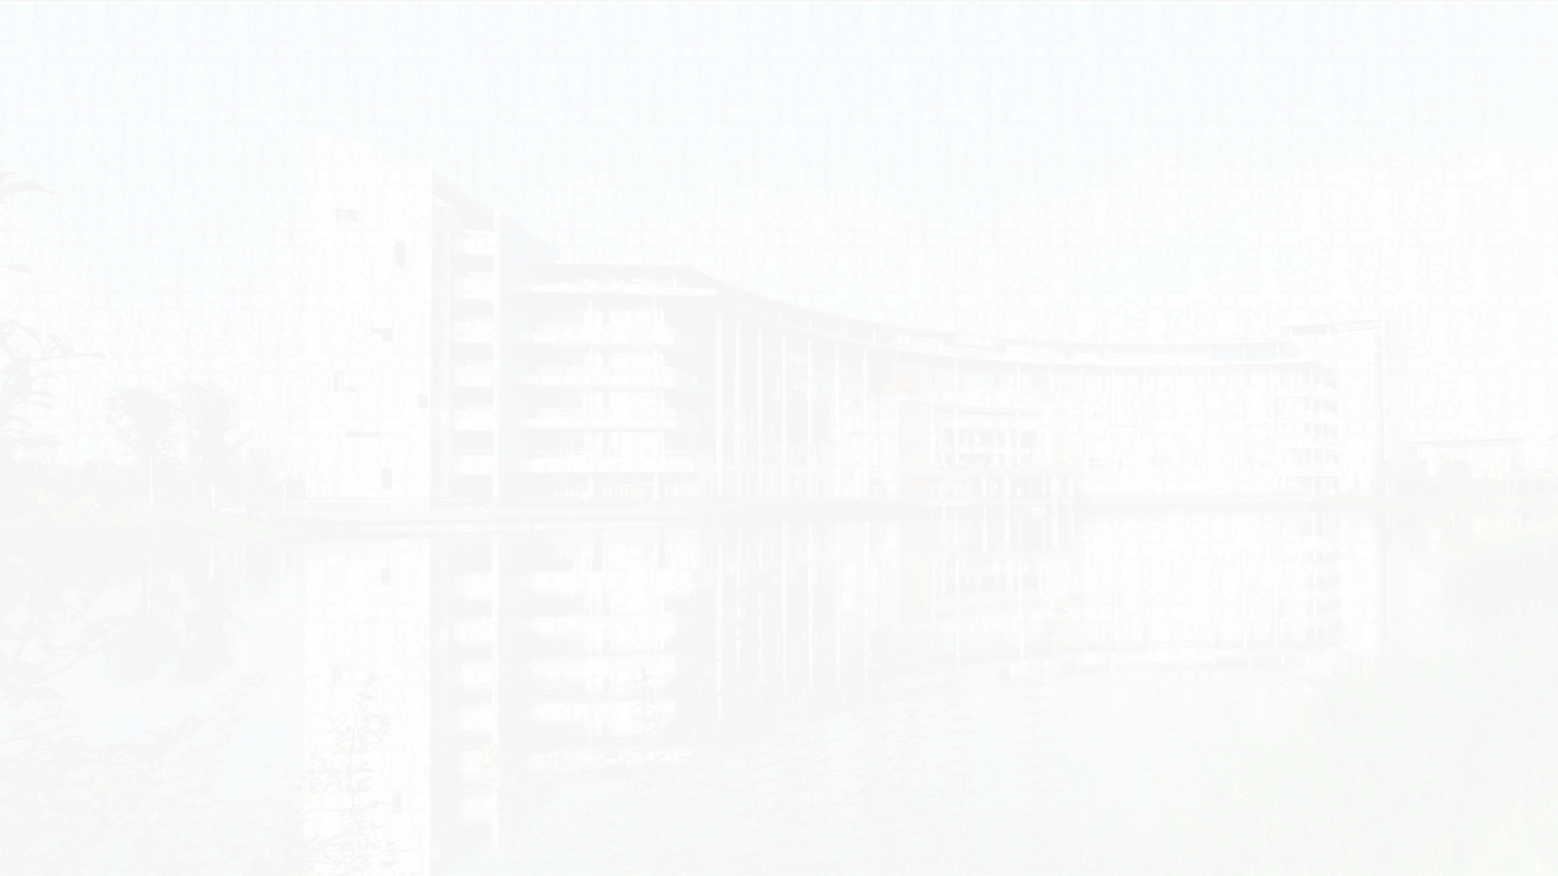
1.History & Geography of Dunhuang Maogao Caves
（1）Geography：
Located 25 km southeast of Dunhuang, Gansu, China.
（2）History：
the Mogao Caves (UNESCO World Heritage, 1987) were carved into the cliffs of Mingsha Mountain. As a Silk Road hub, Dunhuang bridged China, Central Asia, and Europe. Founded in 366 CE by monk Lezun, the caves were
expanded over 10 dynasties for 1,000 years. Today, 492 caves remain, housing 2,000 painted sculptures and 45,000㎡ of murals—the world’s largest Buddhist art treasury.
竢实扬华 自强不息
Notes:
制作人:@芃苇_PengV

Slide 4
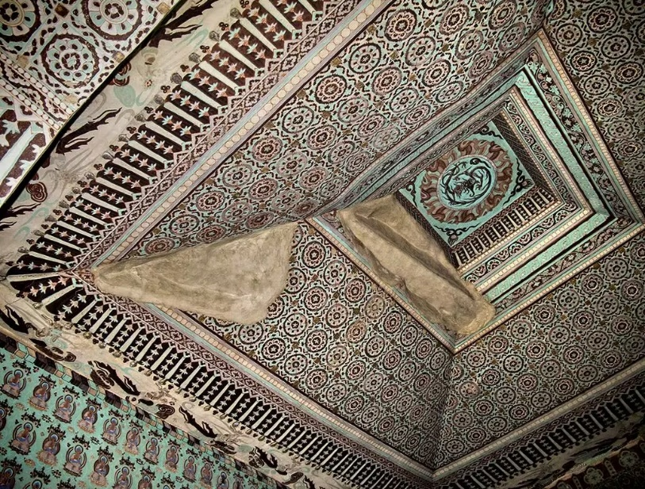
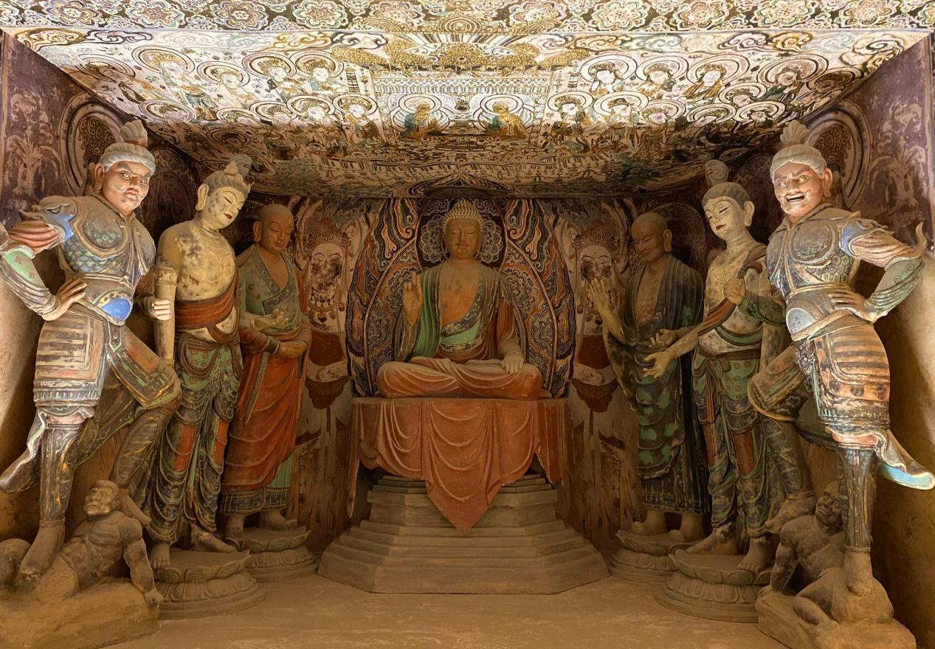
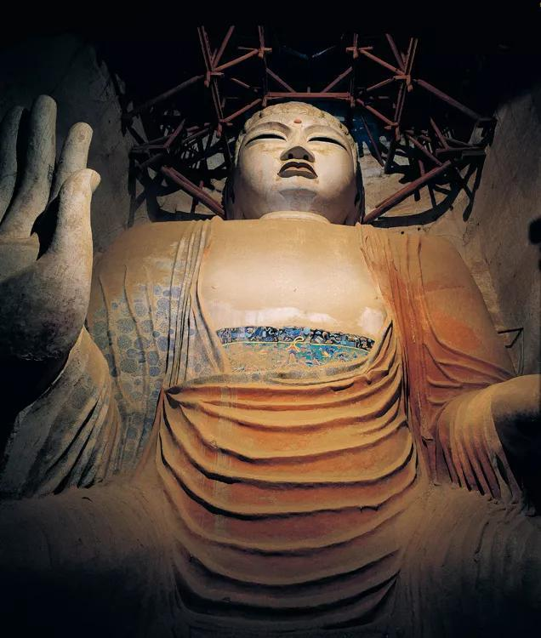
2.Architectural and Artistic Features of Dunhuang Maogao Caves
(1).Evolution of Cave Structures
The Mogao Caves' architecture evolved with Buddhist traditions and historical needs:
<1>Central Pillar Caves (Early Period): Exemplified by Northern Wei Cave 259, modeled after Indian chaitya caves. A central pillar allowed ritual circumambulation, with sculpted niches and murals fused into a unified sacred space.
<2>Ceiling Caves (Mid-Late Period): Tang-era Cave 45 features an inverted-funnel-shaped ceiling, maximizing wall space for monumental murals and housing elaborate group sculptures.
<3>Colossal Buddha Caves: The 33-meter seated Maitreya ("Northern Colossal Statue") in Early Tang Cave 96 and the14.4-meter reclining Nirvana Buddha in High Tang Cave 148 epitomize imperial Buddhist grandeur.
竢实扬华 自强不息
Notes:
制作人:@芃苇_PengV

Slide 5
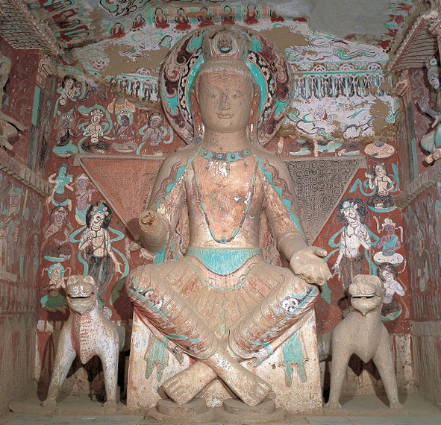
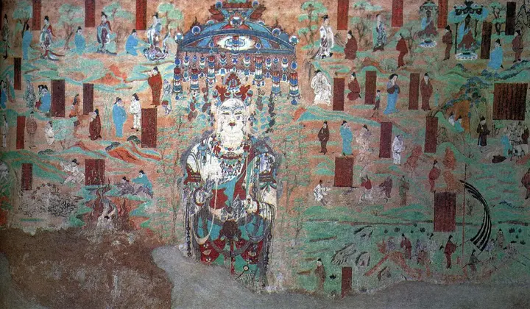
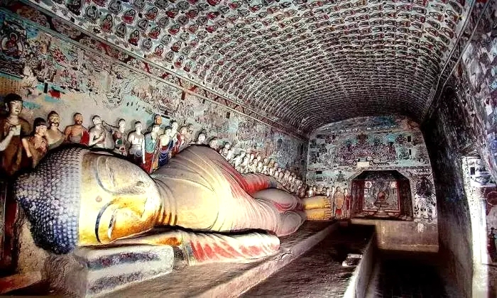
2.Architectural and Artistic Features of Dunhuang Maogao Caves
(2).Stylistic Phases of Painted Sculptures
Early Period
Mid Period
Late Period
Empty and transcendent
Theory that man is an integral part of nature
Social metaphor
Fishermen, woodcutters, farmers and scholars
Human beings and nature blend together
The clouds and mist are ethereal
竢实扬华 自强不息
Notes:
制作人:@芃苇_PengV

Slide 6
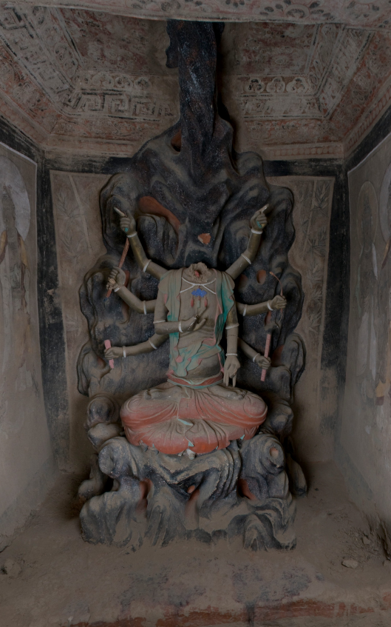
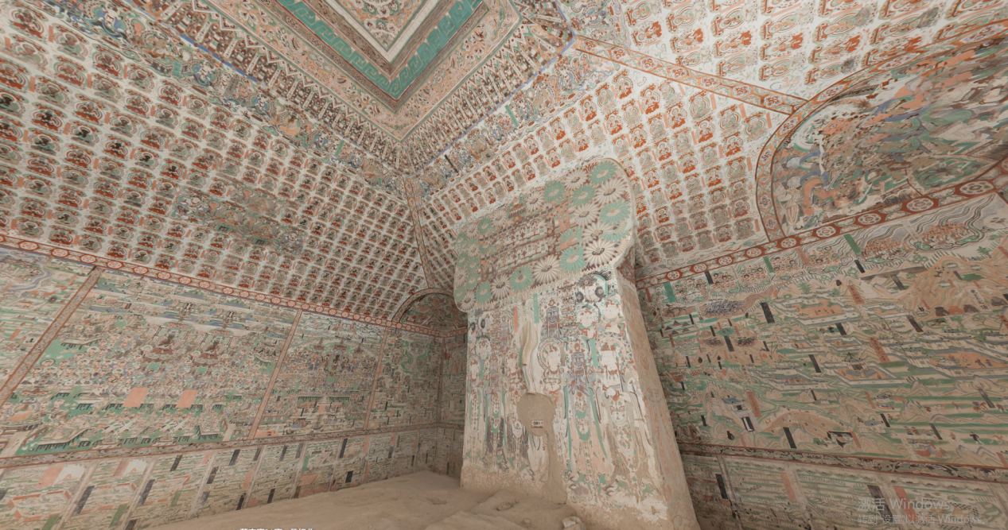
2.Architectural and Artistic Features of Dunhuang Maogao Caves
(3).The Mogao murals encompass Buddhist cosmology, secular life, and cultural fusion:
<1>Buddhist Paintings:
<2>Sutra Illustrations:
Cave 3’s 11-faced, 40-armed Guanyin, rendered with three-dimensional shading (aotu technique), exemplifies Esoteric Buddhism’s ornate brilliance.
Cave 61’s Mount Wutai Painting transforms Buddhist texts into visual storytelling, using a bird’s-eye view to map the sacred mountain’s landscape while weaving spiritual devotion into geography.
竢实扬华 自强不息
Notes:
制作人:@芃苇_PengV

Slide 7
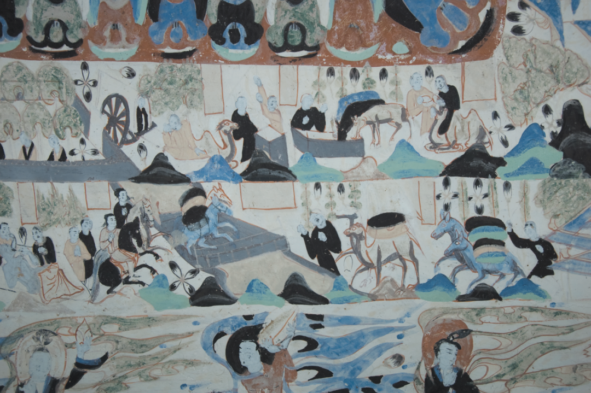
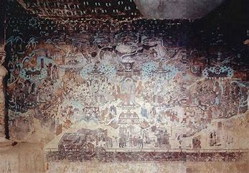
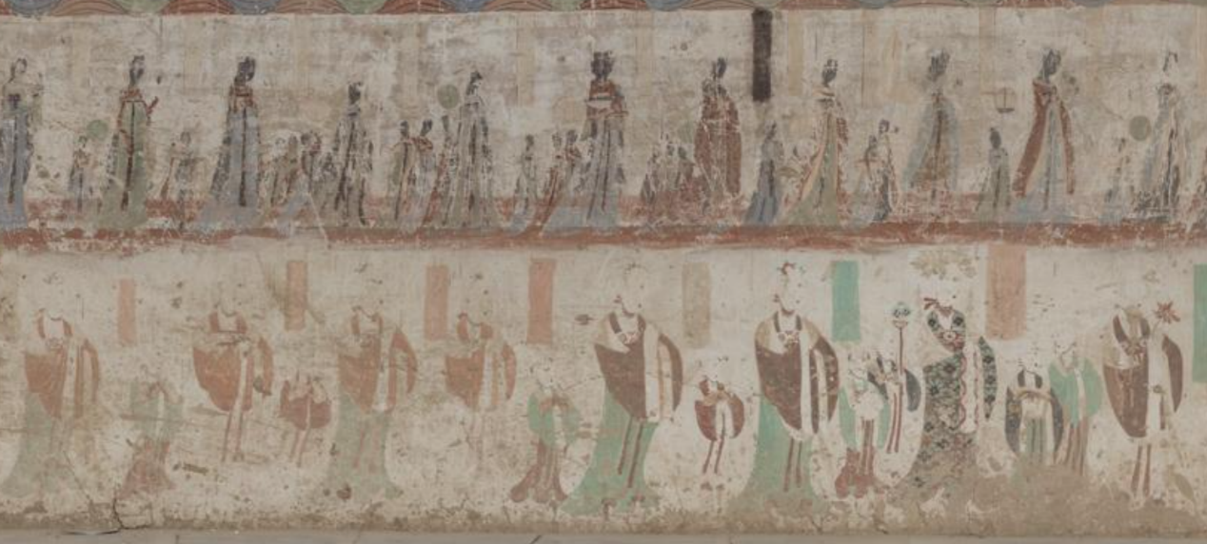
2.Architectural and Artistic Features of Dunhuang Maogao Caves
<3>Secular Themes:
Cave 296’s caravan scenes and Cave 445’s wedding rituals document Silk Road trade and folk life; Cave 61’s Cao family donor portraits, clad in lavish attire, epitomize Guiyi Jun era elite culture.
cave:296
cave:445
cave:61
竢实扬华 自强不息
Notes:
制作人:@芃苇_PengV

Slide 8
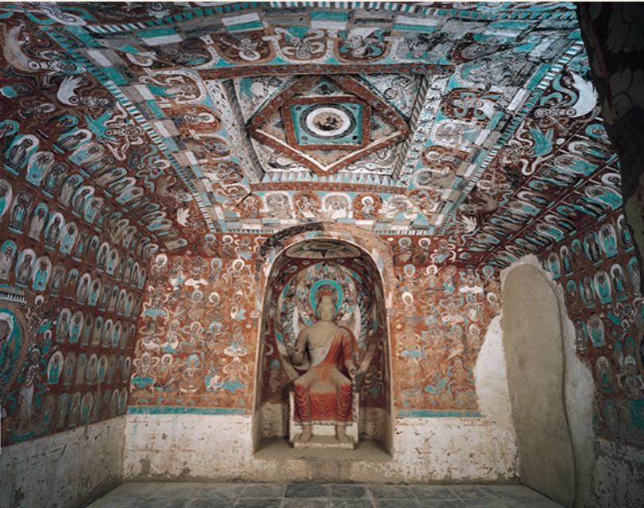
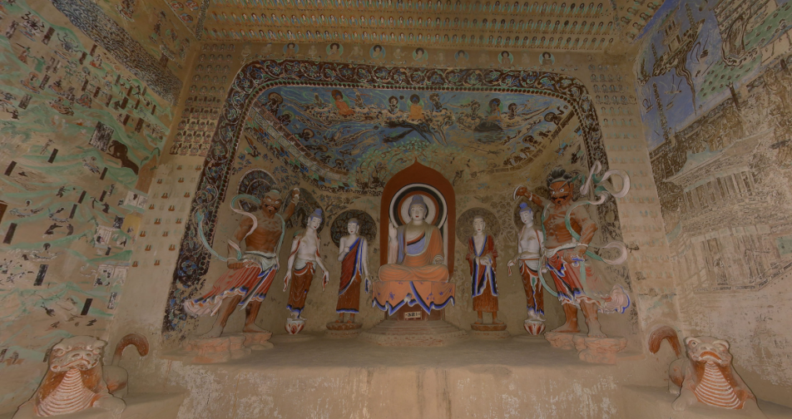
2.Architectural and Artistic Features of Dunhuang Maogao Caves
<4>The Evolution of Flying Deities
Early depictions featured sturdy and compact forms (for example., Cave 272, Northern Liang Dynasty), while post-Sui and Tang dynasties saw increasingly graceful and ethereal figures (like the paired flying deities in Cave 321 of the early Tang). Their fluttering ribbons embody the poetic rhythm of "celestial garments
Dancing in wind, walls alive with motion.”
cave:272
cave:321
竢实扬华 自强不息
Notes:
制作人:@芃苇_PengV

Slide 9
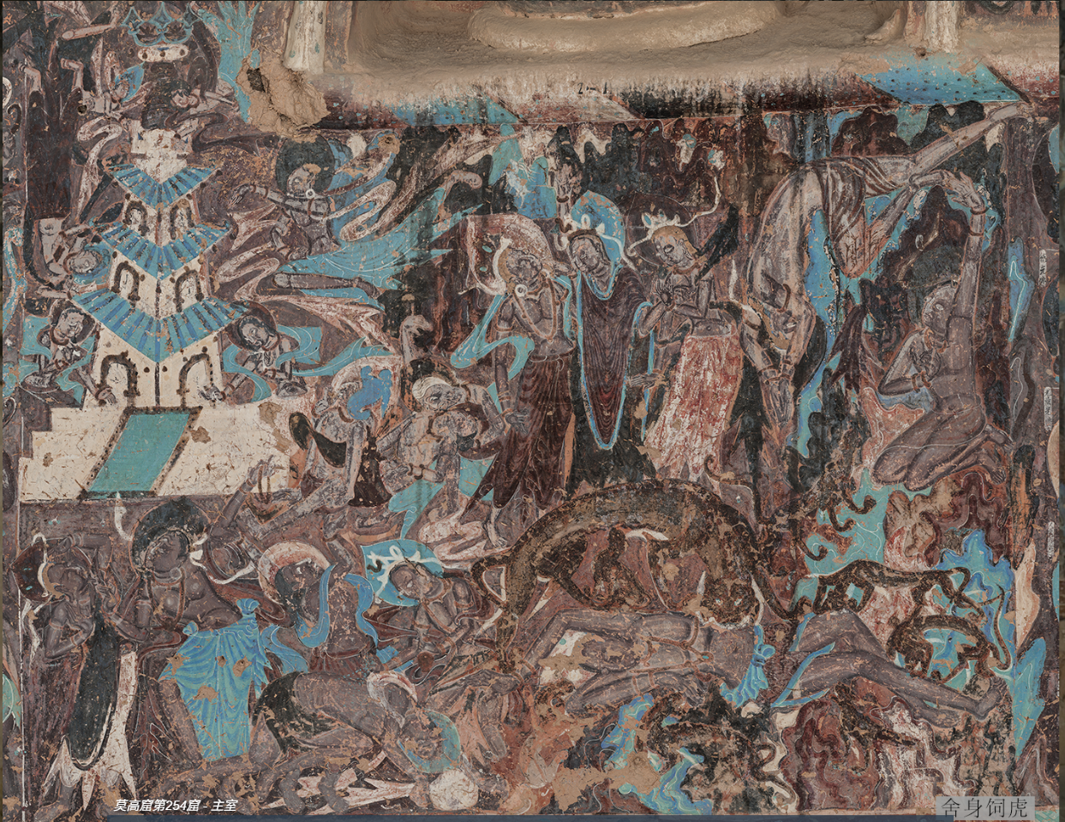
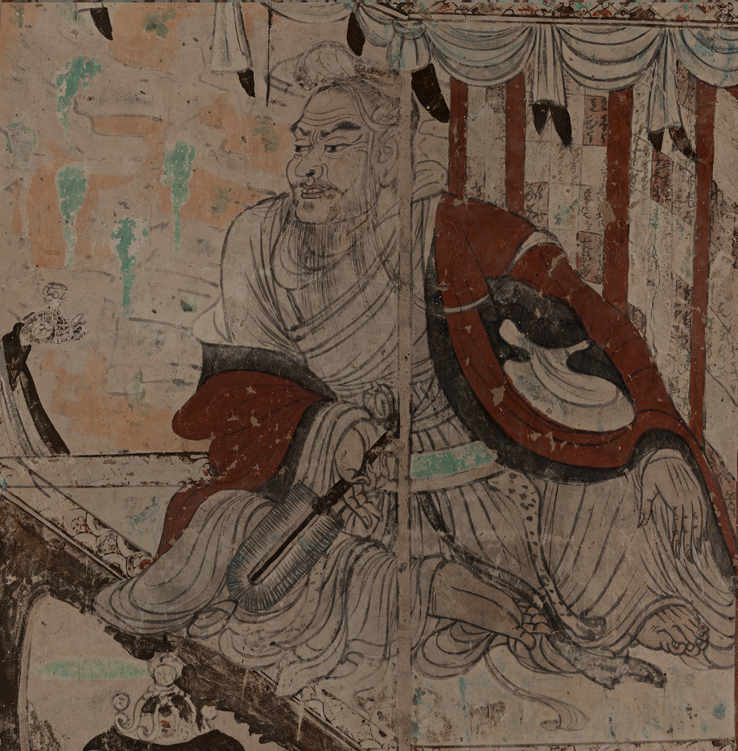
3.Cultural Fusion and Global Significance of Dunhuang Maogao Caves
The Mogao Caves epitomize Buddhism’s Sinicization.
(1)Early murals, like the Sattva Prince Offering His Body to a Tiger in Northern Wei Cave 254, adopted Central Asian "aotu" shading techniques. By the Tang era, these evolved into the "Wu-style ‘wind-blown robes’ brushwork" seen in Cave 103’s Vimalakirti Sutra Illustration—synthesizing Indian, Persian, and Chinese artistic genius.
Cave 254: "Prince Mahasattva’s Self-Sacrifice to a Tiger"
cave:103
竢实扬华 自强不息
Notes:
制作人:@芃苇_PengV

Slide 10
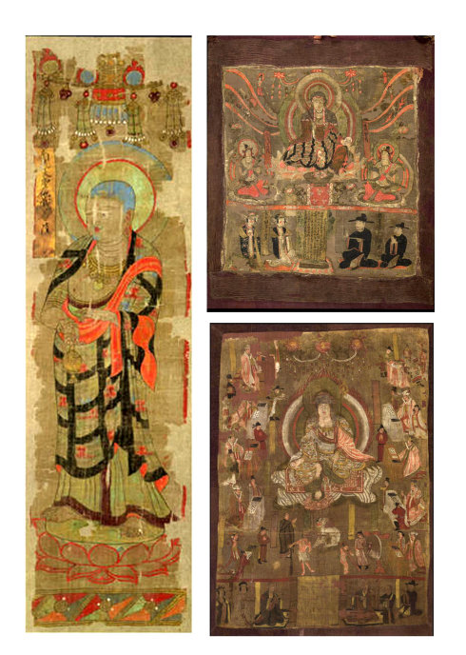
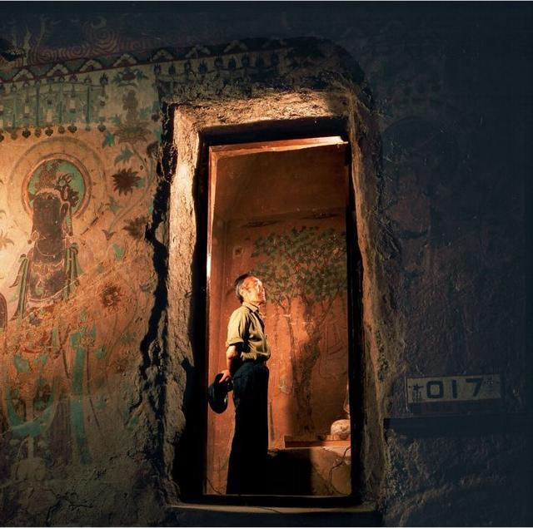
3.Cultural Fusion and Global Significance of Dunhuang Maogao Caves
(2)The Library Cave (Cave 17): Discovered in 1900 by Taoist monk Wang Yuanlu, this trove held over 50,000 manuscripts spanning the 4th–11th centuries—Buddhist texts, household registers, contracts, and multilingual documents in Chinese, Tibetan, Sanskrit, and Uighur. A "time capsule" of medieval Eurasia. Yet explorers like Aurel Stein and Paul Pelliot acquired vast quantities at minimal cost, scattering the artifacts globally—a symbol of modern China’s cultural dispossession.
竢实扬华 自强不息
Notes:
制作人:@芃苇_PengV

Slide 11
4.Preservation and Challenges of Dunhuang Maogao Caves
The Mogao Caves face threats
natural weathering
visitor pressure
pigment fading
Digitalization (for example, the Digital Dunhuang project), using high-precision scans and virtual restoration
Scholars like Rong Xinjiang and Fang Guangchang investigate why the Library Cave was sealed, linking it to historical crises like Tangut invasions and the Kara-Khanid Khanate’s eastward expansion
limiting open cave access
Epilogue:The Mogao Caves are not just an artistic sanctuary but a testament to civilizational exchange. They immortalize the footsteps of Silk Road traders, the devotion of monks, the ingenuity of artisans, and the joys and sorrows of a millennium. To protect this legacy is to honor humanity’s shared memory—and ensure its light endures for ages to come.
-
竢实扬华 自强不息
Notes:
制作人:@芃苇_PengV

Slide 12
References
[1] Chen Lin, Chen Enhui. A Brief Discussion on the Similarities and Differences between Tang Dynasty Tomb Murals and Dunhuang Mogao Grottoes Murals [J]. Art Science and Technology, 2016, (10).
[2] Shi Tingming, Chen Zhou. A Brief Analysis of the Artistic Characteristics of Dunhuang Flying Apsaras Murals [J]. Art Education, 2016, (01).
[3] Lei Guang, Li Yuanyuan. Exploration and Research on the Mural Art of Dunhuang Mogao Grottoes [J]. Art Panorama, 2015, (11).
[4] Zhang Tingting. Mogao Grottoes in Dunhuang Culture [J]. Heilongjiang History Records, 2015, (01): 127.
竢实扬华 自强不息
Notes:
制作人:@芃苇_PengV

Slide 13

01
魏小雨，冯启轩
Search for information and collect pictures
Thank you！
02
惠子贤，曾邓斌
The logical train of thought and writing of the text
03
王飞，刘康祺
PPT production and video

