Slide 1
Parallel Matlab programming using Distributed Arrays
Jeremy Kepner
MIT Lincoln Laboratory
This work is sponsored by the Department of Defense under Air Force Contract FA8721-05-C-0002. Opinions, interpretations, conclusions, and recommendations are those of the author and are not necessarily endorsed by the United States Government.
Notes:
1
1
Title Slides

Slide 2
Goal: Think Matrices not Messages
In the past, writing well performing parallel programs has required a lot of code and a lot of expertise
pMatlab distributed arrays eliminates the coding burden
  However, making programs run fast still requires expertise
This talk illustrates the key math concepts experts use to make parallel programs perform well
100
10
1
0.1
hardware limit
Expert
acceptable
Performance Speedup
Novice
hours
days
weeks
months
Programmer Effort
Notes:
The goal of the presentation is to show the techniques for writing well performing parallel Matlab programs.

Slide 3
Outline
Serial Program
Parallel Execution
Distributed Arrays
Explicitly Local
Parallel Design
Distributed Arrays
Concurrency vs Locality
Execution
Summary
Notes:
Outline Slide

Slide 4
Serial Program
Math
Matlab
X = zeros(N,N);
Y = zeros(N,N);
X,Y : ^{NxN}
Y = X + 1
Y(:,:) = X + 1;
Matlab is a high level language
Allows mathematical expressions to be written concisely
Multi-dimensional arrays are fundamental to Matlab
Notes:
Mathematical notation and corresponding matlab code for a simple calculation.

Slide 5
Parallel Execution
Math
pMatlab
Pid=Np-1
P_{ID}=N_{P}-1
Pid=1
Pid=0
P_{ID}=1
P_{ID}=0
X = zeros(N,N);
Y = zeros(N,N);
X,Y : ^{NxN}
Y = X + 1
Y(:,:) = X + 1;
Run N_{P} (or Np) copies of same program
  Single Program Multiple Data (SPMD)
Each copy has a unique P_{ID} (or Pid)
Every array is replicated on each copy of the program
Notes:
Mathematical notation and corresponding matlab code for a simple parallel calculation with replicated arrays.

Slide 6
Distributed Array Program
Math
pMatlab
Pid=Np-1
P_{ID}=N_{P}-1
Pid=1
Pid=0
P_{ID}=1
P_{ID}=0
XYmap = map([Np 1],{},0:Np-1);
X = zeros(N,N,XYmap);
Y = zeros(N,N,XYmap);
X,Y : ^{P(N)xN}
Y = X + 1
Y(:,:) = X + 1;
Use P() notation (or map) to make a distributed array
Tells program which dimension to distribute data
Each program implicitly operates on only its own data (owner computes rule)
Notes:
Mathematical notation and corresponding matlab code for a simple parallel calculation with distributed arrays.

Slide 7
Explicitly Local Program
Math
pMatlab
XYmap = map([Np 1],{},0:Np-1);
Xloc = local(zeros(N,N,XYmap));
Yloc = local(zeros(N,N,XYmap));
X,Y : ^{P(N)xN}
Y.loc = X.loc + 1
Yloc(:,:) = Xloc + 1;
Use .loc notation (or local function) to explicitly retrieve local part of a distributed array
Operation is the same as serial program, but with different data on each processor (recommended approach)
Notes:
Mathematical notation and corresponding pMatlab code for a simple parallel calculation with distributed explicitly local arrays.

Slide 8
Outline
Parallel Design
Distributed Arrays
Concurrency vs Locality
Execution
Summary
Maps
Redistribution
Notes:
Outline Slide

Slide 9
Parallel Data Maps
Array
Math
Matlab
^{P(N)xN}
Xmap=map([Np 1],{},0:Np-1)
^{NxP(N)}
Xmap=map([1 Np],{},0:Np-1)
^{P(N)xP(N)}
Xmap=map([Np/2 2],{},0:Np-1)
Computer
P_{ID}
0
1
2
3
Pid
A map is a mapping of array indices to processors
Can be block, cyclic, block-cyclic, or block w/overlap
Use P() notation (or map) to set which dimension to split among processors
Notes:
Mathematical notation and corresponding matlab code for different parallel data distributions.

Slide 10
Maps and Distributed Arrays
A processor map for a numerical array is an assignment of blocks of data to processing elements.
Amap = map([Np 1],{},0:Np-1);
Processor Grid
List of processors
Distribution
{}=default=block
A = zeros(4,6,Amap);
P0
pMatlab constructors are overloaded to take a map as an argument, and return a distributed array.
A =
P1
0
0
0
0
0
0
P2
0
0
0
0
0
0
0
0
0
0
0
0
P3
0
0
0
0
0
0
Notes:
Example illustrating how maps are use to distribute matrices.
introduced a new datatype, the distriburted array:
1. Duplicates “look and feel” of the Matlab matrix
2. Adds capability to automatically parallelize a matrix
A map is an object that concisely describes how a matrix is partitioned into blocks and how the blocks are assigned to different processors.

Slide 11
Advantages of Maps
Maps are scalable. Changing the number of processors or distribution does not change the application.
MAP1
MAP2
%Application
A=rand(M,map<i>);
B=fft(A);
map1=map([Np 1],{},0:Np-1)
map2=map([1 Np],{},0:Np-1)
Matrix Multiply
FFT along columns
Maps support different algorithms. Different parallel algorithms have different optimal mappings.
*
map([2 2],{},[0 2 1 3])
map([2 2],{},0:3)
map([2 2],{},1)
map([2 2],{},3)
Maps allow users to set up pipelines in the code (implicit task parallelism).
foo1
foo2
foo3
foo4
map([2 2],{},0)
map([2 2],{},2)
Notes:
Scalability is achieved because the task of writing the application is separated from the task of mapping the application.

Slide 12
Redistribution of Data
Math
pMatlab
Xmap = map([Np 1],{},0:Np-1);
Ymap = map([1 Np],{},0:Np-1);
X = zeros(N,N,Xmap);
Y = zeros(N,N,Ymap);
X : ^{P(N)xN}
Y : ^{NxP(N)}
Y = X + 1
Y(:,:) = X + 1;
X =
Y =
P0
P1
Data Sent
P2
P3
P0
P1
P2
P3
Different distributed arrays can have different maps
Assignment between arrays with the “=” operator causes data to be redistributed
Underlying library determines all the message to send
Notes:
Mathematical notation and corresponding matlab code for redistributing data in a simple parallel program.

Slide 13
Outline
Parallel Design
Distributed Arrays
Concurrency vs Locality
Execution
Summary
Definition
Example
Metrics
Notes:
Outline Slide

Slide 14
Definitions
Parallel Concurrency
Number of operations that can be done in parallel (i.e. no dependencies)
Measured with:
  Degrees of Parallelism
Parallel Locality
Is the data for the operations local to the processor
Measured with ratio:
  Computation/Communication
  = (Work)/(Data Moved)
Concurrency is ubiquitous; “easy” to find
Locality is harder to find, but is the key to performance
Distributed arrays derive concurrency from locality
Notes:
Definitions of parallel concurrency and parallel locality.

Slide 15
Serial
Math
Matlab
X = zeros(N,N);
Y = zeros(N,N);
X,Y : ^{NxN}
for i=1:N
for j=1:N
Y(i,j) = X(i,j) + 1
for i=1:N
for j=1:N
Y(i,j) = X(i,j) + 1;
end
end
Concurrency: max degrees of parallelism = N²
Locality
  Work = N²
  Data Moved: depends upon map
Notes:
Concurrency and locality calculation for a simple serial program.

Slide 16
1D distribution
Math
pMatlab
XYmap = map([NP 1],{},0:Np-1);
X = zeros(N,N,XYmap);
Y = zeros(N,N,XYmap);
X,Y : ^{P(N)xN}
for i=1:N
for j=1:N
Y(i,j) = X(i,j) + 1
for i=1:N
for j=1:N
Y(i,j) = X(i,j) + 1;
end
end
Concurrency: degrees of parallelism = min(N,N_{P})
Locality: Work = N², Data Moved = 0
Computation/Communication = Work/(Data Moved) → ∞
Notes:
Concurrency and locality calculation for a simple 1D parallel program.

Slide 17
2D distribution
Math
pMatlab
XYmap = map([Np/2 2],{},0:Np-1);
X = zeros(N,N,XYmap);
Y = zeros(N,N,XYmap);
X,Y : ^{P(N)xP(N)}
for i=1:N
for j=1:N
Y(i,j) = X(i,j) + 1
for i=1:N
for j=1:N
Y(i,j) = X(i,j) + 1;
end
end
Concurrency: degrees of parallelism = min(N²,N_{P})
Locality: Work = N², Data Moved = 0
Computation/Communication = Work/(Data Moved) → ∞
Notes:
Concurrency and locality calculation for a simple 2D parallel program.

Slide 18
2D Explicitly Local
Math
pMatlab
XYmap = map([Np/2 2],{},0:Np-1);
Xloc = local(zeros(N,N,XYmap));
Yloc = local(zeros(N,N,XYmap));
X,Y : ^{P(N)xP(N)}
for i=1:size(X.loc,1)
for j=1:size(X.loc,2)
Y.loc(i,j) =
X.loc(i,j) + 1
for i=1:size(Xloc,1)
for j=1:size(Xloc,2)
Yloc(i,j) = Xloc(i,j) + 1;
end
end
Concurrency: degrees of parallelism = min(N²,N_{P})
Locality: Work = N², Data Moved = 0
Computation/Communication = Work/(Data Moved) → ∞
Notes:
Concurrency and locality calculation for a simple 1D explicitly local parallel program.

Slide 19
1D with Redistribution
Math
pMatlab
Xmap = map([Np 1],{},0:Np-1);
Ymap = map([1 Np],{},0:Np-1);
X = zeros(N,N,Xmap);
Y = zeros(N,N,Ymap);
X : ^{P(N)xN}
Y : ^{NxP(N)}
for i=1:N
for j=1:N
Y(i,j) = X(i,j) + 1
for i=1:N
for j=1:N
Y(i,j) = X(i,j) + 1;
end
end
Concurrency: degrees of parallelism = min(N,N_{P})
Locality: Work = N², Data Moved = N²
Computation/Communication = Work/(Data Moved) = 1
Notes:
Concurrency and locality calculation for a simple 1D parallel program with redistribution.

Slide 20
Outline
Parallel Design
Distributed Arrays
Concurrency vs Locality
Execution
Summary
Four Step Process
Speedup
Amdahl’s Law
Perforfmance vs Effort
Portability
Notes:
Outline Slide

Slide 21
Running
Start Matlab
  Type: cd examples/AddOne
Run pAddOne
  Edit pAddOne.m and set: PARALLEL = 0;
  Type: eval(pRUN(’pAddOne’,1,{}))
Repeat with: PARALLEL = 1;
Repeat with: eval(pRUN(’pAddOne’,2,{}));
Repeat with: eval(pRUN(’pAddOne’,2,{’cluster’}));
Four steps to taking a serial Matlab program and making it a parallel Matlab program
Notes:
Example matlab code for the four step parallel debugging process.

Slide 22
Parallel Debugging Processes
Simple four step process for debugging a parallel program
Serial
Matlab
Add distributed matrices without maps, verify functional correctness
PARALLEL=0; pRUN(’pAddOne’,1,{});
Step 1
Add DMATs
Serial
pMatlab
Functional correctness
Add maps, run on 1 processor, verify parallel correctness, compare performance with Step 1
PARALLEL=1; pRUN(’pAddOne’,1,{});
Step 2
Add Maps
Mapped
pMatlab
pMatlab correctness
Step 3
Add Matlabs
Run with more processes, verify parallel correctness
PARALLEL=1; pRUN(’pAddOne’,2,{}) );
Parallel
pMatlab
Parallel correctness
Step 4
Add CPUs
Run with more processors, compare performance with Step 2
PARALLEL=1; pRUN(’pAddOne’,2,{‘cluster’});
Optimized
pMatlab
Performance
Always debug at earliest step possible (takes less time)
Notes:
Methodology for debugging parallel applications.

Slide 23
Timing
Run dAddOne: pRUN(’pAddOne’,1,{’cluster’});
  Record processing_time
Repeat with: pRUN(’pAddOne’,2,{’cluster’});
  Record processing_time
Repeat with: pRUN(’pAddone’,4,{’cluster’});
  Record processing_time
Repeat with: pRUN(’pAddone’,8,{’cluster’});
  Record processing_time
Repeat with: pRUN(’pAddone’,16,{’cluster’});
  Record processing_time
Run program while doubling number of processors
Record execution time
Notes:
Example matlab code for timing a parallel code.

Slide 24
Computing Speedup
Speedup
Number of Processors
Speedup Formula: Speedup(N_{P}) = Time(N_{P}=1)/Time(N_{P})
Goal is sublinear speedup
All programs saturate at some value of N_{P}
Notes:
Computing speedup for a parallel program.

Slide 25
Amdahl’s Law
Linear
S_{max} = w|⁻¹
Speedup
w| = 0.1
S_{max}/2
N_{P} = w|⁻¹
Processors
Divide work into parallel (w||) and serial (w|) fractions
Serial fraction sets maximum speedup: S_{max} = w|⁻¹
Likewise: Speedup(N_{P}=w|⁻¹) = S_{max}/2
Notes:
Definition and illustration of Amdahl’s Law.

Slide 26
HPC Challenge Speedup vs Effort
1000
ideal speedup = 128
100
STREAM
STREAM
C + MPI
HPL
10
Matlab
FFT
FFT
pMatlab
HPL(32)
1
HPL
FFT
STREAM
Serial C
Speedup
0.1
0.01
Random Access
Random Access
0.001
Random Access
0.0001
0.001
0.01
0.1
1
10
Relative Code Size
Ultimate Goal is speedup with minimum effort
HPC Challenge benchmark data shows that pMatlab can deliver high performance with a low code size
Notes:
Examples of the performance achieved vs the code size for different parallel codes.

Slide 27
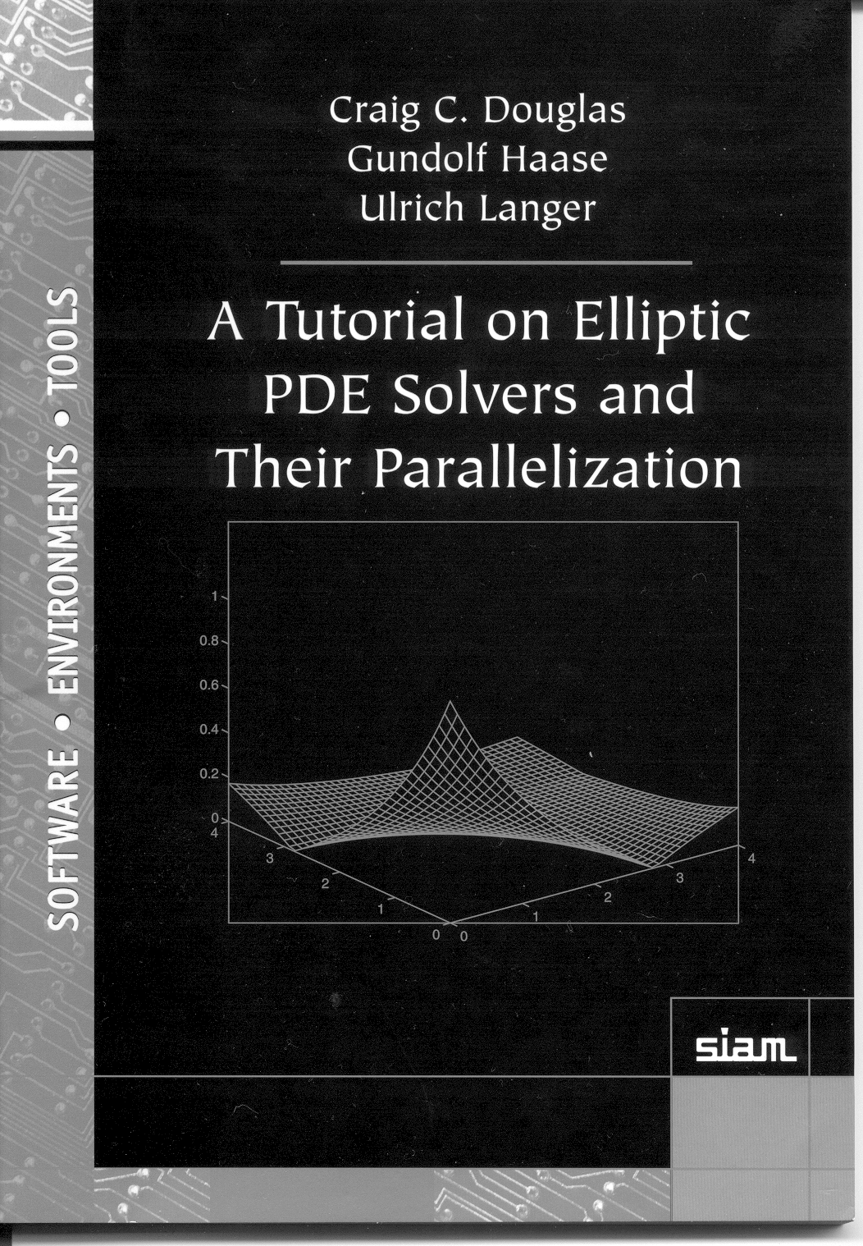
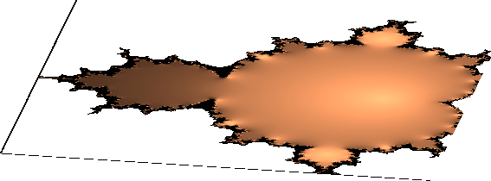
Portable Parallel Programming
Universal Parallel Matlab programming
Jeremy Kepner
Parallel MATLAB
for Multicore and Multinode Systems
Amap = map([Np 1],{},0:Np-1);
Bmap = map([1 Np],{},0:Np-1);
A = rand(M,N,Amap);
B = zeros(M,N,Bmap);
B(:,:) = fft(A);
pMatlab runs in all parallel Matlab environments
Only a few functions are needed
  Np
  Pid
  map
  local
  put_local
  global_index
  agg
  SendMsg/RecvMsg
1
2
3
4
Only a small number of distributed array functions are necessary to write nearly all parallel programs
Restricting programs to a small set of functions allows parallel programs to run efficiently on the widest range of platforms
Notes:
Universal API for parallel Matlab programming.

Slide 28
Summary
Distributed arrays eliminate most parallel coding burden
Writing well performing programs requires expertise
Experts rely on several key concepts
  Concurrency vs Locality
  Measuring Speedup
  Amdahl’s Law
Four step process for developing programs
  Minimizes debugging time
  Maximizes performance
Step 1
Step 2
Step 3
Step 4
Serial
MATLAB
Serial
pMatlab
Mapped
pMatlab
Parallel
pMatlab
Optimized
pMatlab
Add DMATs
Add Maps
Add Matlabs
Add CPUs
Functional correctness
pMatlab correctness
Parallel correctness
Performance
Get It Right
Make It Fast
Notes:
Summary.

