Slide 1

A
PROJECT PRESENTATION
ON
SMART CROP PREDICTION AND CLASSIFICATION SYSTEM
Submitted
In partial Fulfillment
For the Award of the Degree of
BACHELOR OF TECHNOLOGY
IN
COMPUTER SCIENCE & ENGINEERING
SUBMITTED TO: SUBMITTED BY:
ER. PAWAN SEN RAVI KUMAR (21EAYCS117)
HOD, CSE AYUSHI KUMARI (21EAYCS030)
B TECH, CSE (VIII SEM)

Slide 2
INTRODUCTION
Agriculture is a key economic sector in India.
Farmers face issues like unpredictable yield and undetected diseases.
Technology (AI, ML, and Satellite Data) can provide smart solutions.
Our system offers disease detection, yield forecasting, and field classification.

Slide 3

OBJECTIVES
Early detection of crop diseases using images.
Predict crop yield based on environmental data.
Classify agricultural land using satellite images.
Provide real-time insights and farmer-friendly UI.

Slide 4
PS REVIEW
CNNs are widely used for disease detection (Mohanty et al., 2016).
Regression and XGBoost models are accurate for yield prediction.
Mask R-CNNs enable field-level segmentation in satellite imagery.
Most systems focus on single features — we offer an integrated solution.
UI Look and Feel is Most Importent

Slide 5

SYSTEM ARCHITECTURE
Frontend: JavaFX
Backend: Python (Flask / FastAPI)
Models: CNN (disease), XGBoost (yield), Mask R-CNN (satellite)
Database: MySQL + MongoDB
Cloud Deployment: AWS EC2 + Docker

Slide 6
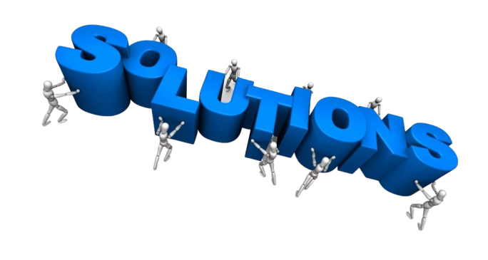
METHEDOLOGY
Collect crop images, environmental parameters, and satellite data.
Preprocess and clean datasets.
Train ML models using TensorFlow, XGBoost, and PyTorch.
Create REST APIs to serve models.
Integrate APIs with the Java-based frontend.

Slide 7
FEATURES & MODULES
Disease Detection Module – Leaf image input → Prediction output.
Yield Prediction Module – Data input → Predicted yield.
Satellite Analysis Module – Field map input → Crop zone classification.
Dashboard – User records, NDVI graphs, download reports

Slide 8

RESULTS
Unit, Integration, System & UAT completed.
CNN Accuracy: 96.4%, XGBoost R²: 0.87
Satellite Classification mAP: 0.29
Real-time performance under 2 seconds for most predictions.

Slide 9
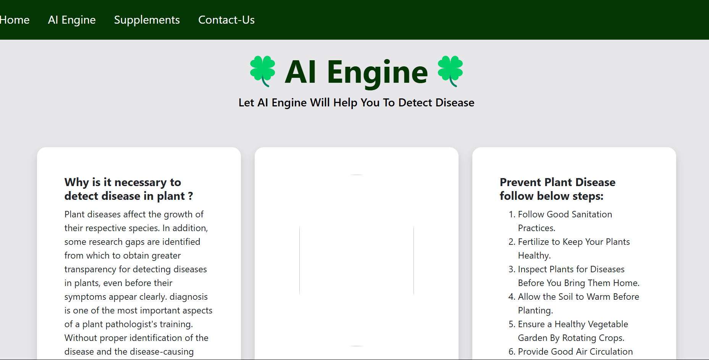
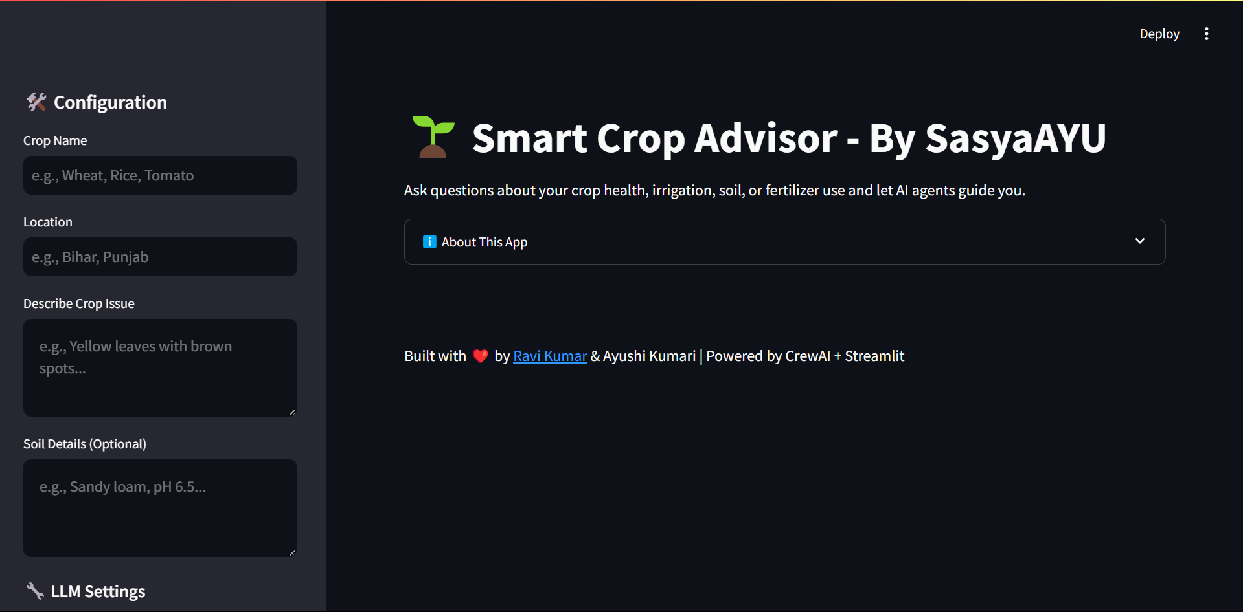
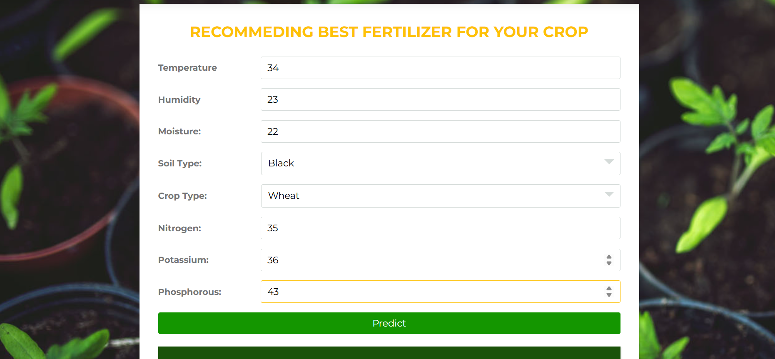
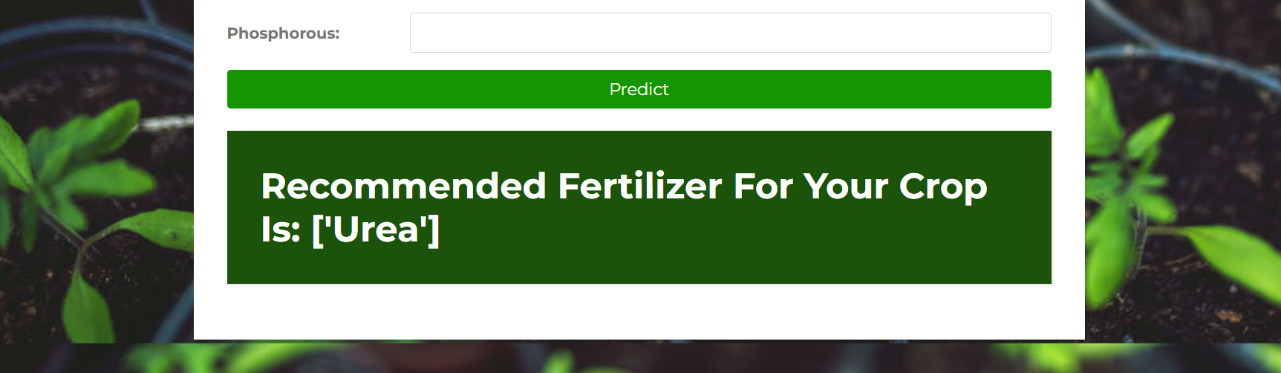
RESULTS

Slide 10
RESULTS
Tomato leaf input → Detected: Early Blight (94.3% confidence)
Rice + rainfall data → Predicted Yield: 4.5 tons/hectare
Field coordinates → NDVI map with 85% irrigated zones identified
Positive feedback from initial users

Slide 11
LIMITATIONS
Image quality affects detection accuracy.
Real-time weather/soil data may be unavailable in remote areas.
Satellite imagery limited by resolution/cloud cover.
Currently supports only selected crops and diseases.

Slide 12


REFERENCE
Ahuja, S., & Kumar, P. (2020). Application of machine learning in agriculture: A survey. Journal of Agricultural Informatics, 11(1), 12–26. https://doi.org/10.17700/jai.2020.11.1.574
Mohanty, S. P., Hughes, D. P., & Salathé, M. (2016). Using deep learning for image-based plant disease detection. Frontiers in Plant Science, 7, 1419. https://doi.org/10.3389/fpls.2016.01419
Zhang, X., & Wang, J. (2022). Big data analytics in agriculture: Opportunities and challenges. Journal of Big Data, 9(1), 67. https://doi.org/10.1186/s40537-022-00655-8
Van der Heijden, G., & Timmers, L. (2019). Precision agriculture and IoT: Technologies and applications. Springer.
Rustowicz, R. M., Cheong, R., Wang, S., & Lobell, D. (2019). Semantic segmentation of crop type in Africa: A novel dataset and analysis of deep learning methods. IEEE Conference on Computer Vision and Pattern Recognition Workshops (CVPRW), 2019, 93–100. https://doi.org/10.1109/CVPRW.2019.00018

Slide 13


