Slide 1
Hindsight Debugging
Daniel Sommermann, Michael Gummelt

Slide 2
Current Difficulties
What's wrong with breakpoint based debugging?
  Breakpoints require knowing point of interest before you run the program
  Often not possible to play a program in reverse (you have to restart execution if you go beyond point of interest)
  No way to easily skip around in the program execution
Many programmers revert to debugging output (e.g. printf) rather than using a debugger

Slide 3
New Approach
Save as much information as possible during the execution of your program
Use that information to answer queries about the state of the program at any line of code
Disambiguate code that has been called more than once

Slide 4
Our Toy Language...

Slide 5
MGDS Language Definition
f = fn(x1, .., xn) { s; [s;] }
s = var = e
return e
returnif e, e
e = c1 | ... | cn
(e)
x
e1 + e2
e1 - e2
e1 * e2
e1 / e2
e1 == e2
!e1
e1 && e2
e1 || e2
e1 == e2
e1 < e2
e1 > e2
if e1 then e2 else e3
f(e1, ..., en)

Slide 6
Example MGDS Code
Computing tetrahedral numbers
// returns the the number of balls in a triangular pyramid with
// n balls in one side of the base
tetra(n) {
returnif n < 2, n;
ballsHere = tetraLevel(n);
restOfPyramid = tetra(n-1);
return ballsHere + restOfPyramid;
}
tetraLevel(n) {
returnif n < 2, n;
return tetraLevel(n-1) + n;
}
main() {
return tetra(5);
}

Slide 7
Summary of Commands
quit
s <line number>
fs <line number>
run
p
help
l [<line number>]

Slide 8
Demo!

Slide 9
Implementation Overview
Parsing
Interpreting
Saving state

Slide 10

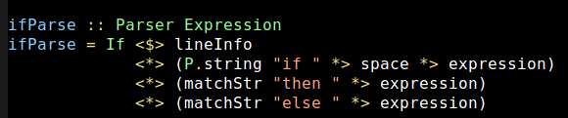
Parsing
Quickly prototyped with Attoparsec
Switched to Parsec to get line information
Extremely natural code using
Applicative Functors
Mirrors BNF closely

Slide 11
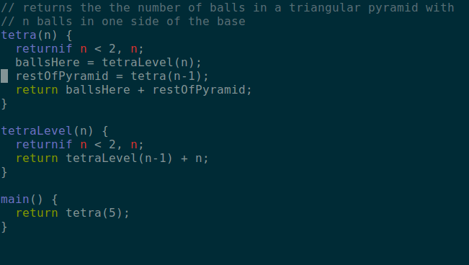
Interpreting

Slide 12
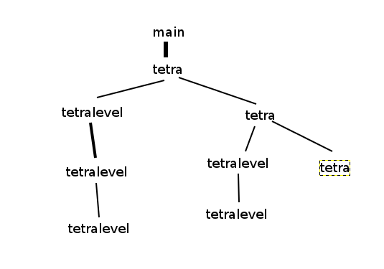
Call Graph

Slide 13
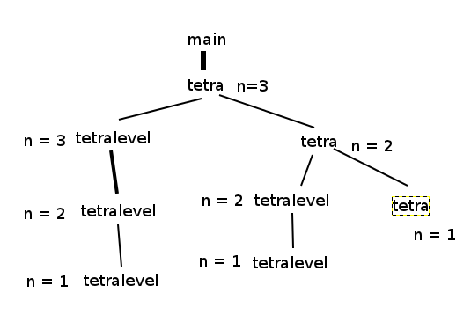
Save Args

Slide 14
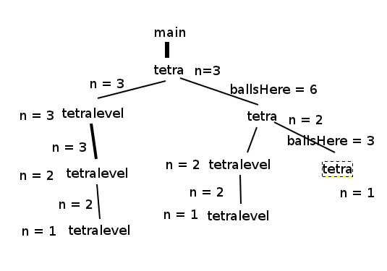
Save Call State

Slide 15
Previous work
Closest is Visual Studio's IntelliTrace
  Only available in $10,000/license uber-mega-neato version of Visual Studio
  Does similar snapshotting
  We capture entire program execution
    Can visualize the entire call tree using our tool

Slide 16
Questions?

