Slide 1
Citizen Science Ontologies
Esena Aliaj
David Southwick

Slide 2
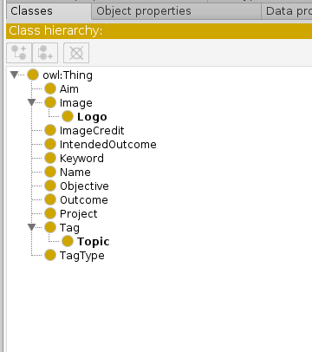
Status
Created Ontologies from given graphs using Protege- many sub-ontologies from cs-full graph and another ontology from cs abstract graph.
Doubts either are classes/objects and data properties/object properties.
Same relations with different domains,range:(hasPart)
Importing individuals from data-sources:
  Starting with Zoo.ttl (smallest), individuals import correctly, yet inconsistencies exist

Slide 3
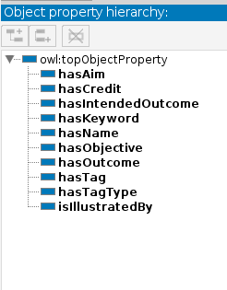
Status
Script required to convert axioms, object properties not regularly encoded in TTL files (or missing)
Additional relations for equivalences between sets (naming differences)
Work ongoing to unify datasets...

Slide 4
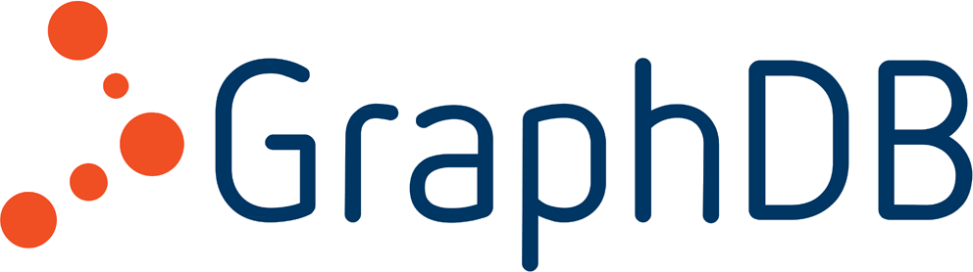
Plans
Use similar graphDB storage as project 1
Python sparql interface to DB
Search also built via python – execute sparql queries

