Slide 2
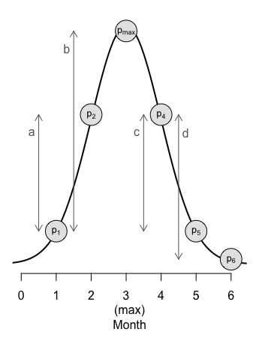

Prevalence ratio (θ_{t}) is defined as
$$θ_{t}=\left\{\begin{matrix}\frac{p_{t+1}−p_{t}}{p_{max}−p_{t}} if t≤t+1 \\ 1−\frac{p_{t}−p_{t+1}}{p_{t+1}} if t≥t+1\end{matrix}\right.$$
where t and t+1 identify pairs of adjacent months. Prevalence in months t, t+1, and the month (max) corresponding to peak prevalence, are denoted by p_{t}, p_{t+1}, and p_{max}, respectively.
In the illustrated example, in month 1, prevalence increases by “a” units out of a possible “b”, and so θ₁=a/b. In month 4, prevalence decreases by “c” units out of a possible “d”, and so θ₄=1-c/d.

Slide 3
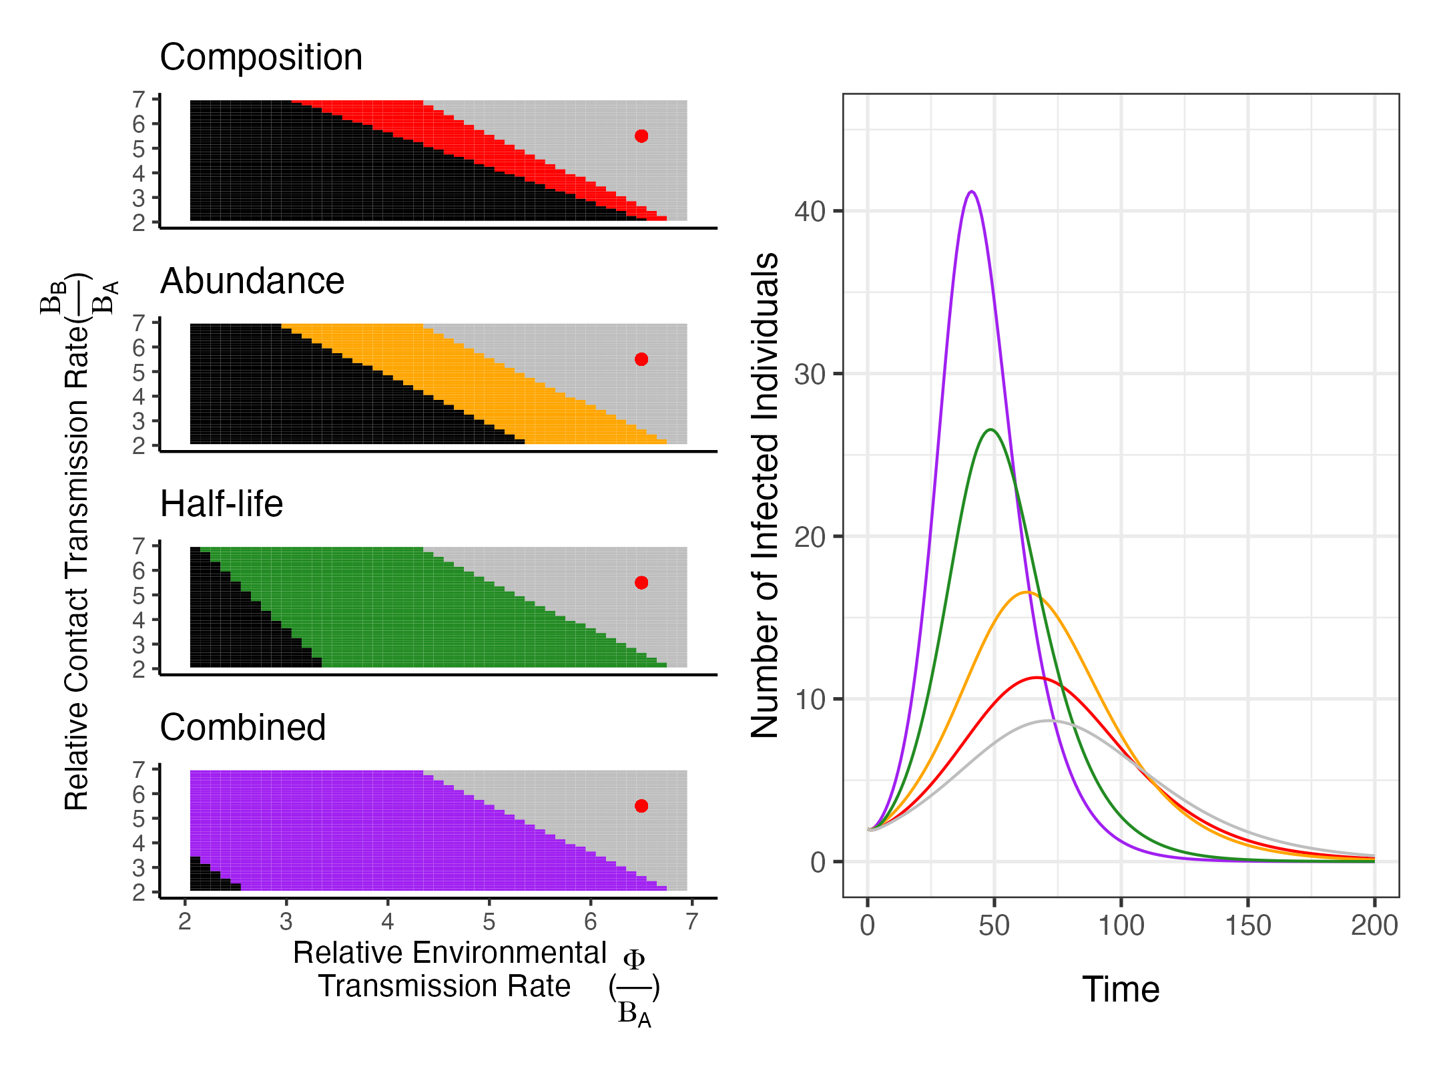
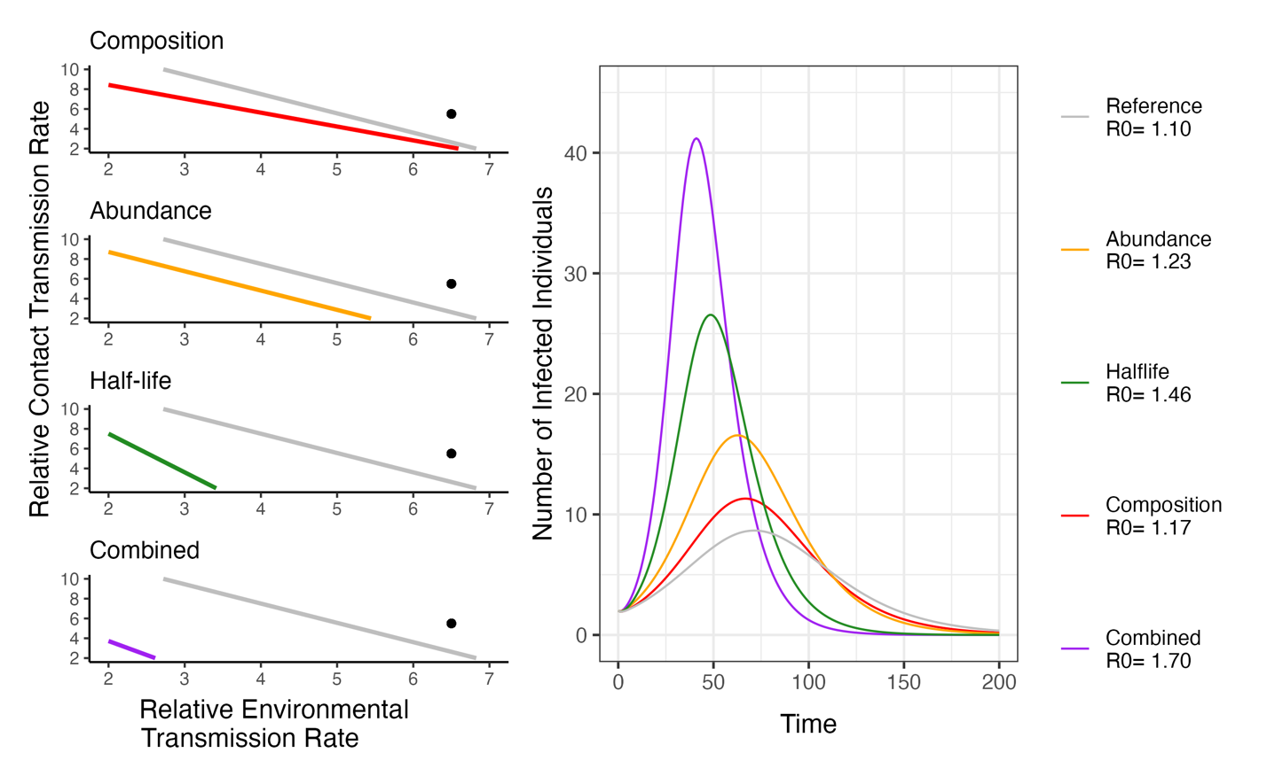
A
B

Slide 4
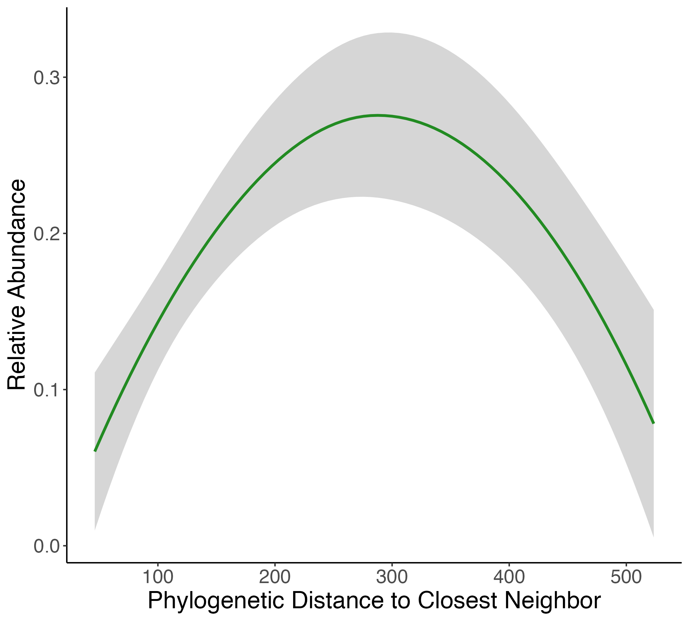

D
A
B
C

