Slide 2
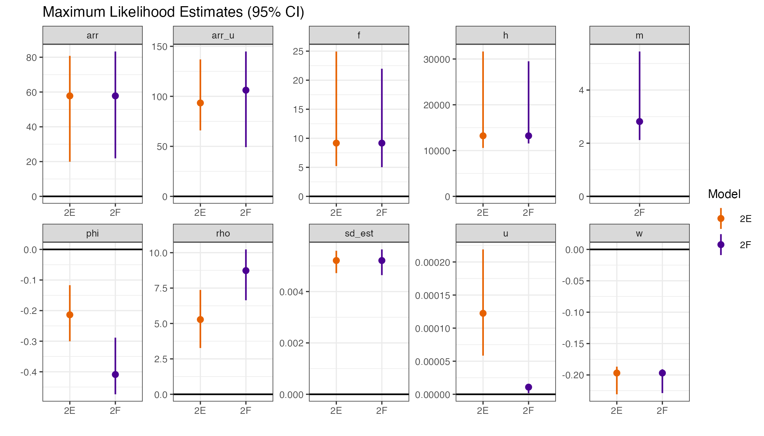










Maximum Likelihood Estimates (95% CI)
$$T_{A}^{f}$$
$$T_{A}^{u}$$
$$f′$$
$$h′$$
$$m$$
$$ϕ$$
$$ρ$$
$$σ$$
$$u′$$
$$ω$$

Slide 3
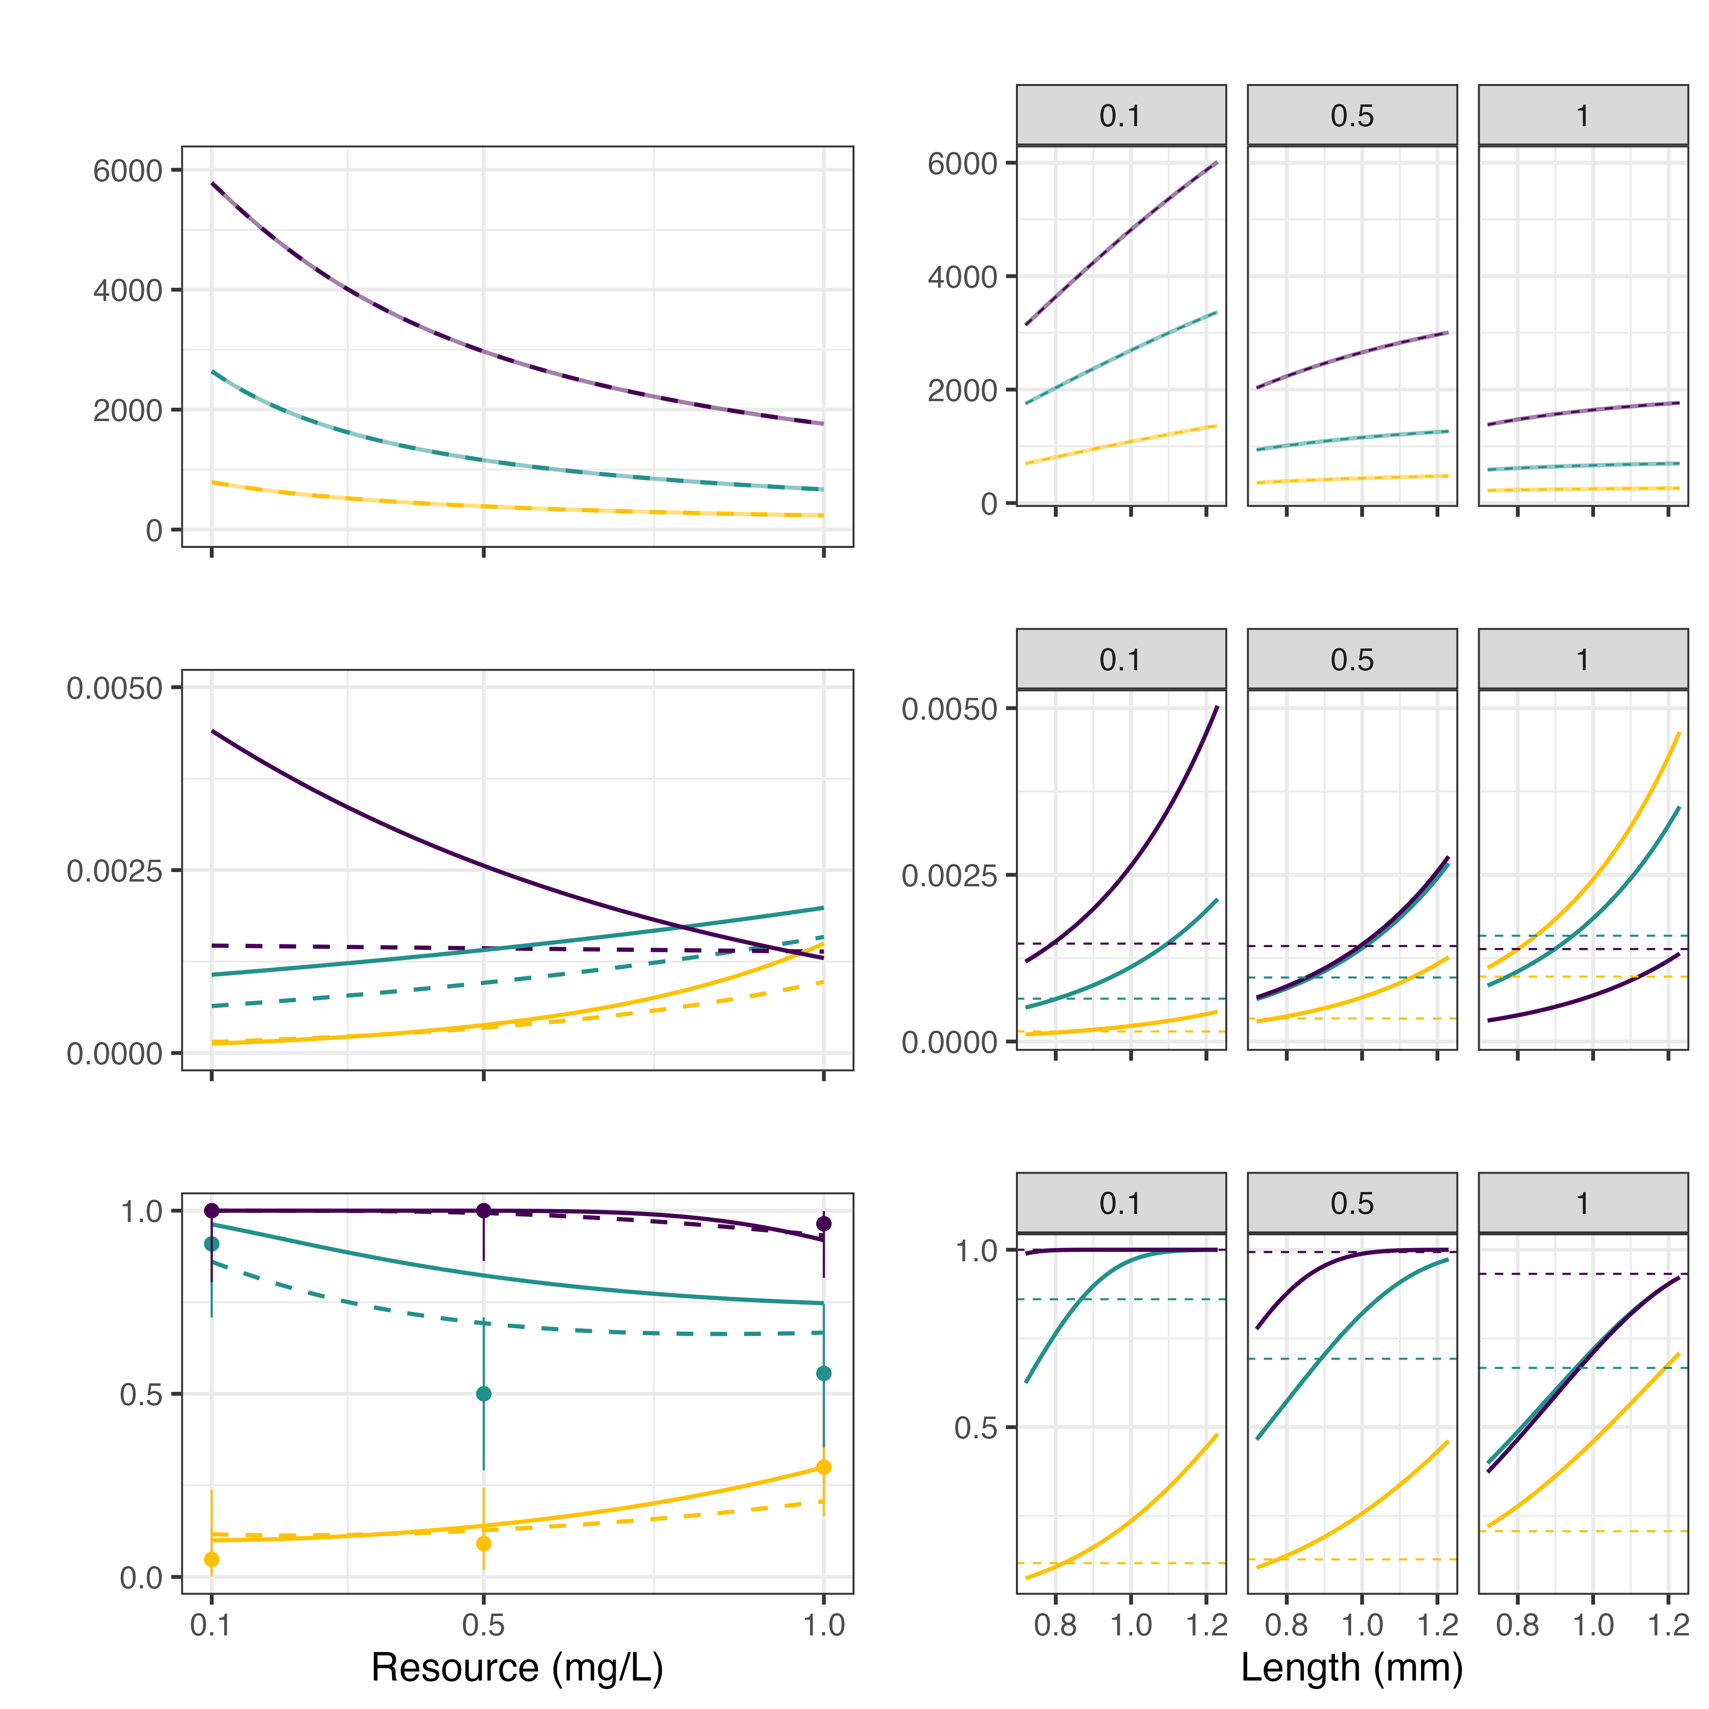
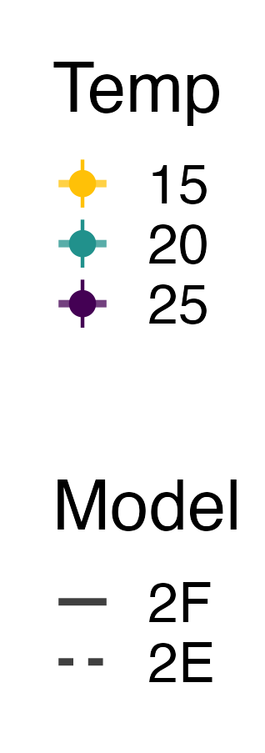
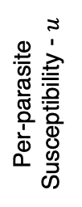
Spores consumed
Temp. (°C)
Per-parasite
Susceptibility - $u$
Model
Infection
Prevalence
Resource Concentration (mg/L)
Length (mm)

