Slide 1
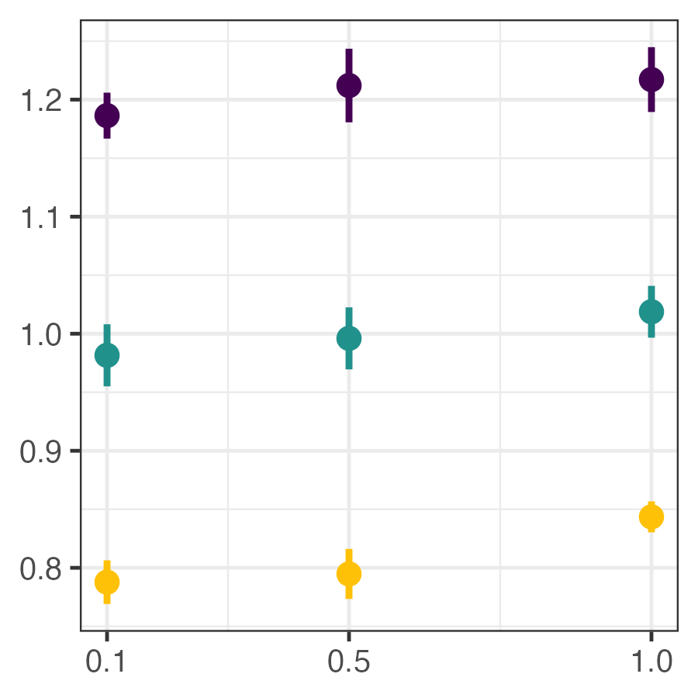
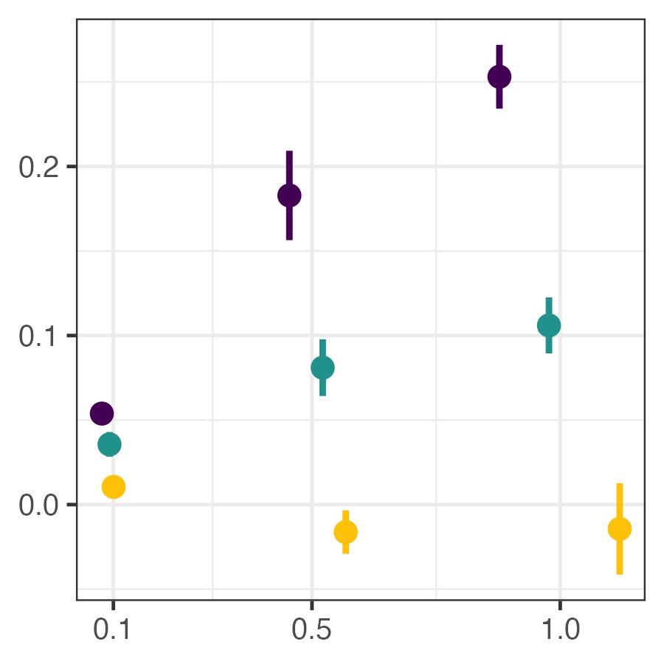
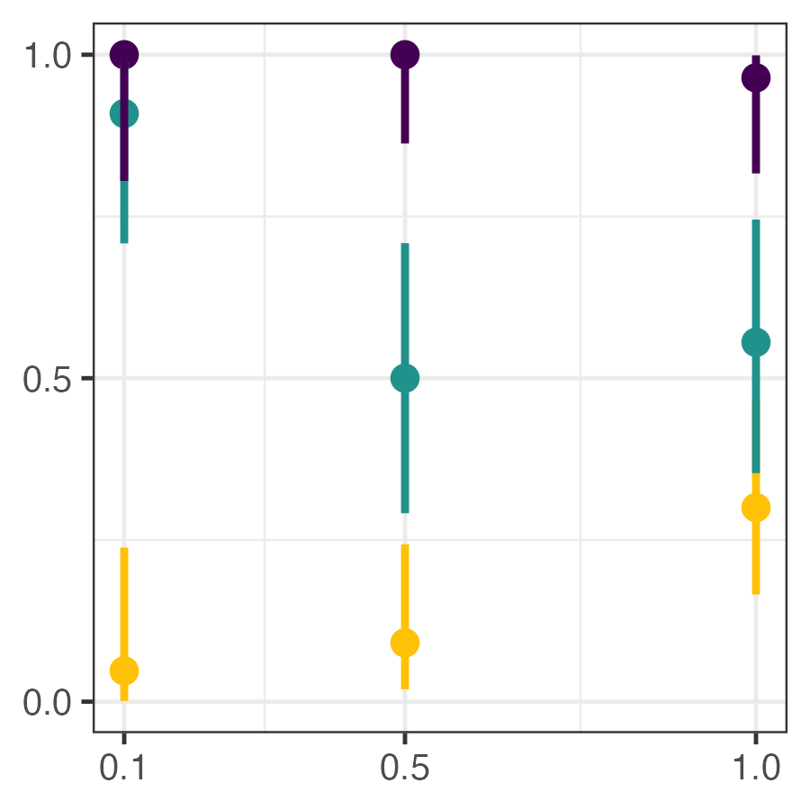
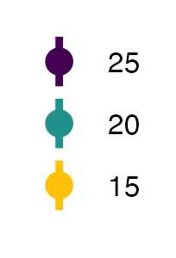
A
T: p < 0.001 R: p < 0.01
TxR: p = 0.294
B
T: p < 0.01 R: p < 0.001
TxR: p < 0.001
C
T: p < 0.001 R: p < 0.001
TxR: p < 0.001
Temp. (°C)
Body Length (mm)
Resource consumed (mgC/L)
Infection Prevalence
Resource Concentration (mgC/L)

Slide 2
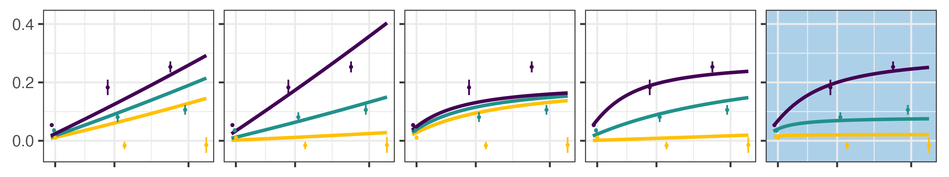
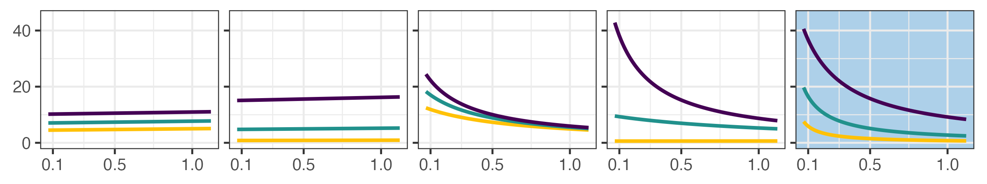

(1A) Size-only
(1B) Temperature-only
(1C) Resource-only
(1D) Additive
(1E) Interactive
Resources consumed (mgC/L)
Temp. (°C)
Foraging Rate - $f$ (mL/day)
Resource Concentration (mgC/L)

Slide 3
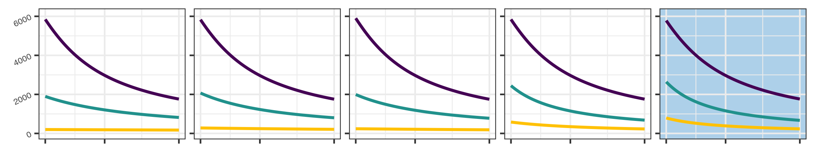
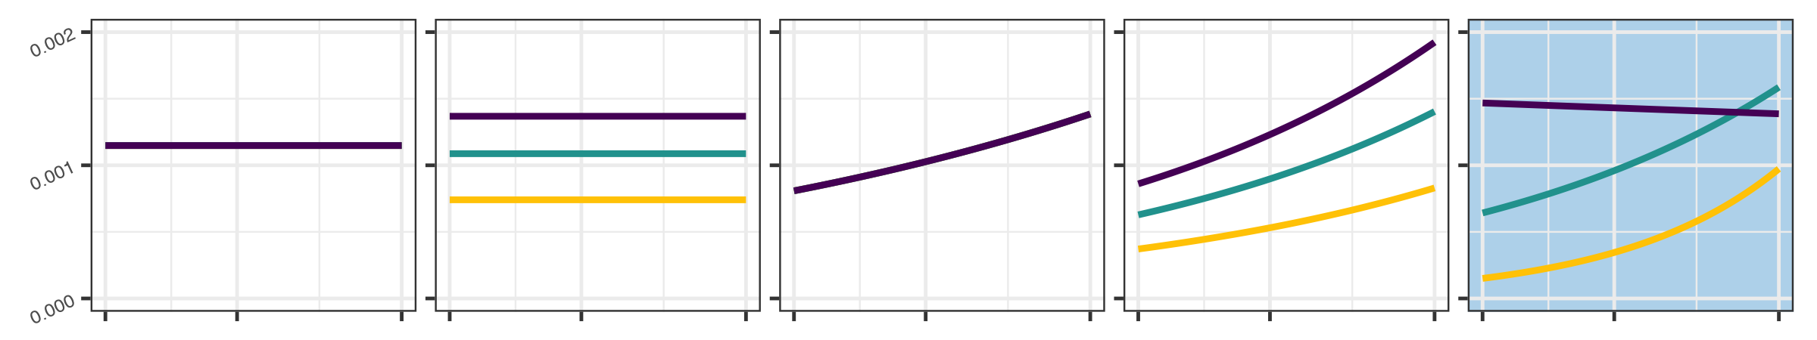
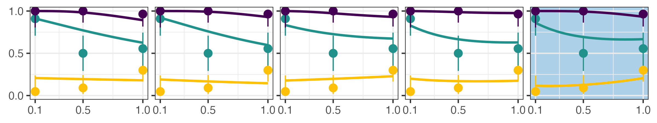
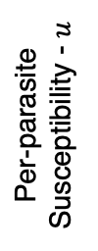
(2A) Independent
(2B) Temperature-only
(2C) Resource-only
(2D) Additive
(2E) Interactive
Spores consumed
Temp. (°C)
Per-parasite
Susceptibility - $u$
Infection
Prevalence
Resource Concentration (mgC/L)

Slide 4
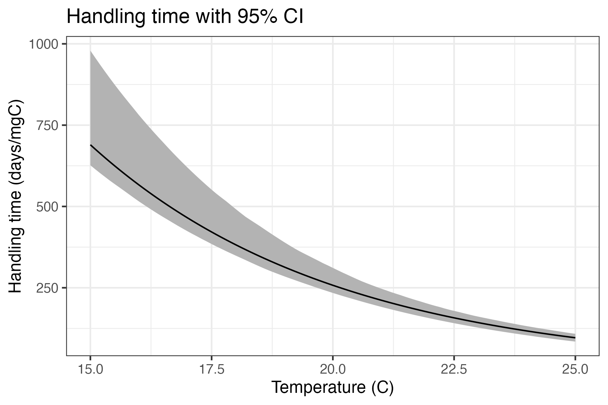
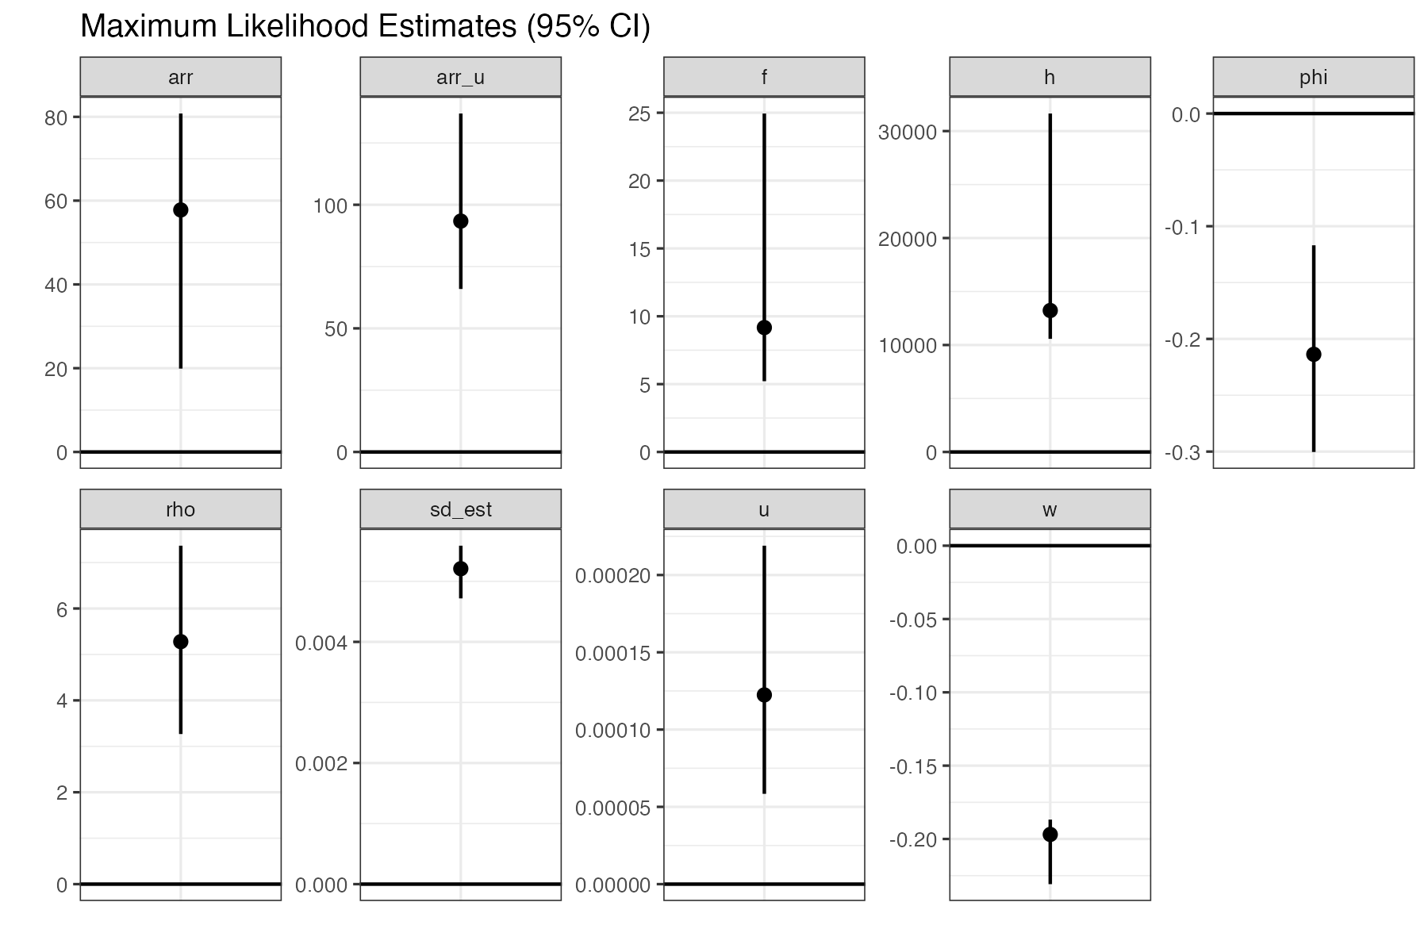








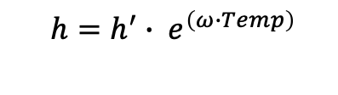


Maximum Likelihood Estimates with 95% CI
A
Handling time with 95% CI
B
$$T_{A}^{f}$$
$$T_{A}^{u}$$
$$f′$$
$$h′$$
$$ϕ$$
$$h=h^{′}∙ e^{\left(ω∙Temp\right)}$$
Handling time $h$ (days/mgC)
$$ρ$$
$$σ$$
$$u′$$
$$ω$$
Temperature (°C)
Notes:
Temperature-dependent handling time

Slide 5
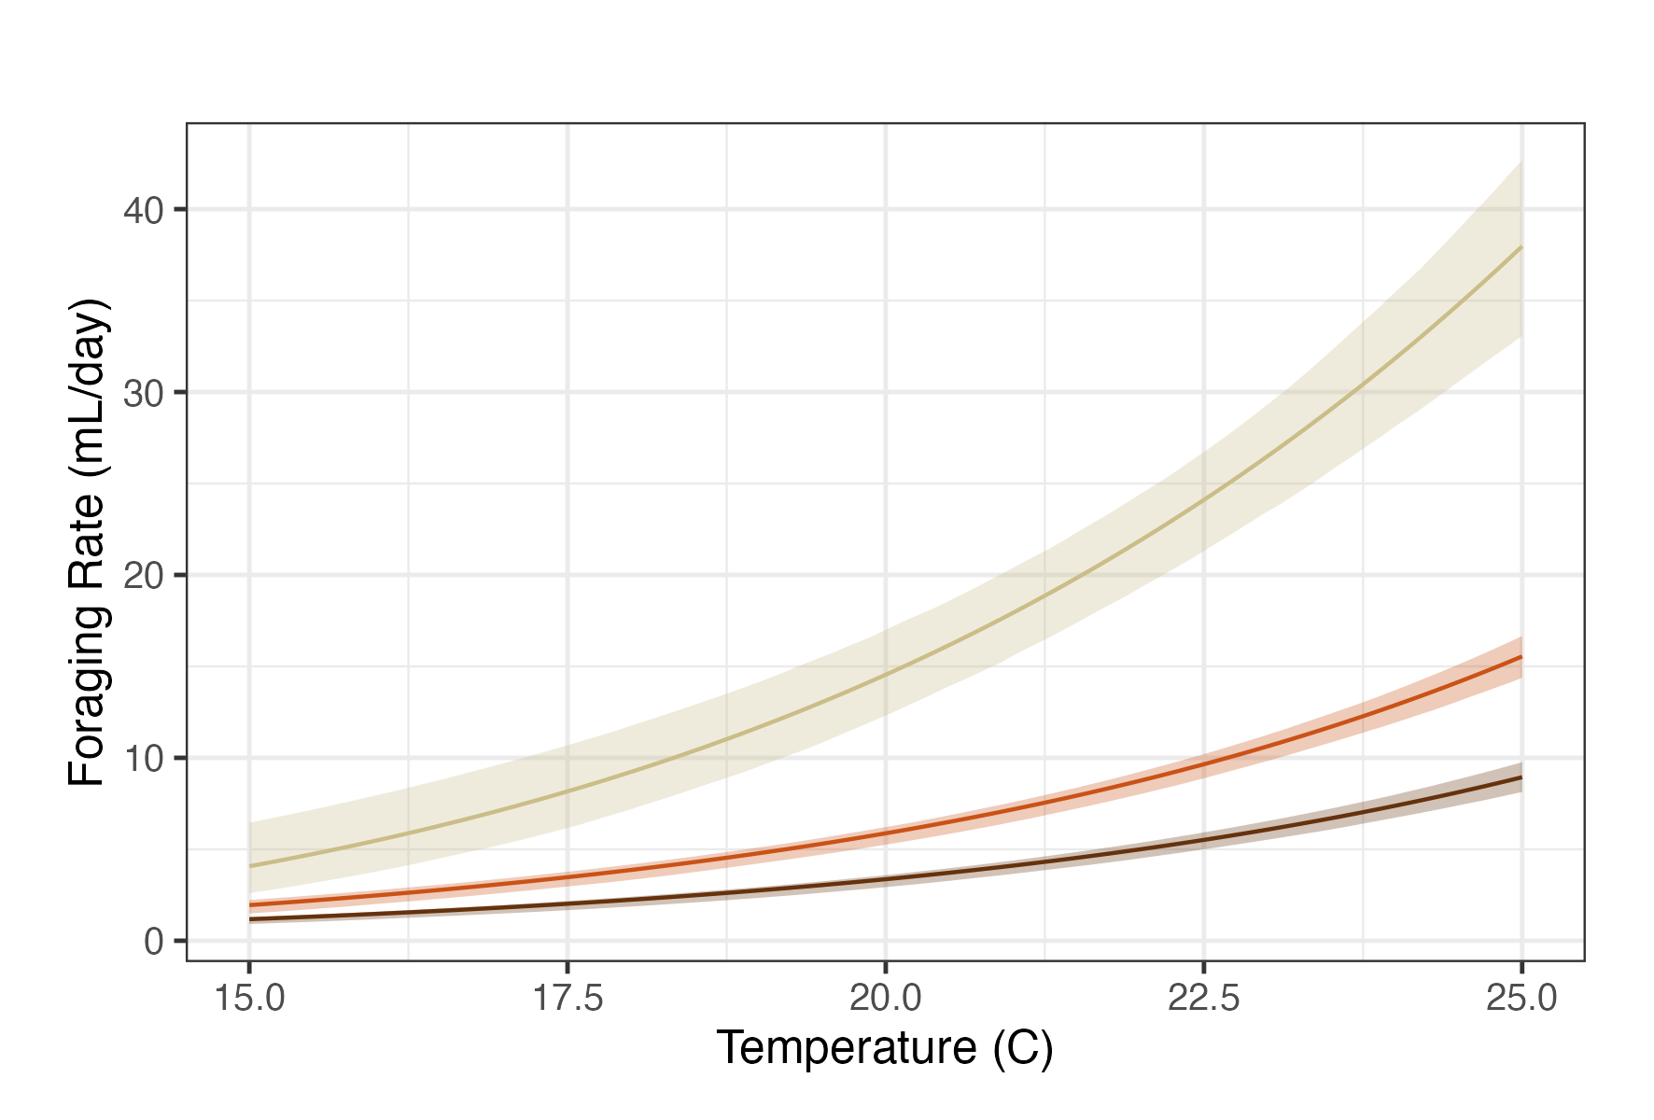
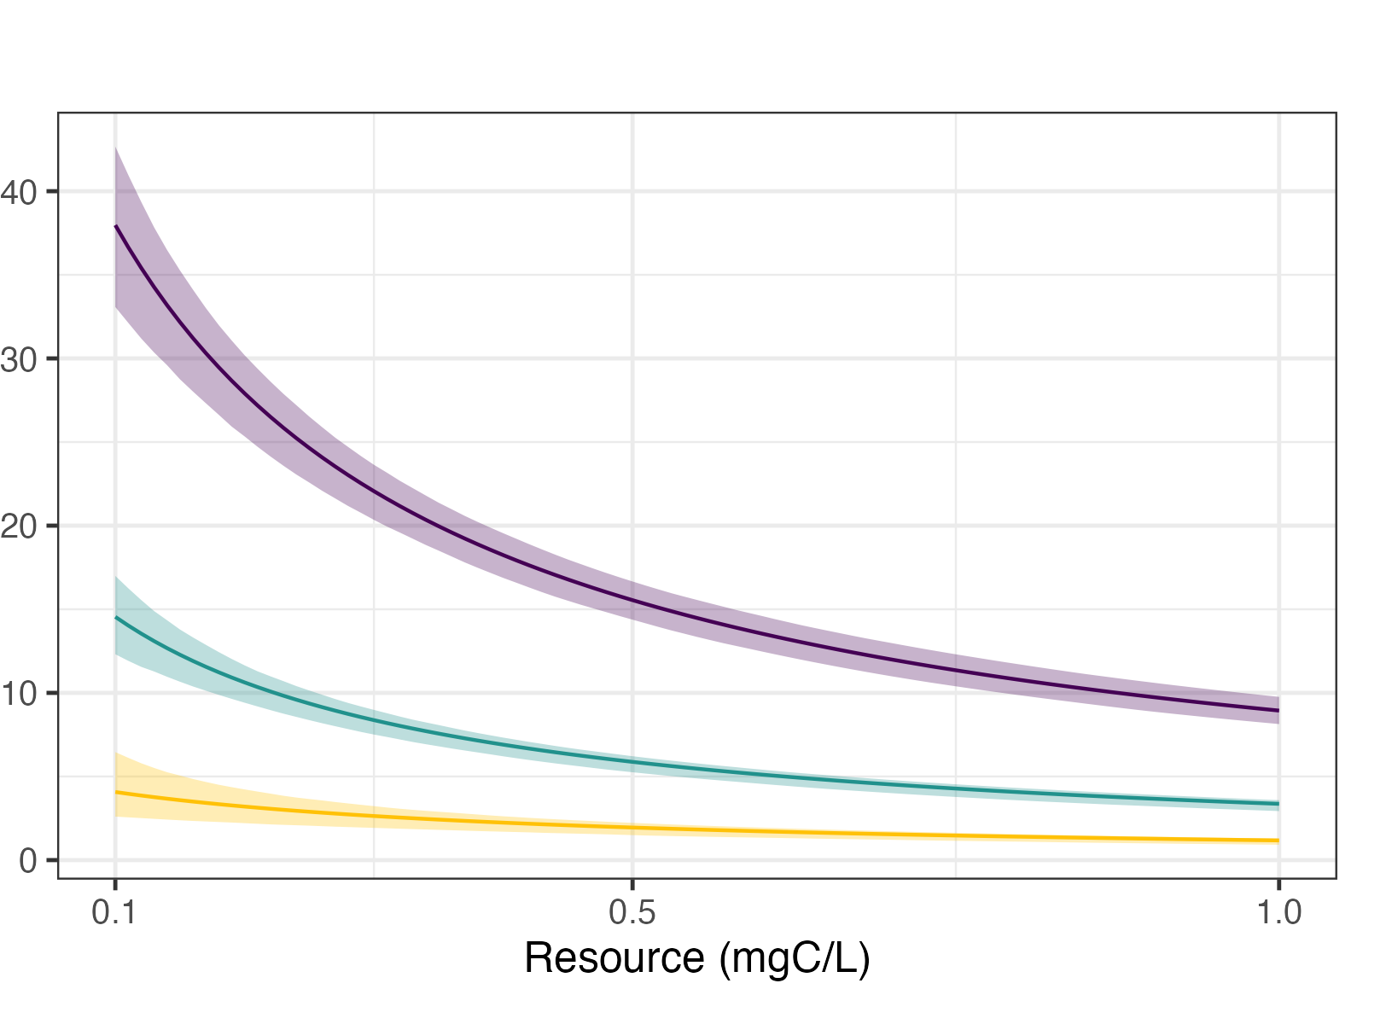
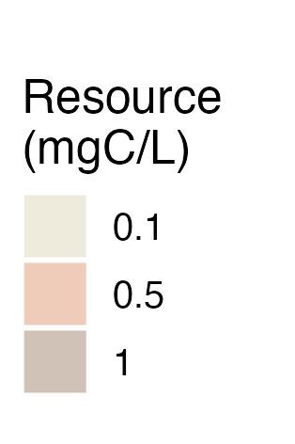
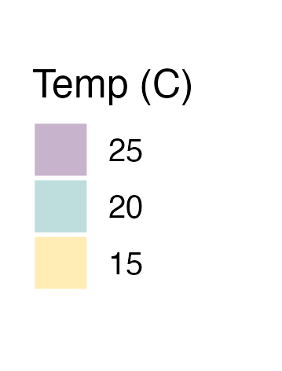
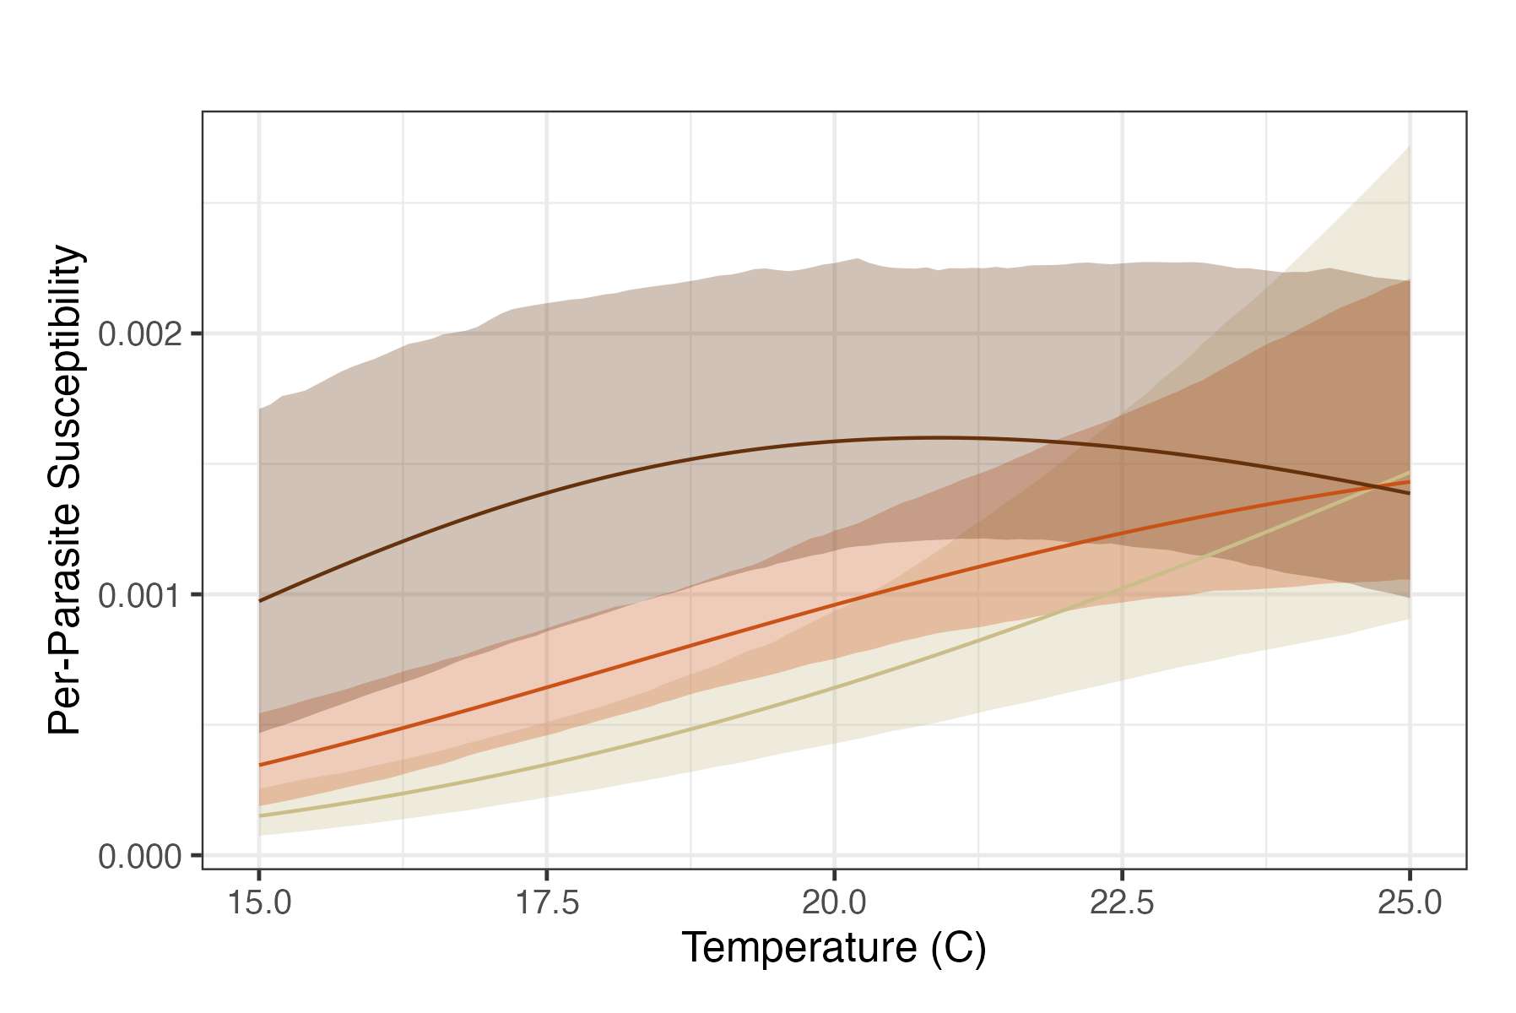
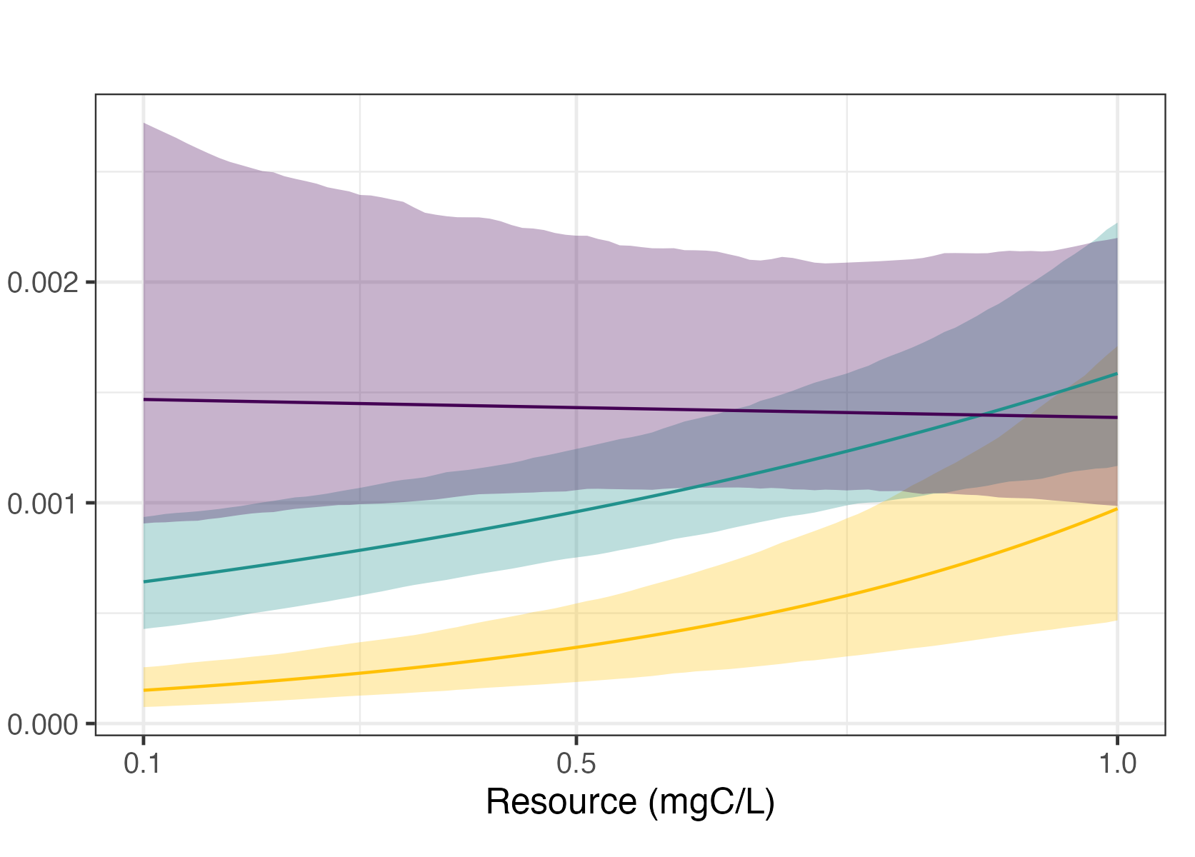


A
B
Resource (mgC/L)
Temp. (° C)
Foraging Rate - $f$ (mL/day)
C
D
Per-parasite susceptibility - $u$
Temperature (°C)
Resource (mgC/L)

