Slide 1
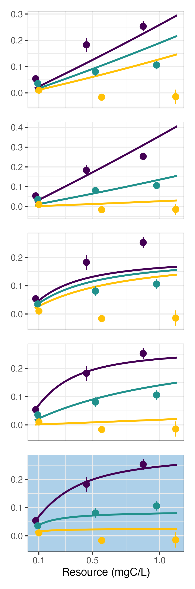
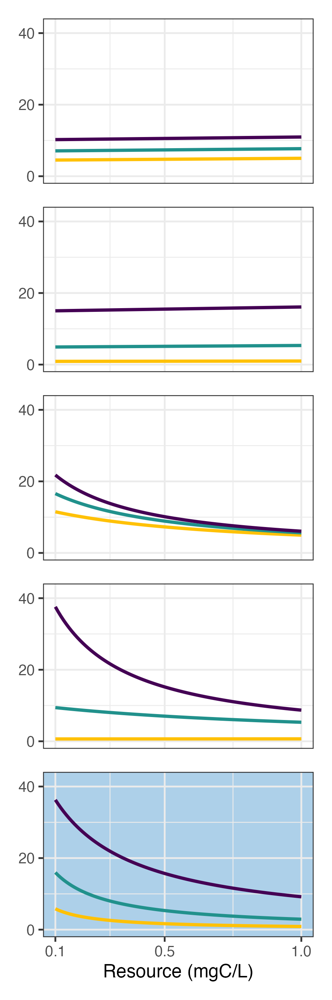
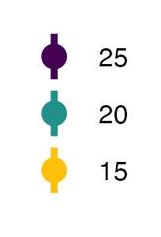





(1A) Size-only $f$
(1B) Temperature-only $f$
Resources consumed (mgC/L)
Clearance Rate (mL/day)
(1C) Resource-only $f$
(1D) Additive $f$
Temp. (C)
(1E) Interactive $f$
Resource Concentration (mgC/L)
Notes:
OLD VERSION of Foraging rate assay model fits

Slide 2
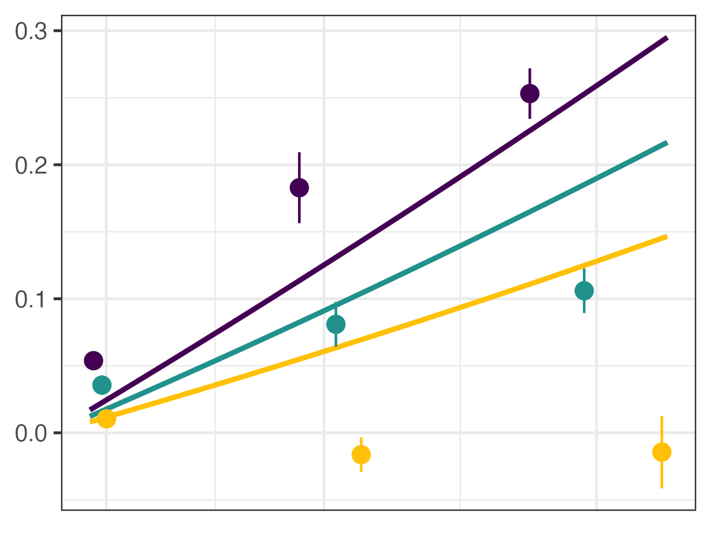
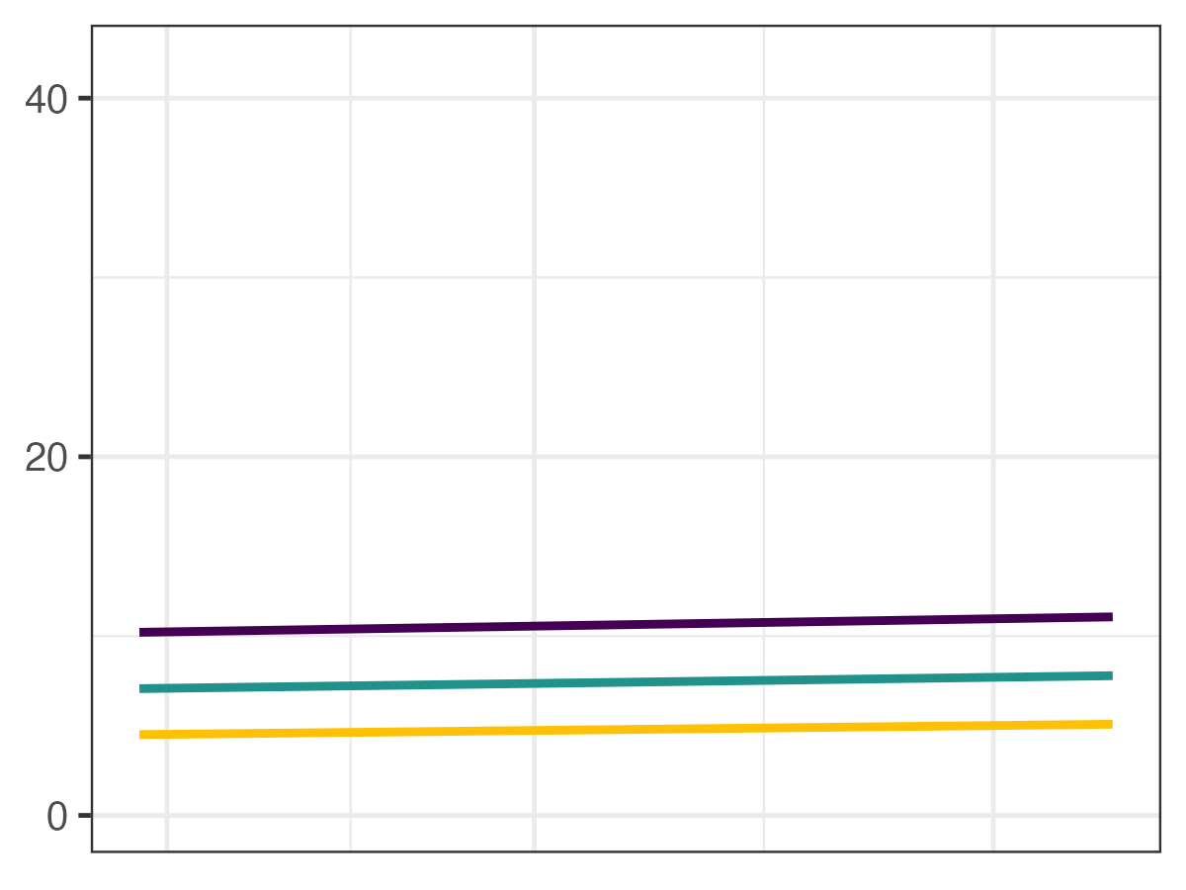
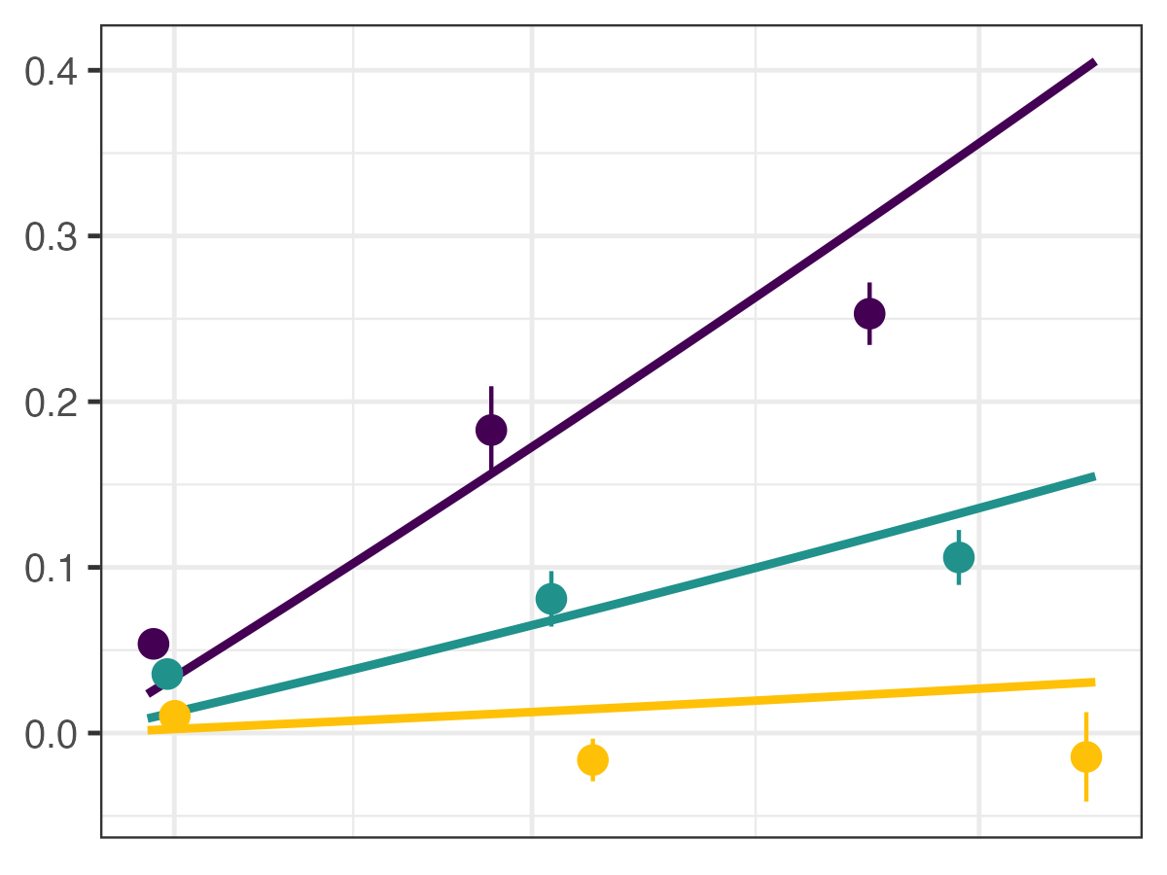
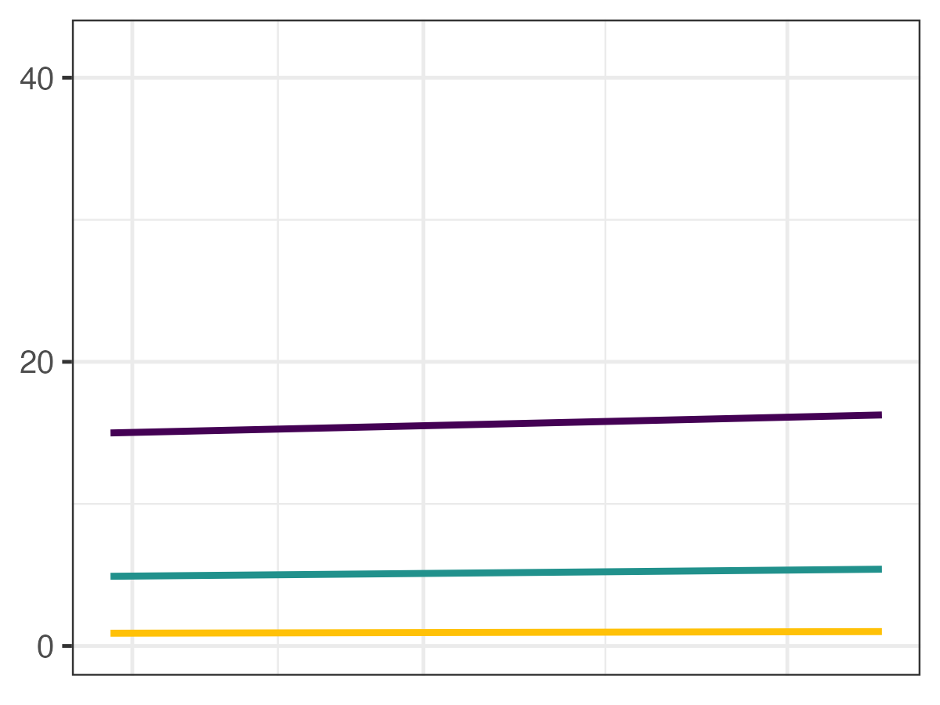
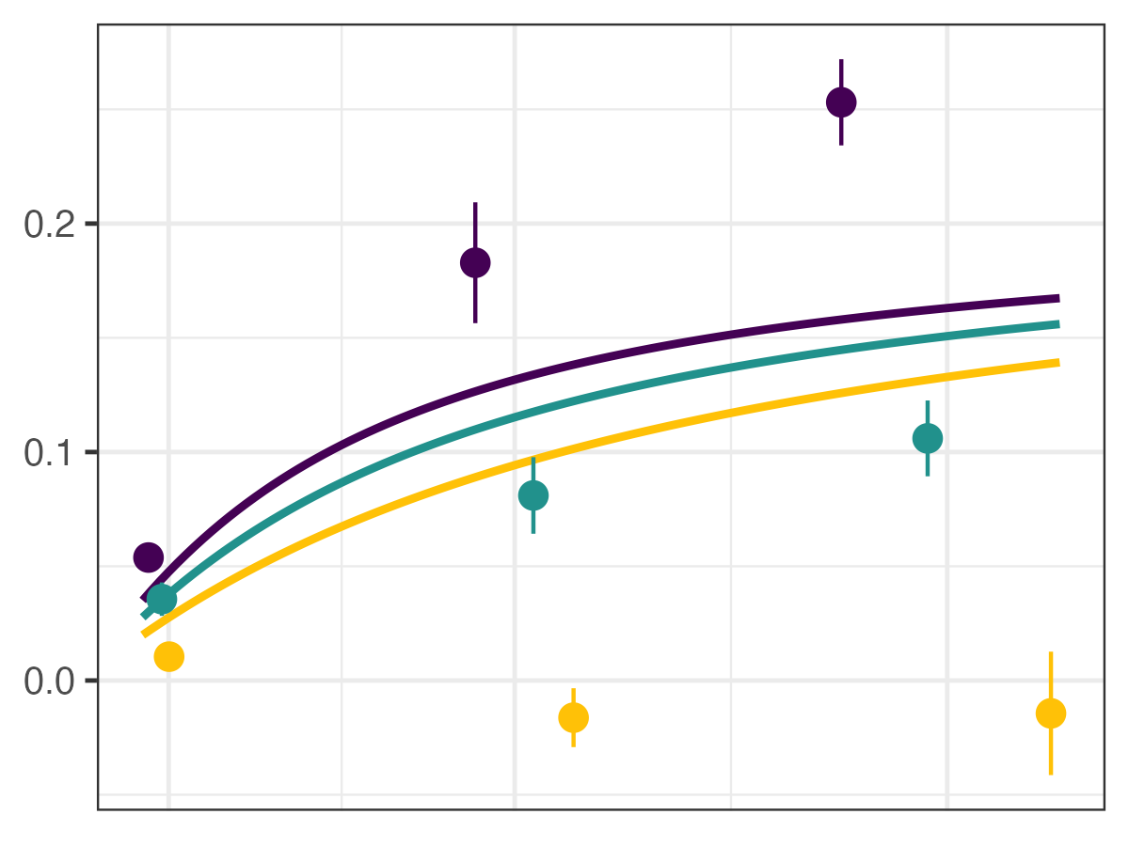
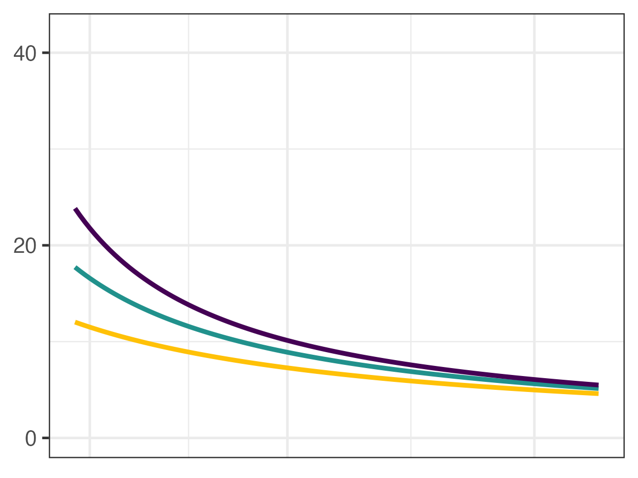
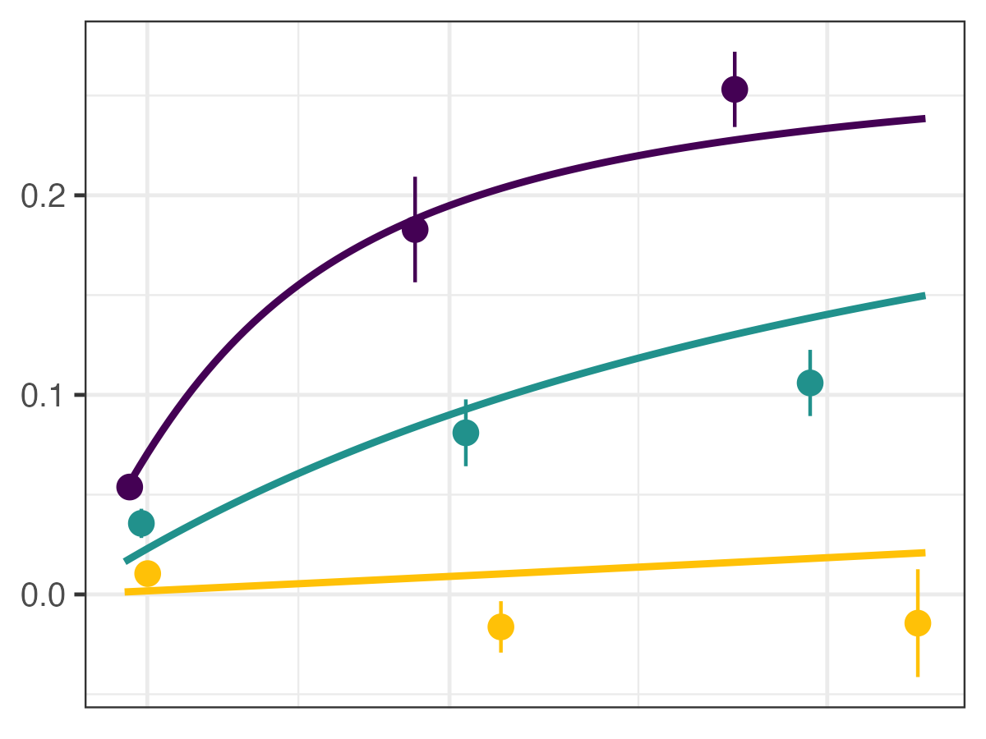
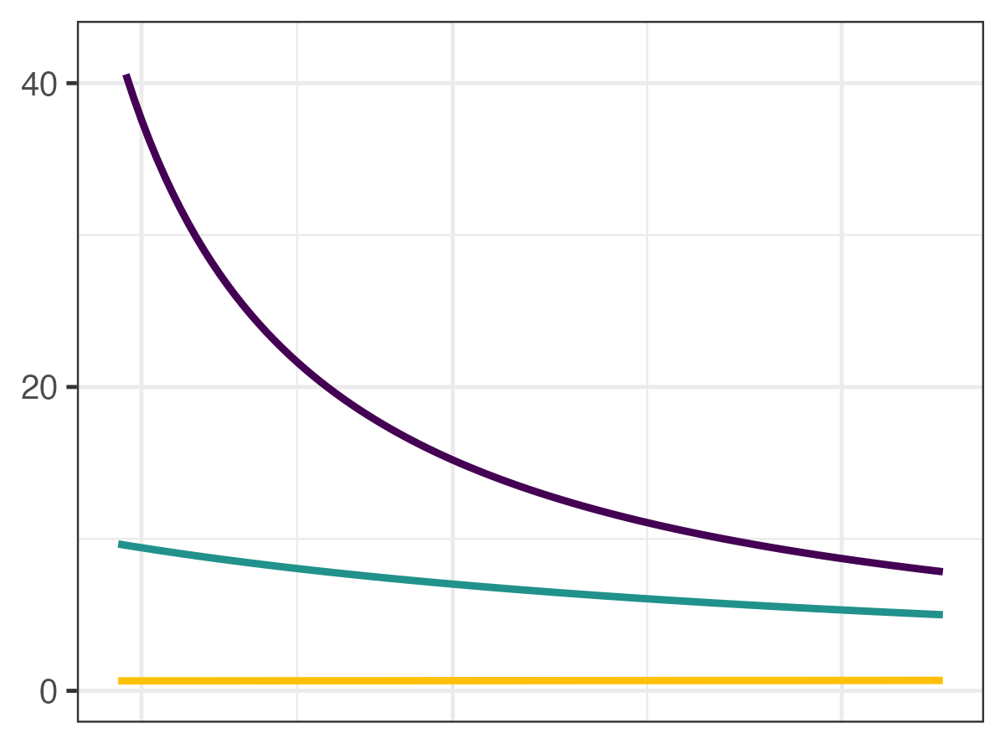
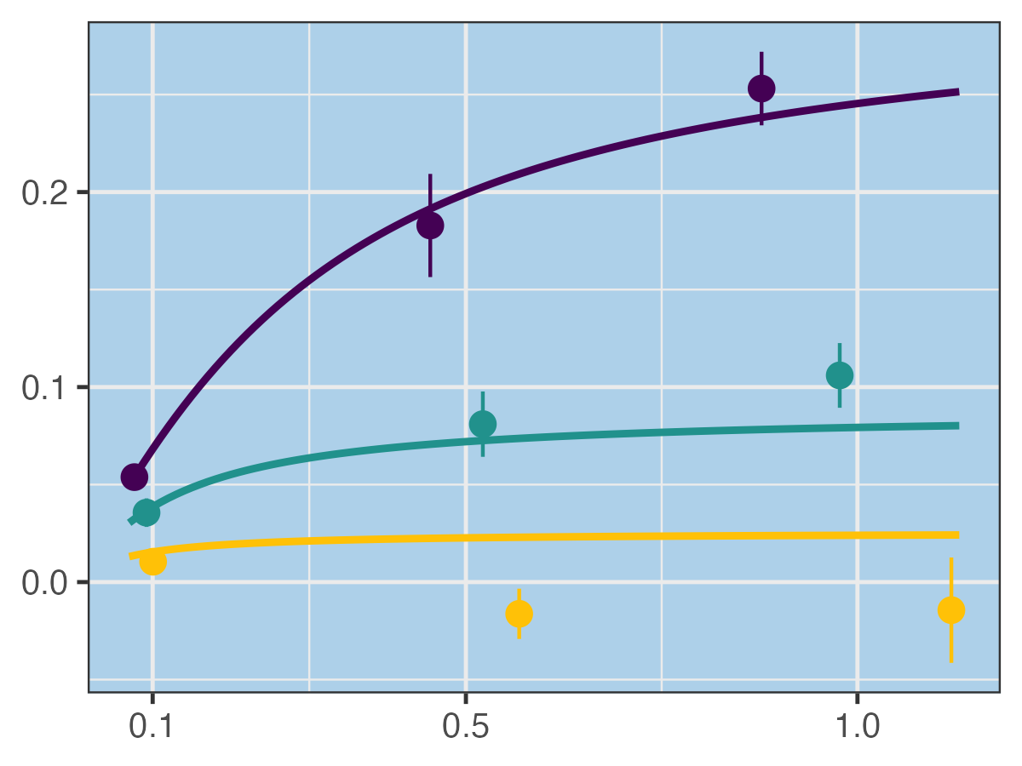
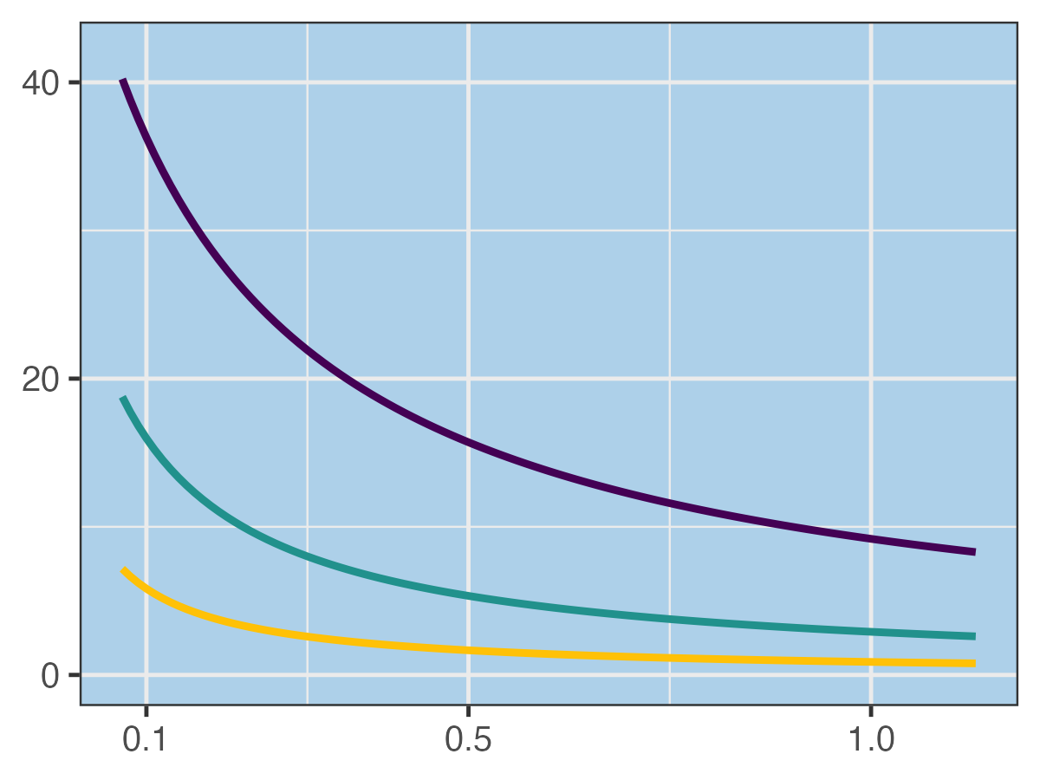





(1A) Size-only $f$
(1B) Temperature-only $f$
(1C) Resource-only $f$
Resources consumed (mgC/L)
Clearance Rate (mL/day)
Temp. (C)
(1D) Additive $f$
(1E) Interactive $f$
Resource Concentration (mgC/L)
Notes:
NEW Version

Slide 3
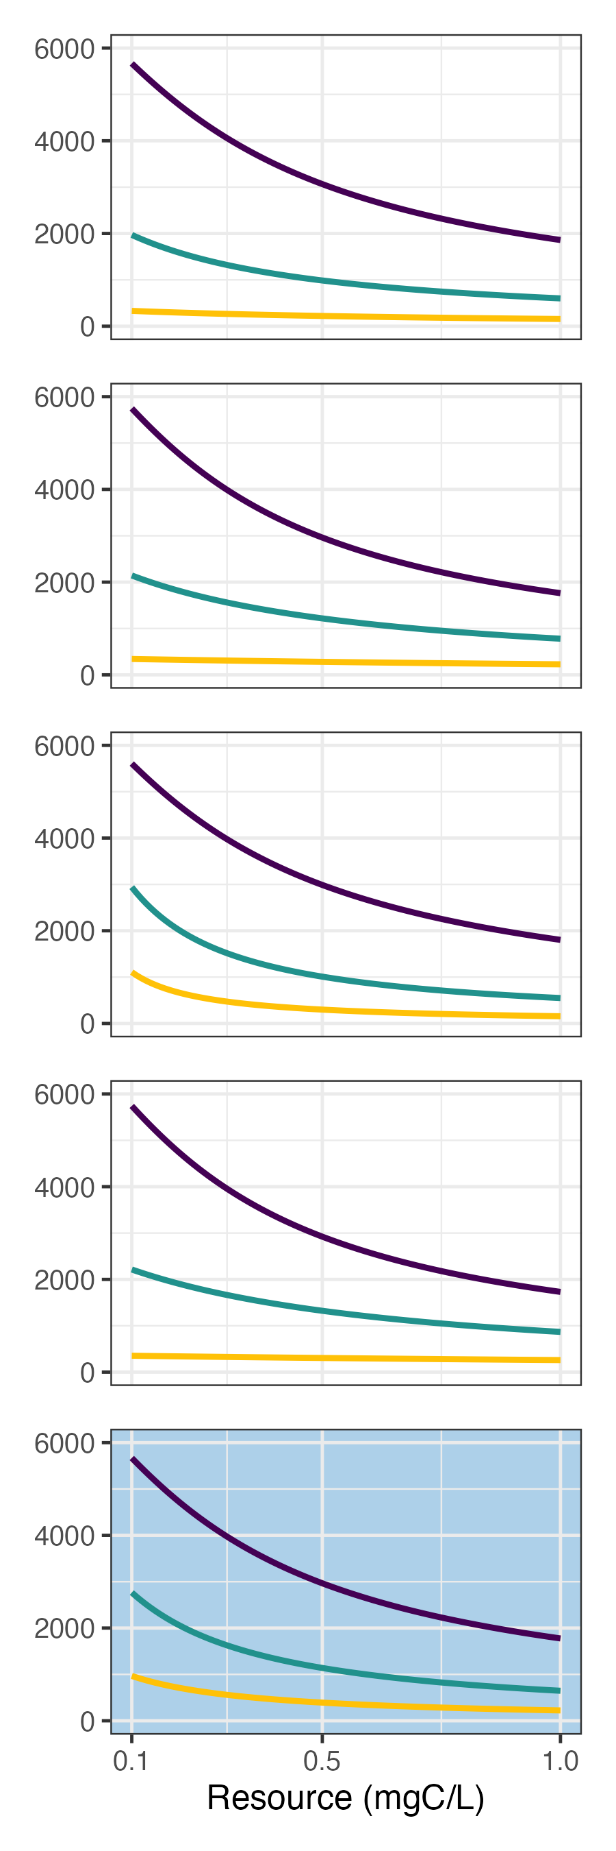
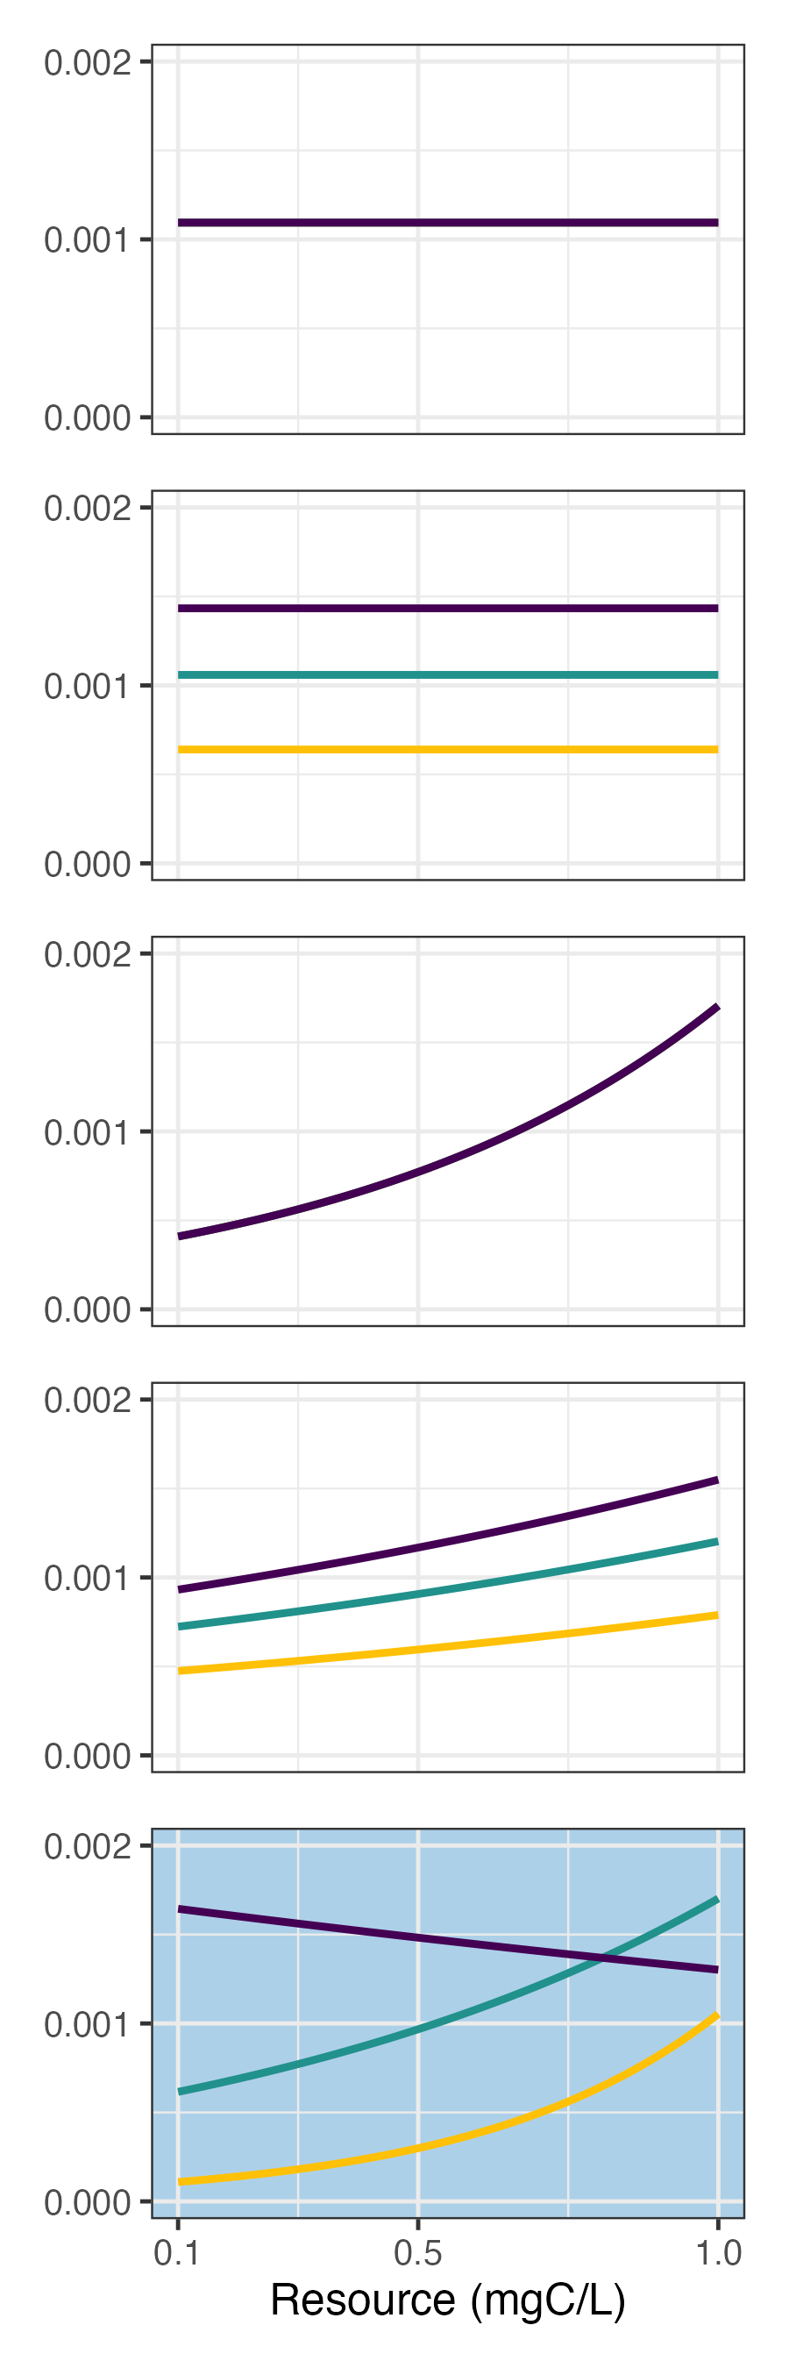
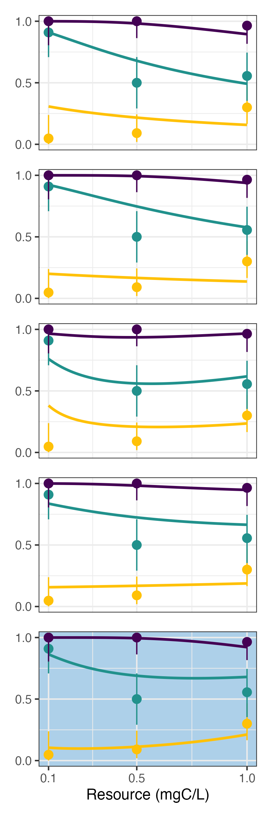
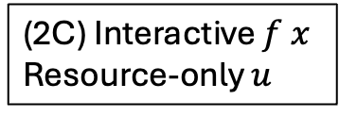
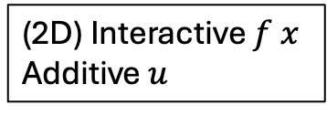
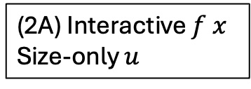
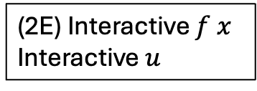
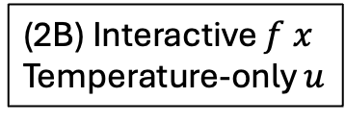
(2A) Interactive $f x$
Size-only $u$
(2B) Interactive $f x$
Temperature-only $u$
Spores Consumed
Per-spore susceptibility
Infection Prevalence
(2C) Interactive $f x$
Resource-only $u$
(2D) Interactive $f x$
Additive $u$
Temp. (C)
(2E) Interactive $f x$
Interactive $u$
Resource Concentration (mgC/L)
Notes:
OLD VERSION of Infection assay model fits

Slide 4
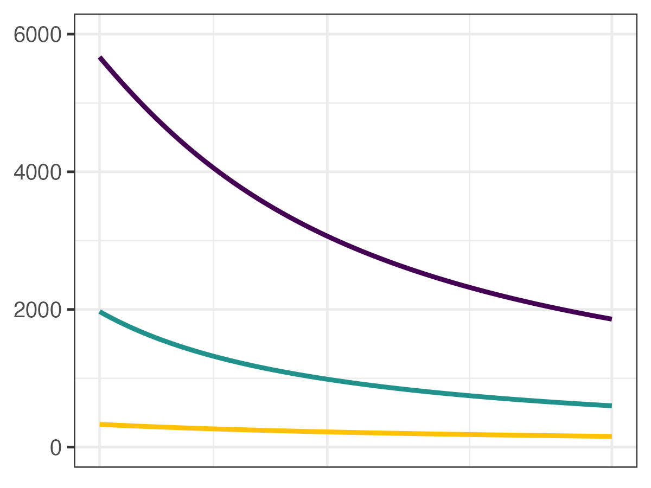
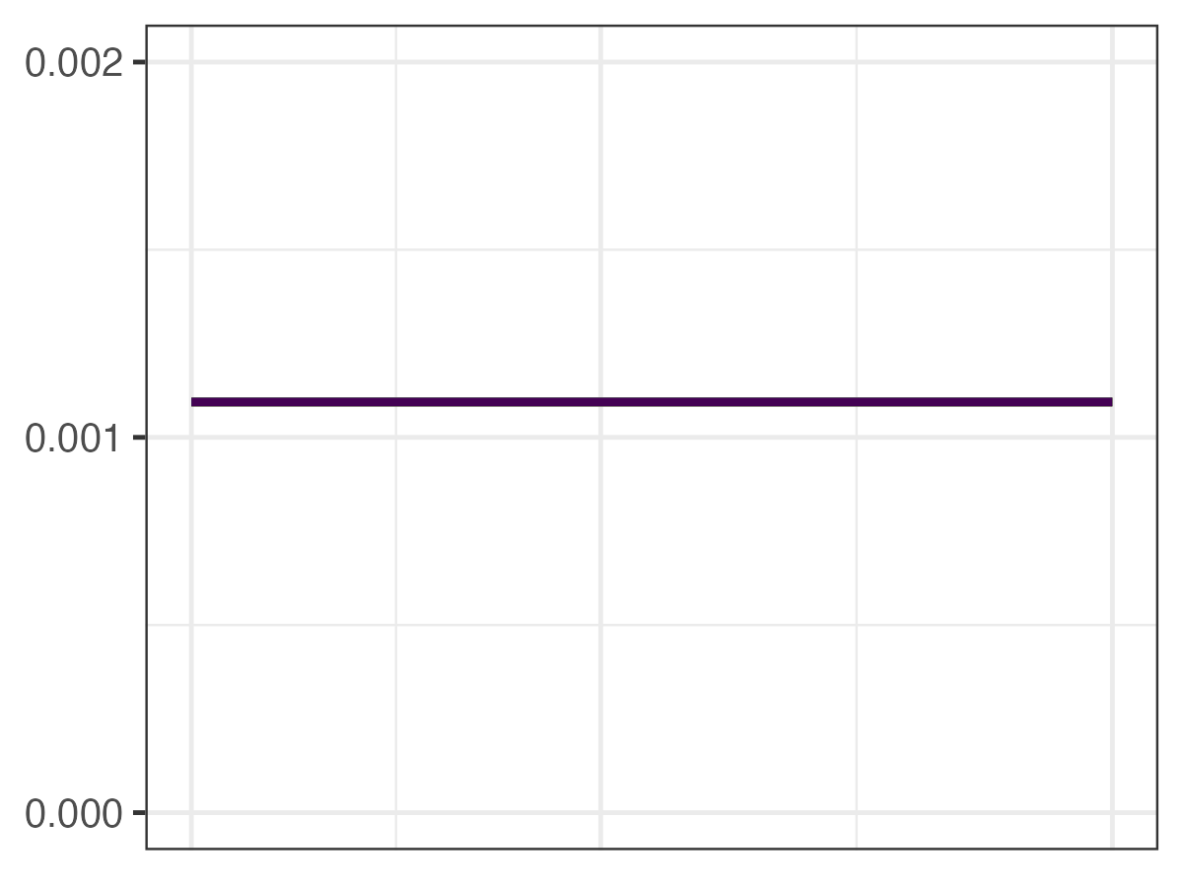
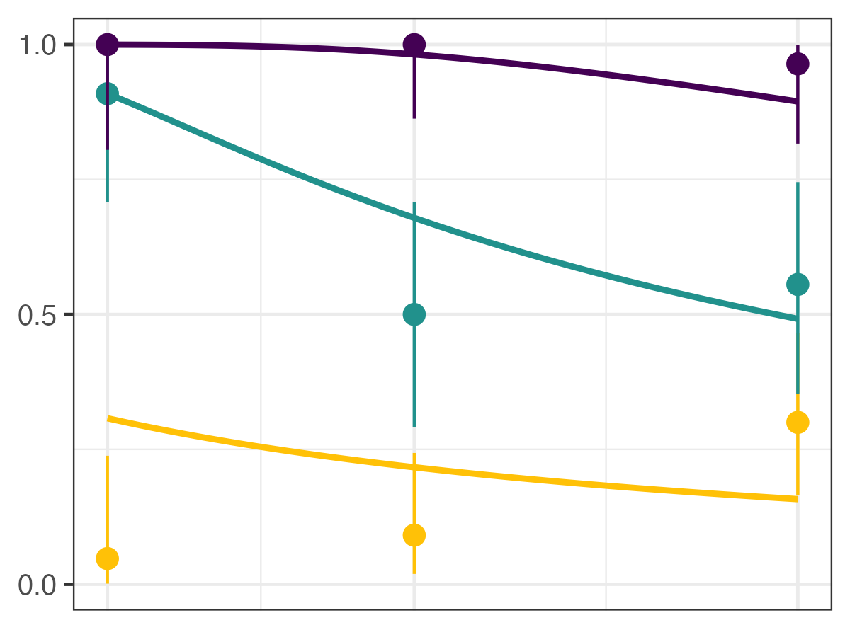
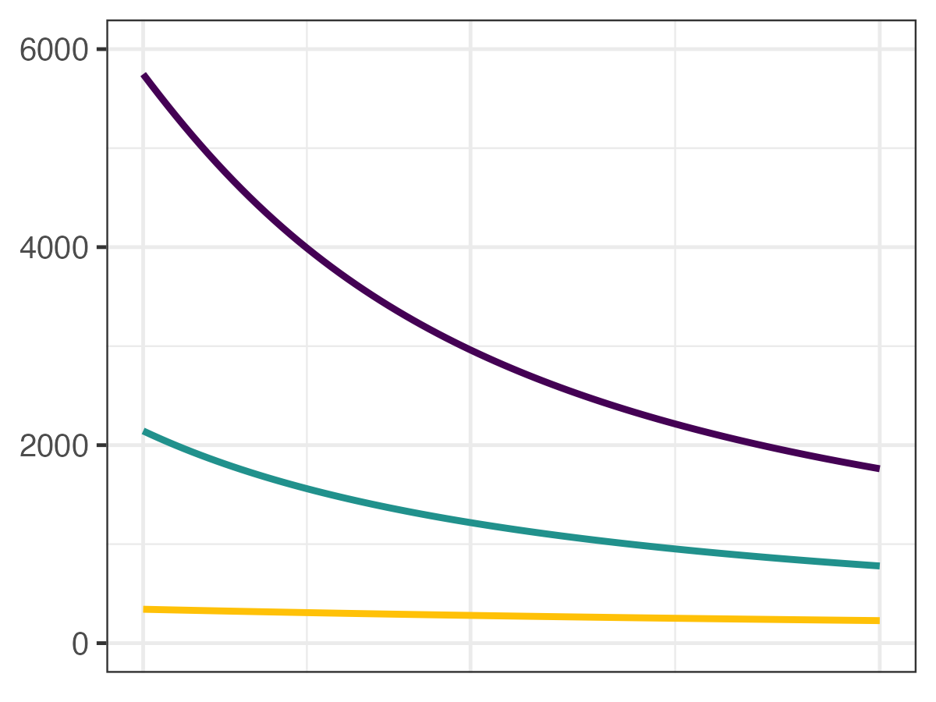
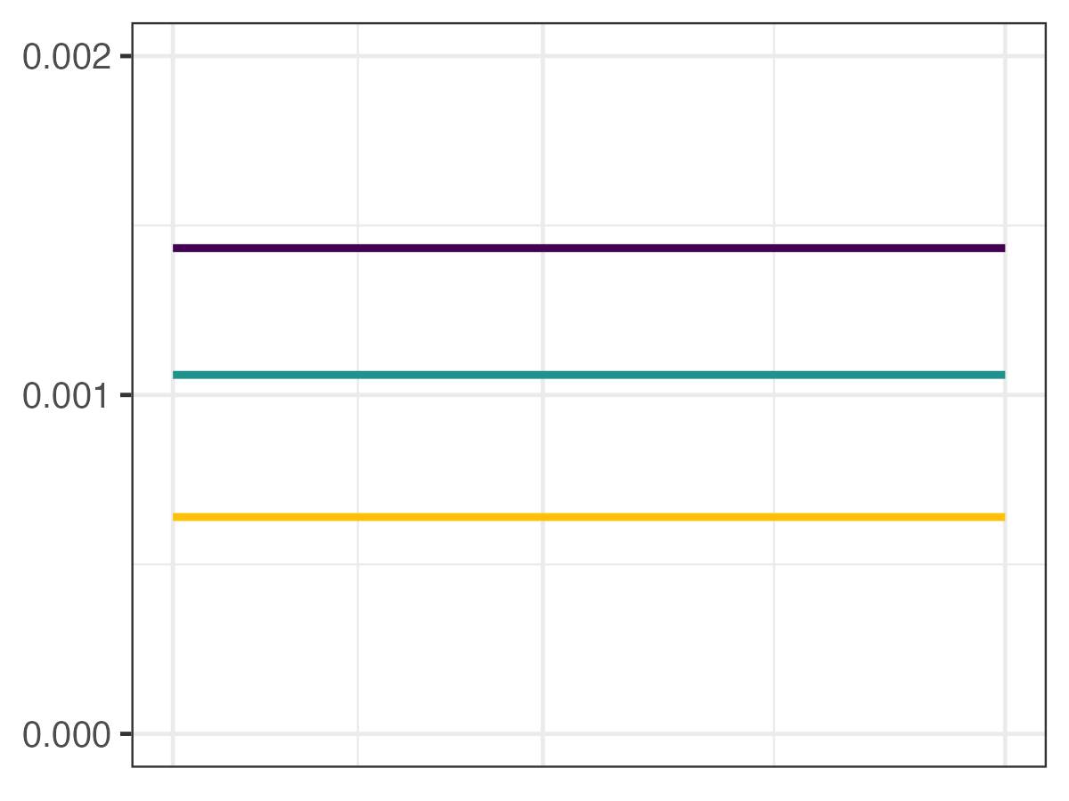
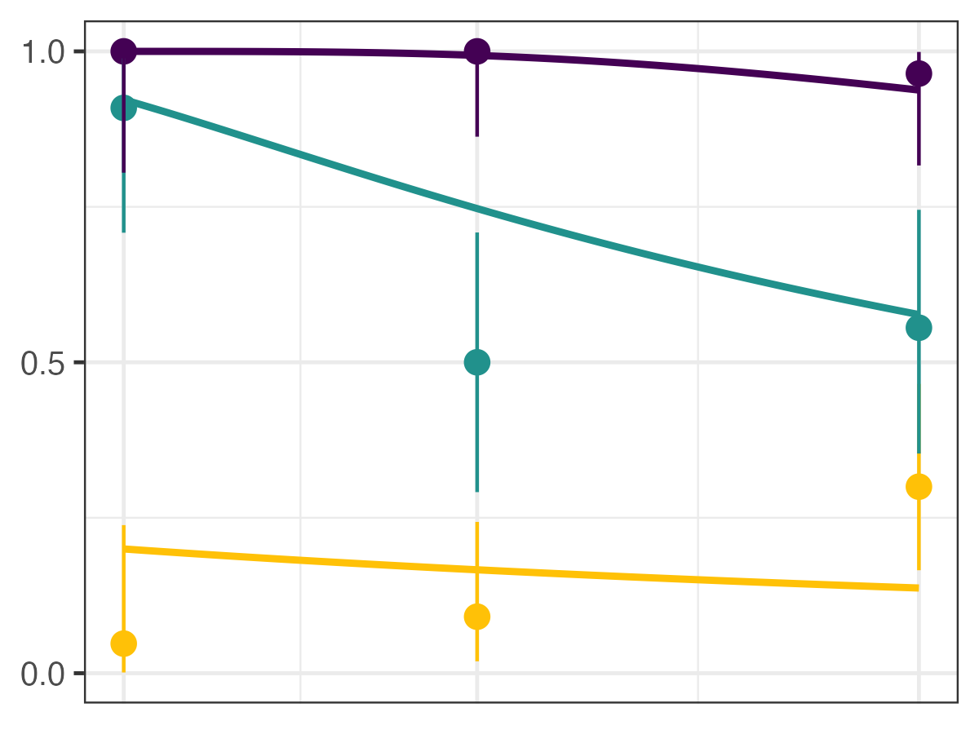
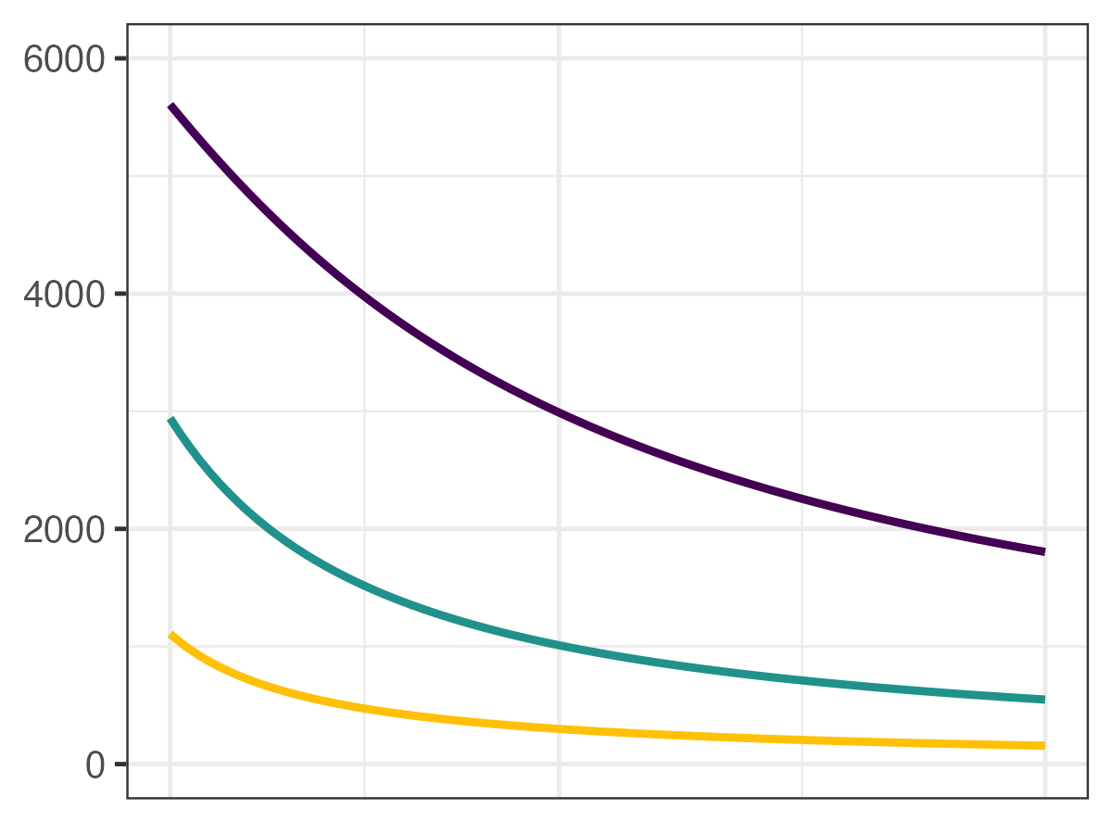
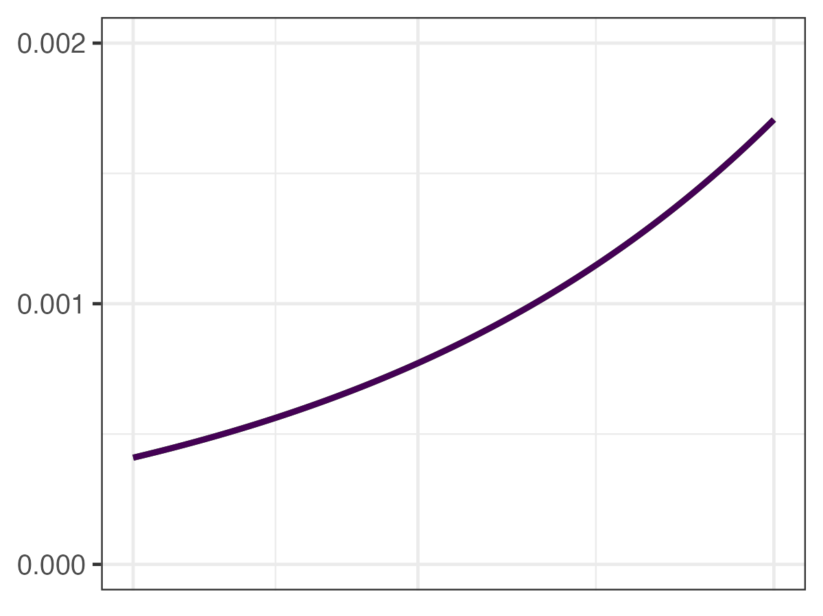
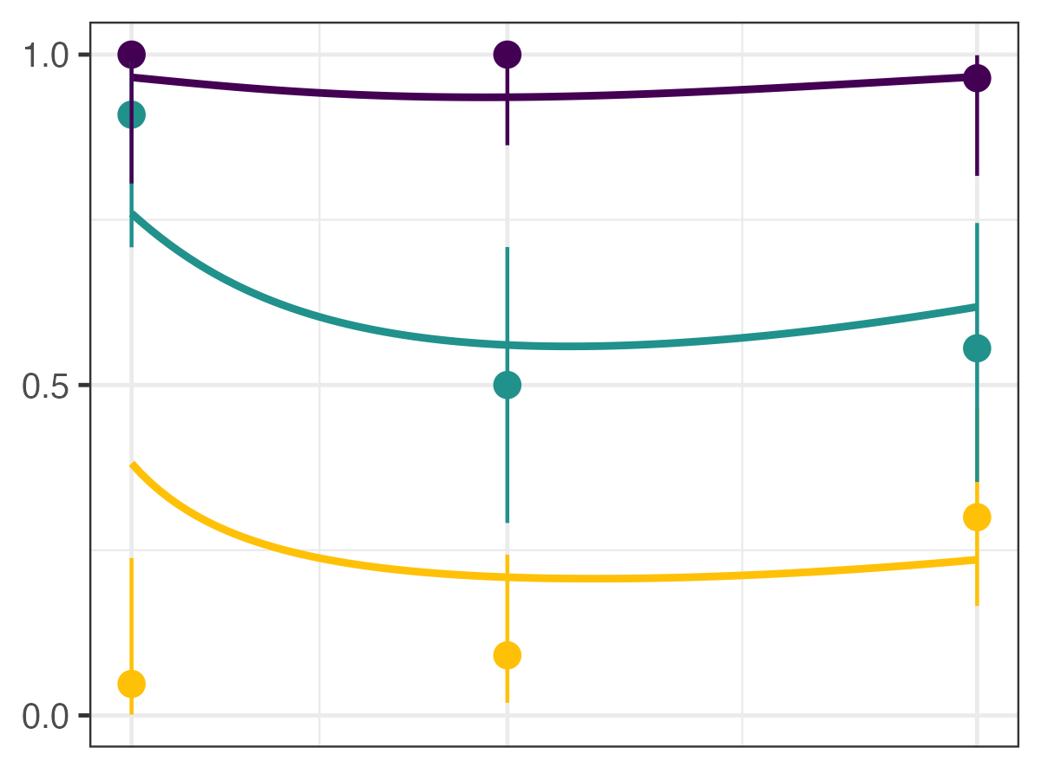
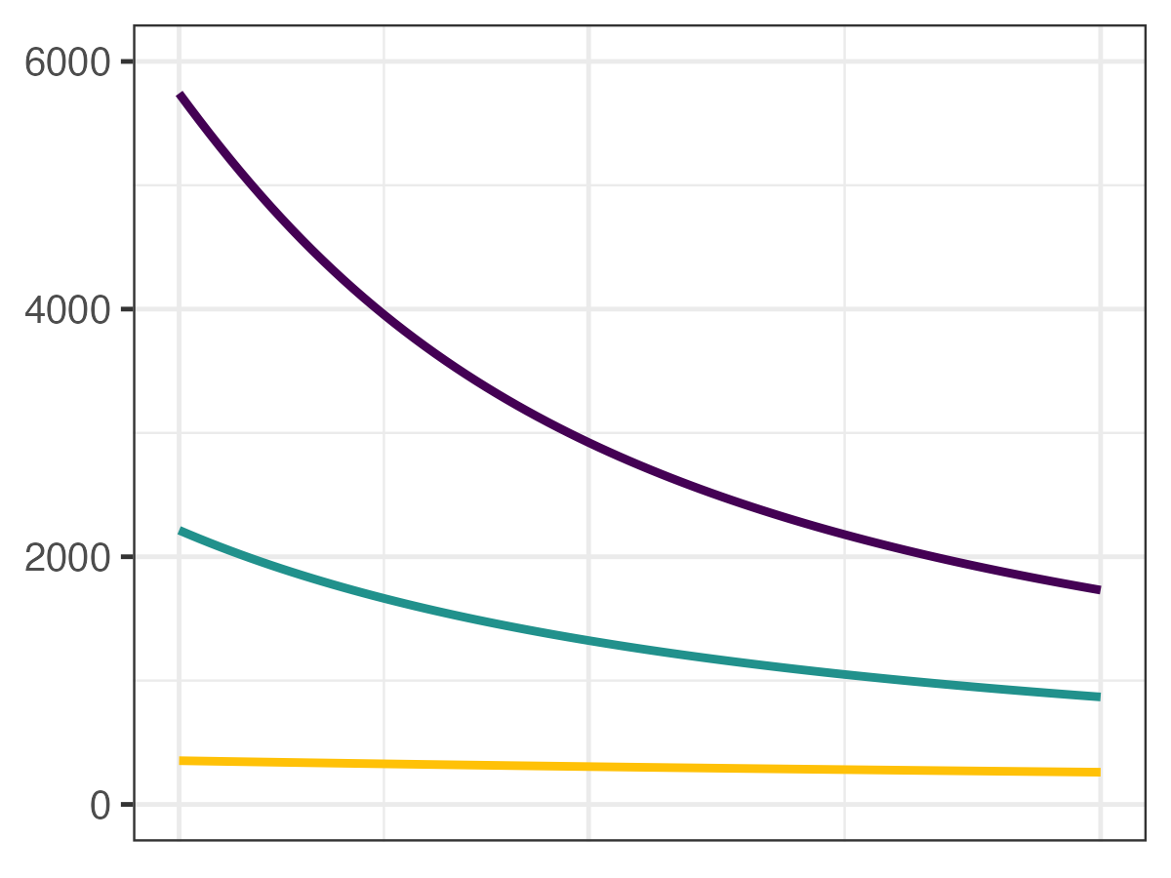
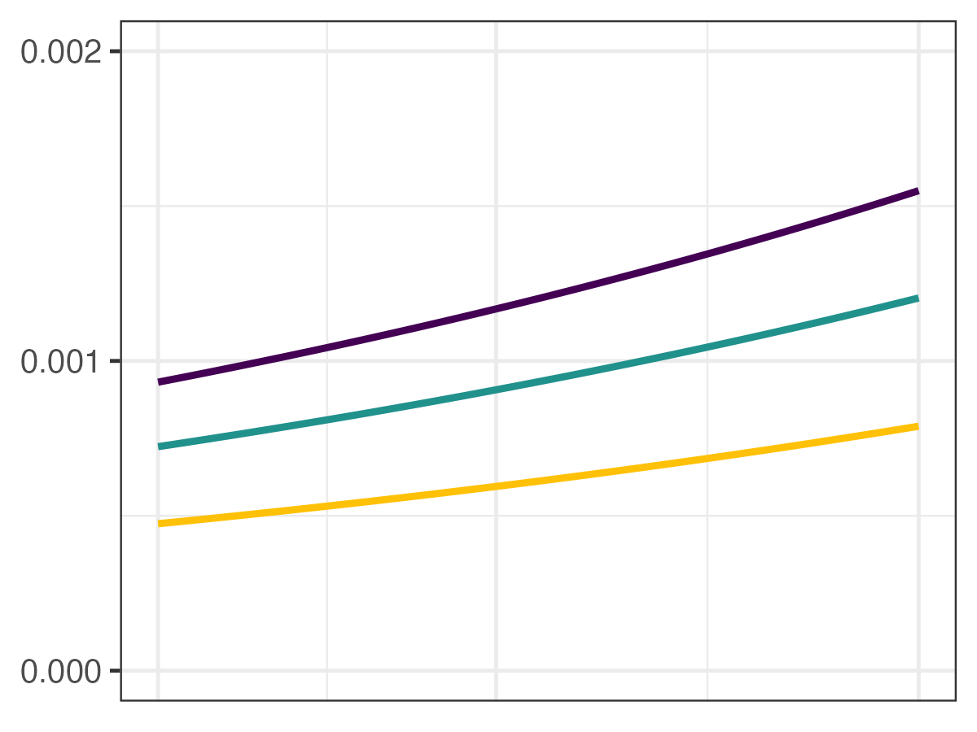
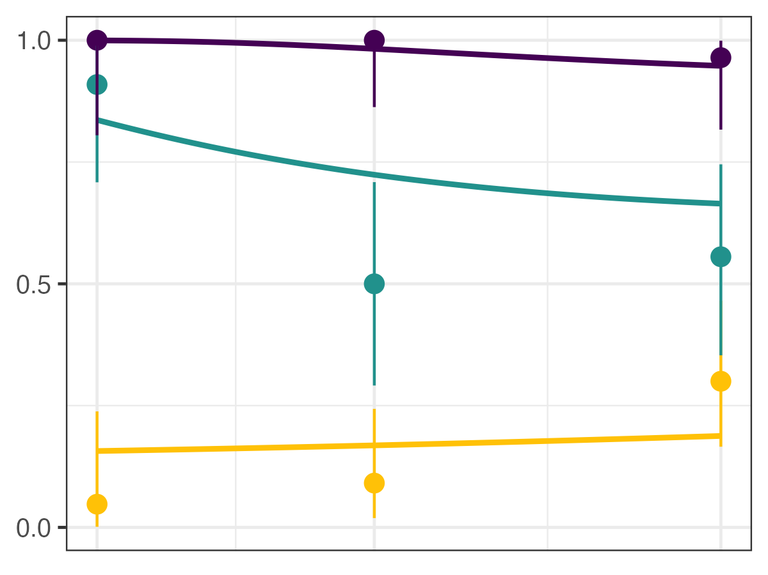
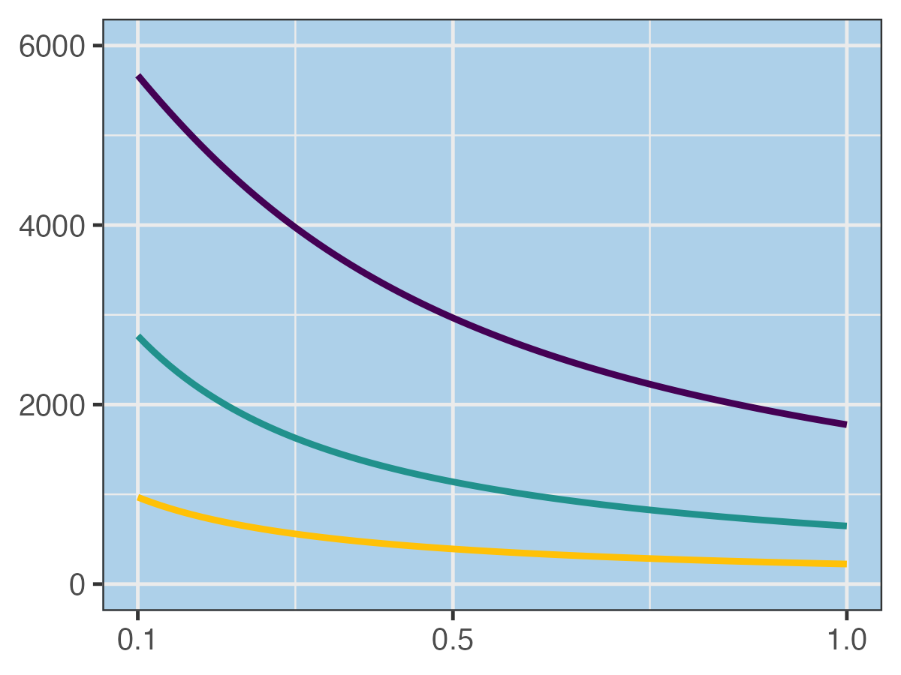
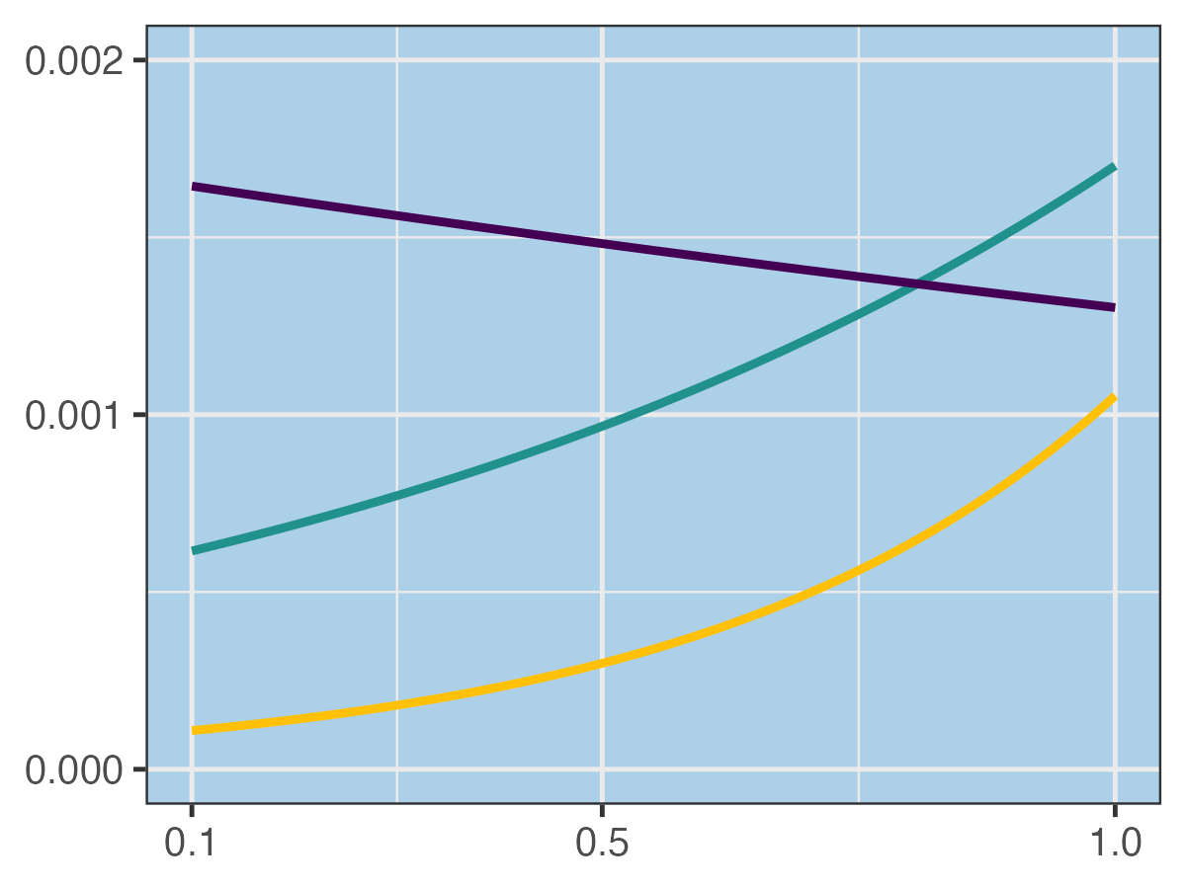
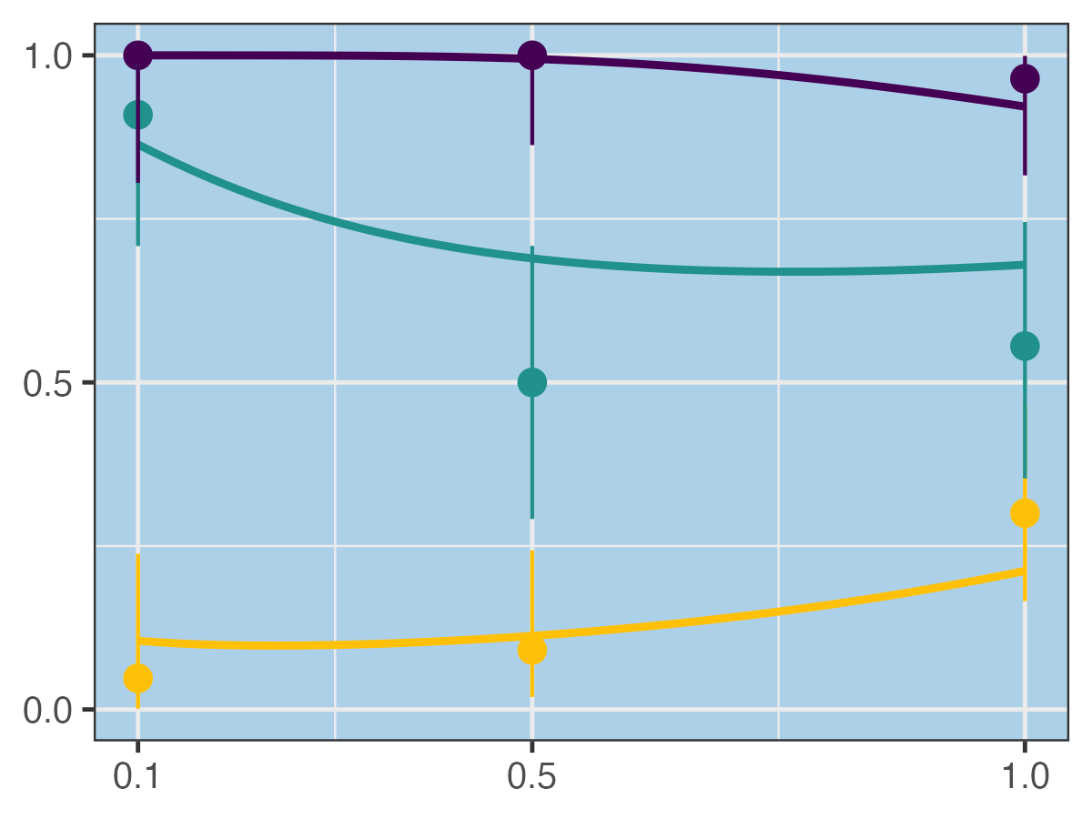
(2A) Interactive $f x$Size-only $u$
(2B) Interactive $f x$Temperature-only $u$
Per-spore
susceptibility
Spores Consumed
Infection Prevalence
(2C) Interactive $f x$Resource-only $u$
(2D) Interactive $f x$Additive $u$
Temp. (C)
(2E) Interactive $f x$Interactive $u$
Resource Concentration (mgC/L)
Notes:
NEW version

Slide 5
