Slide 1
Predicting Medical Insurance Costs with Linear and Ridge Regression
Presenters: ZHANG SISHEN
SYARAH ZAFIRA
XU CHENGJUN

Slide 2
Presentation Outline
Dataset Intro
Analysis Approach
Results
Conclusion

Slide 3
Dataset Introduction
Dataset: "Medical Cost Personal Dataset" from Kaggle
Characteristics:
Contains 1,338 observations of insurance beneficiaries.
Features: age, sex, bmi, children, smoker, region
Target Variable: charges (medical insurance cost)
Reason for Selection :
The dataset is suitable for regression as it includes both numerical (age, bmi) and categorical (sex, smoker) features, with a continuous target variable (charges).

Slide 4
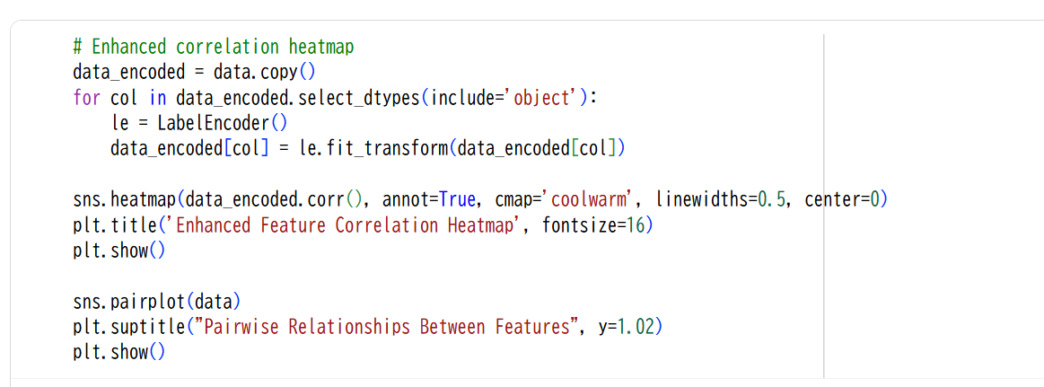
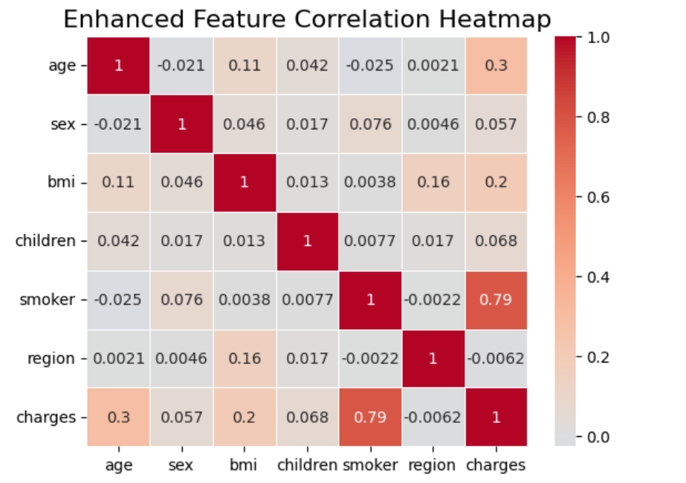
Exploratory Data Analysis (EDA)
Purpose: To understand the data's characteristics and form hypotheses about key predictive variables.
Key Insight:Smoker status is the most significant predictor of higher costs Charges also show an increasing trend with age.

Slide 5
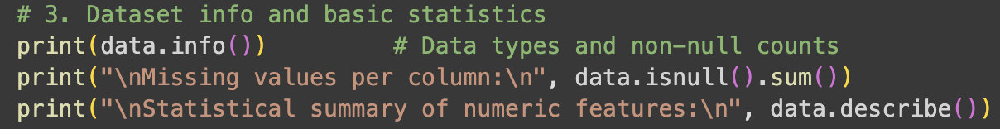
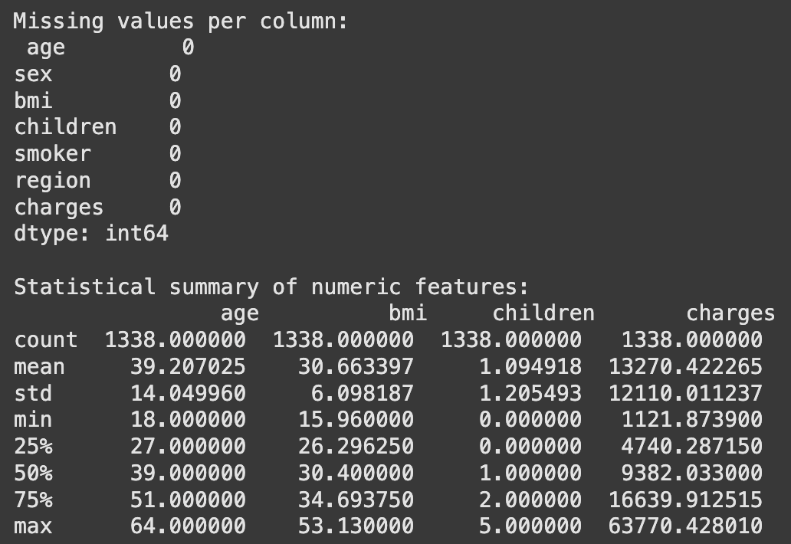
Data Preprocessing
Notes:
Hi everyone, I’ll be explaining the data preprocessing and regression modeling steps of our project, focusing on how I handled data preparation and implemented Linear and Ridge Regression as well as going through the respective results and comparison.
I started by checking for missing values in the dataset using data.isnull().sum().
This helps ensure there are no gaps that could bias the model.
In this case, the insurance dataset was complete, so no imputation was required — but if there were missing values, I would replace them with the mean or median for numerical features and the mode for categorical ones.

Slide 6
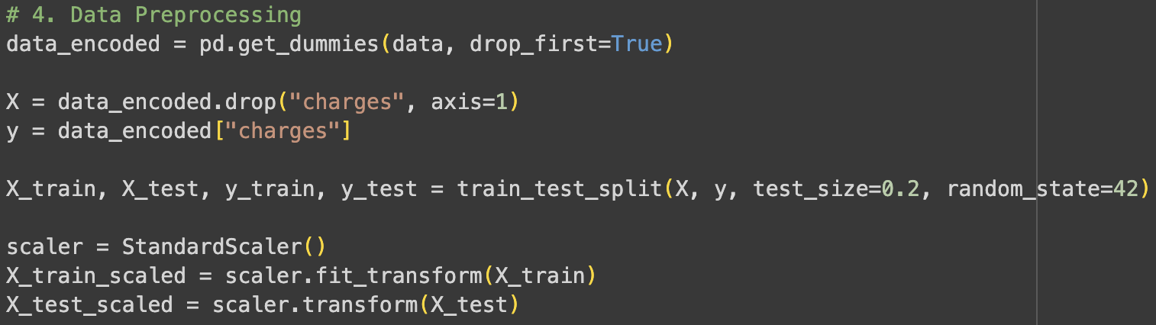
Data Preprocessing
Purpose: To prepare the data for model training
Steps Taken:
Categorical Variable Encoding:
Converted sex, smoker, and region into numerical format using One-Hot Encoding.
Numerical Feature Scaling:
Used StandardScaler to standardize the scale of numerical features.
Why is this important?: For regularized models like Ridge Regression, it ensures that the penalty is applied fairly across all features .
Data Splitting:
Split the dataset into an 80% training set and a 20% testing set.
Notes:
Next, I moved on to encoding categorical variables.
Since regression models work only with numerical inputs, I used One-Hot Encoding with pd.get_dummies(data, drop_first=True).
This converts categories like sex, smoker, and region into numeric columns without implying any false ranking between them.
After that, I applied feature scaling using StandardScaler() from scikit-learn.
This standardizes all numerical variables to have a mean of zero and unit variance.
Scaling is especially important for Ridge Regression because it uses regularization — if features are on different scales, the penalty term could distort the model weights.
Once preprocessing was done, I split the dataset into training and testing sets using an 80–20 split with train_test_split.
This ensures that model evaluation is done on unseen data to measure real performance.

Slide 7
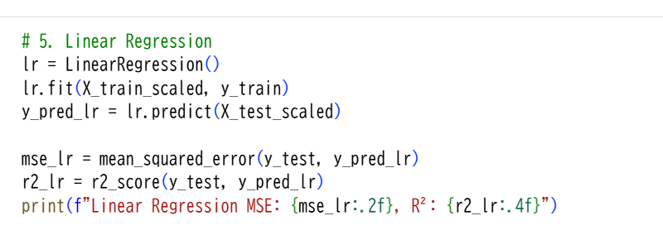
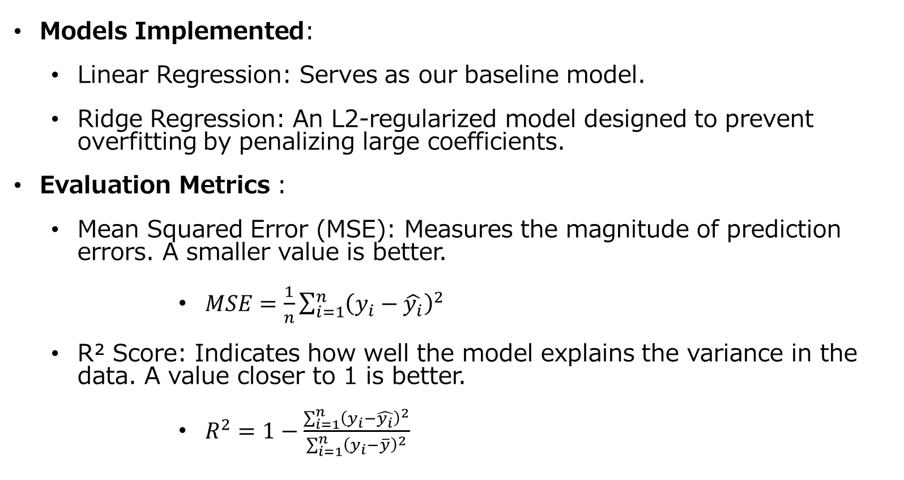
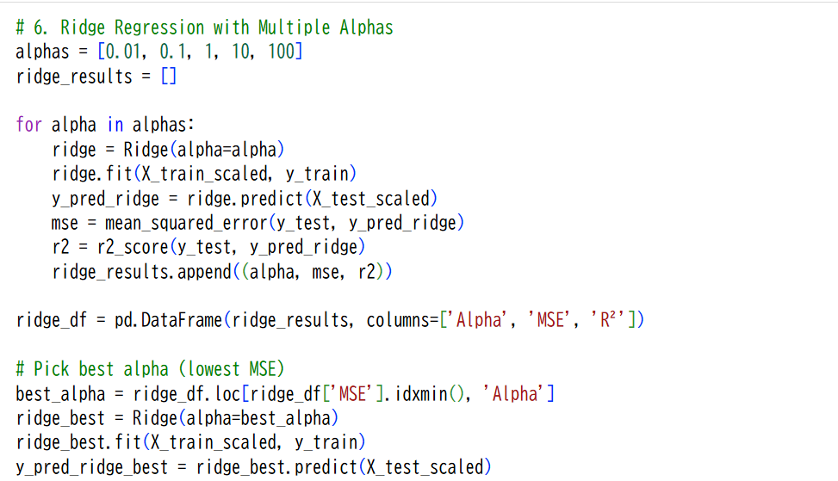
Model Implementation & Evaluation Metrics
Notes:
Then, I trained a Linear Regression model using the LinearRegression()function. After fitting it on the training data, I predicted on the test set and evaluated performance using Mean Squared Error and R-squared score.
The Linear Regression model gave a strong baseline with a decent R² score.
Finally, I implemented Ridge Regression, which adds an L2 regularization term to control overfitting. I trained multiple Ridge models across different alpha values — for example 0.01, 0.1, 1, 10, and 100 — and compared their MSE and R² scores.
As alpha increased, the model became more stable, reducing variance at the cost of a small increase in bias.

Slide 8
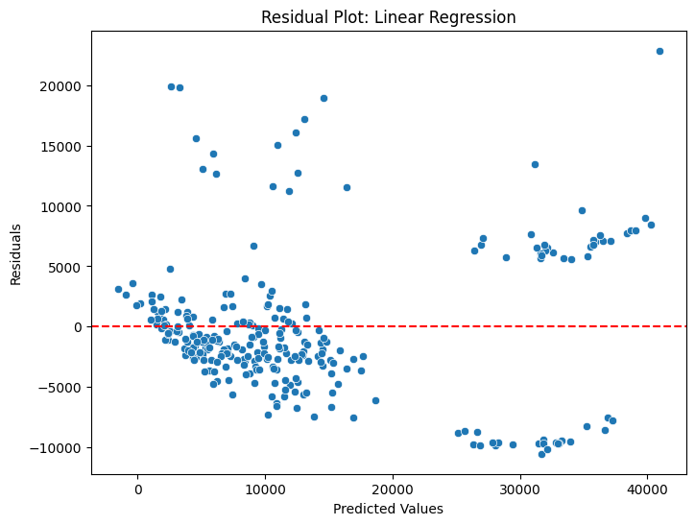
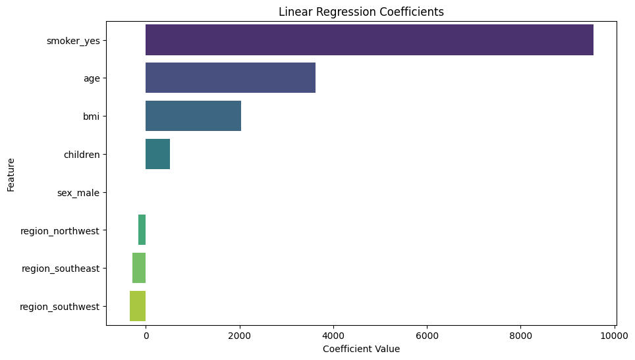
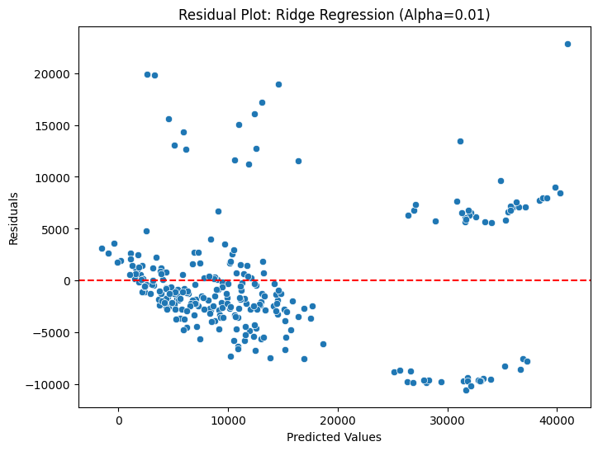
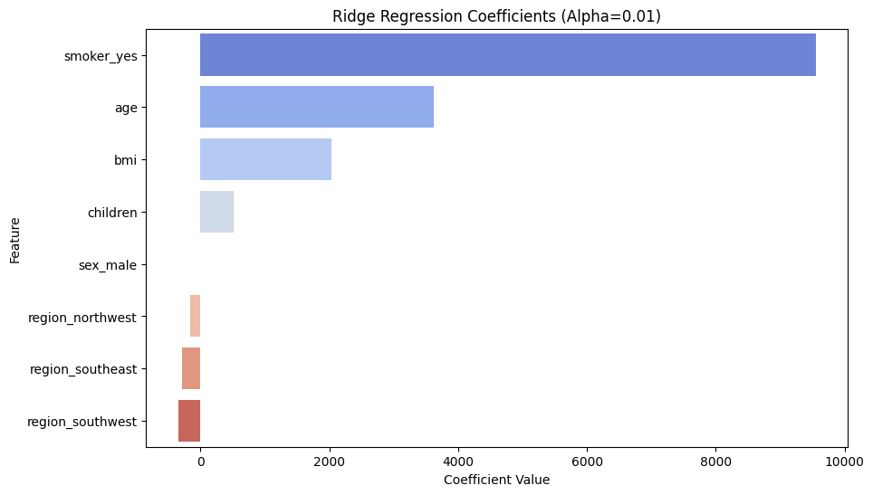
Model Implementation & Evaluation Metrics
Notes:
I added these visualizations to better understand model performance and feature influence.
The residual plot checks if predictions are unbiased — residuals should scatter randomly around zero.
The coefficient plot shows which features most impact the target after scaling.
Together, they provide clearer insight into model fit and feature importance, complementing metrics like MSE and R²

Slide 9
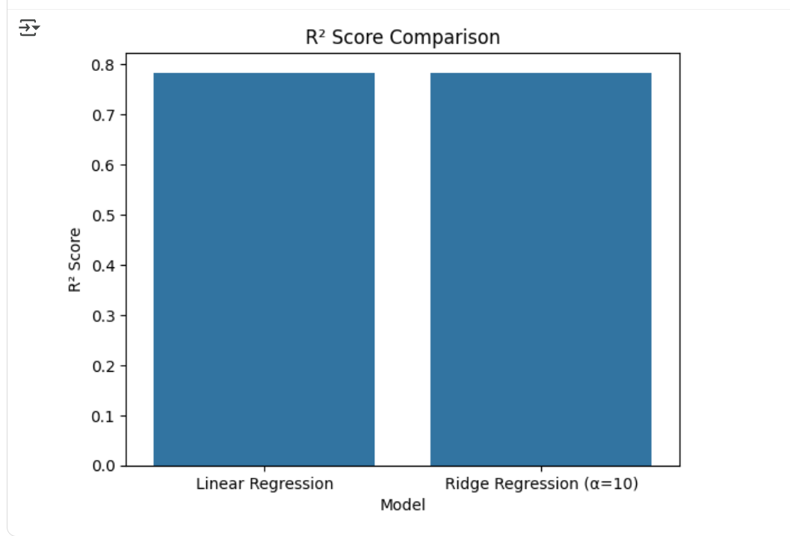
Results & Model Comparison
Performance on a Single Train/Test Split:
Analysis:In this specific split, both models performed similarly. However, Linear Regression is generally more prone to overfitting the training data compared to Ridge Regression.
Notes:
In our results, both Linear and Ridge Regression achieved nearly identical R² scores.
This happens because our dataset is relatively small and clean, so regularization didn’t make a big difference.
To study the models’ behavior more meaningfully, we extended our analysis by creating polynomial features to expand the feature space.
I’ll now hand over to Sishen, who’ll explain how that helped us compare the two models in greater depth.

Slide 10
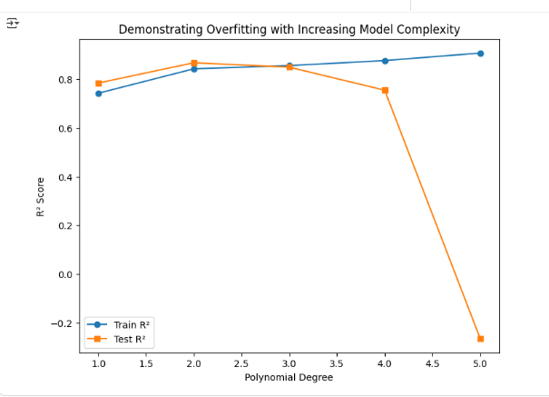
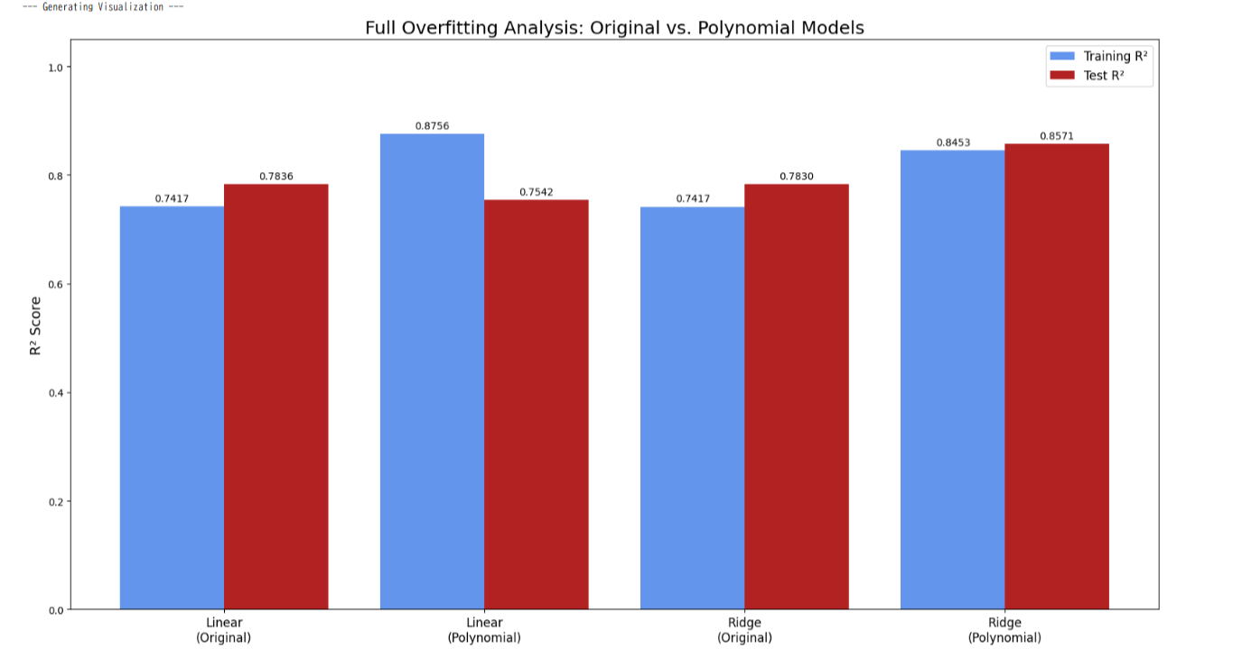
Demonstrating Overfitting with Polynomial Features
Degree=4

Slide 11
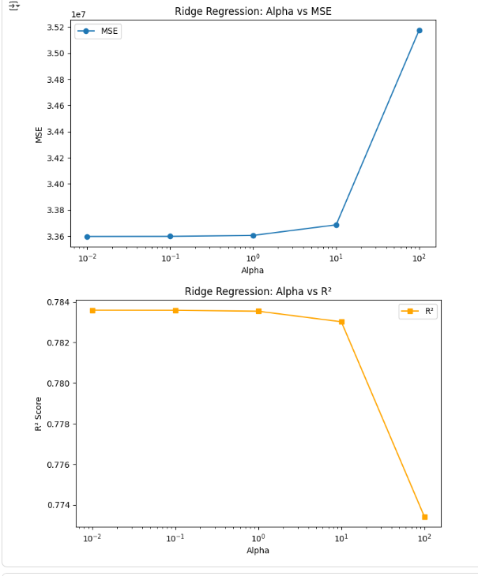
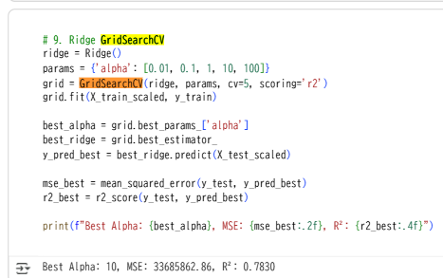
Hyperparameter Tuning
Purpose: To find the optimal regularization parameter α that maximizes the performance of the Ridge Regression model.
Method: Used GridSearchCV to evaluate performance across a range of α values ([0.01, 0.1, 1, 10, 100]).
Relationship between Alpha and Performance:
Analysis: As α increases, regularization becomes stronger, which can lead to underfitting (increased bias) and lower performance. We found α=10 to be the optimal value in our test.

Slide 12
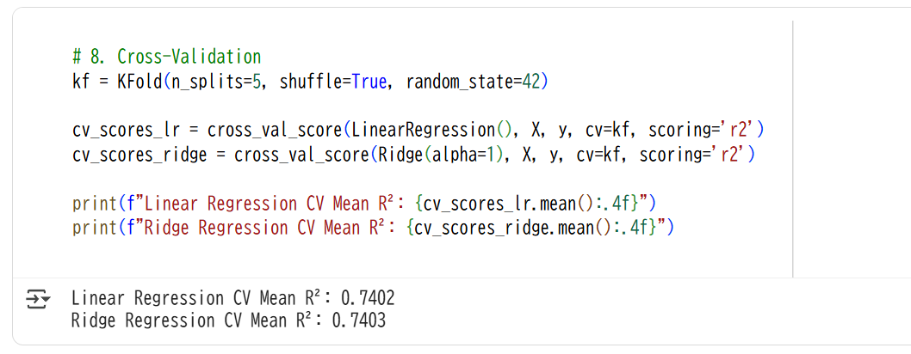
The Role of Cross-Validation
Purpose: To obtain a more reliable and robust measure of model performance, independent of a single data split.
Method: Implemented 5-Fold Cross-Validation.
Average R² Score from Cross-Validation:
Linear Regression: 0.7402
Ridge Regression (α=10): 0.7403
Conclusion:The cross-validation results confirm that Ridge Regression provides slightly more consistent and higher performance, indicating better generalization ability.

Slide 13
Conclusion & Key Insights
Summary of Key Insights (from README.md):
Strongest Predictor: Smoker status was the most influential feature for predicting medical costs.
Model Performance: Ridge Regression demonstrated better generalization by preventing overfitting through regularization .
Importance of Alpha: Tuning the alpha parameter is crucial for balancing the bias-variance tradeoff in Ridge Regression.
Value of Cross-Validation: Cross-validation provides a more robust evaluation of a model's true performance compared to a single train-test split.
Future Work: Further work could involve exploring other regularization techniques like Lasso or more complex models like Gradient Boosting.

Slide 14
Team Member Contributions
XU CHENGJUN [slides 1-4, 13]:
Contributions: Responsible for creating the markdown text in Jupyter Notebook to explain the data and the README.md file, which documents the project overview, dataset details, steps taken, and key insights.
SYARAH ZAFIRA[slides 5-9]:
Contributions: Responsible for writing the majority of the Python code, including data preprocessing, model training (Linear and Ridge), and evaluation scripts.
ZHANG SISHEN[slides 10 - 12]:
Contributions: Responsible for creating the presentation slides and conducting the analysis on model overfitting, comparing the performance of Linear and Ridge regression.

Slide 15
Thank you
ZHANG SISHEN
SYARAH ZAFIRA
XU CHENGJUN

