Slide 1
An In-Depth Look at Advanced Attacks on Asymmetric Cryptosystem
Thịnh – Phát - Ngô

Slide 2
Overview
01
04
Proposing research direction
02
05
03
06
Recommend application context, demo implementation
Đây là cái struct cho cuối kỳ luôn, them thì điền zo
Topic, Scenario, Relatives, Security requirement and result
Reference, research direction and results
Prevention and demo for each attack

Slide 3
OVERVIEW

Slide 4






Scenario
c: ciphertext
Alice
Bob

Slide 5
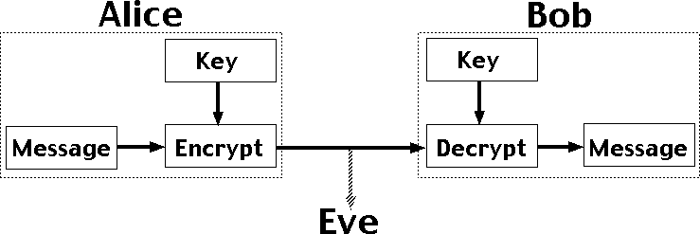
Scenario
Schenario: Alice and Bob decide to use AES algorithm to encrypt message and use asymmetric cipher to transfer the AES key. Bob generates public and private key then sends the public one to Alice. Alice uses this key to encrypt the AES key and send it to Bob. Then Bob uses his private key to decrypt Alice’s cipher to get AES key.
Unfortunately, Eve can use the public key to decrypt cipher of Alice.
In this project, the message is encrypted directly instead of AES key.
Related parties: Sender(Alice), Receiver (Bob), third party (storage) and Attacker(Eve);

Slide 6
Main results - outcome
ECC:
P and Q are elements in group, find k so that Q = k.P
Order of curve N is know and G is know

Slide 7
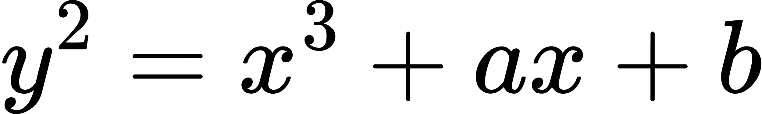
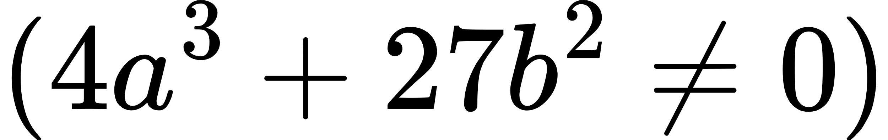
What is ECC
It’s an asymmetric/public key cryptosystem
It’s provide equal security with smaller key size as compared to non ECC algorithms
It’s makes use of elliptic curves
Elliptic curves are define by some mathematical functions
Weierstrass

Slide 8
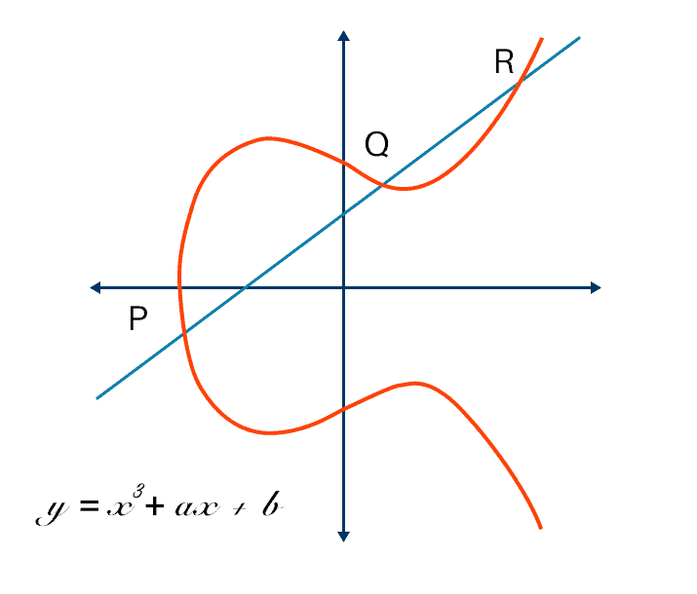
What is ECC

Slide 9
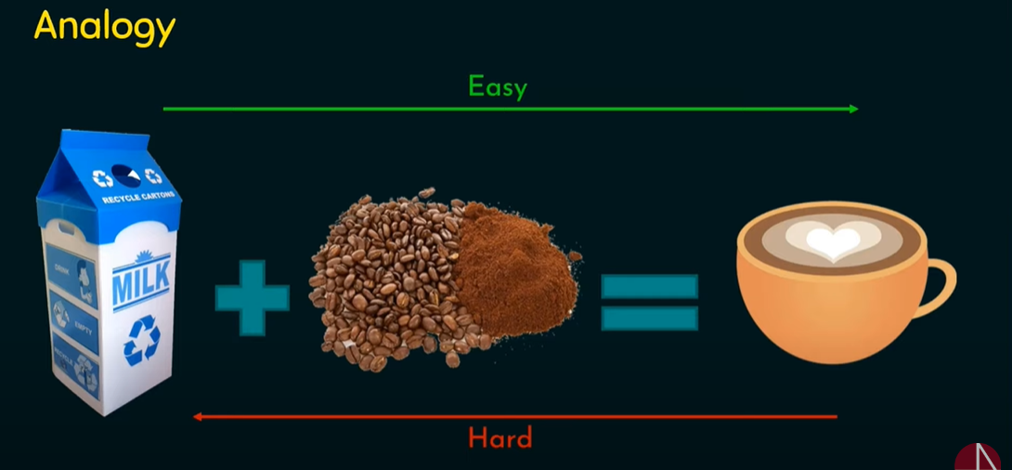
ELLIPTIC CURVE DISCRETE LOGARITHM PROBLEM

Slide 10
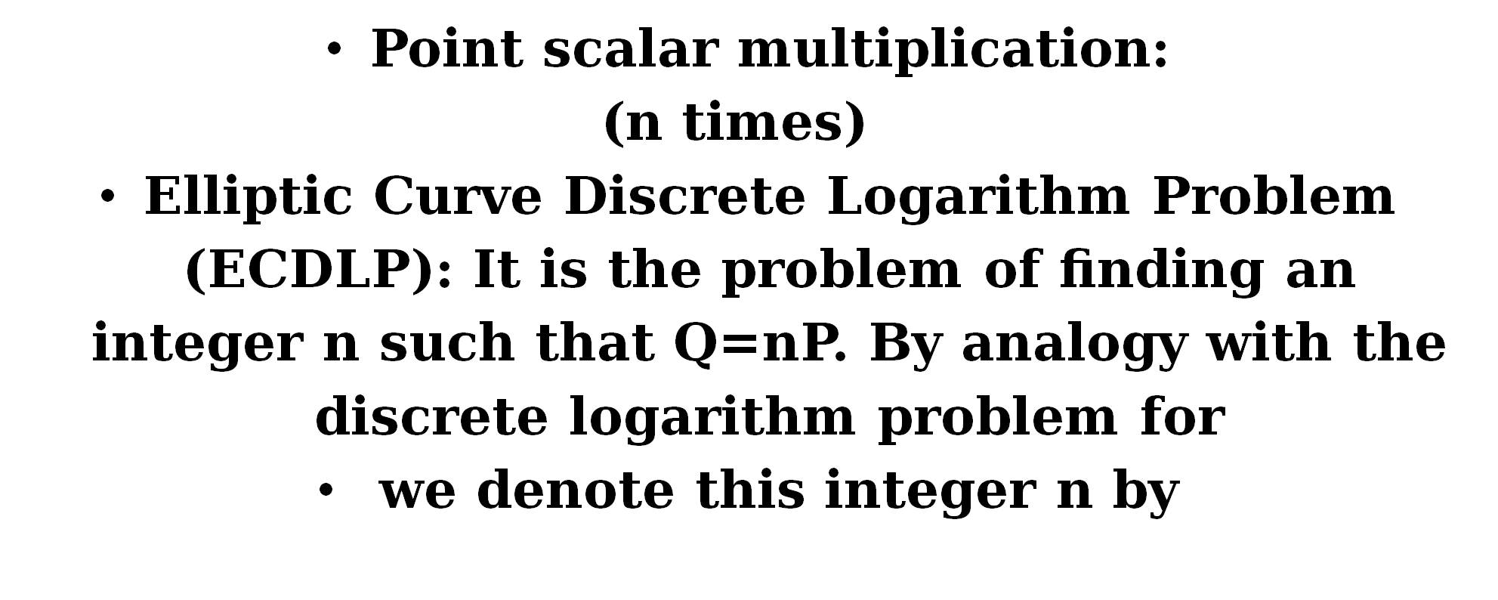
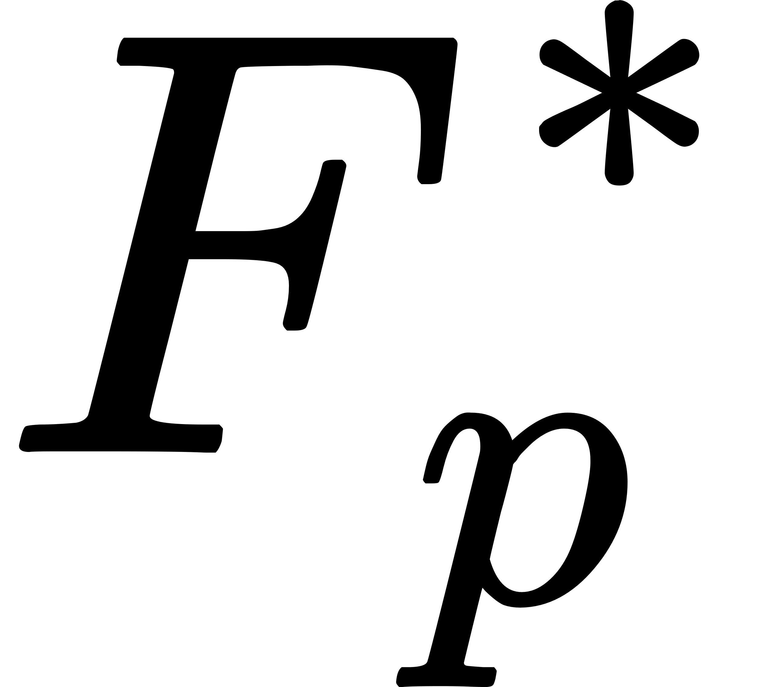

Elliptic Curve Discrete Logarithm Problem

Slide 11
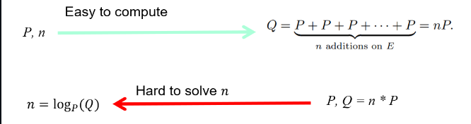
Elliptic Curve Discrete Logarithm Problem

Slide 12
Proposing research direction

Slide 13
Elliptic Curve discrete log problem – ECC attack

Slide 14

Elliptic Curve discrete logarithm problem
Elliptic curve on finite field is a set of points which sastisfy the equation y^2 = x^3 + ax + b,
Together with definition of point addition, forming a group
G : a point, generater point on elliptic curve
k : a coefficient
P = k.G, the hard problem rely on that calculation of k.G can be very fast, but to find back the k, given P, G could take really long
Our goal in this section is to find the k given P, G, the curve parameters, we will use Diffie Hellman key exchange protocol to perform the encryption between Alice and Bob

Slide 15
Baby step giant step
Baby step giant step is a space time trade-off algorithm for finding discrete log value of element in an abelian group

Slide 16

Baby step giant step
Any integer number can be represent as x = np – q, with n is pre-select number.
We can pre-calculate a^i (i<=n) and a^j.n to build a lookup table, using later on for calculate discrete log of a^x
=> Meet in the middle idea

Slide 17
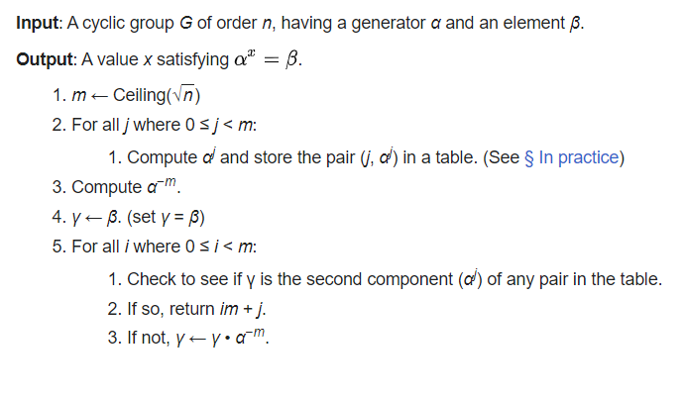

Slide 18
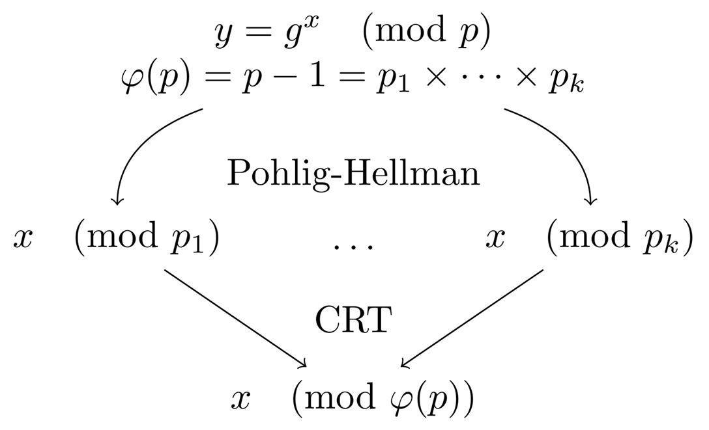
Pohlig Hellman algorithm

Slide 19
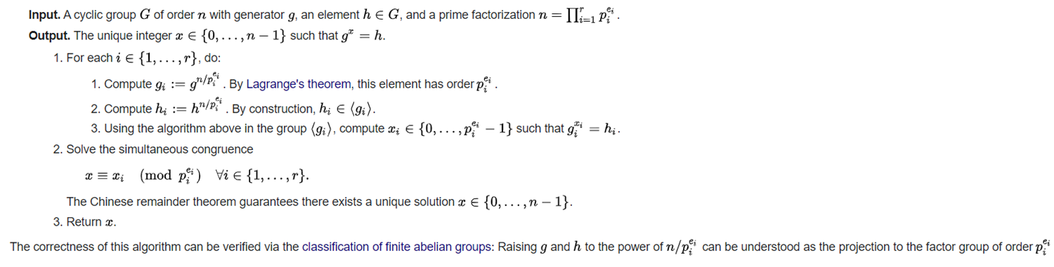
Pohlig Hellman algorithm
Assume that the order of group is a smooth number, the idea of pohlig hellman algorithm is to calculate the discrete log value of each subgroup, then use the CRT to combine the result.

Slide 20
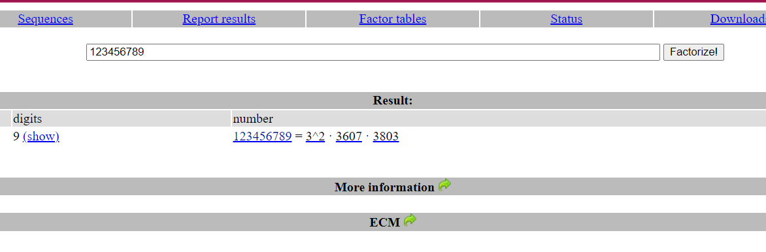
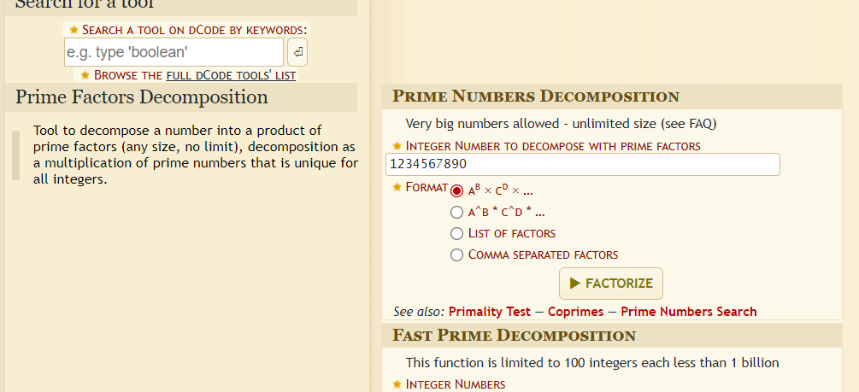
TOOLS
Online tools: dcode.fr, factordb.com, alpertron.com.ar, …
Sagemath
Python modules for cryptography: primefac, pycryptodome, z3, sympy, numpy, ...

