Slide 1
Cryptanalysis on ECC-based Algorithms
Đặng Chí Thịnh –
Nguyễn Tuấn Phát –
Lê Quốc Ngô

Slide 2
OVERVIEW

Slide 3

Scenario
Scenario: A tech company has integrated ECC-based algorithms for secure communications in their IoT devices. They want to validate the strength and security of their ECC implementation to prevent potential breaches.
Gaps: Gaps: ECC, while offering good security with shorter key lengths compared to traditional methods, can be vulnerable if not implemented correctly or if weak curves are chosen.

Slide 4
Main results - outcome
ECC:
P and Q are elements in group, find k so that Q = k.P
Order of curve N is know and G is know

Slide 5
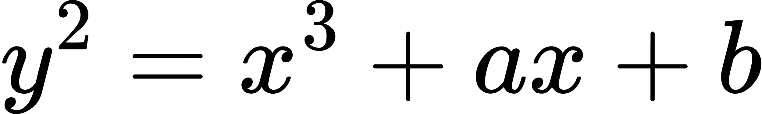
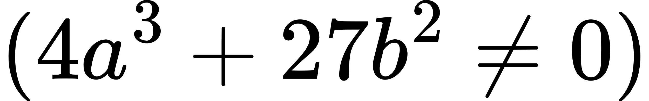
What is ECC
It’s an asymmetric/public key cryptosystem
It’s provide equal security with smaller key size as compared to non ECC algorithms
It’s makes use of elliptic curves
Elliptic curves are define by some mathematical functions
Weierstrass

Slide 6
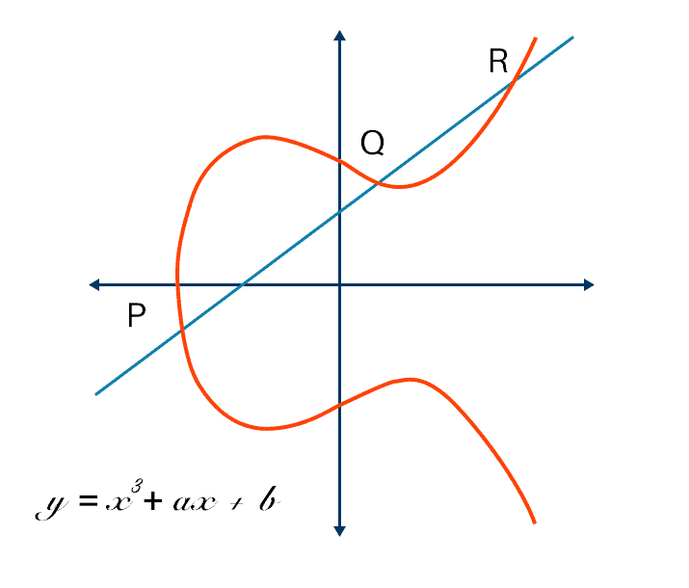
What is ECC

Slide 7
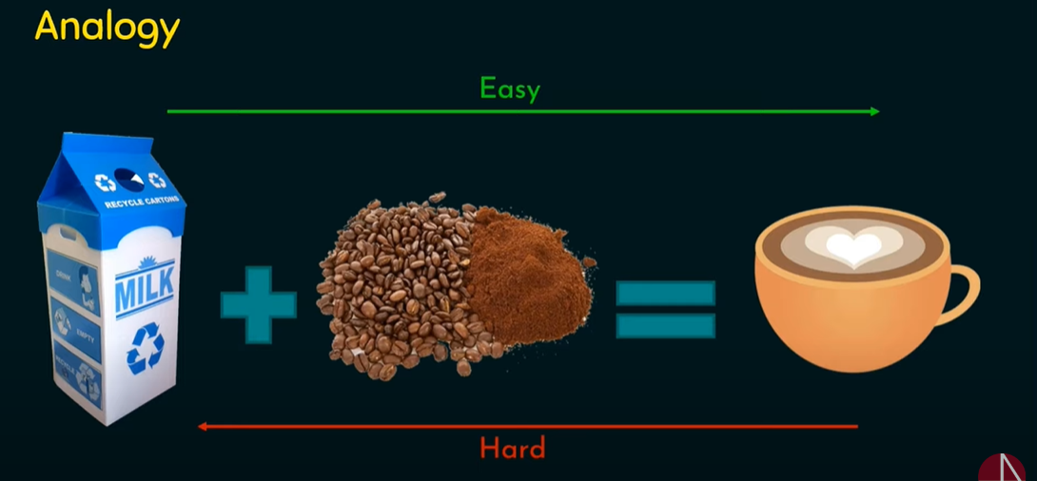
ELLIPTIC CURVE DISCRETE LOGARITHM PROBLEM

Slide 8
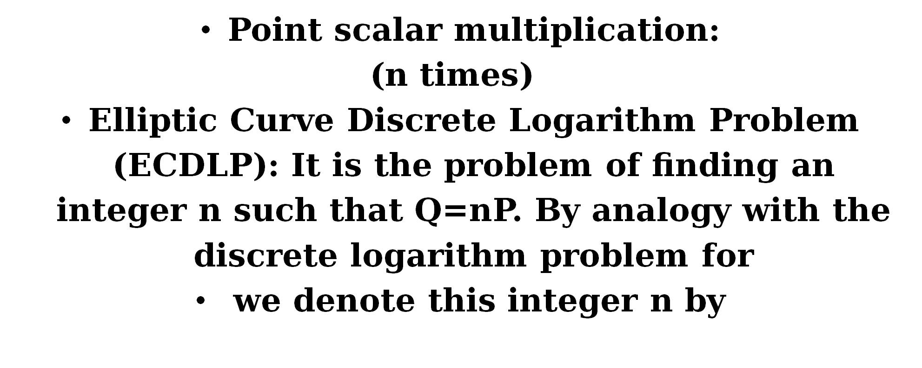
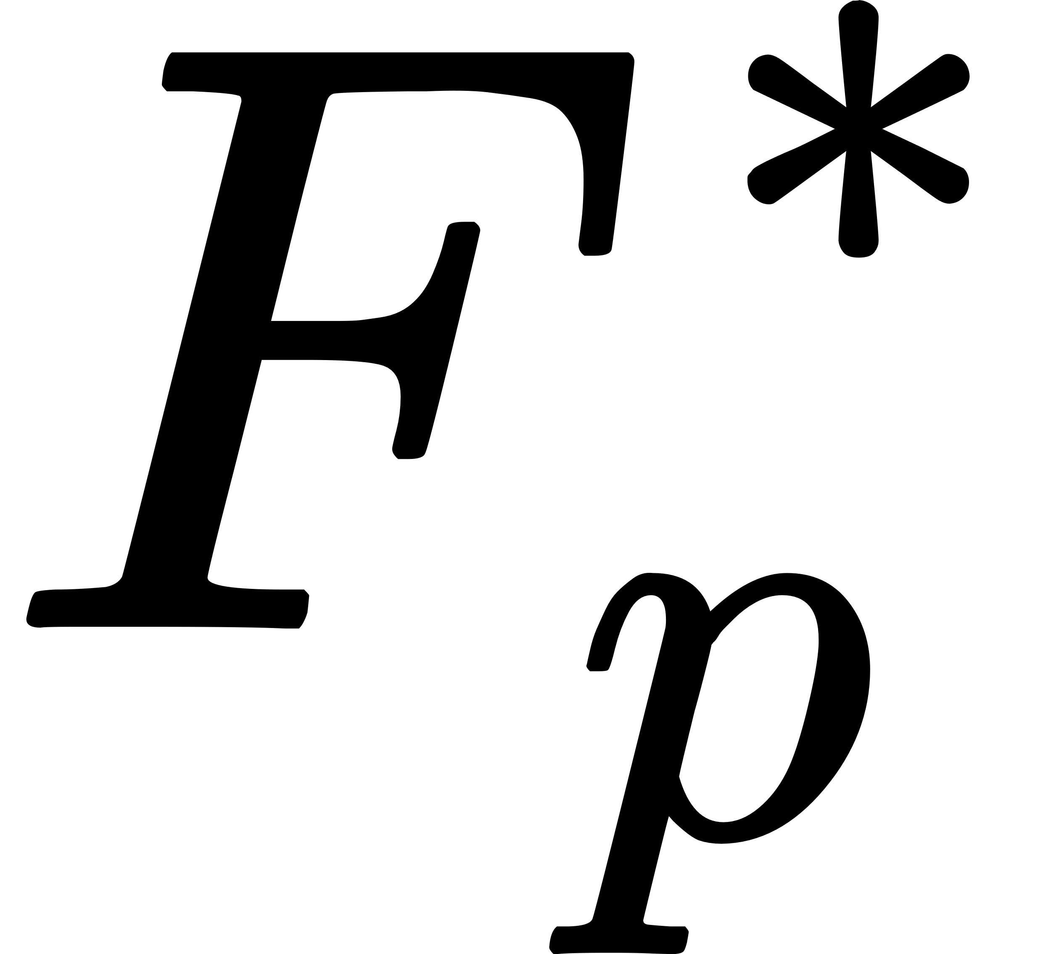

Elliptic Curve Discrete Logarithm Problem

Slide 9
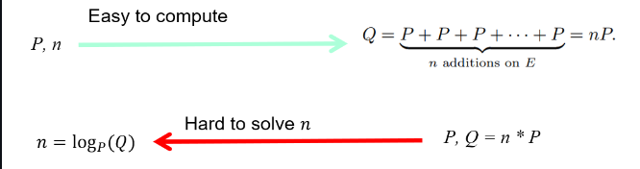
Elliptic Curve Discrete Logarithm Problem

Slide 10
Proposing research direction

Slide 11
Elliptic Curve discrete log problem – ECC attack

Slide 12

Elliptic Curve discrete logarithm problem
Elliptic curve on finite field is a set of points which sastisfy the equation y^2 = x^3 + ax + b,
Together with definition of point addition, forming a group
G : a point, generater point on elliptic curve
k : a coefficient
P = k.G, the hard problem rely on that calculation of k.G can be very fast, but to find back the k, given P, G could take really long
Our goal in this section is to find the k given P, G, the curve parameters, we will use Diffie Hellman key exchange protocol to perform the encryption between Alice and Bob

Slide 13
Baby step giant step
Baby step giant step is a space time trade-off algorithm for finding discrete log value of element in an abelian group

Slide 14

Baby step giant step
Any integer number can be represent as x = np – q, with n is pre-select number.
We can pre-calculate a^i (i<=n) and a^j.n to build a lookup table, using later on for calculate discrete log of a^x
=> Meet in the middle idea

Slide 15
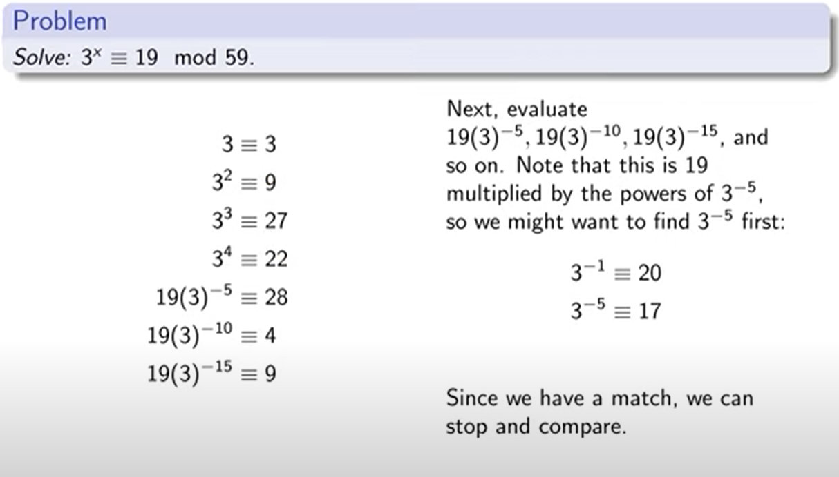
Baby step giant step

Slide 16
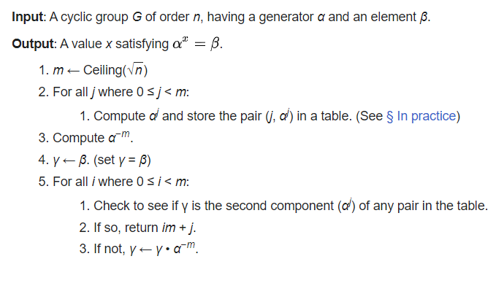

Slide 17
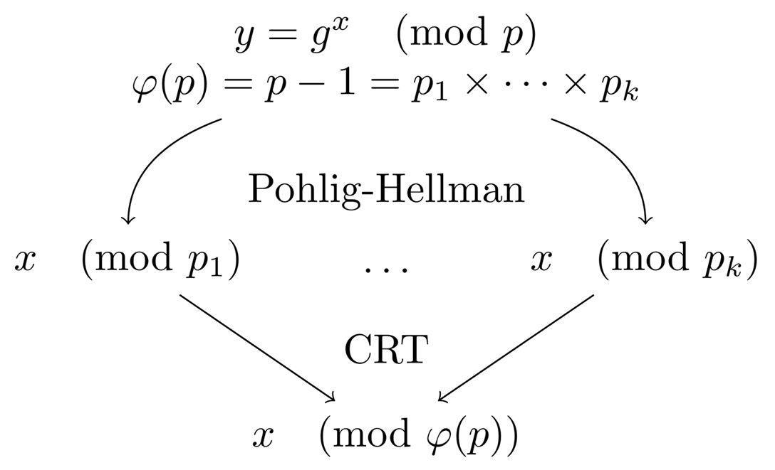
Pohlig Hellman algorithm

Slide 18
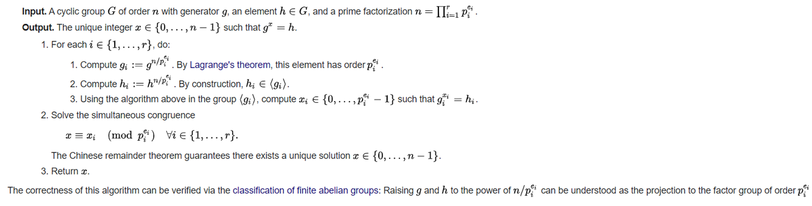
Pohlig Hellman algorithm
Assume that the order of group is a smooth number, the idea of pohlig hellman algorithm is to calculate the discrete log value of each subgroup, then use the CRT to combine the result.

Slide 19
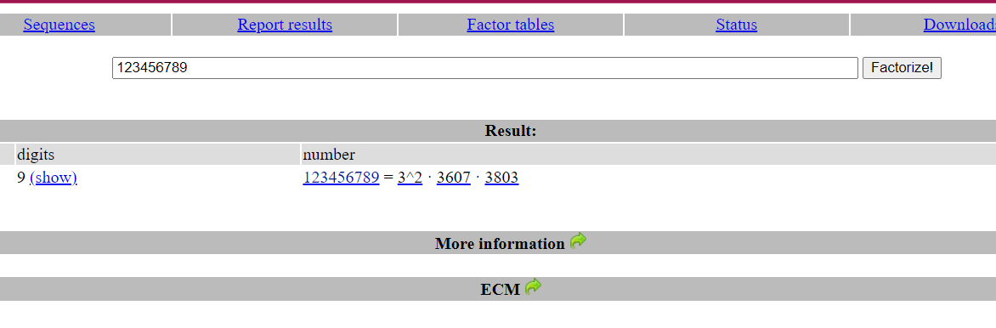
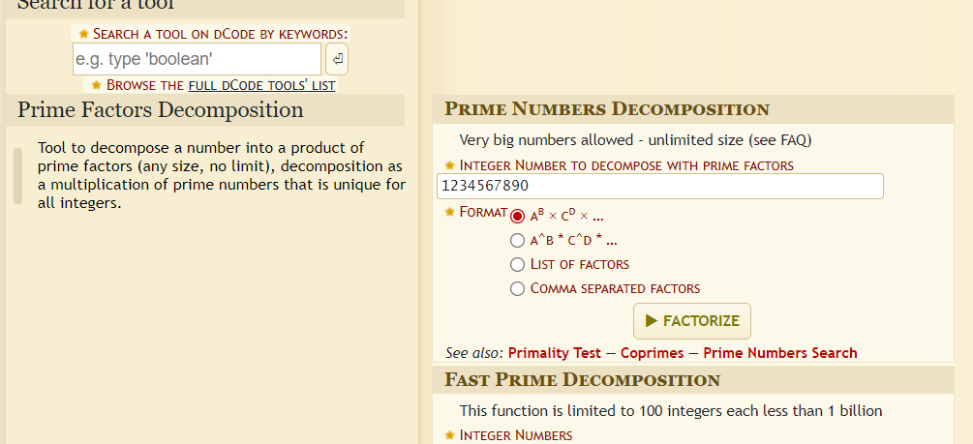
TOOLS
Online tools: dcode.fr, factordb.com, alpertron.com.ar, …
Sagemath
Python modules for cryptography: primefac, pycryptodome, z3, sympy, numpy, ...

