Slide 1
Cross the Rainbow Bridge
Students will watch the sequence and fly on the hot air balloon to get to the rainbow bridge on the clouds. After the students arrive, they will begin a race. They will race from one side of the rainbow to the other side of the rainbow.
Students can be individuals or be broken up into teams. Teams are broken up by the color of the tracks on the rainbow. You can prompt them or ask them a question. They must respond correctly and then they get to move one space.

Slide 4


Slide 5
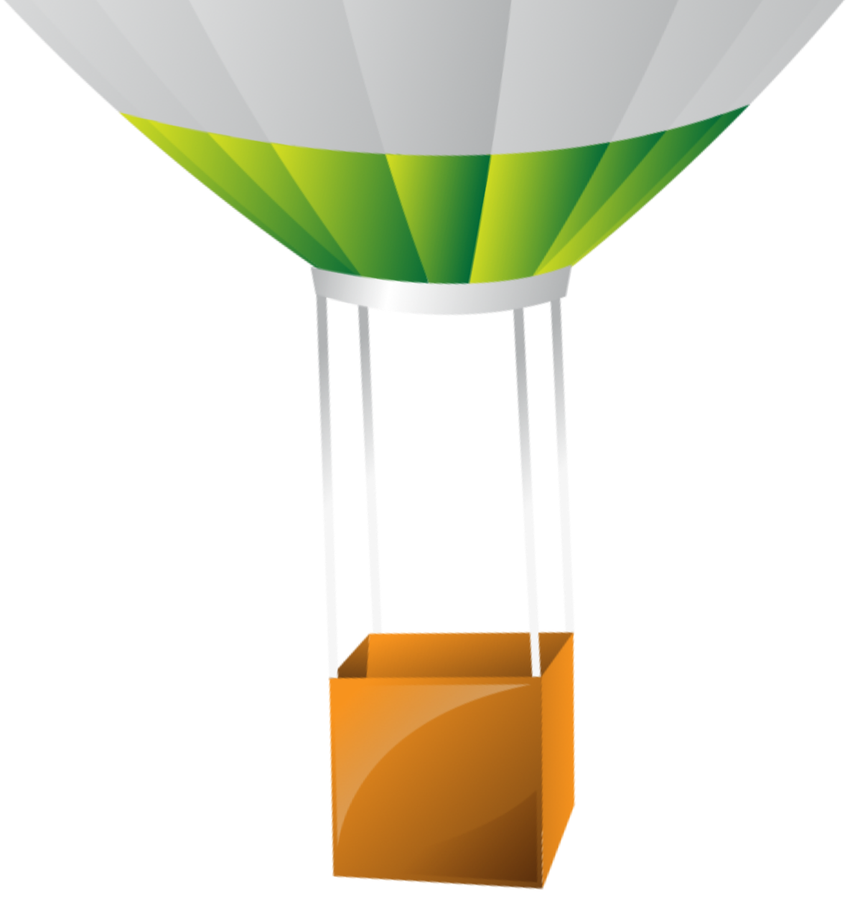

Slide 6


Slide 7


Slide 8

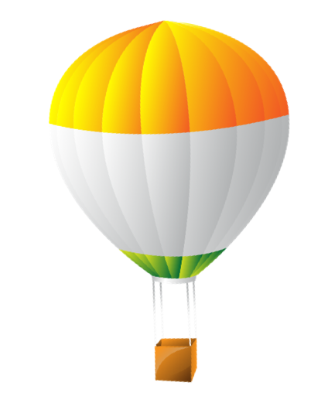

Slide 9



Slide 10

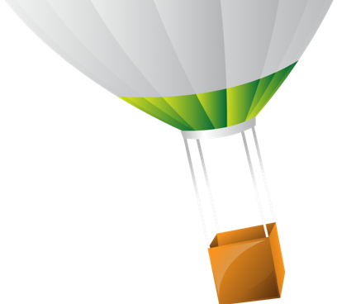

Slide 11



Slide 12


Slide 13


Slide 14


Slide 15


Slide 16

We are here!

Slide 17

Let’s play!

Slide 18

Notes:
https://pixabay.com/illustrations/background-black-box-checked-1317286/
https://svgsilh.com/image/1295532.html

