Slide 1
Keyboard Search
Phonics, Letter, and Number Search
Say a phoneme or number or show a letter or number that is on the keyboard. Students must find and circle it.

Slide 2
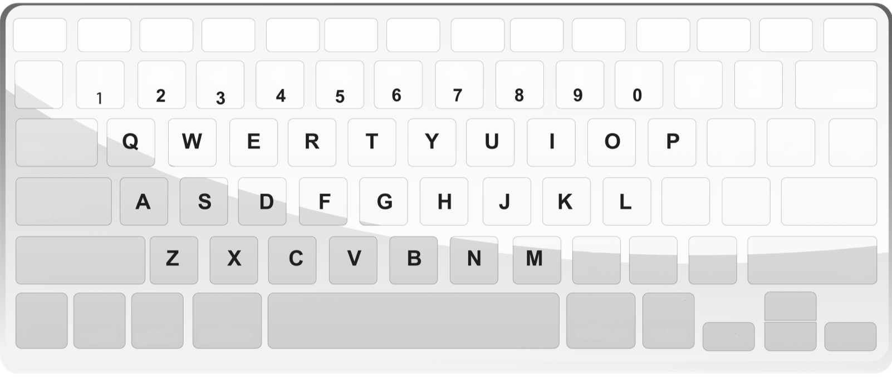
Find the letter!

Slide 3
Find the number!

Slide 4
Find the letter!

Slide 5
Find the number!

