Slide 1
Race Car Driver
Assign each student a color. If you have more than 4, assign multiple students to each color/ car. If you are practicing the target structures, ‘What do you like? and ‘I like…’ students could say a sentence and when they are done, they could draw a small circle on each row (until they reach the ‘finish line’).

Slide 2
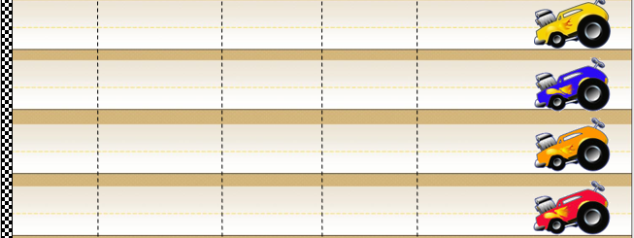
Race Car Driver
Notes:
https://pixabay.com/vectors/car-racing-speed-auto-green-312571/

Slide 3
Race Car Driver
Notes:
https://pixabay.com/vectors/car-racing-speed-auto-green-312571/

Slide 4
Race Car Driver
Notes:
https://pixabay.com/vectors/car-racing-speed-auto-green-312571/

Slide 5
Race Car Driver
Notes:
https://pixabay.com/vectors/car-racing-speed-auto-green-312571/

