Slide 1
The Spider Game
There are two teams who each have three lives (hearts). They will use a six-piece turntable or a six-sided dice. If you get a spider, you lose one life. If you get a 1, 3, or 4, then you need to make a sentence with the word of picture in that box. If you get a 6, then you make any sentence you want that is related to the lesson or unit.

Slide 2
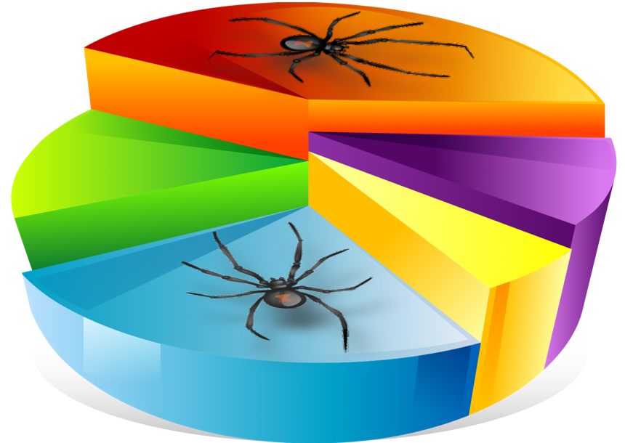
1
2
3
Make any sentence.
4
6
5
Notes:
spider
pie

Slide 3
1
2
3
Make any sentence.
4
6
5
Notes:
spider
pie

