Slide 1
Time Bomb
Set the language structure that players need to use for the game. Set a time limit. The teacher can choose to start the game with anyone. The movement goes clockwise. Start the clock, the initial player must make a sentence and then ask a question to the player to his or her right. Continue in this direction until the time runs out. The student who is answering or asking when the timer is up and the person to his or her left and right will be the losers. Everyone else will get one point. Give feedback for any mistakes you heard during the round and then play another. Keep playing more rounds as much as is necessary for the lesson.

Slide 2

Time Bomb
(insert structure / prompt here)
Notes:
https://upload.wikimedia.org/wikipedia/commons/d/df/Cartoon_Man_Holding_A_Time_Bomb.svg

Slide 3
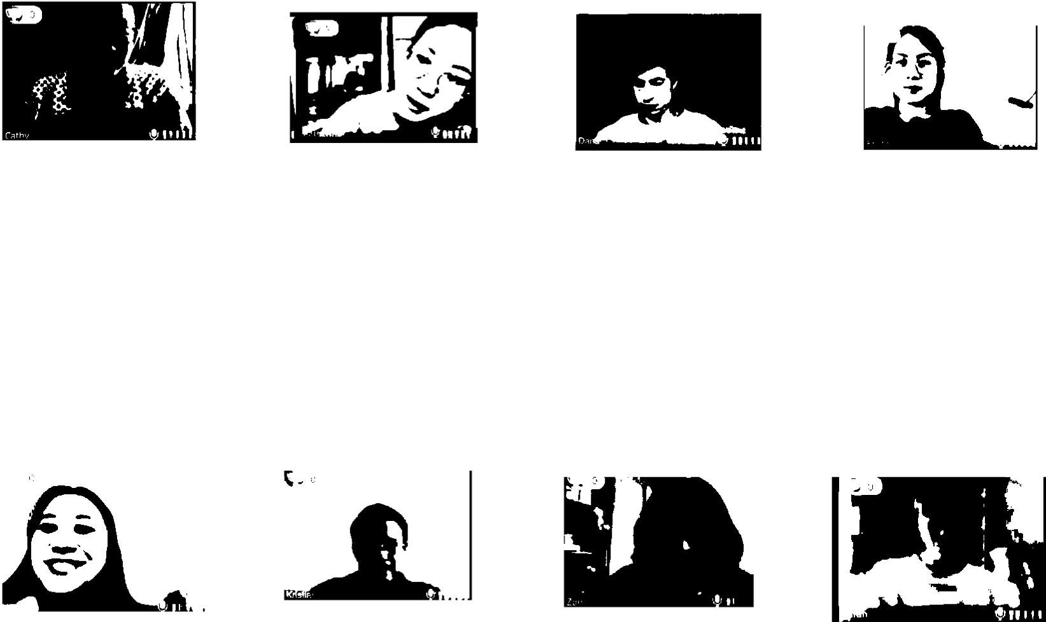
Time Bomb
I want to be a ... when I ...
Notes:
https://upload.wikimedia.org/wikipedia/commons/d/df/Cartoon_Man_Holding_A_Time_Bomb.svg

