Slide 1
EXECUTION OF STRATEGY BY CALCULATING THE EFFECTIVENESS
BETWEEN TRADITIONAL AND MODERN MARKETING
STRATEGY IN BUSINESS ENTERPRISE
: COMPARATIVE ANALYSIS

Slide 2
ABSTRACT
Marketing Strategy is the section of business plan that outlines the overall game plan for finding clients and customers for the business, and it is a long-term, forward-looking approach to planning with the fundamental goal achieving a sustainable competitive advantage. The study investigates and describes the concept of calculating effectiveness of strategy it intends to examine relationships between traditional and modern as well as differences in attitudes and implementing related to the business’ strategy.
The objective of this study is to identify which is more effective of traditional and modern marketing strategy business enterprise attributes for firms in Different conditions and explore factors that influence the business attributes.

Slide 3
The survey-questionnaire was personally distributed to the owner managers who attended various entrepreneurship and small business conferences, trade meetings, and short-term training programs. A total of 20 useable responses were collected. Regression analysis was conducted to test the hypotheses. Although adequate care was taken in minimizing bias due to sampling method, single respondent, common method variance, the possibility of bias due to these issues cannot be completely eliminate.

Slide 4
Statement of the Problem
The study determines individual’s personal data.
Specially, this study sought to answer the following questions:
1 How may the profile of the respondents be described in terms of:
Name
Gender
Age
Civil status
Kind of business

Slide 5
2. Which is more effective? Traditional or the Modern Strategy?
3. Why the Traditional Marketing Strategy are slow to react to external and internal changes?
4. How to maintained the effectiveness of front-line staff in Traditional Marketing Strategy?
5. Why is it Modern Marketing Strategy are having hard time to run a business because of diversification?
6. What are the strategies to utilize in innovation while still maintaining a sense of control over the business?

Slide 6
SCOPE AND DELIMITATION
This study focused on the Marketing Strategy used between Traditional and Modern Marketing Strategy in Business Enterprise. The respondents of the study are composed of twenty person who engaged in business and practiced the said study being conducted. The presence of every respondent will be located at Quezon City. The time-frame of the study is only 14 weeks and it will end on the second week of October Academic Year 2018 - 2019
The results of this study are applicable only to the respondents of this study being conducted and should not be used as a measure of the effect of a certain company or business that does not belong to the place where this study administers. The researcher considered working on this study to find out if there's an effect on the certain company about the strategy being used.

Slide 7
RESEARCH DESIGN
Researchers used the Descriptive Method of Research wherein descriptive research is fact finding with adequate interpretation according to Aquino. The descriptive method is something more and beyond just data gathering the latter part is not reflective thinking as research which all the data and information gathered are accurate and came from the reliable source. In this study the researchers used the survey as an instrument to show the accurate data needed to the study being conducted which is traditional and modern marketing strategy in business enterprise by calculating the effectiveness of both topic.

Slide 8
Respondents
The researchers chose twenty (20) managers/heads with the age of 20 – 50 years old in Quezon City for the academic year 2018-2019. The number of respondent is considering enough for valid analysis and interpretation.

Slide 9
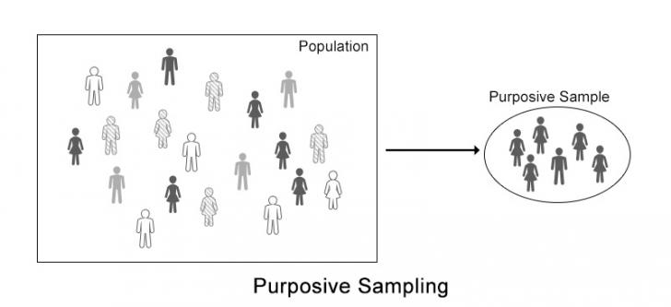
SAMPLING TECHNIQUE
According to William G. Cochran business and industry have many uses for sampling in attempting to increase the efficiency of their internal and external operations. The sampling technique that researchers used was purposive sampling technique taken from selected managers/heads that are engaged in the business This is based on the intention or the purpose of study. Only those elements will be selected from the population which suits the best for the purpose of our study. The twenty (20) respondents are all current residence of Quezon City. This technique was place to ensure a fairly equal representation of the variables of the study. The stratification was based on the traditional and modern strategy in business enterprise

Slide 10
RECOMMENDATION -More increase of productivity and become more highly effective, focus on most important tasks first before doing anything else. (mod) -They need to implement strategy like Diversity marketing such as expectation, beliefs to enhance the growth potential of a business(trad) -To know how to manage understanding potential risks to the business and finding ways to minimize their impacts. (Q3) -Having confident & being consistent is not enough the strategy of those frontline staff should have possessed positive interactions with a client can give a frontline worker great satisfaction (Q4) -Need to more understand the target audience/worker to identify how to get their attention & focus on present problem by considering future demands (Q5) -Must know the purpose and motive that requires developing own clear vision of where you want to go and the goal you wanted to choose. (Q6)

Slide 11










PRESENTORS
Lamentac, Vincent Karl D.
De leon, Lyka Mae B.
Soriano, Azenith L.
Encabo, Carol B.
Pelausa, Ivy Grace A.
Darole, Ramon Joseph R.
Dimalaluan, Kaila E.
Garcia, Mc Klain B.
Panes, Marian Abigail B.
Prof. R. A. Martinez
Adviser

Slide 12
Thank you Panels! May you have a wonderful sembreak. God Bless!

