Slide 1
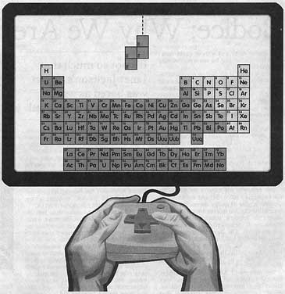

Artificial Soviet Intelligence

Slide 2

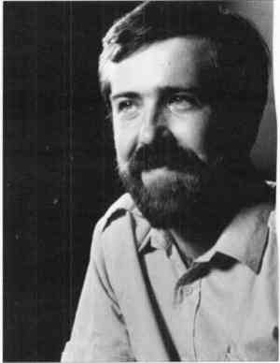
History
1985 - Pazhitnov creates for Electronica 60, ported to IBM PC by Gerasimov, receives a 286 clone from the Academy
1986 - Ported to Apple II and C64 in Budapest
Stein sells rights to Tetris to subsidiary Mirrorsoft without consent from the Russians
Nov. '86 – Russians refuse Stein's contract
Jan. '88 – Pazhitnov appears on CBS, ELORG takes over negotiations with Stein
Notes:
Alexei Pazhitnov, Vadim Gerasimov
Moscow Academy of Science's Computer Center
Robert Stein, president of the British software house Andromeda

Slide 3
More History
May '88 – Stein and ELORG reach an agreement, Tetris sales peak in US
July '88 – ELORG meets in Paris with Stein, Mirrorsoft and Spectrum sub-license to Bullet-Proof Software and Atari Games
Nov. '88 – Famicom version released. Stein, BPS, Mirrorsoft, all meet in Moscow
Stein gets arcade rights, BPS and Nintendo get handheld and console rights for $5M, Famicom version declared pirated
Notes:
To straighten out a huge licensing mess

Slide 4
Even More History
Mar. '89 – Console rights fully handed over to Nintendo and BPS, all others declared pirate
May '89 – Tengen releases Tetris for Nintendo
June '89 – Tengen version taken off shelves
July '89 – Tetris for Gameboy sells 3M copies
Late '96 – Tetris Company LLC organized, royalties paid to Pazhitnov for his creation

Slide 5
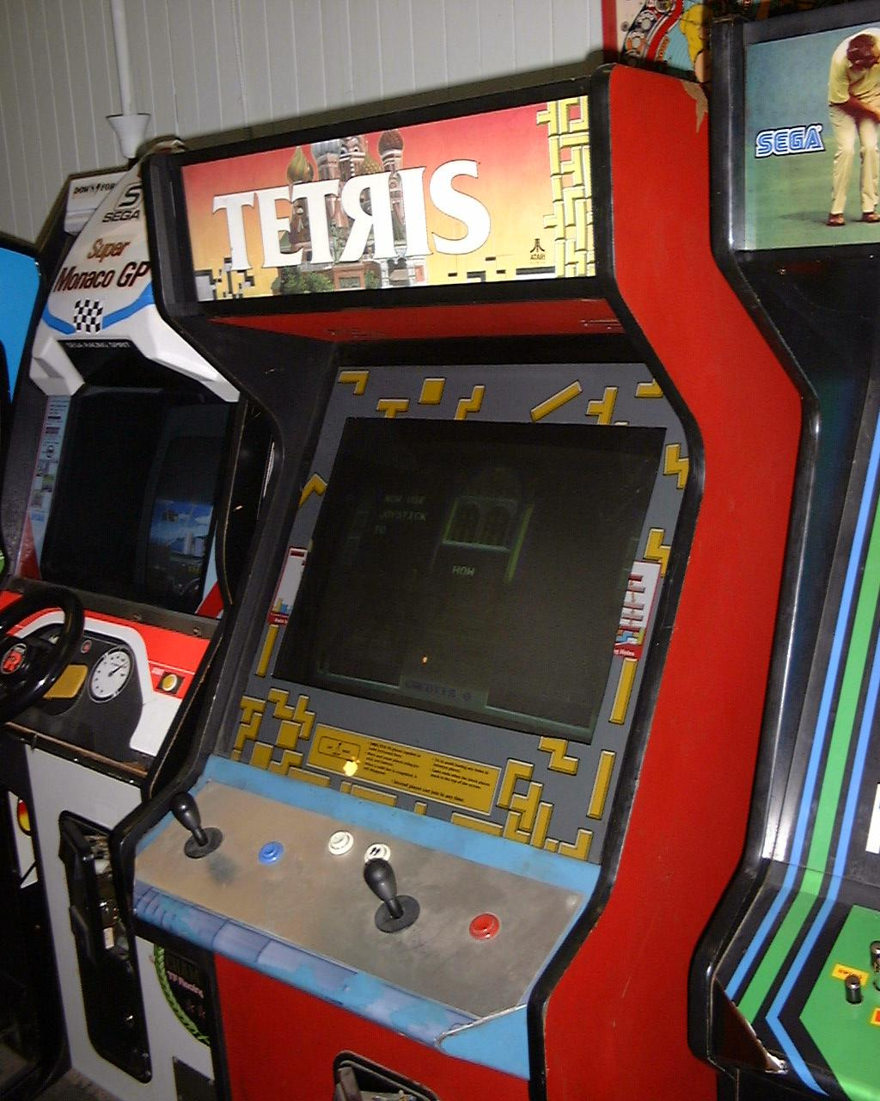
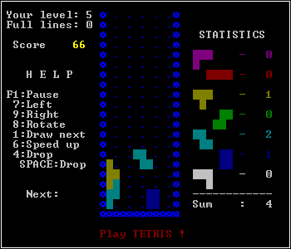
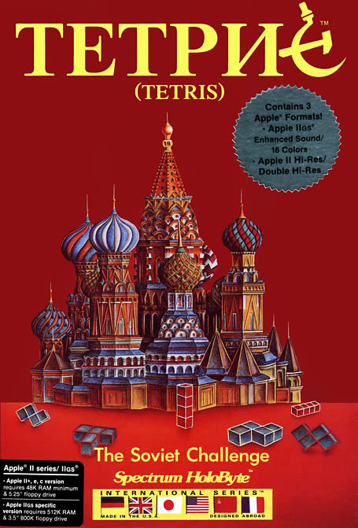
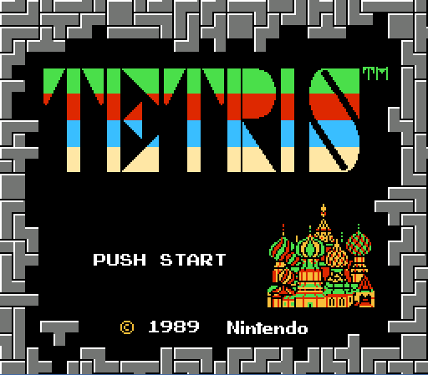
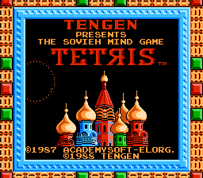
Some Tetris variants

