Slide 1
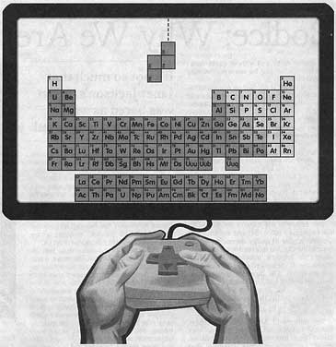

Artificial Soviet Intelligence

Slide 2


History
1985 - Pazhitnov creates for Electronica 60, ported to IBM PC by Gerasimov, receives a 286 clone from the Academy
1986 - Ported to Apple II and C64 in Budapest
Stein sells rights to Tetris to subsidiary Mirrorsoft without consent from the Russians
Nov. '86 – Russians refuse Stein's contract
Jan. '88 – Pazhitnov appears on CBS, ELORG takes over negotiations with Stein
Notes:
Alexei Pazhitnov, Vadim Gerasimov
Moscow Academy of Science's Computer Center
Robert Stein, president of the British software house Andromeda

Slide 3
More History
May '88 – Stein and ELORG reach an agreement, Tetris sales peak in US
July '88 – ELORG meets in Paris with Stein, Mirrorsoft and Spectrum sub-license to Bullet-Proof Software and Atari Games
Nov. '88 – Famicom version released. Stein, BPS, Mirrorsoft, all meet in Moscow
Stein gets arcade rights, BPS and Nintendo get handheld and console rights for $5M, Famicom version declared pirated
Notes:
To straighten out a huge licensing mess

Slide 4
Even More History
Mar. '89 – Console rights fully handed over to Nintendo and BPS, all others declared pirate
May '89 – Tengen releases Tetris for Nintendo
June '89 – Tengen version taken off shelves
July '89 – Tetris for Gameboy sells 3M copies
Late '96 – Tetris Company LLC organized, royalties paid to Pazhitnov for his creation

Slide 5
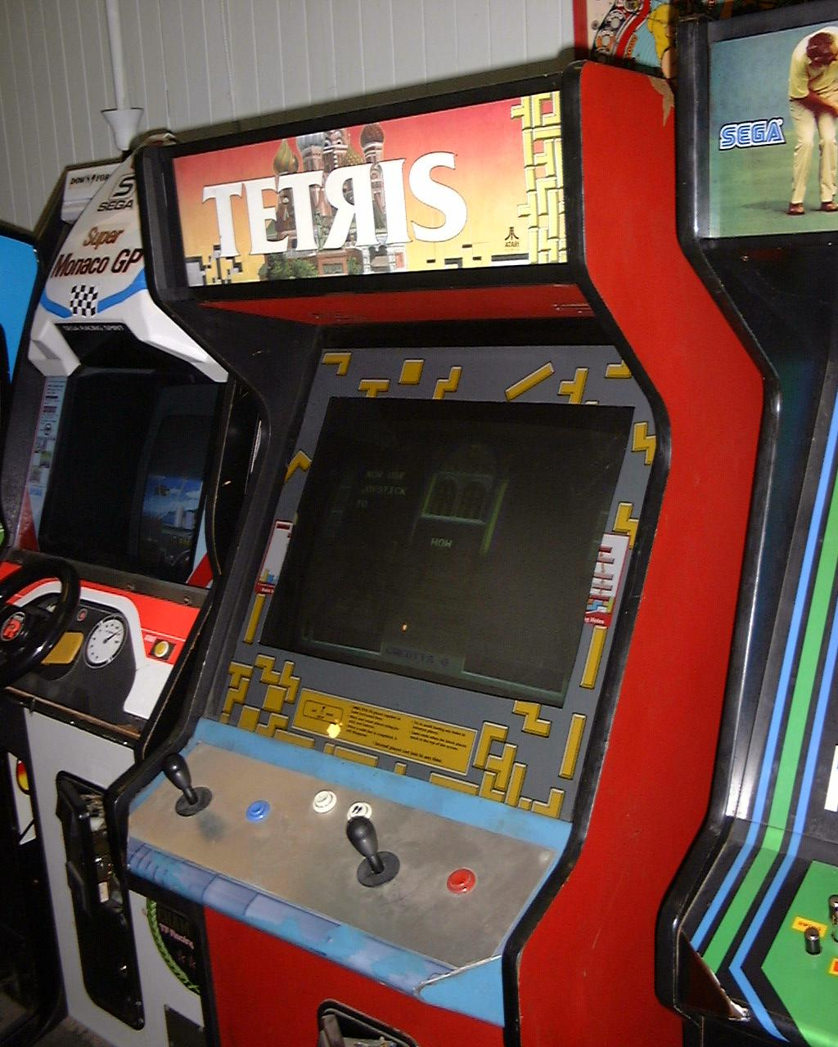
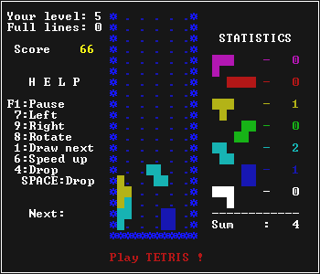

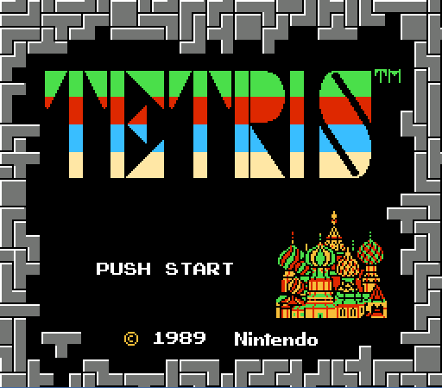
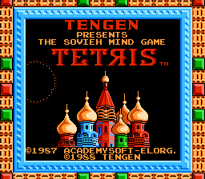
Some Tetris Variants

Slide 6
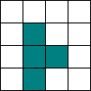
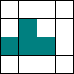
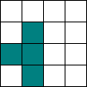




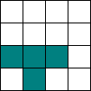


Tetris Review
Seven pieces, four blocks to each piece
Each piece has a maximum of:
  four possible rotations
  ten translations
Some pieces have only two rotations,
the O piece only has one
Objective: Create lines by filling a column, minimize gaps which prevent lines
The well is a 20 row, 10 column grid. A point can be expressed as x_{ij} for the i^{th} row and the j^{th} column, and is equal to 0 if empty, 1 if occupied
L T J
S O Z
I-beam
4 3 6
5 0 2
1
=
=

Slide 7
Tetris AI
For each new piece, check each combination or translation and rotation, and rate each move. Objectives:
  Fit the piece in with the other blocks
  Avoid creating gaps in the well, preventing lines
  Reduce the playing field by forming lines by
    Filling a row horizontally
  Try not to stack the pieces too high all at once
There are a maximum of 40 possible moves
A barbecue sandwich would be awesome

Slide 8
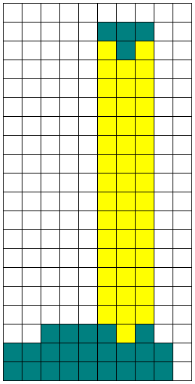
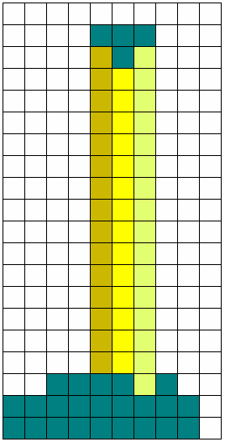
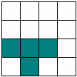

Metrics of Tetris AI
D_{j} = pants_{J+j} – (skirt_{j}–1), skirt_{J+j}≠0
fit = fit^{max} – | Σ_{j} D_{j} – D_{j+1} |
D = 2, 2, 2, *
D = 2, 3, 1, *
Distances from piece’s landing zone must be equal
Each of the seven pieces have an intrinsic four-element landing array called skirt for each rotation.
This is compared against
the column height
array, pants
skirt =
2, 1, 2, 0
Good
Bad
pants =
2, 2, 3, 3, 3, 3, 2, 3, 3, 0

Slide 9
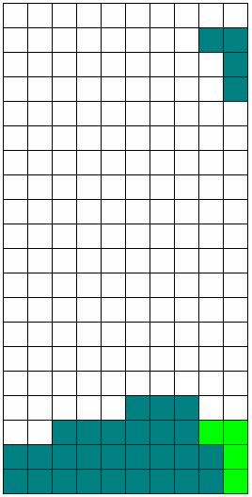
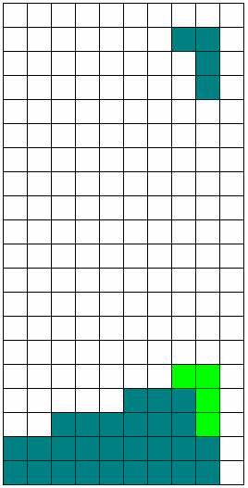

Metrics
How many lines will result from this placement
Lines are created by filling a row, therefore the sum of the row must be equal to the number of columns
Σ_{j}x_{ij} before
Σ_{j}x_{ij} after
6
9
9
8
10
10
Two lines
No lines

Slide 10
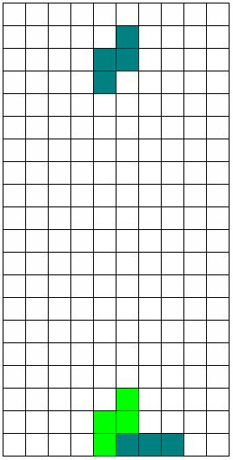
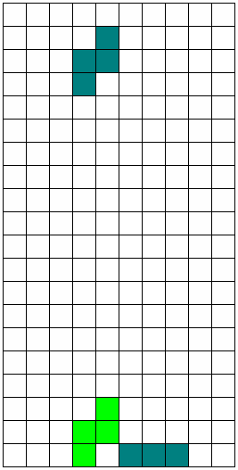
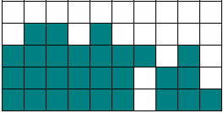
Metrics
gaps = Σ_{j}Σ_{i=I}(1 – x_{ij}), I ≤ i < 20
The number of gaps the piece will block as a negative measurement of health
For each landing column, look further down until the first block is encountered, then add all spaces
I=18
No gaps
Σ_{i=I} (1 – x_{ij}) = 2, two gaps
Ah ah ah!
One gap

Slide 11
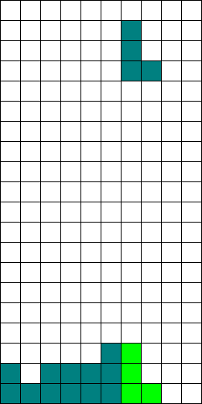
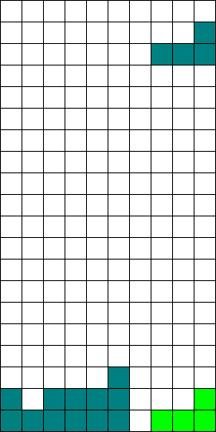
Metrics
fill = Σ_{ij}x_{ij} / i∙j
17 ≤ i < 20
18 ≤ i < 20
How much of the horizontal space will the piece fill
Add the number of blocks in each occupied row, divide by the number of rows and columns
The one on the right is better, since 0.53 < 0.75
fill = 16/30 = 0.53
fill = 15/20 = 0.75

Slide 12
Strategies for Neural Network
First attempt
  Crashed due to lack of memory
    I only have 192 MB of RAM
  Since there are so many different possibilities, perhaps it would not have worked anyhow
200 inputs
Network
output: 10 translations, 4 rotations

Slide 13
Strategies for Neural Network
The latest idea is to train the computer by playing the game and having the computer observe each move, and train the neural network based on the user's decision.
So far, adding each of the values seems to be a good predictor for a good move.
Each move
(40 of them)
Fit
Lines
Overall move health
(40 of them)
Fill
-Gaps
etc...

Slide 14
Strategies for Neural Network
Another idea: many more inputs and nodes connected to fourteen outputs
  10 translation, 4 rotation
This is probably a bad idea
  A huge network with 160 inputs and 14 outputs, are you crazy?!
  It would require training the network with way more combinations
  I haven't tried this yet
  Crazy ideas are ideas worth trying
...

