Slide 1
A DATA-VALIDATION WALKTHROUGH
The Fine Print in the
State Jobs Numbers
What three state-level labor-market datasets actually look like — before you model them
Continued claims
U3 unemployment
Nonfarm payrolls
50 states + DC · FRED / ALFRED point-in-time archive
All three datasets cleared core validation — 55 checks: 38 PASS · 17 WARN · 0 FAIL

Slide 2
Three series that look interchangeable
Three fresh reads on the US job market — one weekly, two monthly
Among the most-used inputs in applied macro: forecasts, lead-lag studies, backtests
They look like three tidy versions of the same labor market
They are not — and the differences are exactly what quietly break a model
Series | Cadence | What it is
● Continued claims | weekly | a count of people still claiming unemployment insurance
● U3 unemployment | monthly | the headline jobless rate — a bounded percentage
● Nonfarm payrolls | monthly | total jobs on employer payrolls — an unbounded count
The Fine Print in the State Jobs Numbers
2

Slide 3
Four plain questions, one point-in-time archive
Each series runs through the same four checks using ALFRED — the archive that remembers not just today's value, but the value printed on the day it was first released.
V1
Is the data even well-formed?
V2
What clock does it run on?
Structure: states, keys, valid values
Calendar & frequency; missing periods
V3
When do you actually learn the number?
V4
How much does it change after you learn it?
Publication lag & the point-in-time boundary
Revision behaviour — the operative split
The Fine Print in the State Jobs Numbers
3

Slide 4
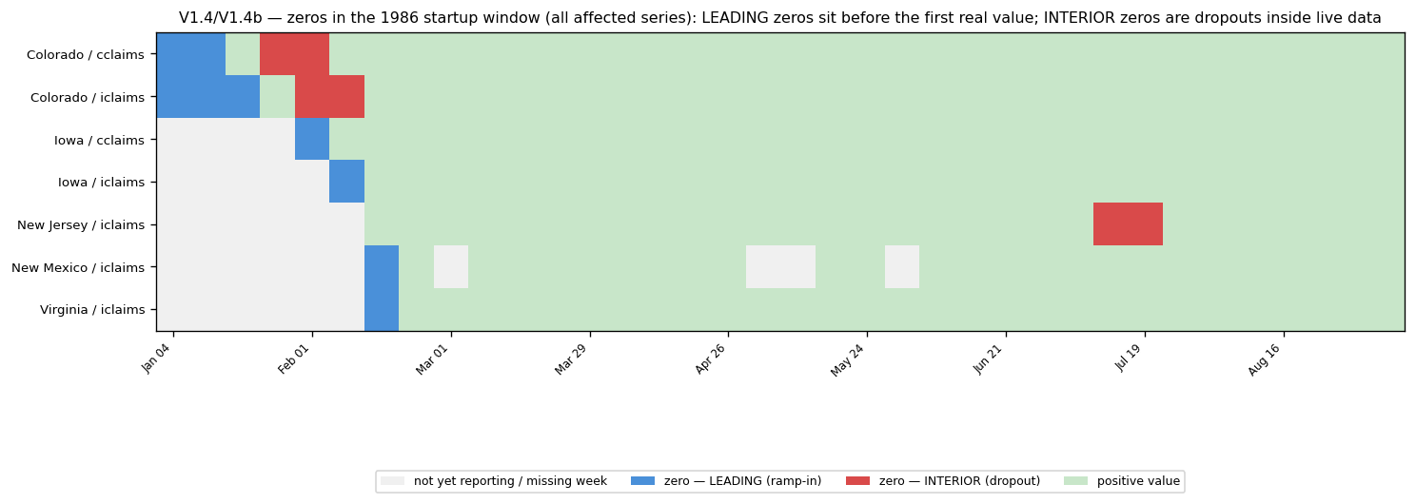
V1
Is the data even well-formed?
All three pass the basics: 51 states, one value per period, no duplicate keys, no missing fields
The subtle part is what a “valid value” means for each series
Claims are counts → should be positive; the 1986 start-up hides a handful of zeros
Leading zeros are harmless; interior zeros are real dropouts — treat as missing, never average through
Claims, V1: blue zeros are harmless start-up; red interior zeros must be treated as missing.
The Fine Print in the State Jobs Numbers
4

Slide 5
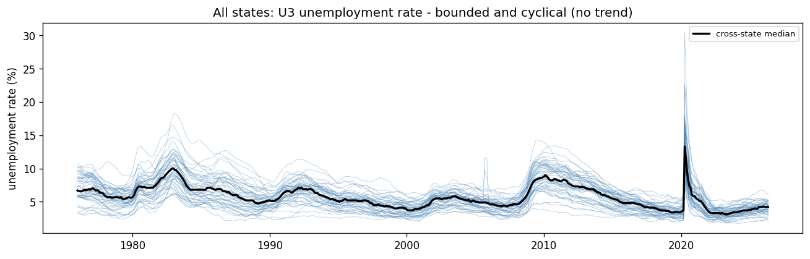
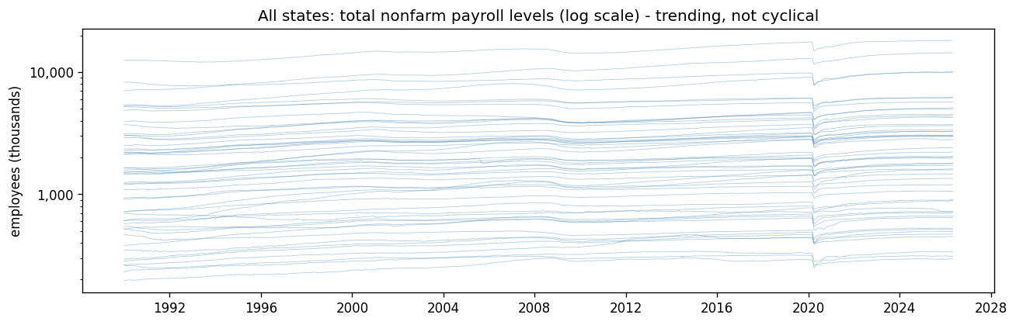
One rate that cycles, one count that trends
The unemployment rate is bounded (~2–30%), quantized to 0.1pp, and cyclical — no long-run trend
Payrolls are an unbounded count that mostly just grows — 51 states climbing near-parallel
One series mean-reverts; the other trends
That single distinction decides how you transform each one before it reaches a model
U3: a bounded, cyclical rate — rises together in recessions, settles back.
Payrolls: an unbounded, trending count — a different mathematical object.
The Fine Print in the State Jobs Numbers
5

Slide 6
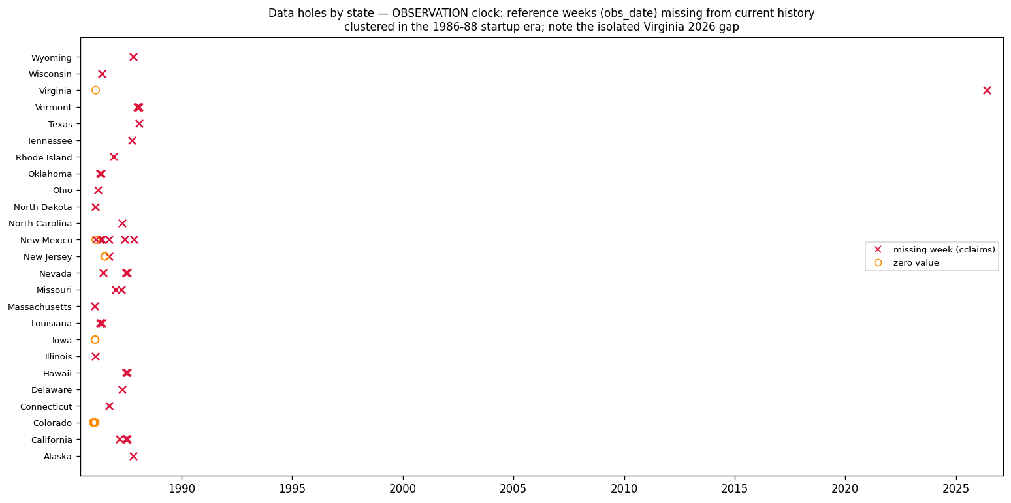
V2
What clock does it run on?
Claims are weekly, stamped to the Saturday that ends the week
The rate and payrolls are monthly, keyed to the pay period containing the 12th
Calendars are mostly clean; claims gaps cluster in the noisy 1986–88 start-up
October 2025 is absent for everyone — the late-2025 federal shutdown; flag it, don’t interpolate
Claims, V2: gaps cluster in 1986–88; the panel is otherwise complete to the present.
The Fine Print in the State Jobs Numbers
6

Slide 7
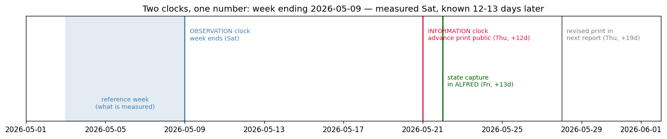
V3
When do you actually learn the number?
Every number has two birthdays: the period it measures, and the day it became public
Confuse them and you build a model that ‘knew’ things before anyone could
Join every feature on the second date — never the first
A week of claims is measured on its Saturday, but only public ~2 weeks later
V3: measured on its Saturday, public ~12–13 days later. Join on the second date.
The Fine Print in the State Jobs Numbers
7

Slide 8
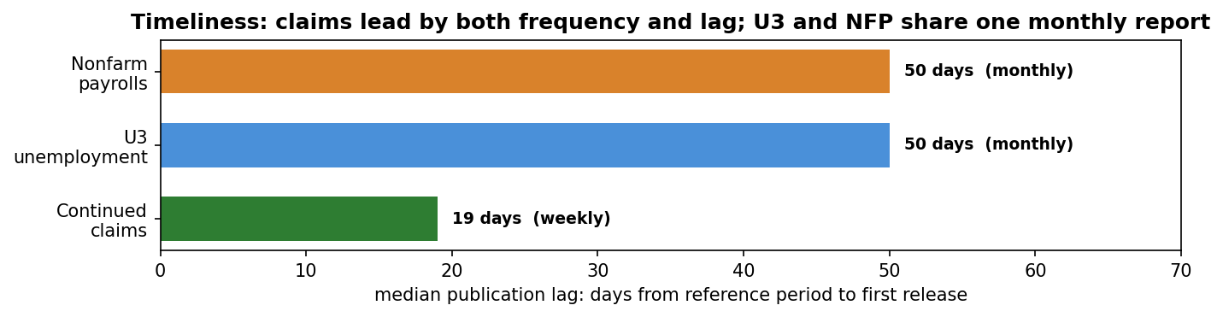
Timeliness: weekly leads, monthly lags
Publication lag is where the weekly and monthly series split
Continued claims land about 19 days after the week they describe
The rate and payrolls arrive together, ~50 days later, in one monthly report
Shared release means U3 and NFP align for free; the PIT archive starts ~2007–2010
Claims lead on both frequency and lag; the rate and payrolls share one slower release.
The Fine Print in the State Jobs Numbers
8

Slide 9
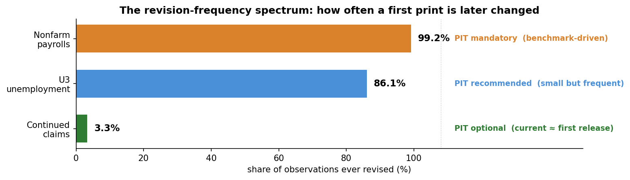
V4
How much does the number change after you learn it?
When first published — is it the number, or a first guess quietly rewritten later?
Share of observations ever revised: claims 3.3%, U3 86%, payrolls 99%
This single axis decides how hard you must work to avoid look-ahead
Optional (claims) → recommended (U3) → mandatory (payrolls)
V4, the whole story in one chart: the share of values ever revised after first release.
The Fine Print in the State Jobs Numbers
9

Slide 10
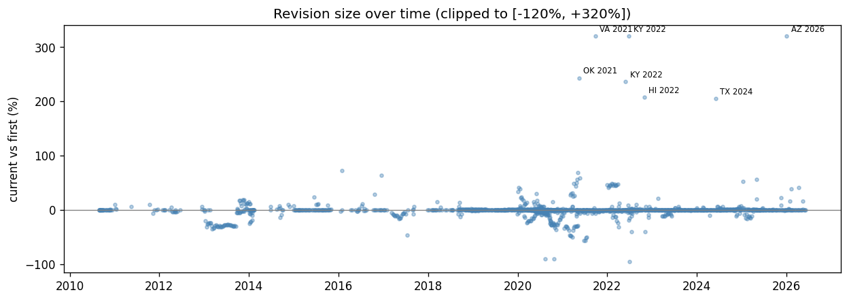
Claims — essentially final on release
Continued claims
About 3% of weekly values ever change
When they do, it’s usually a one-off data-entry fix — not a systematic correction
The number you saw in real time is essentially the number you see today
Point-in-time discipline is optional here
Claims, V4: revisions hug zero across fifteen years; the few outliers are labelled input errors.
The Fine Print in the State Jobs Numbers
10

Slide 11
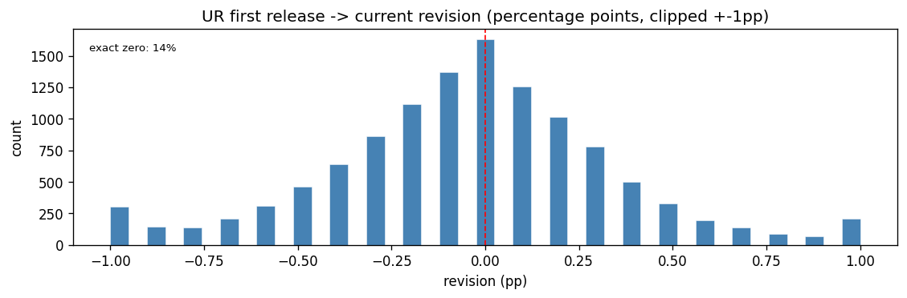
Unemployment — tiny, rounding-level revisions
U3 unemployment
Most months do get revised — but the rate is published to only 0.1pp
The overwhelming majority of revisions are rounding-level nudges
Benchmark years and the COVID shock produce the occasional move past a full point
Day to day the first print is close to final — PIT recommended
U3, V4: revisions pile up in the smallest bins — a tenth of a point either way.
The Fine Print in the State Jobs Numbers
11

Slide 12
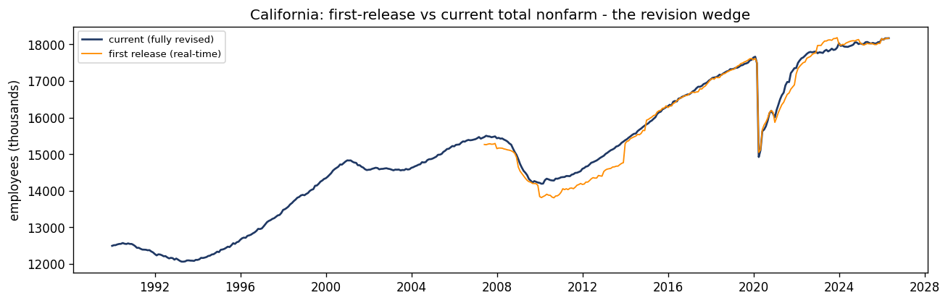
Payrolls — the cautionary tale
Nonfarm payrolls
Nearly every month is revised — and not by rounding
Each winter the whole recent history is re-anchored to the annual benchmark
The correction can run to hundreds of thousands of jobs in a big state
The gap between real-time (orange) and revised (navy) is what a non-PIT backtest silently leaks
Payrolls, V4: the orange real-time path pulls away from the navy revised history.
The Fine Print in the State Jobs Numbers
12

Slide 13
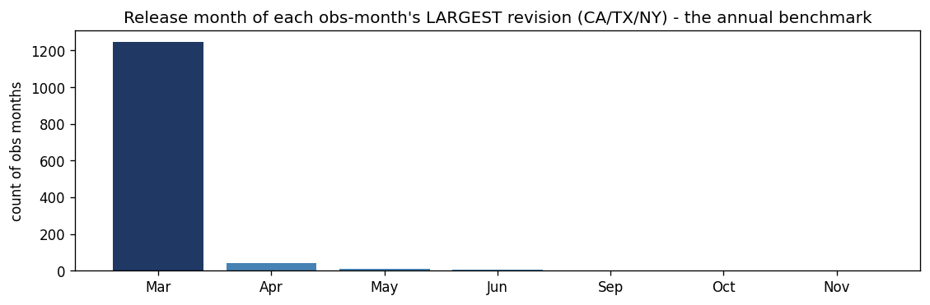
Revisions arrive in one burst — March
Nonfarm payrolls
Revisions don’t trickle randomly through the year
Line up each month’s largest revision and one bar towers over the rest: March
That March tower is the annual benchmark re-anchoring
Apply it on its release date — never spread it backward. PIT is mandatory
Payrolls, V4: each observation’s biggest revision lands in March, benchmark season.
The Fine Print in the State Jobs Numbers
13

Slide 14
So what does this mean for a model?
Four plain questions, and the three datasets that looked interchangeable now sort themselves cleanly.
Transform each for what it is
1
Claims and payrolls are counts → model them in logs or growth rates. The unemployment rate is bounded → model percentage-point changes. Payrolls trend (use growth); claims and the rate cycle (the level is fair game).
Respect the two birthdays
2
Index every feature by when it was knowable, not the period it measures — and enforce point-in-time in proportion to revisions: a nicety for claims, advisable for U3, non-negotiable for payrolls.
Aggregate with the right operator
3
To rebuild a national total, sum the counts — but you cannot sum rates. The national unemployment rate is a labor-force-weighted average of the state rates; the naïve average comes out biased low.
The Fine Print in the State Jobs Numbers
14

Slide 15
The verdict: all three cleared
The same four modules, applied identically to all three series
55 core checks in total: 38 PASS · 17 WARN · 0 FAIL
Every WARN is a documented handling rule, not an open defect
The data isn’t bad — it’s specific, and now the specifics are known
Dataset | Checks | PASS | WARN | FAIL
All datasets | 55 | 38 | 17 | 0
● Continued claims | 21 | 13 | 8 | 0
● U3 unemployment | 17 | 12 | 5 | 0
● Nonfarm payrolls | 17 | 13 | 4 | 0
Claims: PIT optional
U3: PIT recommended
NFP: PIT mandatory
The Fine Print in the State Jobs Numbers
15

Slide 16
None of this makes the data bad.
It makes it specific.
All three series cleared validation.
Knowing exactly how they differ is the difference between a feature that helps and one that leaks.
That is what the fine print is for.

