Slide 1
Highly Parallelized Image Recognition via TensorFlow
CS 205
Final Project
Daniel Cusworth
Tim Clements
Joannes (Bram) Maasakkers
Project Updates – 4/6/17

Slide 2
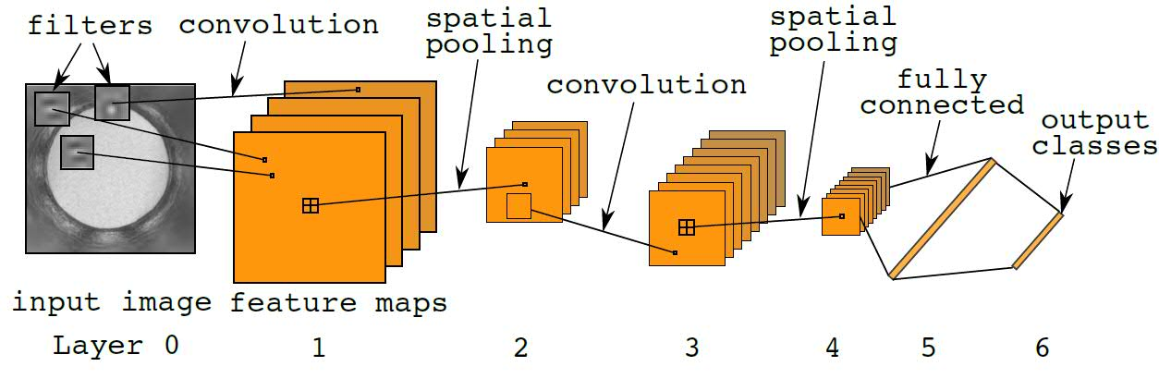
TensorFlow is a software package that allows users to train a convolutional neural network (CNN) for image recognition.
https://www.worldcommunitygrid.org

Slide 3
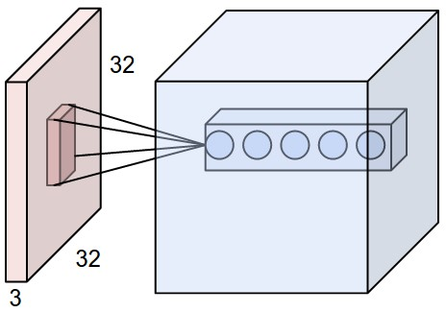
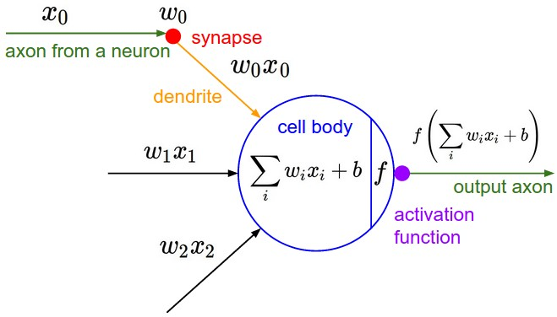
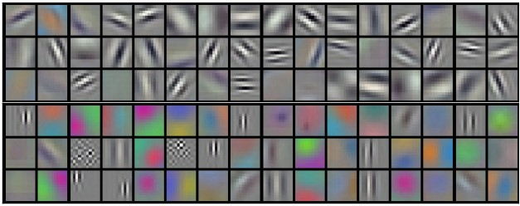
A filter (or neuron) in the CNN passes over a region of the image, and computes a dot product.
filter 1
…
filter 1
filter 4
http://cs231n.github.io/convolutional-networks/

Slide 4
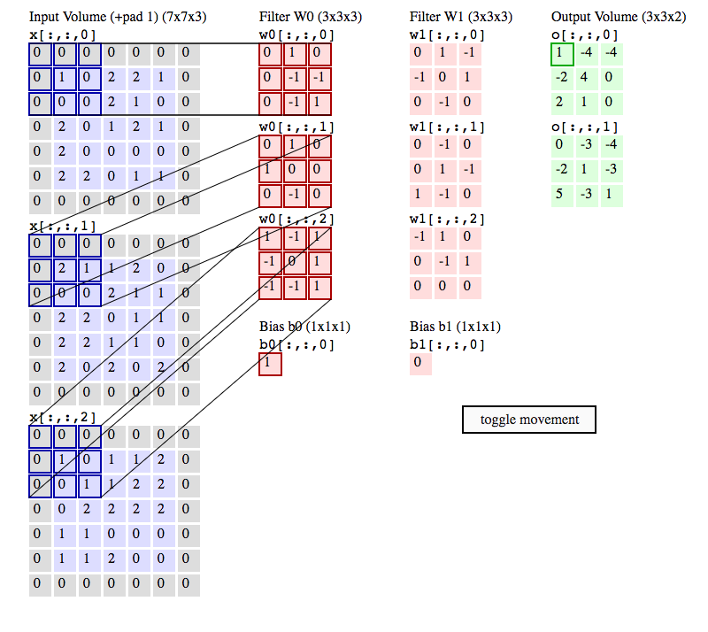
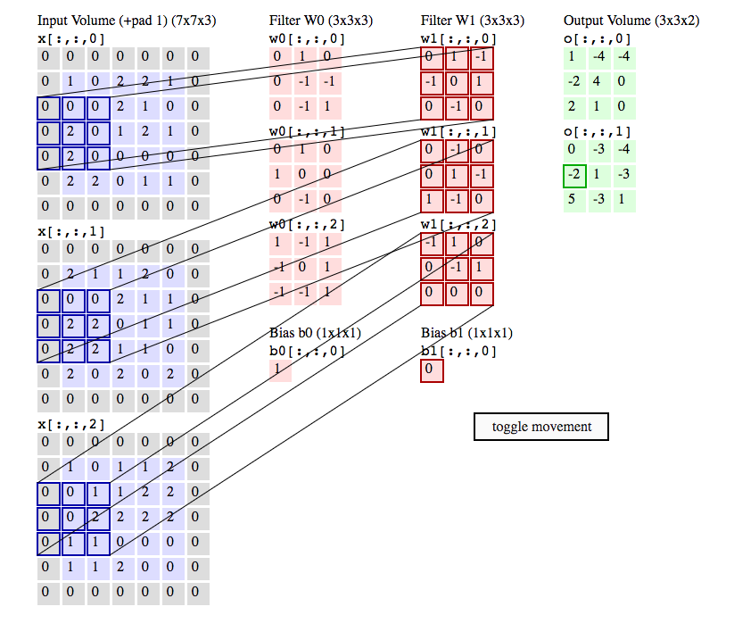
The user has to specify the size of the filter, how many pixels to “slide” the filter, and how much padding should be specified.
filter W0 applied to a subsection of image
filter W1 applied to a subsection of image

Slide 5

A CNN simulates the brain by “firing” a neuron if it reaches a threshold.
Apply activation function to output
Has biological intuition, but also mathematical intuition:
adding a nonlinearity transforms output to a plane that may have easily separable classes.

Slide 6
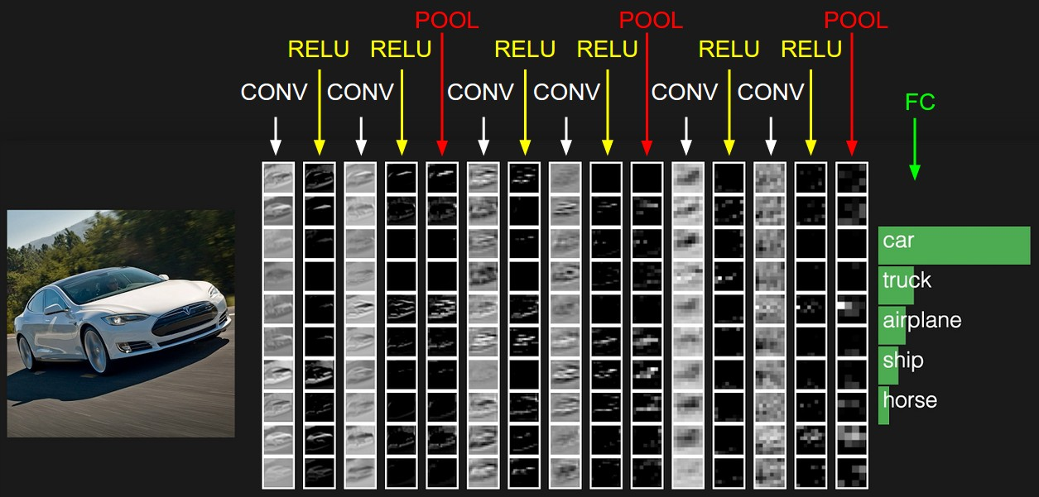
Subsequent filters can be passed until the CNN reaches it output layer, where the classification prediction against the actual labeled image.
During training, the filters are fitted. A predictive model requires many images, which requires a lot of computation.
http://cs231n.github.io/convolutional-networks/

Slide 7
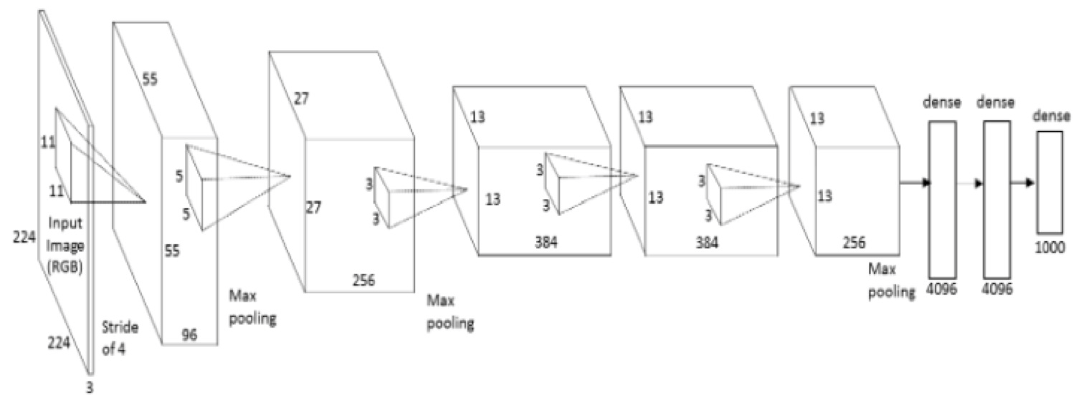
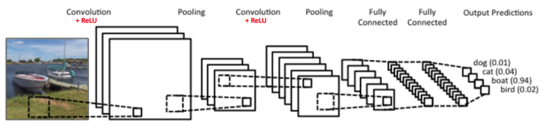
Different companies, research institutions use different architectures of CNNs – no theorem exists to say which is best!
AlexNet
LeNet

Slide 8
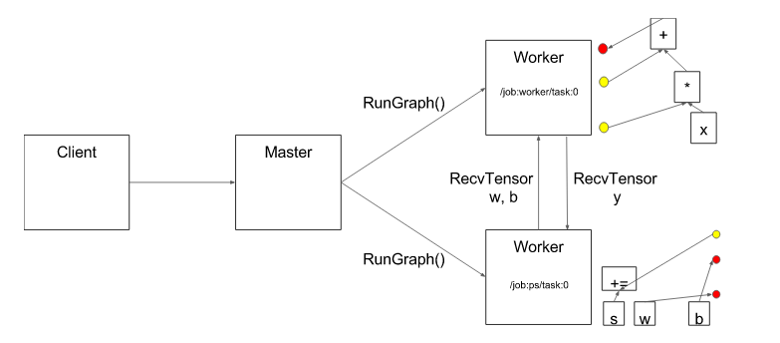
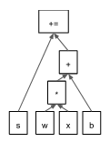
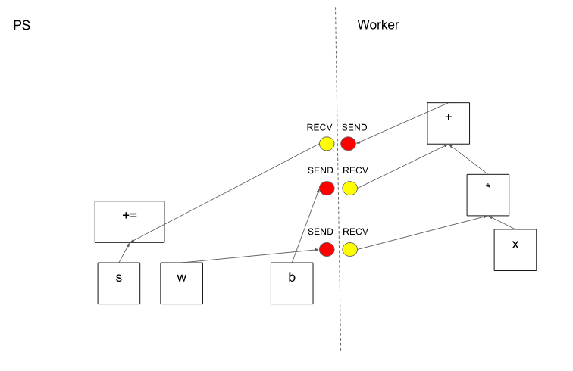
Our project: Build a distributed CNN framework on Odyssey using TensorFlow.
user specified graph
tensorflow.org

Slide 9
Project Objectives
Done
Get single-core TensorFlow running on Odyssey with MNIST CNN
Results: 10k images – 3 hours to train
Get multiple-core TensorFlow running on Odyssey with MNIST CNN
Get GPU-accelerated TensorFlow running on Odyssey with MNIST CNN
Train CNN with custom images
Test performance of different CNN architectures
Needs to be done
If time permits

