Slide 1
Highly Parallelized Image Recognition via Spark + MPI
CS 205
Final Project
Daniel Cusworth
Tim Clements
Joannes (Bram) Maasakkers
Project Updates – 4/6/17

Slide 2
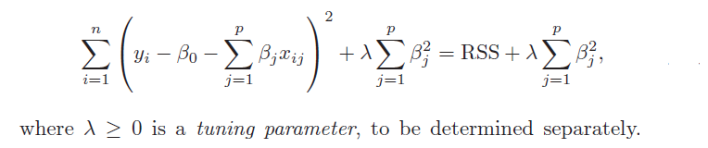
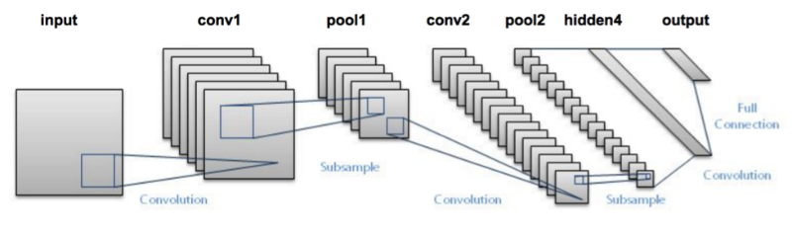
Image Recognition is a rapidly developing area of research.
Image recognition is based in optimization/machine learning algorithms
Can be further developed by adding more layers – e.g. a neural network
LeNet

Slide 3
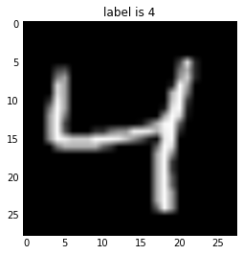
We plan to leverage the framework of Spark and MPI to train 60,000 images of written digits for image recognition.
Example image
Have to train 10 separate digits using 60,000 examples
data parallelism: use MPI to break up training set, and train separate models – combine optimal weights
model parallelism: use MPI to train each digit separately

Slide 4
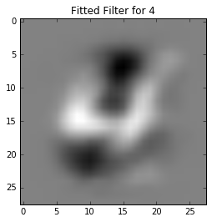
Project Updates
Done
Implemented preliminary image detection program in pySpark
https://github.com/dcusworth/image_spark_mpi/blob/master/model/ML_algorithm_MNIST_CV.ipynb

Slide 5
Project Updates
Needs to be done
Update pySpark for multi-class classification
Implement MPI parallelization
Benchmark vs. serial algorithm
Explore data vs. model parallelism
If time permits
Train model on our own set of images – e.g. pictures of stretched fingers (literal digits)

